Slide 1
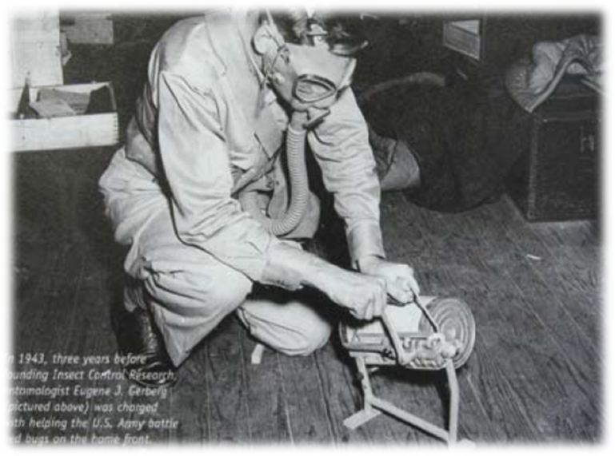
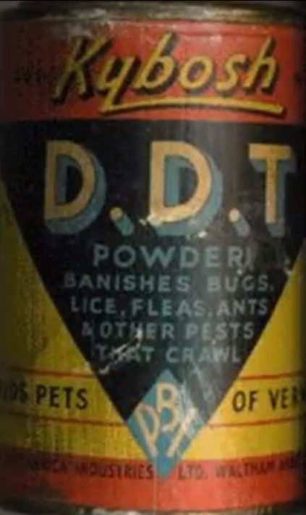
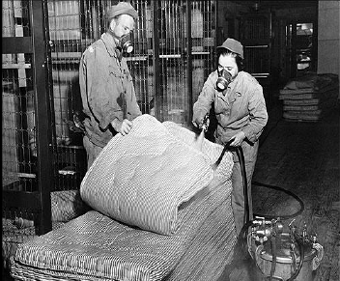
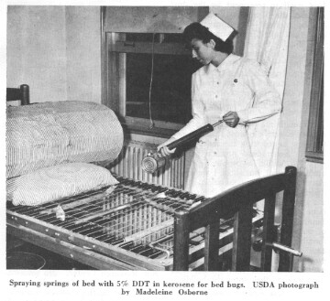
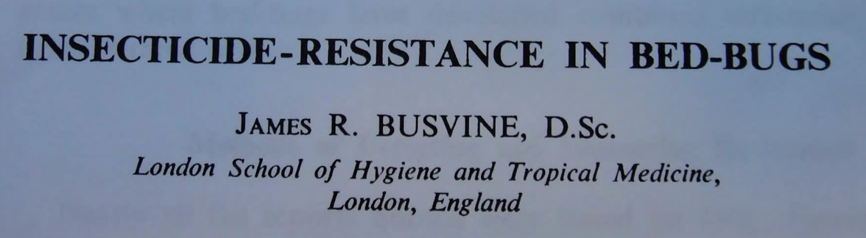
Bed bugs were virtually eradicated from the U.S. in 1940-50

Slide 2
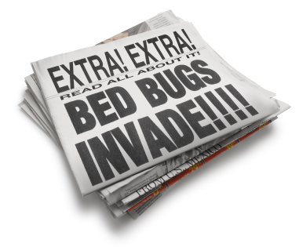
Limited mostly to hotels in 1999, then quickly spread into residential sector.
99.6% of nationwide surveyed pest management professionals (PMP) have encountered a bed bug infestation in 2012, compared to the 99% in 2011 and 95% from 2010 (2013 Bugs Without Borders).
Overall increase of 20% between 2012 and 2013.

Slide 3
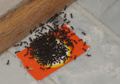
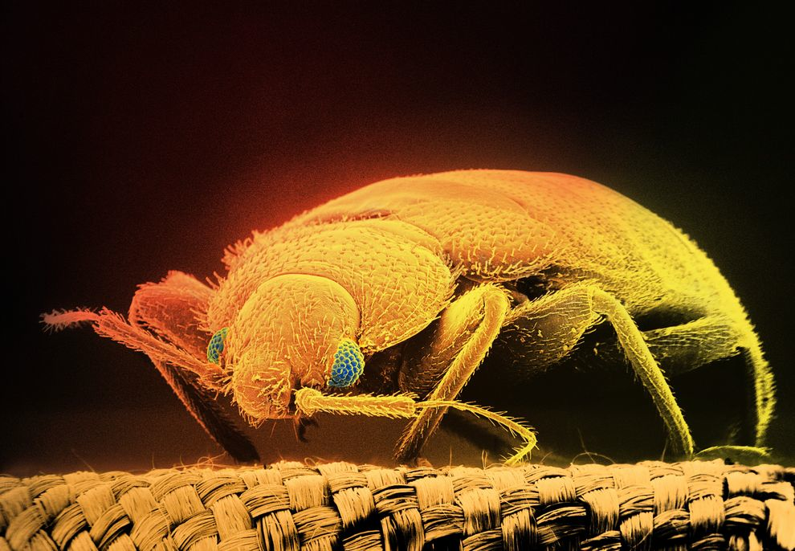
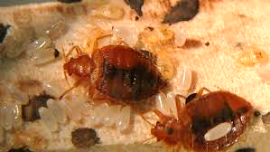
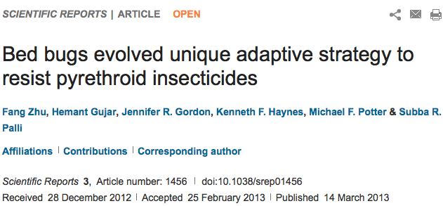

Changes in pest management strategies
  Increase in global and domestic travel
  Increased resistance to insecticides that are widely used
Photography by Tim Flach, Getty Images.
Notes:
Reduction in pesticide use indoors.
Introduction and use of pest specific baits instead of liquid pesticides.
Introduction of bed bugs into U.S. on the luggage of foreign travelers, and re-infestation by native bugs.
Mobile society that can carry bed bugs to all corners of the U.S.
Pyrethroid insecticides are commonly used in bedbug control because of their relative safety for humans and pets, effectiveness, and low cost, but their use has also led to widespread development of resistance in the pests.

Slide 4
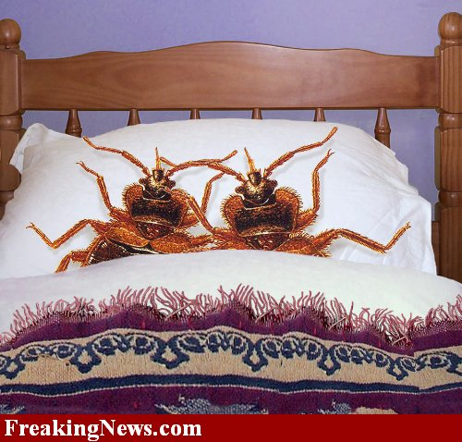
Bed bugs arrive
Passive
Bed bug is introduced hitchhiking on something:
Furniture
Mattress
Things we carry or wear (purse, coat, shoes, backpacks)
Active
Bed bug moves by walking from an infested area:
From one room to another
From one apartment to another via pipes, telephone or cable wires
Down a hallway after dropping of an item being discarded
100-500% increase in bed bug jobs in US, Europe, and Singapore

Slide 5
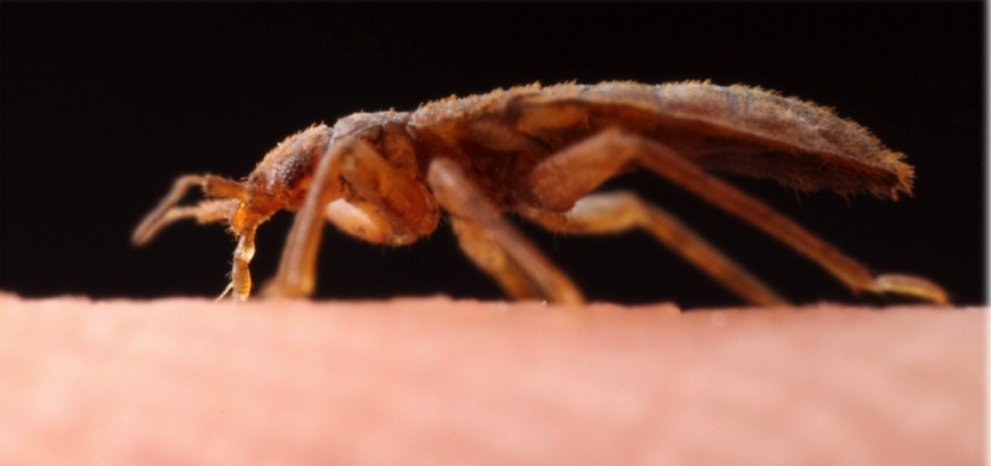
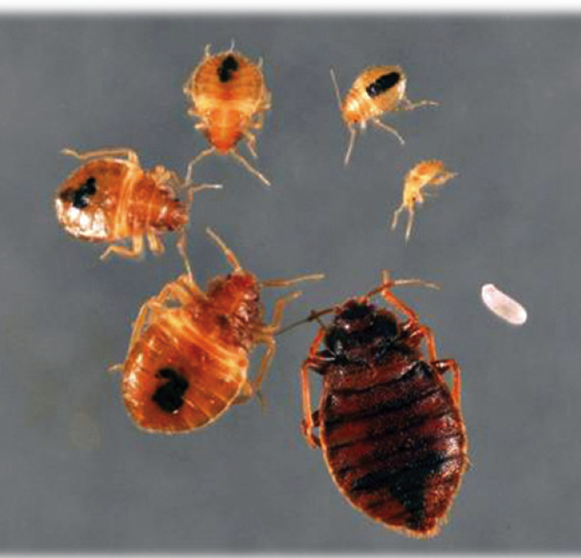
What do bed bugs look like?
Blood feeding true bugs – family Cimicidae, order Hemiptera
Small
Flattened
Wingless
Piercing-sucking mouthparts
Undergoes incomplete metamorphosis

Slide 6
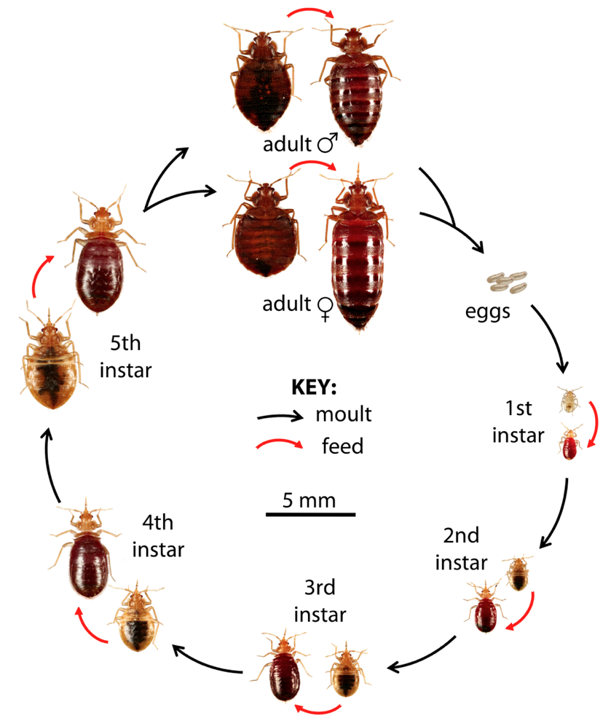
The bed bug life cycle
Bed bugs go through an egg stage, and five nymph stages before they become reproductive adults.
Bed bugs need to feed on blood at least once during each life stage.

Slide 7
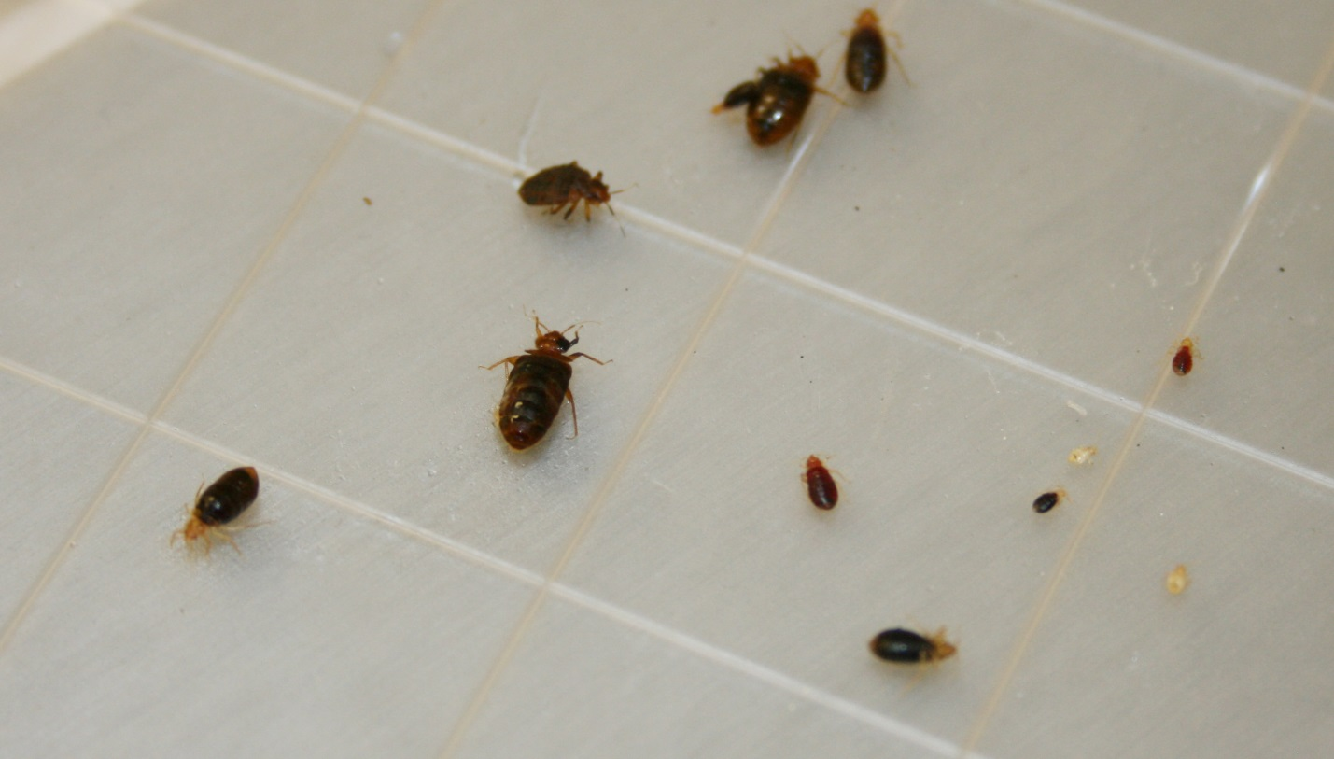
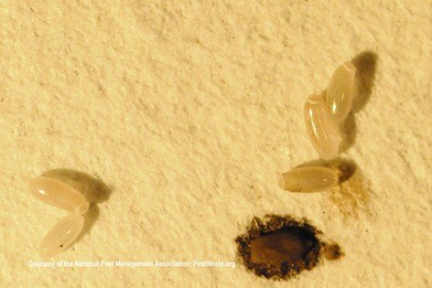
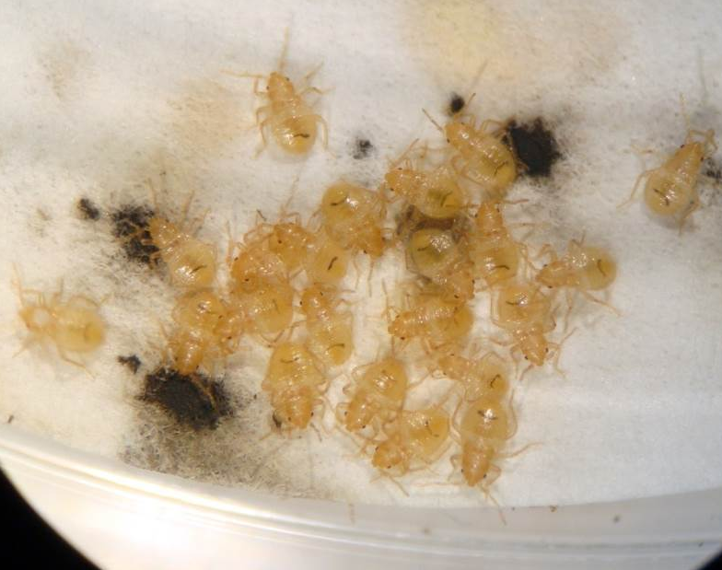
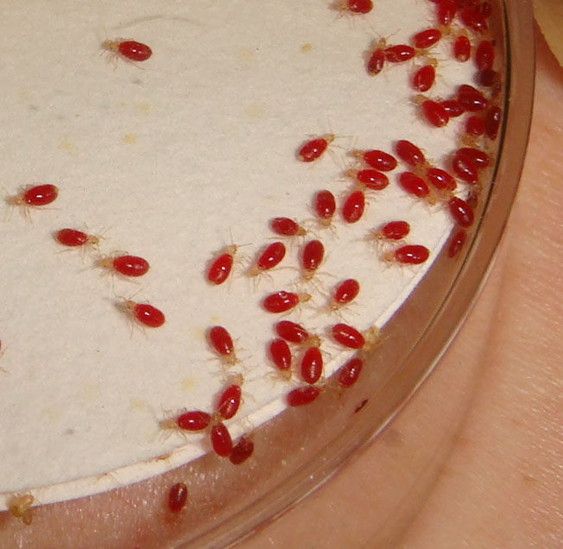

Slide 8
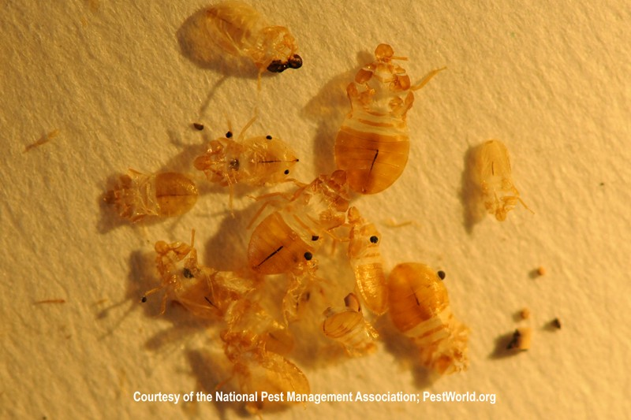
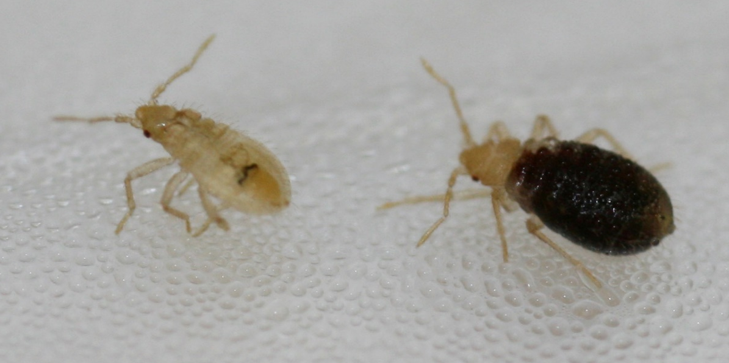
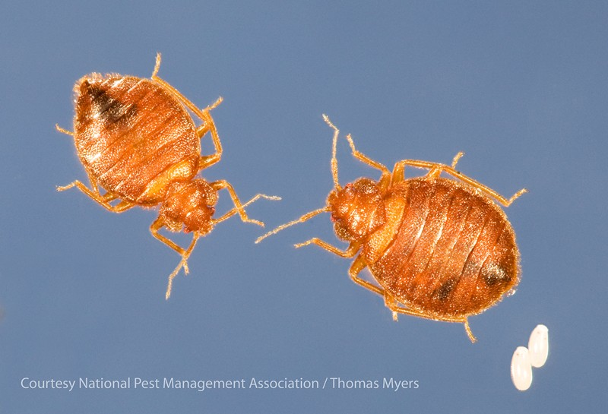
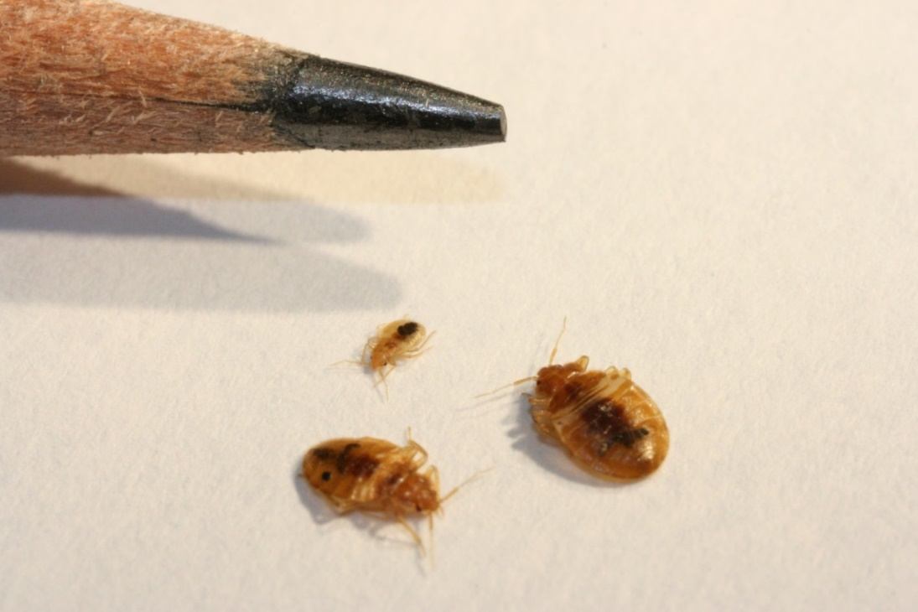
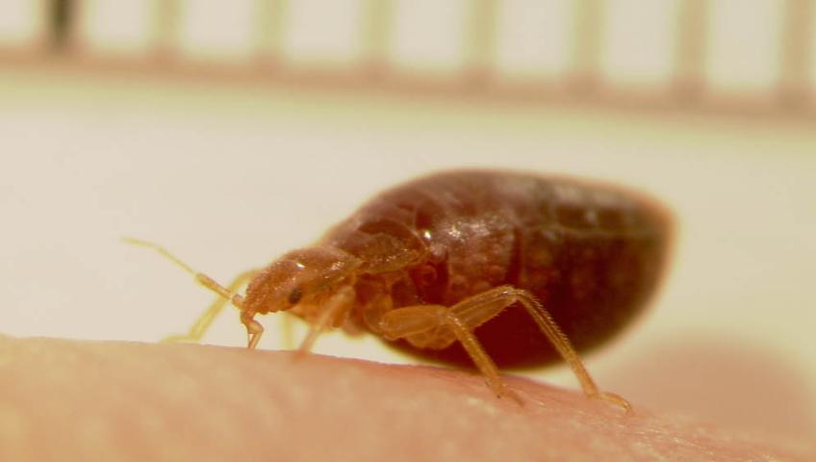

Slide 9
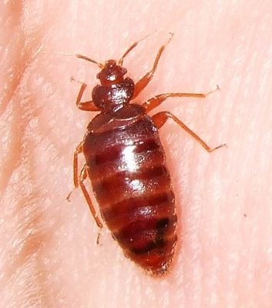
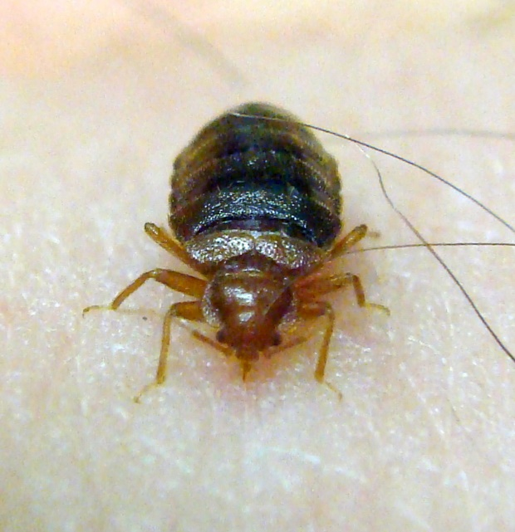
Biology and behavior
Bed bugs feed exclusively on blood. Usually feed every 3-7 days.
Usually feed at night. Hungry ones will feed any time.
Can survive several months without feeding at 70°F (21°C), and can live longer at lower temperatures.

Slide 10
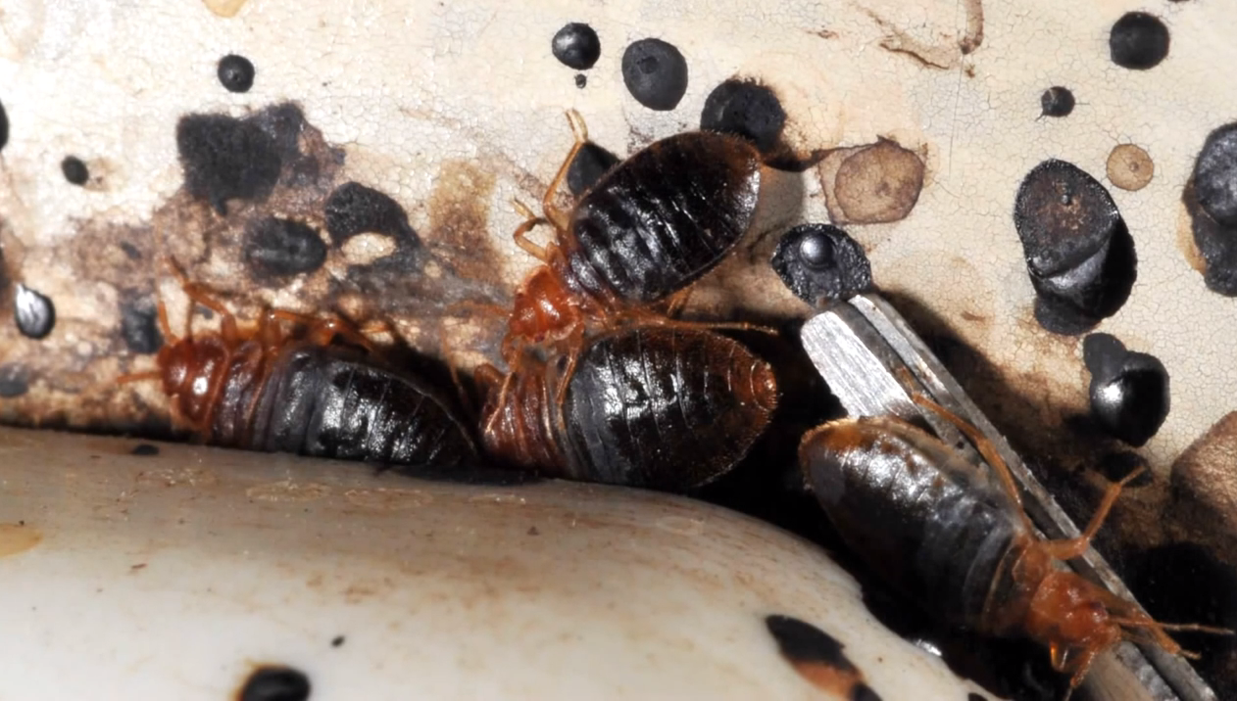
A blood meal takes about 5-10 minutes.
After feeding, they go back into hiding and move to aggregations.
Aggregate in cracks and crevices all day.
Stimulated by the increase of CO₂ in the room. Travel many yards to get to host.
Digested blood is excreted as black or brown fecal spots.
Notes:
Probe the skin to find a capillary space that allows the blood to flow rapidly.
May probe the skin several times before feeding.

Slide 11
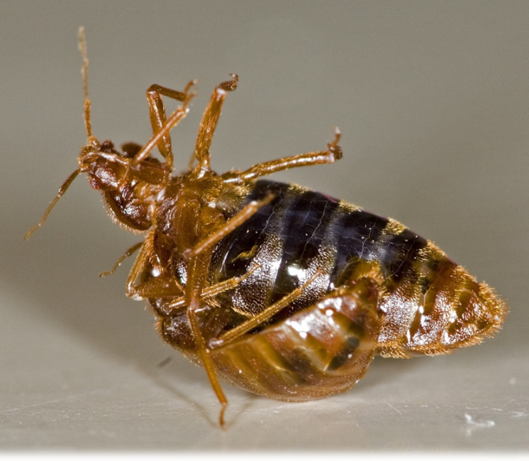
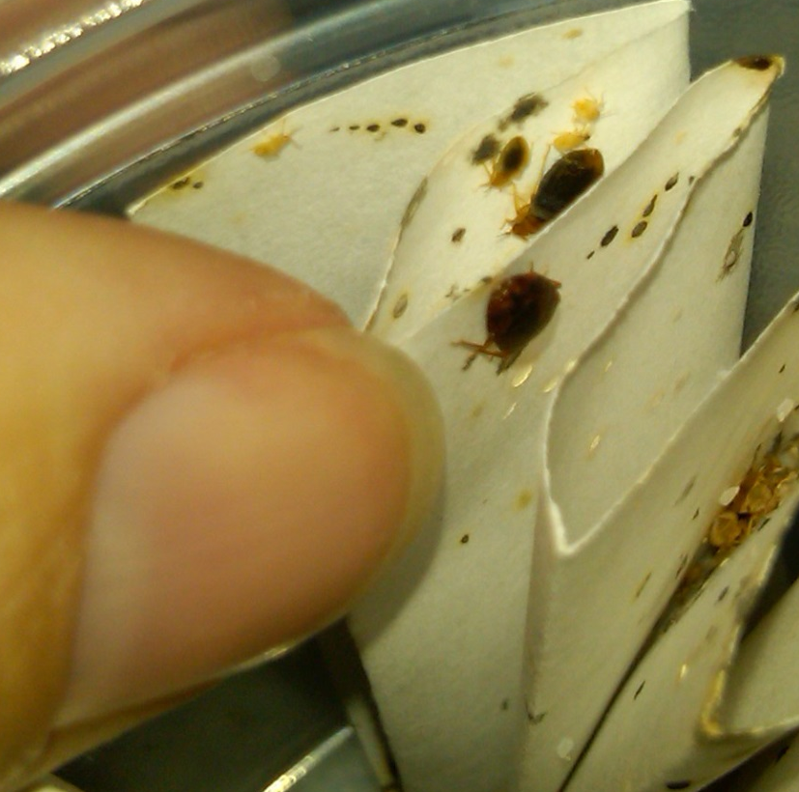
They engage in traumatic insemination.
Females may be mated by many different males.
A single mated female can cause an infestation.
A female produces 5-20
eggs over ~12 days.
Females produce
~143 eggs in a lifetime.

Slide 12
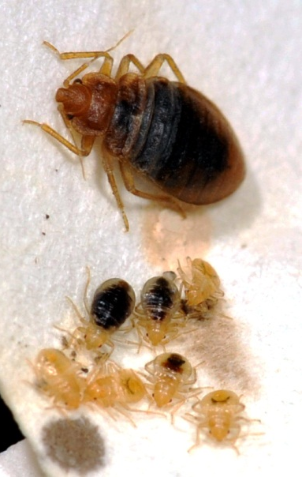
Bed bug development rates are temperature dependent.
Development is faster in warmer environments and slower in colder environments.
At typical household temperatures (70 - 80°F) bed bug eggs hatch in 6 to 10 days, and nymphs take a meal and molt every 5 to 8 days, making development time from egg to adult 31 days at 80°F and 50 days at 70°F.

Slide 13
40 bed bugs are in a 70°F room on May 2. By Nov 2 how many are there?
5,905!

Slide 14
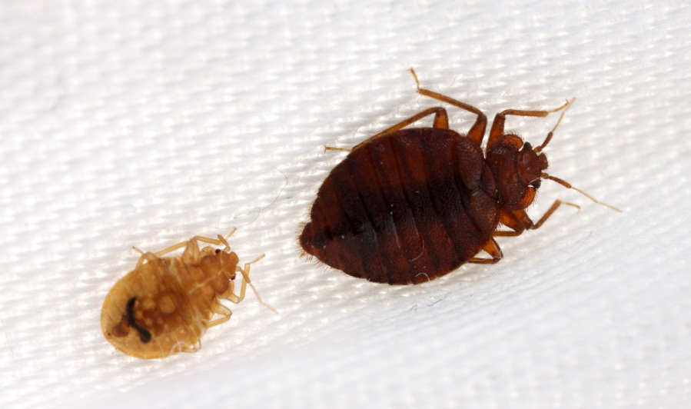
Bed bugs are not known as competent vectors but are capable of transferring some
Notes:
Bed bugs are not known as competent vectors (i.e. not good at transmitting disease causing pathogens) but are capable of transferring some (e.g. trench fever Bartonella quintana).

Slide 15
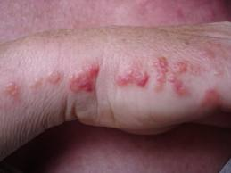
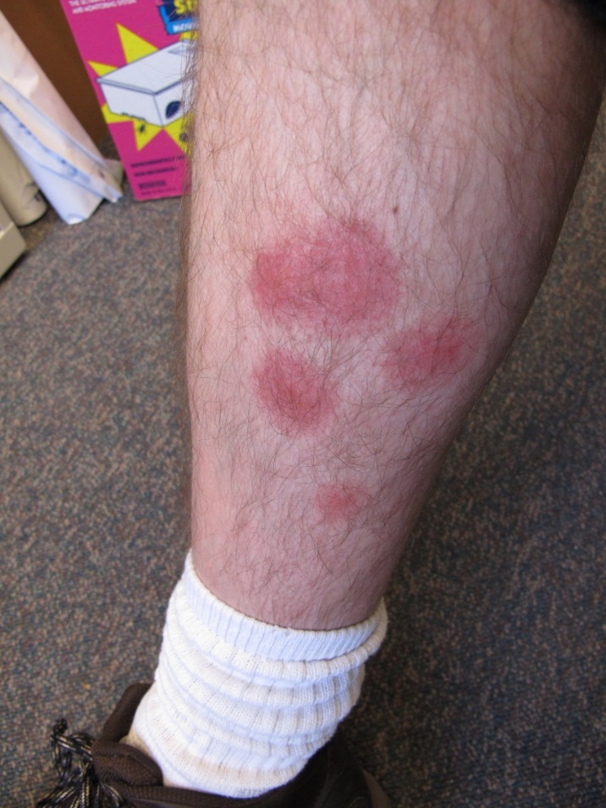
Reactions to bites
Bites may occur in lines
- usually on exposed skin.
Saliva can cause a
person to itch
and cause swelling.
Scratching can
lead to secondary infections.

Slide 16
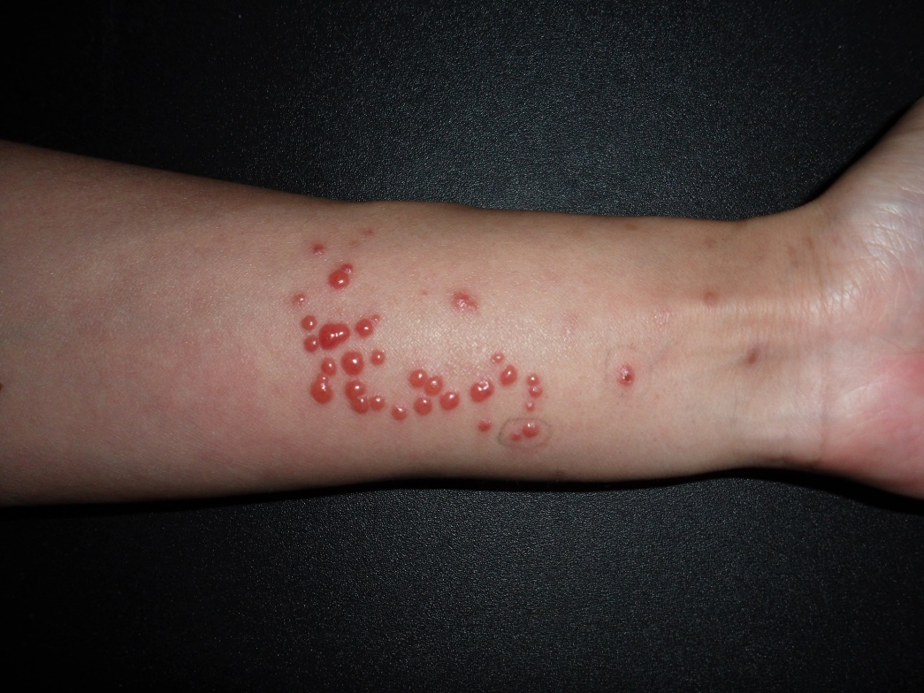
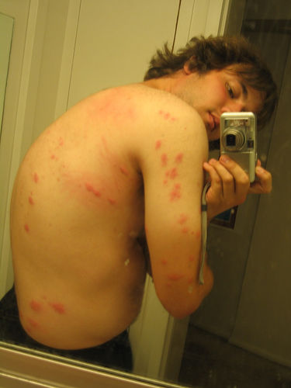
  Emotional impact
    Loss of sleep
    Nightmares
    Stress/anxiety
    Feeling isolated
    Loss of self esteem
    Feelings of depression
    Cannot relax
    Loss of friends and family connections
    Etc.
    http://cals.arizona.edu/apmc/public-health-IPM

Slide 17
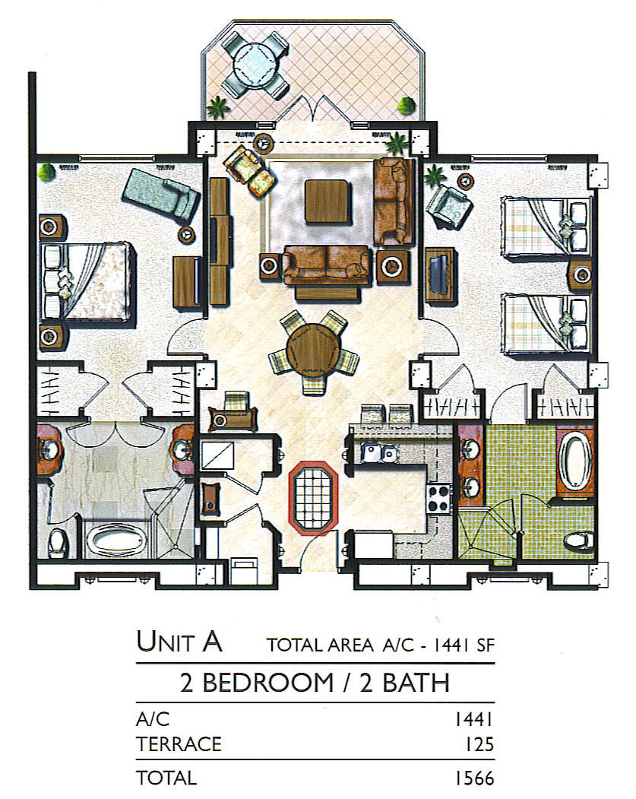
How to detect an infestation
Beds, sofas, bedside tables, recliners, picture frames…
= Hot Spot

Slide 18
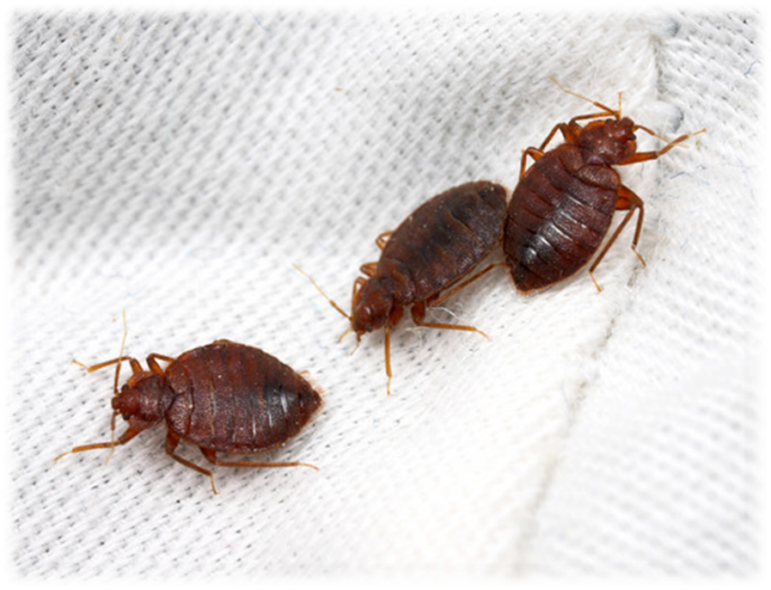
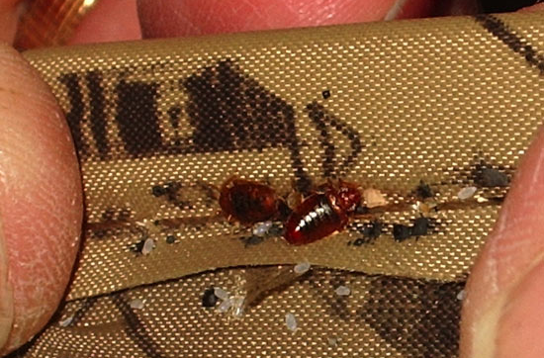

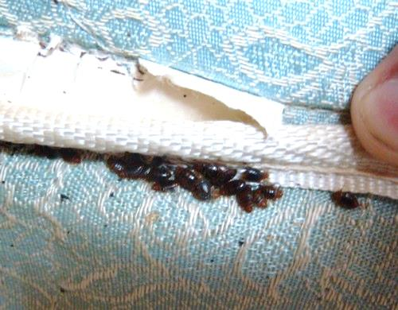
1. Visual inspection
Bed bugs

Slide 19
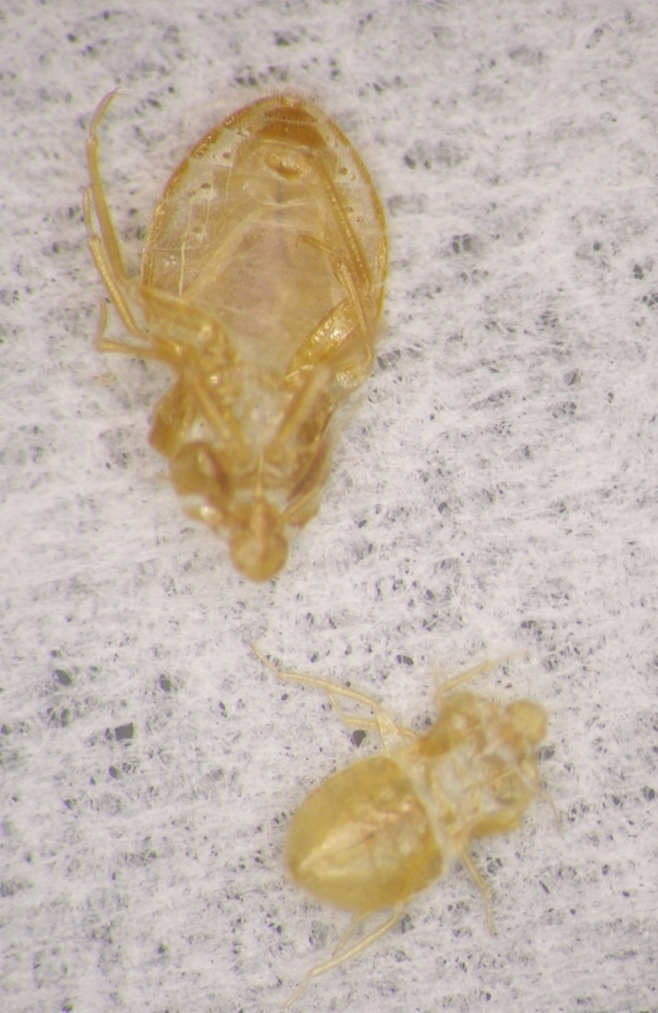
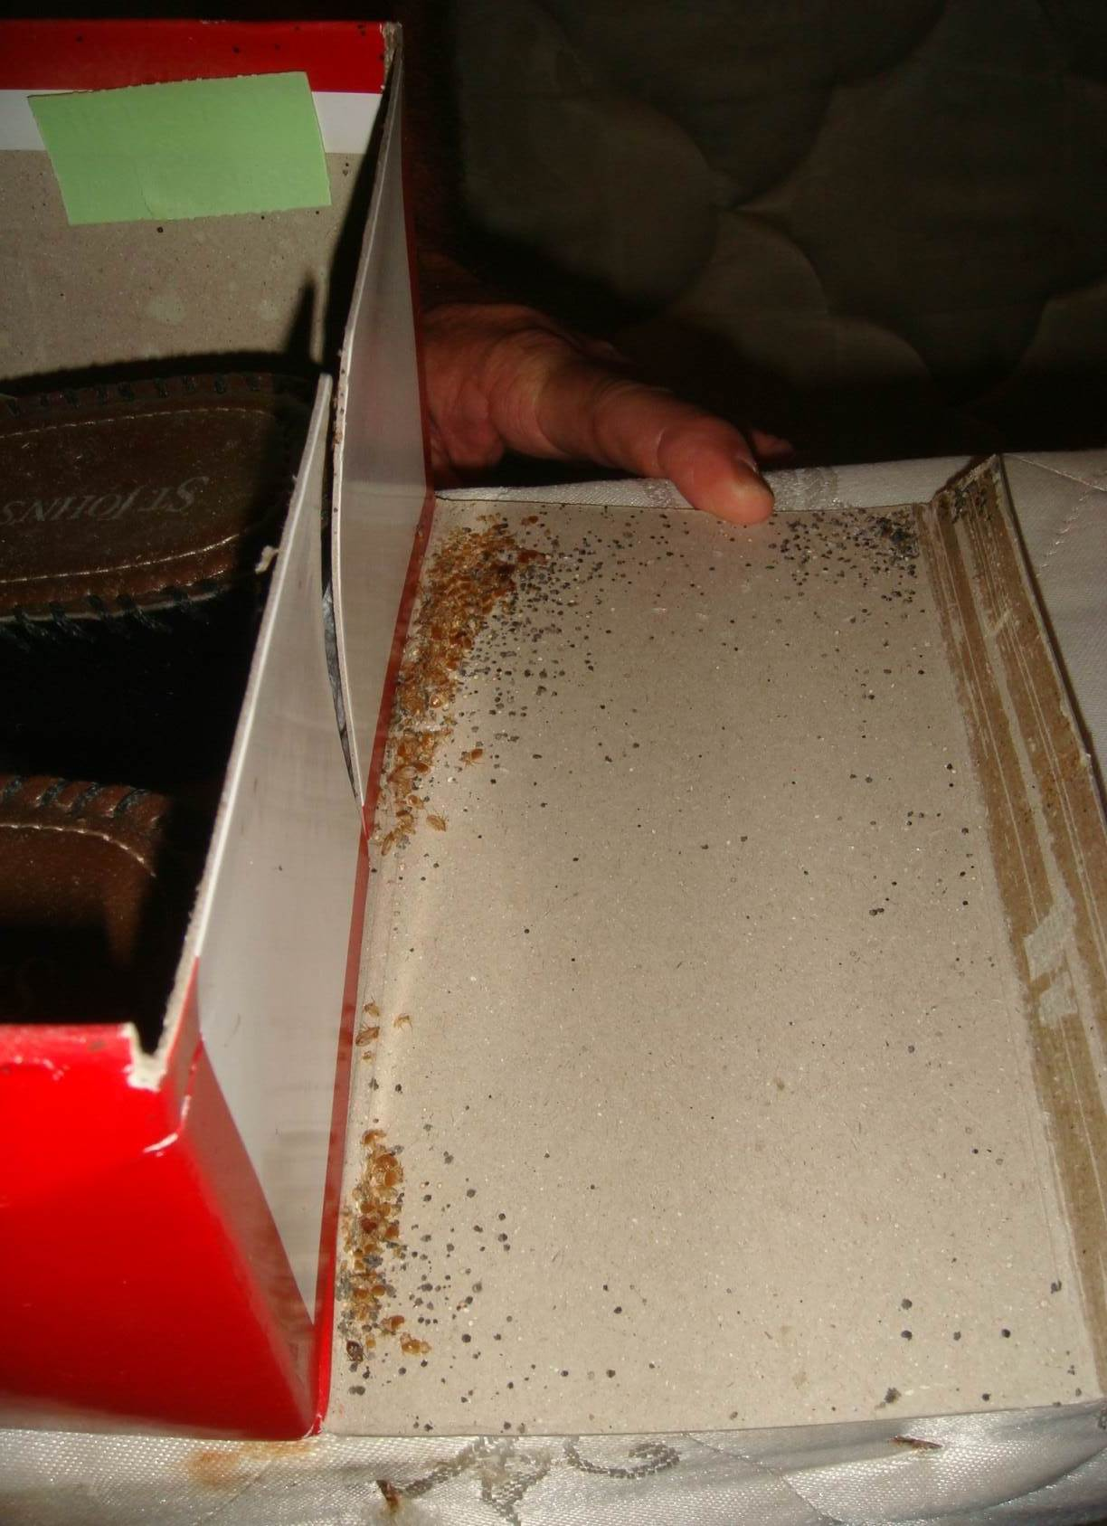
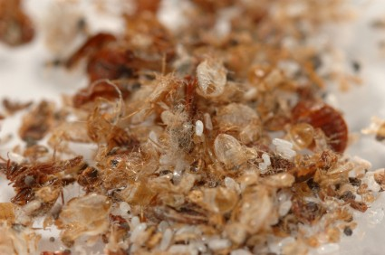
Shed skins

Slide 20
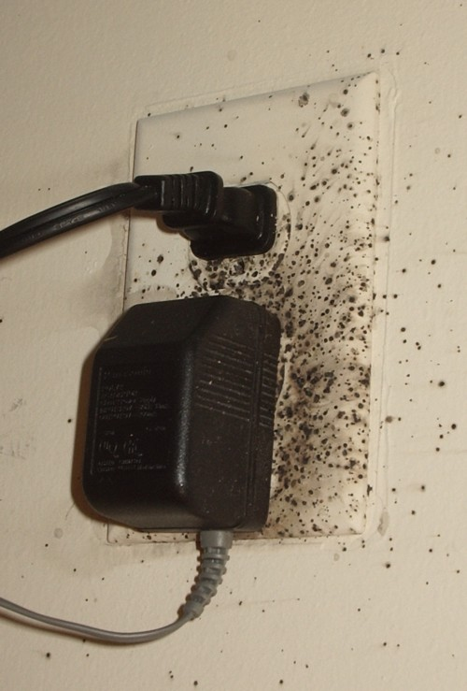
Frass spots (bed bug poop)
  Mattress seams and on the tag
  Wood frame of the box springs
  Behind the head board
  Along the tops of
  baseboards / the edge
  of carpeting
  Ceiling / wall junctions
  behind pictures
  Electrical outlets
  In curtain seams

Slide 21
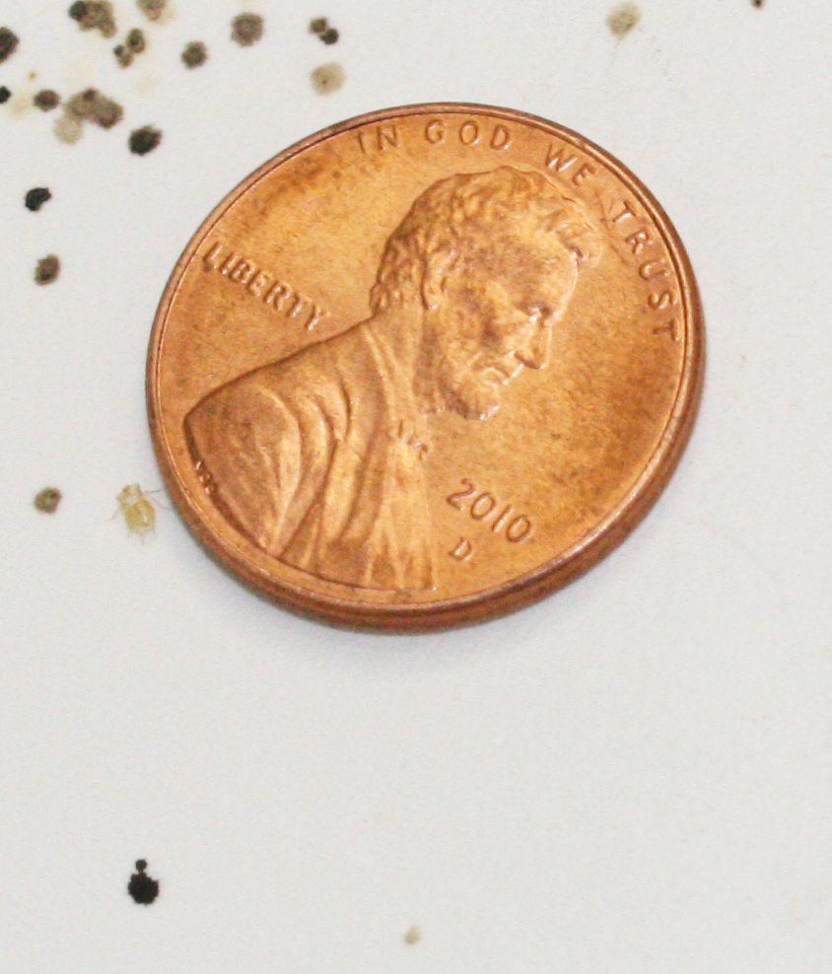
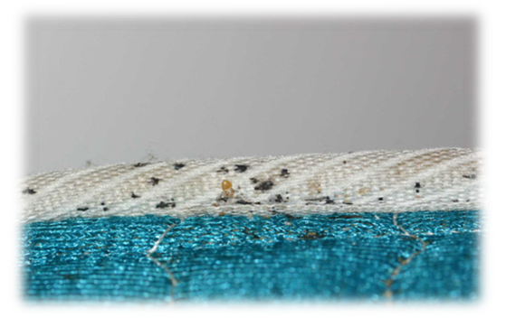
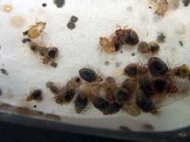
Excreted digested blood
Looks like cockroach
feces but feels flat or smooth

Slide 22
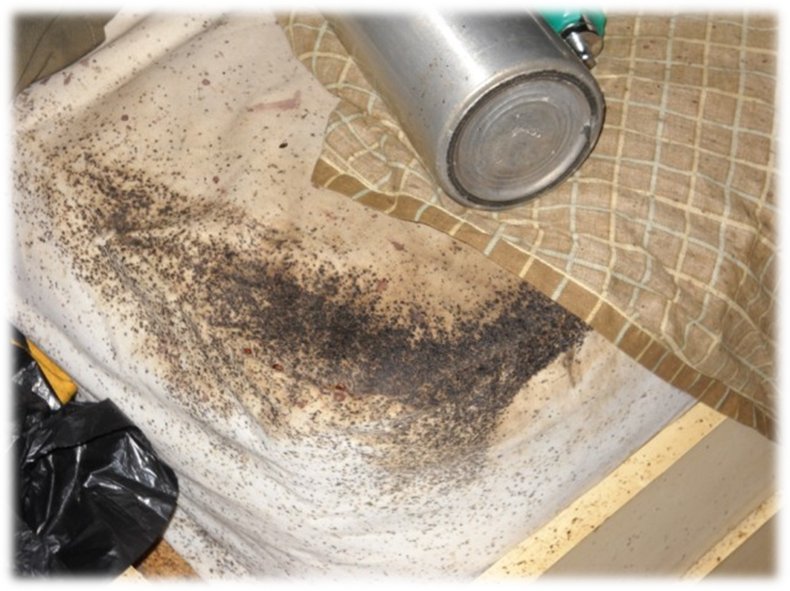
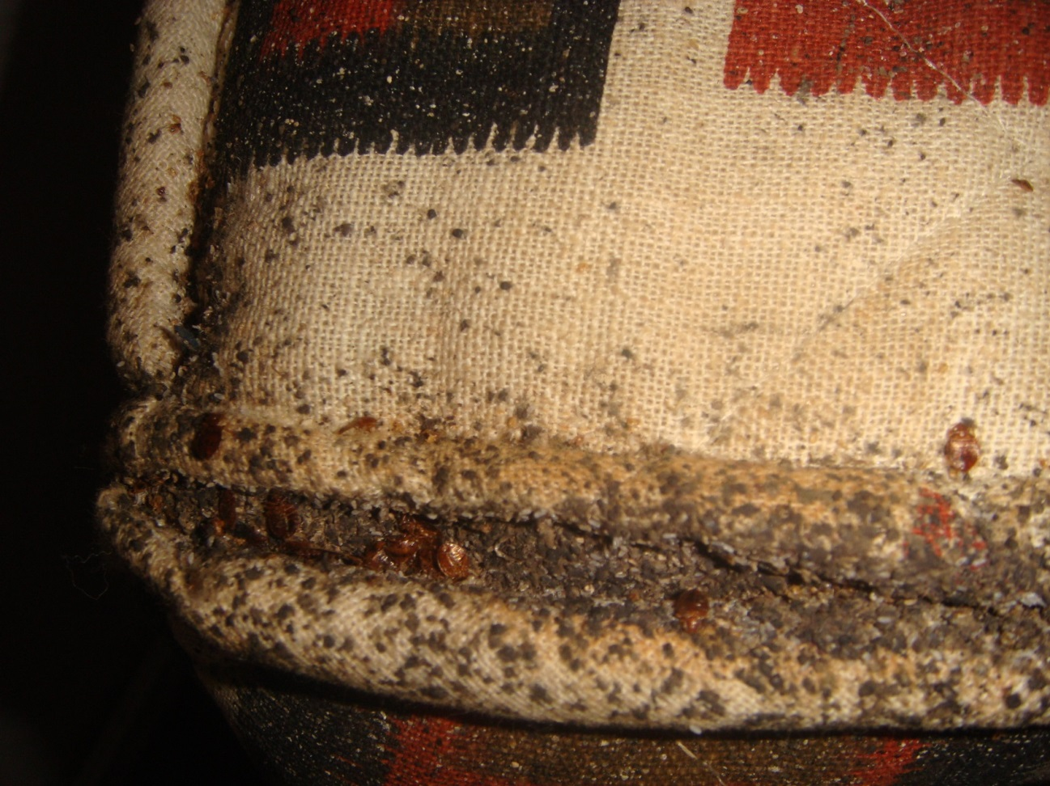
Fecal crust

Slide 23
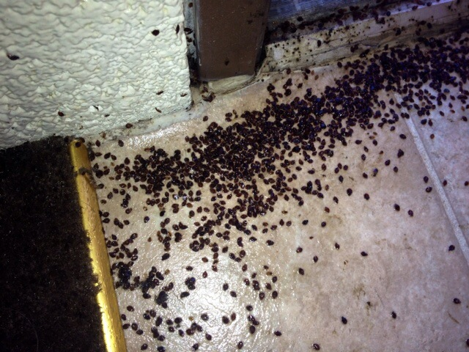
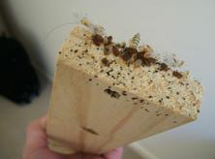
Not all aggregations are obvious

Slide 24
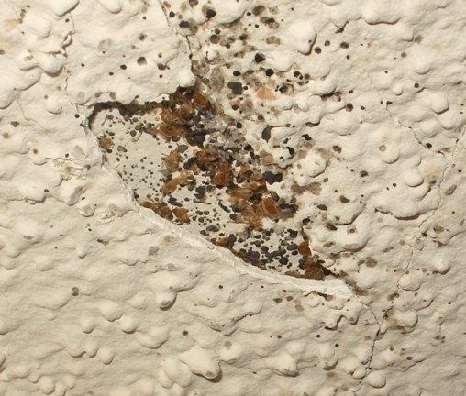

Less obvious unless you know
Looks like mold
But are actually bed bug aggregations
What are we looking at?

Slide 25




Blood: Smash and drag

Slide 26


Eggs

Slide 27




Slide 28




Slide 29






2. Monitoring devices
NightWatch
CDC 3000
Verifi
BuggyBed
2 Bed Bug First Response
Bed Bug Beacon

Slide 30






Passive monitors or traps
12 Volcano Trap
4 Climb Up Interceptors
4 Bed Moat
12 Blackout BB Detector
BB Alert
6 BB Detection System
Notes:
30

Slide 31


3. Canine detection
Excellent detectors
Can distinguish between live and dead bugs
Expensive and require constant training
Are only as good as their handler
Dog handlers need to keep up with training
Notes:
31

Slide 32

Training differs
Verification differs
Few third party certifications

Slide 33

How to control bed bugs
Integrated Pest Management (IPM) approach is the most likely strategy to result in successful elimination of bed bugs and safeguard the clients and the environment.
Choose most appropriate treatment options based on:
  Level of infestation
  Level of clutter
  Square footage
  Customer needs
  Structure types
Notes:
IPM is sustainable approach to managing pests by combining biological, physical, and chemical methods in order to minimize economic, health and environmental risks.

Slide 34



Prevention
Prevention is a very cost-effective tool for managing bed bugs.
Notes:
Avoid picking up discarded or second-hand items (especially beds & furniture) • Avoid sitting on furniture when in infested apartments & limit what you bring in with you • If itchy welts occur, immediately conduct a thorough inspection.

Slide 35

Non-chemical methods
Becoming the primary methods used in combination with chemical methods
  Heat (>122°F)
  Cold
  Vacuuming
  Encasements
  Desiccant dusts
How do you treat libraries?

Slide 36


Chemical methods
Multiple applications of
insecticides.
Crack and crevice applications.
Resistance to pyrethroid
products is very high.
Not all populations are resistant to the same
products.
Three general types of
resistance occurring.

Slide 37
Summary of treatment options
Vacuuming
Isolation
  Encasements
  Contain infested items
  Make the bed an island
Freezing
  Liquid CO2
  Chest freezer
Heat
  Clothes dryer
  Steam
  Container
  Whole unit
Pesticides
  Spray
  Dust

Slide 38

Why bed bugs in school?
Bed bugs are excellent hitchhikers
  Clothing
  Backpacks
  Books
Bed bugs are good runners

Slide 39

Schools are NOT good transition zones for bed bugs. It can happen, but is highly unlikely.
Notes:
Schools usually lack a food source at night.
Boarding schools are the exception.
Backpacks, books, clothing, wheelchairs from home provide harborage and transport.
can occur, but is unlikely unless……..e.g., students exchange clothes, clothing and back-packs are piled together, etc

Slide 40






Accurately identify all specimens

Slide 41
Swallow bug
Bat bug
Bed bug
Apple seed
Chimney swift bug
Cat flea

Slide 42

Notify all parents of kids in the room
Provide basic information
Inspect room, monitor, careful cleaning and vacuuming
Reduce clutter
Isolate student
belongings in clear
plastic bags
Usually no need for
residual insecticides
Notes:
Take a piece of scotch tape and tape the bed bug between tape layers. Save for proper identification.

Slide 43

Bed bug prevention in school
The school community should be notified about bed bug sightings and offered resources
Belongings of
students should be
separated as a
matter of policy
Use ziplock bags and
storage containers for belongings
This is not easy – but it is reality

Slide 44

Parents
Inform parents how to send students to school free of bugs
  Launder clothes, dry heat for shoes, backpacks, etc.
  Clothing items
  stored separated
  from bed bug
  areas in
  airtight bags

Slide 45
If a bed bug is discovered in the school
Do not panic
or cause panic!
Often it’s a
stray, single bug
Collect it for proper ID
Do not evacuate the classroom or office
Thoroughly inspect the room

Slide 46


Resources
http://www2.epa.gov/bedbugs
http://cals.arizona.edu/apmc/public-health-IPM
http://www2.epa.gov/sites/production/files/2015-02/documents/fed-strategy-bedbug-2015.pdf
http://extension.arizona.edu/sites/extension.arizona.edu/files/pubs/az1563.pdf
http://extension.arizona.edu/sites/extension.arizona.edu/files/pubs/az1625-2014.pdf
https://extension.arizona.edu/sites/extension.arizona.edu/files/pubs/az1642-2014.pdf
Acknowledgements

Slide 47



Head Lice
Shujuan (Lucy) Li
University of Arizona

Slide 48

A Problem of Society
More commonly found in children of preschool and early elementary age (3-11 years old).
It can happen to anyone! Parents, siblings and caregivers sometimes acquire.
The most common symptoms are itching and sleeplessness.
Scratching leads to secondary bacterial skin infection.
Notes:
According to the Centers for Disease Control and Prevention (CDC), “an estimated 6 million to 12 million infestations occur each year in the United States among children 3 to 11 years of age.” Girls are infested more often than boys.
Head lice infestations are common in many parts of the world. Head lice can infest people of all ages, but children are prone to infestations due to their play activity and close contact. Getting head lice is not related to cleanliness of the person or his or her environment.
Head lice can cause discomfort, e.g. irritation, scratching, sleepless nights, and subsequent secondary infection.
In fact, the problem of head lice can be so rampant among preschool and school-aged children that often schools must work in conjunction with many families to control an infestation.

Slide 49


A Problem of Society Cont.
Head lice: embarrassment; unnecessary days lost from school; pesticide exposure; millions of dollars spent on remedies.
Know how to manage it!
You can ditch the itch!!!
Notes:
Head louse infection is more a societal than an infectious disease problem
Excessive public and professional reactions lead to an inflated perception of prevalence, to unnecessary, inappropriate or ineffective action, and to a great deal of unwarranted anxiety and distress. These actions and reactions in themselves cause problems, especially from the misuse and overuse of treatments.
American Pediatrics - Itching can develop in a sensitized individual.

Slide 50


What are head lice?
Pediculosis humanus capitis
A small parasitic insect that lives on the scalp and neck hairs of a human host.
Six legs.
No wings. Cannot fly.
Cannot jump.
Move around using claw-like legs.
Notes:
They bite the scalp of the humans . Head lice prefer to live on the hair of the head, although they have been known to wander to other parts of the body.
Head lice don’t have wings or powerful jumping legs, so they move around by clinging to hairs with specially adapted claw-like legs

Slide 51


Requires human blood to grow, develop and lay eggs (nits).
Unable to survive more than 48 hours without a blood meal.
Cannot live within rugs, carpets, or school buses.
Not a sign of uncleanliness.
Female
Male
Notes:
Head lice feed every 4 – 6 hours so must remain in close contact with the host.
They are unable to survive away from a human host for more than about 48 hours (thus, they cannot live within rugs, carpets, or school buses).

Slide 52


Found on animals or pets?
Transmitted from pets to humans?
Transmit infectious disease?
Discriminate among socioeconomic groups?
NO.
NO.
NO.
NO.
Notes:
Head lice are not found on animals or household pets, and are not transmitted from pets to humans.

Slide 53



Life Stages of Head Lice
Lice have three different life stages: egg (or nit); nymph; adult.
Notes:
Egg (commonly known as nit)
Adult lice lay eggs (nits) that attach directly to individual strands of hair. Eggs stick to the hair shaft, close to the scalp (for warmth).
Nits are camouflaged with pigment to match the hair color of the infested person. Most easily seen at the posterior hairline.
Eggs hatch in approximately 7-10 days. Empty nit casings are easier to see.
Nits look similar to dandruff but are firmly attached to the hair strand. Empty nit casings are easier to see, white against darker hair.
Once the eggs hatch, nymphs leave the shell casing, grow for about 9 to 12 days, and mate, and then females lay
eggs. Immature stage of a louse (baby lice after hatching). Look similar to an adult, only smaller and are unable to reproduce. Mature into an adult about 10-12 days after hatching. Must feed on human blood to survive and grow.
Adult
Move quickly. Difficult to see. Size of a sesame seed (2-3 mm long). Tan in color. Feed several times a day. Nymphs feed more often.
Adult females live up to 30 days if untreated. Adult females lay about 6 eggs a day.
Cannot survive away from the scalp (will die within 2 days).
Adult lice have 6 legs and are approximately the size of a sesame seed (2 to 4mm) and are tan in color. Once hatched, lice are often difficult to see as they change their color to match the environment.
If untreated, adult lice can live for up to 30 days on a human head.
Fewer than a dozen active lice on the head at any time

Slide 54


Head lice can be found anywhere in the hair.
Nits are easier to spot, at the nape of the neck or behind the ears, within 1 cm of the scalp.
Eggs more than ½ inch (or 1 cm) away from the scalp are nearly always hatched and do not, by themselves indicate an active infestation.
Notes:
Head lice can be found anywhere in the hair

Slide 55


Eggs that have died or hatched, remain firmly attached to the hair; but will never again produce another louse.
Lice eggs have curved walls and will pop when squeezed
Dead eggs have collapsed sides
Hatched eggs have a flat top in profile
Notes:
Whitish/grey or tan in color. Oval in shape. About the size of a grain of sand. Nits are firmly attached to the hair strand.

Slide 56


Lice feed by injecting small amounts of saliva and taking tiny amounts of blood from the scalp every few hours. This saliva may create an itchy irritation.
With a first case of head lice, itching may not develop for 4 to 6 weeks, because it takes time to develop a sensitivity to louse saliva.
If not treated, life cycle may repeat itself every 3 weeks.
Notes:
The eggs are incubated by body heat and hatch in 10 to 14 days.
Once the eggs hatch, nymphs leave the shell casing, grow for about 9 to 12 days, and mate, and then females lay
eggs.

Slide 57



Transmission (Spread) of Head Lice
Head-to-head contact with an infested person and sleepovers are the BIG transfer risks.
Only LIVING LICE can transfer from one person to another.
The transmission from hats, combs, pillows, etc. is possible, but unlikely.
Nits cannot be passed onto someone else.
Notes:
How is lice transmitted from one person to another? The transmission from hats, combs, pillows, etc. is possible – but much less likely.
Lice are spread through direct hair to hair contact. Head lice is also commonly spread by indirect contact such as sharing things like hats, combs, hairbrushes, hair accessories, and headphones. Head lice are like trapeze artists - they swing from hair to hair using their strong claws. Head lice need close head-to-head contact to spread from one person to another. Electrostatic charge from combing dry hair can fling head lice up to 1 metre. Only the young lice and adult lice can move from one head to another.

Slide 58

According to CDC, most transmissions occurs in the home environment (friends, sleep-overs, camps, etc.).
Head lice are very communicable (spreads easily) in situations where people are in close contact with other people.
Head lice are most common
amongst school age children
or young children attending
child care services
(1 in 10 children).
Notes:
Research has shown that on average 1% of students are usually infested with head lice. If screeners indicate 10-30 of students in a class infested the chances are the screener is looking at something that is not head lice.

Slide 59

Checking for Head Lice
Periodic inspections for early detection of adult lice are far easier than dealing with advanced infestations.
During the early fall months (August to November) children should be inspected weekly by parents.
Prevention (home screening) is the best way to reduce the spread of lice infestation.

Slide 60



To confirm a case of head lice, you need to find live adult lice. Children can have a few nits without actually having a case of head lice.
Good lighting is important when you are checking.
Head lice move fast and are hard to see. They are usually found very close to the scalp, at the bottom of the neck and behind the ears.
To look for nits, part hair in small sections, moving from one side of the head to the other. Check carefully, looking close to the scalp.
Notes:
A louse can crawl quickly! Up to 30 cm per minute, which makes them difficult to catch. You can slow them down considerably, blowing dry hair with a blow dryer.
Usually children have no more than 10 to 20 live lice.

Slide 61

Look for nits near the scalp. Eggs more than ½ inch away from the scalp are nearly always hatched or dead and do not, by themselves, indicate an active infestation or a need for treatment.
If adults or lots of nits (more than 5 nits occurring in the area of a dime) are found, this is a call to action.
Also check everyone in the household, including adults.
Notes:
Shampoo hair first. Do not use a product with conditioners if you are going to use a lice treatment. Begin with good lighting for your inspection. A lamp or good natural light from a window works. Use a hand lens or magnifying glass to help detect nits and lice. Remove tangles with a comb or hairbrush. Divide the hair in sections and fasten the hair that is not being worked on.
Look for nits near the scalp. Eggs more than 1/2 inch away from the scalp are nearly always hatched or dead and do not, by themselves, indicate an active infestation or a need for treatment. If, however, adults or lots of nits (more than 5 nits occurring in the area of a dime) are found, this is a call to action. Also check everyone in the household, including adults.

Slide 62

While screening children, if you think you may have found nits or lice contact your team leader or school health nurse for additional support.
Confidentiality!
Ensure sensitivity surrounding the child’s feelings. Anyone can get lice and no one is immune (children or adults). Lack of cleanliness does not cause head lice (stigma).

Slide 63


Found lice?
Treatment is recommended only for individuals found with live lice
Notes:
Nits further than ¼ inch from head, are probably hatched and no longer viable

Slide 64

Pediculicides
Treatment of Head Lice
Chemical treatments
Natural products
  mayonnaise, petroleum jelly, vinegar, olive oil, tea tree oil, or aromatherapy
Alcohol
  benzyl alcohol
Never use gasoline or spray insecticides to treat lice.
Notes:
Today, insecticides used for the treatment of head lice include organochlorines (lindane), organophosphates (malathion), carbamates (carbaryl), pyrethrins (pyrethrum), and pyrethroids (permethrin, phenothrin, bio-allethrin).
The only agents approved by the FDA for treatment of pediculosis are lindane and malathion.[2]
Laboratory and clinical studies found that many of the pediculicides in the market are either not fully effective or are ineffective when they are used according to the instructions.[3][4][5][6]
Pediculicides may rapidly lose their efficacy because of the development of resistance. Resistance of head lice to insecticides such as lindane, malathion, phenothrin and permethrin has been reported.[7][8][9]
Home remedies such as mayonnaise, petroleum jelly, olive oil, tea tree oil, vinegar, or aromatherapy have been shown to make it hard for lice to breath. No evidence suggests it effectively kills all nits or lice.
Head lice shampoos contain insecticides and if they are not used properly they can be hazardous. When using a head louse shampoo, minimize body exposure by confining the insecticide to the head hair. Wash the infested person's hair in a basin or sink so insecticide residues do not reach other parts of the body. Never apply treatments to children in the bath or shower! The person applying the treatment should wear rubber gloves. Never apply an insecticide to anyone who has open cuts, scratches, or inflammations, and never use these materials on infants without consulting a doctor. In all cases, follow label directions completely and carefully.

Slide 65


Treatment of Head Lice
Alcohol based lice shampoo
  Resistant lice may need prescription treatment.
  Benzyl alcohol (Ulesfia, 5% solution): non-neurotoxic, highly effective lotion.
  Kills the live lice.
  Not ovicidal (doesn’t kill eggs).
  2 treatments are necessary.
  Consult your doctors before using it.
  No resistance reported.
Notes:
If live lice persist following treatment with over the counter products, parents should discuss with doctors.
Ulesfia® (benzyl alcohol)is a non-neurotoxic,highly effective lotion used for the topical treatment of head lice infestation in patients 6 months of age and older. Ulesfia® like most treatments is not ovicidal(does not kill the eggs), so 2 treatments are necessary. This product is a prescription only treatment but is currently one of the most effective products with fewer side-effects.
With pyrethrin and permethrin shampoos, lice should die within 10 to 30 minutes after treatment. If you find live lice after 30 minutes, resistance may be occurring and you should discontinue use of that product. Switch to a different kind of product e.g. benzyl alcohol Ulesvia prescription). Never resort to dangerous practices such as applying other insecticides, or materials such as kerosene!

Slide 66

Treatment of Head Lice
Lice shampoos
  Contain insecticides (Pyrethrins, Permethrin, Lindane, Malathion, etc).
  Be cautious when applying treatments.
  Directions must be followed exactly.
  Susceptible lice should die within 10 to 30 min after treatment.
  A second treatment may be required in 10 to 14 days.
  Resistance may be occurring.
Notes:
Head lice shampoos contain insecticides and if they are not used properly they can be hazardous. When using a head louse shampoo, minimize body exposure by confining the insecticide to the head hair. Wash the infested person's hair in a basin or sink so insecticide residues do not reach other parts of the body. Never apply treatments to children in the bath or shower! The person applying the treatment should wear rubber gloves. Never apply an insecticide to anyone who has open cuts, scratches, or inflammations, and never use these materials on infants without consulting a doctor. In all cases, follow label directions completely and carefully.

Slide 67

Alternative treatments
  Soap shampoos containing coconut or olive oils.
  Begin with four shampoo applications, each about 3 days apart.
  Kills newly-hatched nymphs.
  Kill lice mechanically: Hair drying and brushing.
Home remedies such as mayonnaise, petroleum jelly, olive oil, tea tree oil, vinegar, or aromatherapy have been shown to make it hard for lice to breath. No evidence suggests it effectively kills all nits or lice.
Standard hair conditioner is as effective.
Notes:
If you want to avoid insecticides entirely, try using soap shampoos that contain coconut or olive oils. Begin with four shampoo applications, each about 3 days apart. Each successive shampooing kills newly- hatched nymphs. Hair drying and brushing is a very effective way of killing lice mechanically.
None of the Natural products have good data to support claims, but any time you mess with an infested head you kill lice. The MOST beneficial low-impact things to mechanically kill lice:
1) Hairdryer
2) Brushing dry hair
3) Nitpicking
4) Regular hair conditioners

Slide 68

Manual Removal
None of the pediculicides are 100% ovicidal.
Manual removal of nits (especially the ones within 1 cm of the scalp) after treatment with any product is recommended.
Special, fine-toothed “nit combs” are needed (LiceMeisterTM combs).
Combing and brushing wet hair damages lice. Hair drying injures adults and nymphs.
Nit removal aids are designed to loosen the attachment of the nit to the hair shaft.
Notes:
Remove lice from the head by combing
Combing with a nit comb can sometimes be effective in removing viable nits and lice
Comb daily until no live lice are discovered ( 2 weeks)
Recheck in 2-3 weeks after you think they are gone
Combing is critical to controlling head lice because 20 to 30% of lice can still be alive after shampooing (especially with the pyrethrin or permethrin based products). Note: using a lice comb to remove the insects can take up to several hours a day, depending on the thickness and curliness of the hair. Time for a movie marathon or board game evening.

Slide 69

Vinegar or vinegar-based products (e.g. Clear Lice Egg Remover Gel) are applied to the hair for 3 minutes before combing out the nits. No clinical benefit has been demonstrated.
Combing is critical to control head lice.
Comb daily until no live lice are discovered (2 weeks).
Recheck in 2-3 weeks after you think they are gone.

Slide 70

Home disinfection
Wash items in hot soapy water and dry in a hot dryer for 15 minutes.
Launder and dry on a high heat, 130 degree F.
Store items in plastic bags for 2 weeks.
Vacuum the surfaces where heads may have rested
(sofas, helmets, car seats, etc).
Notes:
In addition to removal of lice and nits, environmental controls are important, too.
Home disinfection: remove lice and nits from the house household environment
Once an infestation is detected, all clothes should be washed in hot soapy water. Pillowcases, sheets, blankets and other bedding material should also be washed and placed in the clothes dryer on the "high heat" cycle to kill the lice and their eggs. Any non-washable items should be dry cleaned or sealed in plastic bags and placed in the freezer at 5 degreeF or lower for 10 hours or more (a good option for headphones). Vacuuming the home will remove shed hair that has nits attached. Remember if the lice are off the body for 48 hour they are all dead, so simply leaving things that cannot be laundered (very large stuffed animals, duvets, furniture etc.) in a bag or off-limits for 48 hours will do the trick.
Although head lice do not live long off the scalp; to avoid re-infection or transmission to other person it is recommended to clean all hats, combs/brushes, pillowcases, bed sheets, stuffed animals etc. Avoid the use of insecticide sprays.
Wash in hot water all bedding, towels and clothing that came into contact with the infected person's head, within 48 hours of starting treatment. Items such as combs, brushes, and head accessories may be treated by sealing in plastic bags for 2-4 weeks, boiling in water for 5 minutes or soaking in rubbing alcohol for 1 hour. Lice are a common childhood problem. Now you know how to tackle the treatment if it comes to your home.

Slide 71


Check regularly
Daily head checks and nit removal until infestation is gone.
Followed by weekly head checks to detect re-infestation.
Continue weekly head checks of the whole family.
Notes:
Nits are easier to spot, especially at the nape of the neck or behind the ears, within 1 cm of the scalp.
Nits found more than 1 cm from the scalp are unlikely to be viable.

Slide 72
Managing Head Lice in Schools
When parents of elementary school aged children are surveyed as to what childhood health issues concern them most, head lice usually rank higher than much more serious conditions.

Slide 73


Managing Head Lice in Schools
School district policies on head lice vary throughout Arizona.
Majority of students involved.
1% of students are usually infested.
Some have “no nit policies”.
Notes:
Missouri Survey:
91% screen regularly
60% screen at beginning of school year
23% screen monthly
81% screen according to a “situation”
Students missing school due to identification of lice or nits,. 85% of districts removed students from class for the presence of nits.
A “no nit” policy is one that excludes students from school based on the presence of lice eggs whether or not live lice are present. The Department of State Health Services (DSHS) does not recommend a “no nit” policy. We do recognize, however, that school districts may adopt one as a local option.
DSHS does not have authority to impose a set policy regarding head lice on districts. DSHS does, however, urge school districts to ensure that its policy does not cause children to miss class unnecessarily or encourage the embarrassment and isolation of students who suffer from repeated head lice infestations.
Head lice infestation is a social issue not a health threat. “No nit” policies place a disproportionate amount of emphasis on head lice management than on real health concerns which should be a higher priority. This over-emphasis can lead to unproductive use of time by school staff and parents, missed classes, unnecessary absences, and parents missing work.
The American Academy of Pediatrics recommends that no healthy child be excluded from or allowed to miss school because of head lice, and that “no nit policies” for return to school be discouraged
Research has shown that on average 1% of students are usually infested with head lice. If screeners indicate 10-30 of students in a class infested the chances are the screener is looking at something that is not head lice.

Slide 74

Why Ban the No-Nit Policy?
  Not supported by research.
  Not recommended by experts.
  Misdiagnosis of nits is common.
  Encourage use of potentially dangerous pesticides.
  Causes children to miss school needlessly.
  Costs school large
Notes:
Such a policy has not been supported by research and is not recommended by experts.
Misdiagnosis of nits is common.
Encourages use of potentially dangerous pesticides for no reason.
Causes children to miss school needlessly.
Harvard’s School of Public Health obtained samples from health care professionals and the public of “lice and nits”.
Most samples came from schools.
Lice or eggs were present in less than two thirds.
Less than half had either a louse or potentially viable egg.
The researchers found that over-the-counter medications were used as much in those with active infestations as those without viable lice or eggs.
Misdiagnosis leads to the possibility of overuse of pediculocides and inappropriate exclusion from school.
The same researchers have found that the kids sitting next to kids with live lice are NOT more likely to get it than anyone else.
It is transmitted when there is direct head-to-head contact where LIVE lice are concerned.
Nits cannot be passed to another person.
According to the Center For Disease Control most transmission occurs in the home environment. (friends, sleep overs, camps, etc..)
The National Association of School Nurses state that nit free policies disrupt the education process and should not be viewed as an essential strategy in the management of head lice
Health and Health Care in Schools:
“ Children with nits do not pose an immediate risk to the health of others, therefore, excluding these children from school and requiring them to be treated with pesticidal product is probably excessive”.

Slide 75

School Management Plan
Screening for nits is not an accurate way of predicting which children will become infested.
Children having 5 nits or more within 1 cm² of the scalp are significantly more likely to develop an infestation, still only 1/3 of these higher-risk children convert.
Approximately 18% of kids with nits alone, will convert to an active infestation.
Generally, around 30% of school children with nits will have concomitant lice.

Slide 76
Should classroom or school-wide screening be discouraged?
Providing information to families on the diagnosis, treatment, and prevention of head lice is a good plan.
Parents and the school nurses should be encouraged to check their children’s heads for lice if the child is symptomatic.
Parents need to be educated. This is not a hygiene issue.
Children need to be educated about sharing hats, helmets, etc.

Slide 77
Classroom Management
No need to spray the classroom. Regular cleaning agents would work to control head lice.
Lice do not infest classrooms, carpets and chairs.
Space desks and chairs apart so that children are not sitting shoulder-to- shoulder.
Have children hang coats and hats separately.
Notes:
Do not pile them on top of each other.
During outbreaks, minimize use of shared headgear (such as earphones, helmets, etc.) and clothing (such as hats and costumes in drama classes). Always hand vacuum such headgear between users.

Slide 78
Space children apart when standing or walking in lines.
During head lice outbreaks, minimize close contact games and sports, such as wrestling.
During outbreaks, minimize use of shared headgear and clothing. Always hand vacuum such headgear between users.
Provide head louse prevention education to children, such as not sharing combs, brushes, hats, headbands, or clothing.
Notes:
Do not pile them on top of each other.
During outbreaks, minimize use of shared headgear (such as earphones, helmets, etc.) and clothing (such as hats and costumes in drama classes). Always hand vacuum such headgear between users.

Slide 79
Please Remember
Don’t panic! It can happen to anyone, and you can ditch the itch!
Only living lice transfer from person to person.
Head lice don’t fly or jump.
They don’t transmit infectious disease.
Head lice can’t survive more than 48 hours away from the host.
Head lice can’t live within rugs, carpets, or school buses.
No need to exclude infested kids from school.
Work with parents! Routine screening, early detection, accurate ID and thorough removal of lice and nits.

Slide 80
References
http://cals.arizona.edu/apmc/docs/2013SepAZSchoolIPMNewsletter.pdf
Managing head lice in the school setting, Department of Health and Senior Services. Marjorie Cole, health.mo.gov/living/families/schoolhealth/ppt/HEADLICE.ppt
Centers for Disease Control (2001). Fact sheet: treating head lice. Retrieved April 21, 2005 from: http://www.cdc.gov/ncidod/dpd/parasites/headlice/factsht_head_lice_treating.htm
The American Academy of Pediatrics and the National Association of School Nurses (www.nasn.org/po sitions/nitfree.htm)
National Association of school nurses (2004). Position statement: pediculosis in the school community. Retrieved October 20, 2004 from: http://www.nasn.org/positions/2004pediculosis.htm
National Pediculosis Association [n.d]. The no nit policy: A healthy standard for children and their families. Retrieved April 21, 2005 from: http://www.headlice.org/downloads/nonitpolicy.htm
Acknowledgements

