Slide 1

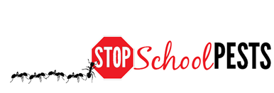
administrators
Self-Guided Educational Module
Lesson 2 of 2

Slide 2
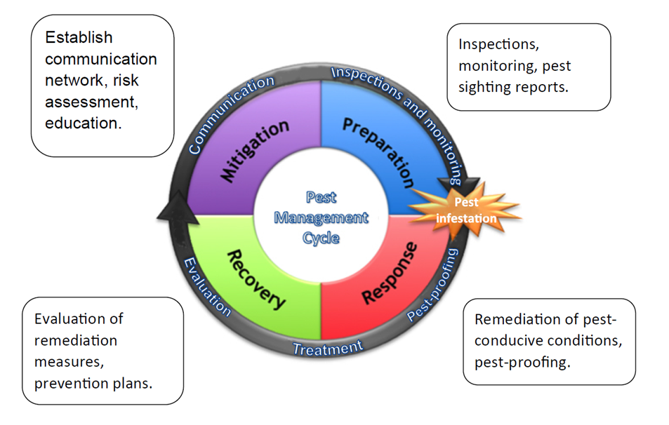
Learning Objectives
Describe key elements of coordinating an IPM policy and plan, including:
Development, implementation and maintenance
Describe
how to
uniformly
enforce IPM
policies
Dawn H. Gouge, University of Arizona

Slide 3

Implement an IPM Plan
Implement an IPM Plan to:
Manage pests effectively
and economically
Minimize the risk associated
with pests and pest
management practices -
Pesticide exposure risk is a
function of formulation,
placement, and timing of application
Maintain a safe, healthy, and beautiful facility

Slide 4
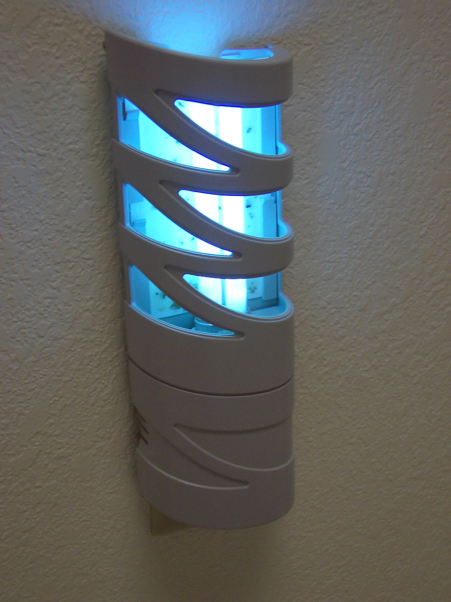
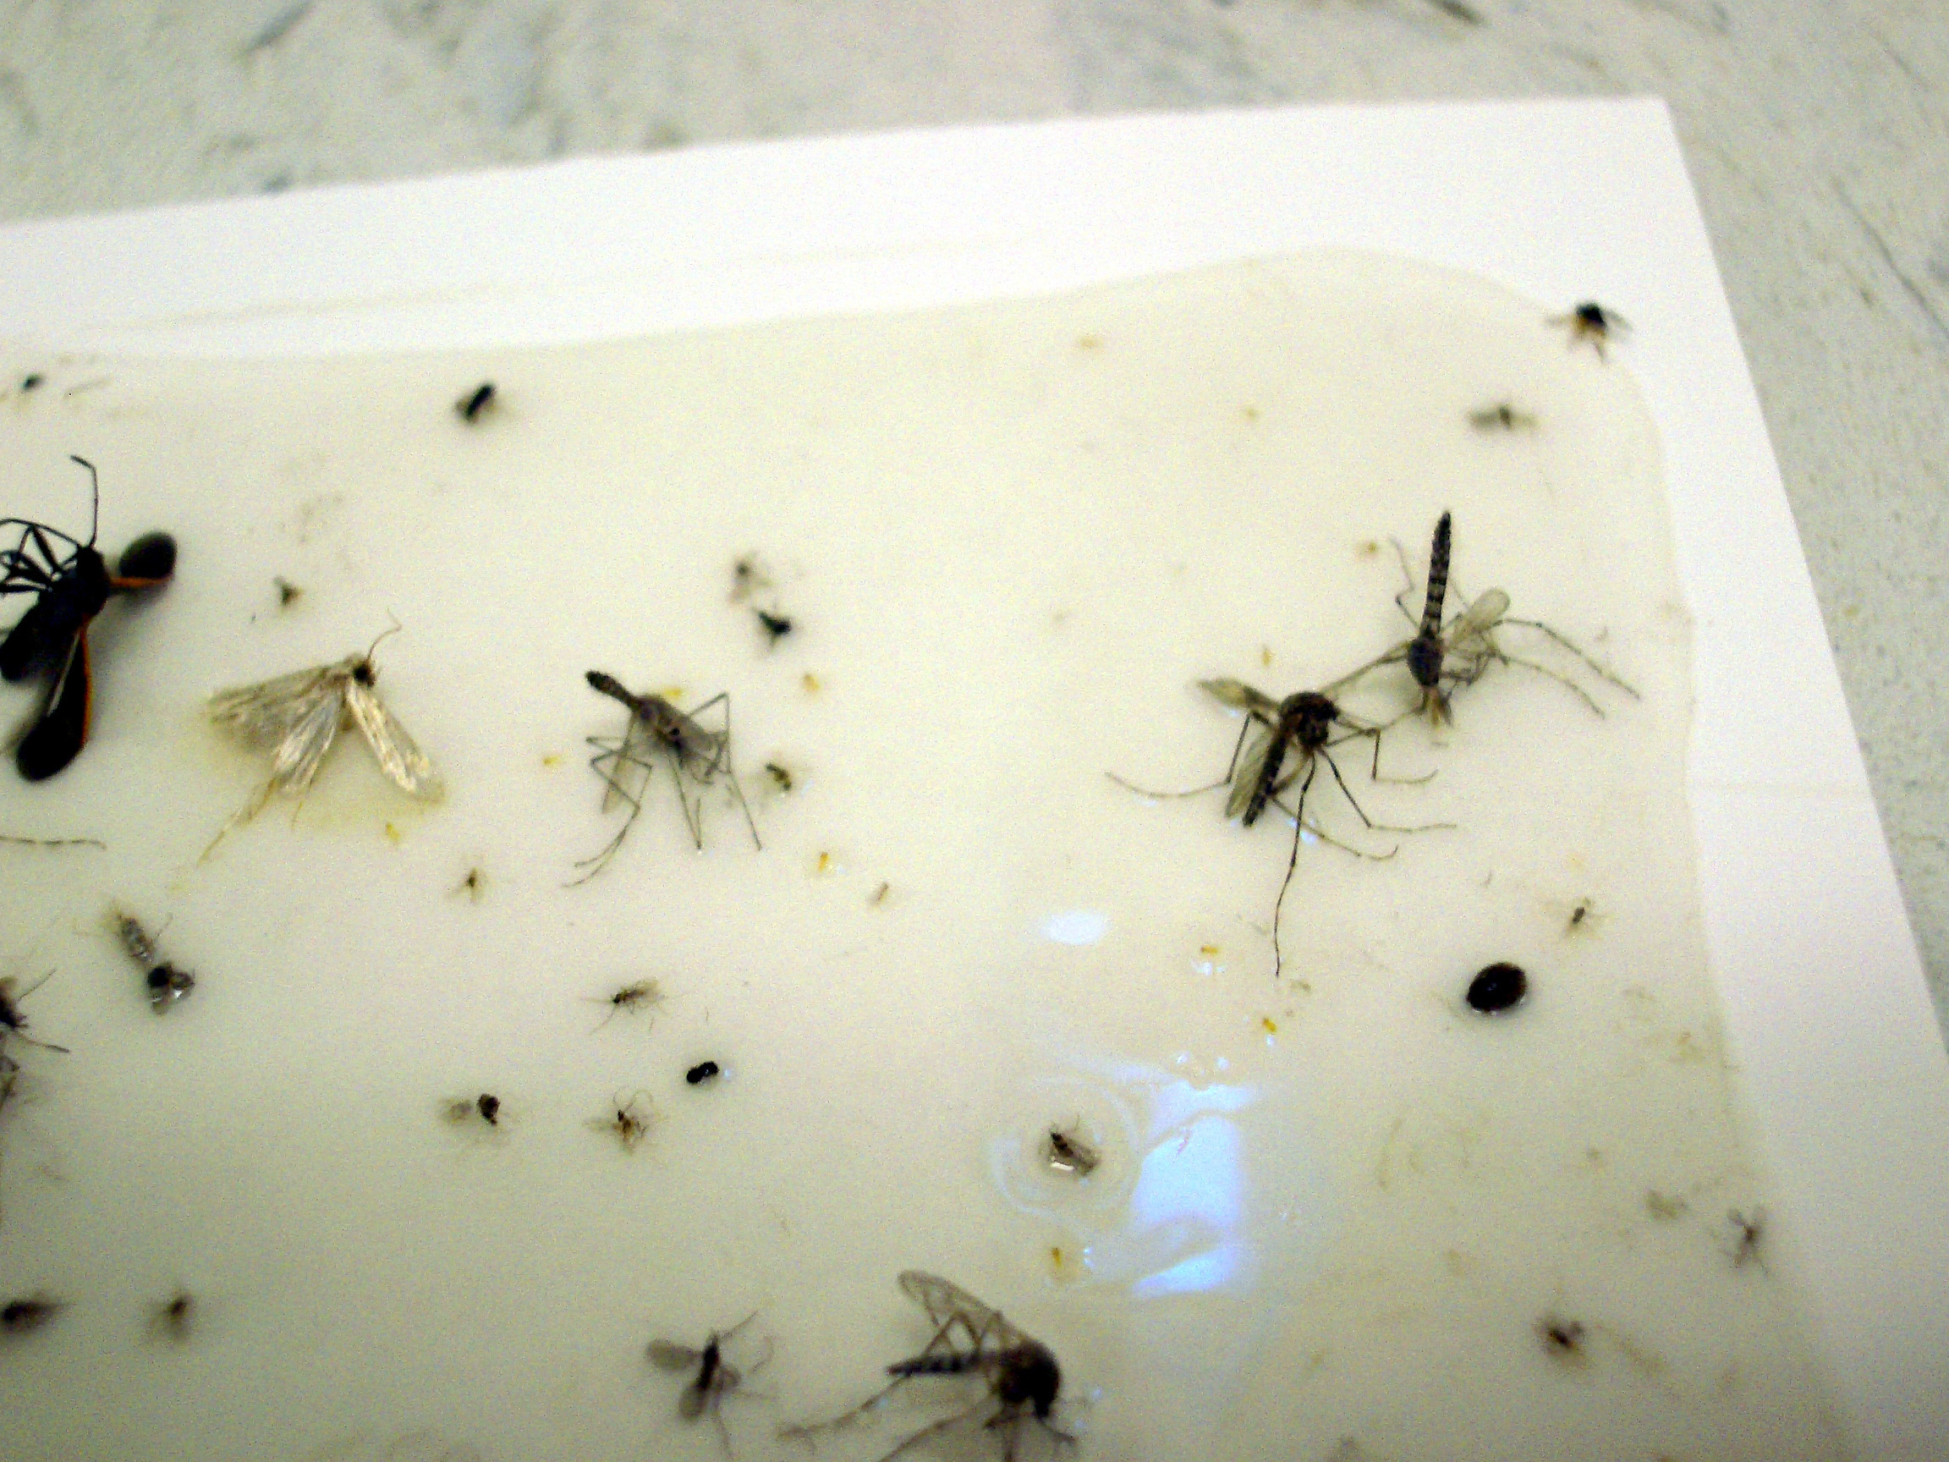
Plan Implementation
Monitoring – Reporting – Action Protocol
Monitoring is an important requirement and the backbone of an IPM program
Information gathered will
be recorded, reported, and
maintained
by appropriate
parties
UV light trap and catch-card –
Dawn H. Gouge, University of Arizona

Slide 5
Program Organization: Roles and Responsibilities
Effective communication, education, and cooperation between school staff, students, and parents is vital
Develop and use an effective command and communication system to ensure that pest management and prevention protocols are implemented according to your IPM plan
As part of your IPM Plan, create a table to identify all roles and responsibilities

Slide 6
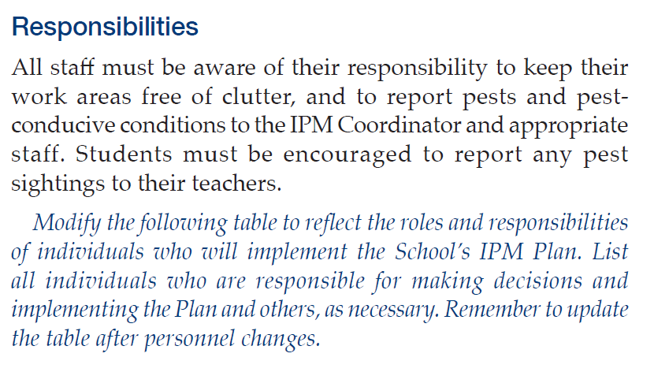
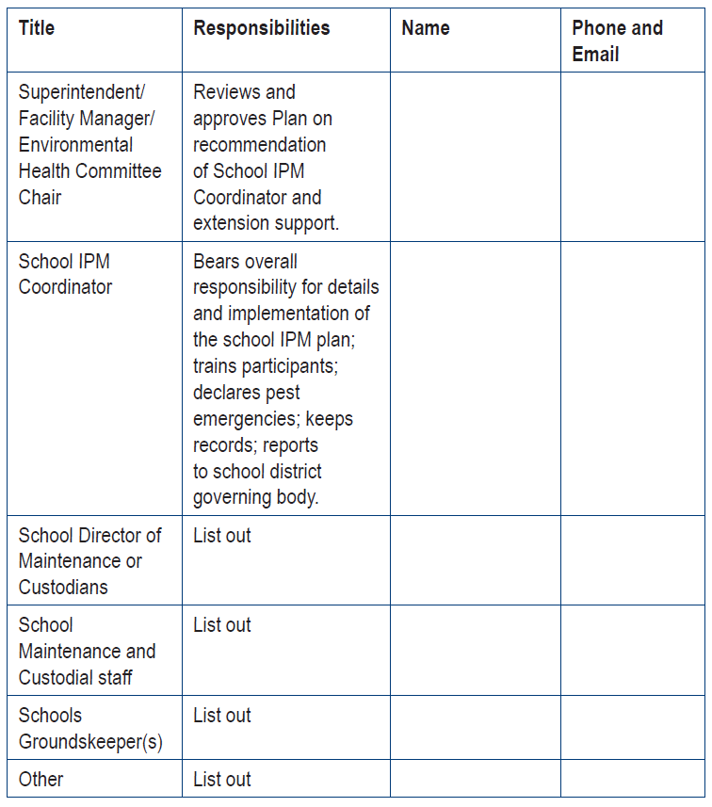
Example Table
Responsibility table from
School IPM Plan Template
https://extension.arizona.edu/
sites/extension.arizona.edu/
files/pubs/az1669-2015.pdf

Slide 7
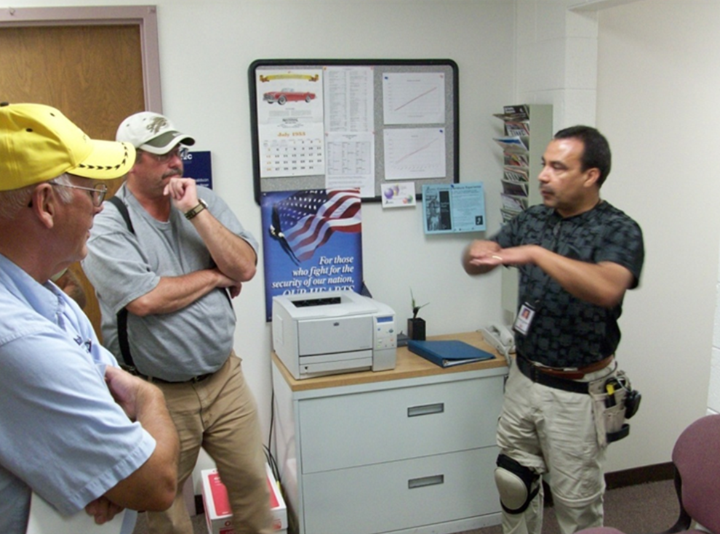
Training/Education and Responsibilities
School IPM Coordinator
Custodial/Maintenance Staff/Public Works Staff
Grounds Department
Kitchen Staff
Faculty
School Principal
Nurses
Others
IPM Coordinator training school staff -
Marc Lame, Indiana University

Slide 8
All Facility Users Influence Pest Levels
All Staff and Faculty
After a brief (15 – 20 minute) training by the IPM Coordinator (or designee) on pests and pest-conducive conditions, staff will be encouraged to report pests or pest-conducive conditions they observe during the normal course of their daily work
Any pests or pest-conducive condition will be reported to the IPM Coordinator orally, by e-mail, using Pest Logs, or by written letter

Slide 9
Monitoring and Reporting
IPM Coordinator and Custodial/Maintenance Staff/Public Works Staff
During the normal course of their daily work, the IPM Coordinator and custodial/ maintenance staff will monitor structures and building perimeters for pest-conducive conditions inside and outside the building, sanitation levels, pest damages, human behaviors that affect pests, and placement and contents of monitoring traps

Slide 10
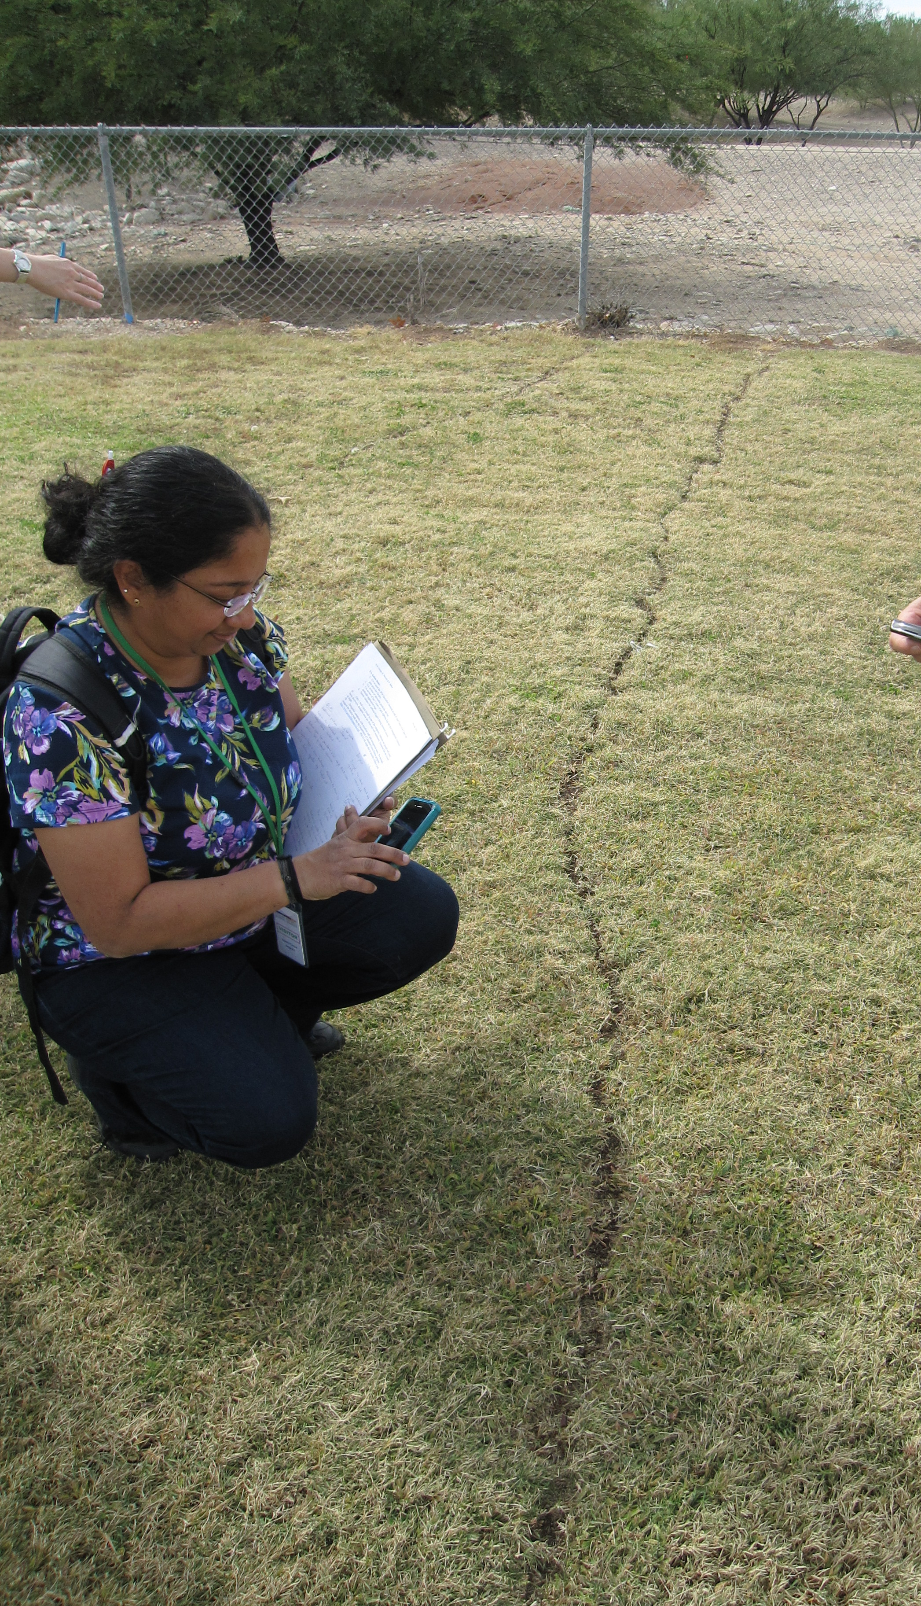
Monitoring and Reporting
Grounds Staff
During normal daily activities, grounds staff will monitor for weeds, rodents,
turf and landscape pest activity or
damage venomous pests, and
other outdoor pests or
pest-conducive conditions, and
upon finding any, inform the
IPM Coordinator
Harvester ant trail across athletic field – Dawn H. Gouge, University of Arizona

Slide 11
Action
When pests of concern (or their droppings, nests, damage, etc.) are observed, staff will contact the IPM Coordinator immediately
Any items (such as cracks or gaps allowing pest entry into buildings or a wasp nest located on playground) that custodial and maintenance staff observe and can resolve, should be corrected and reported to the IPM Coordinator
The IPM Coordinator will keep records of these actions, pest sightings, time invested, and money spent using Pest Logs or a similar reporting system

Slide 12
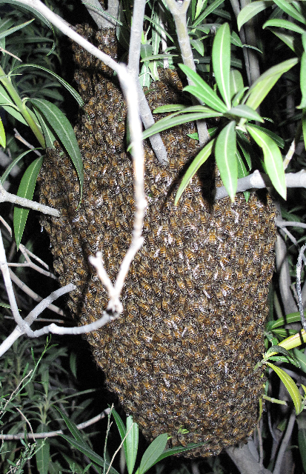
Action
Grounds: When pests on grounds reach a threshold established by the IPM Coordinator, action will be taken
Any condition that grounds staff
observe that they can resolve
should be corrected and reported
to the IPM Coordinator
The IPM Coordinator will keep
records of these actions using
Pest Logs or a similar
reporting system
Wild honey bees -
Carl Olson, University of Arizona

Slide 13

Action
If the action needed cannot be readily accomplished as part of routine duties, the Coordinator will meet with staff or contractors to develop a plan of action with a proposed deadline for completion based on the severity of the risk or nuisance
The Coordinator will keep records of
actions taken, work performed, time
invested, and money spent
The IPM Coordinator will share
records with the superintendent

Slide 14
Inspections
The IPM Coordinator will conduct an annual inspection using established inspection forms, during the inspection he or she will also inspect, review and identify:
1) Human behaviors that affect pests (working conditions that encourage or support pests, food preparation procedures that provide food for pests, etc.)
2) Management activities (sealing, cleaning, setting out traps, treating pests, etc.) and the effects on the pest population
3) Amount and types of pesticides used at each site, matched with pest monitoring records to document need and outcomes

Slide 15
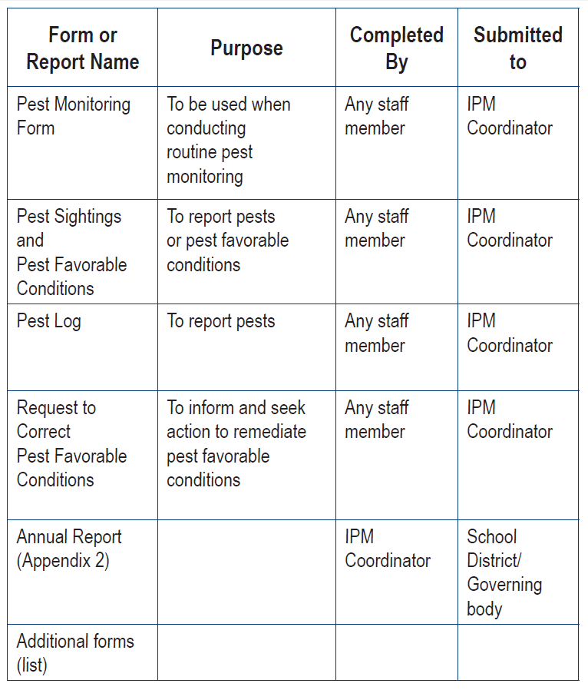
Forms
List forms and paperwork required
Identify the purpose, who is responsible for filling it out, to whom it is submitted, and how records are filed
Keeping good records saves time and money

Slide 16

Filling Procedures (Paper Files)
The IPM Coordinator collects and files hard copies of all of the above forms in a folder and/or maintains electronic files with backups in identified file cabinets and/or known electronic storage locations
When a pest report case is closed (a pest management action is completed or a pest issue is resolved), the report, along with the appropriate forms, is filed alphabetically, by facility or
site name, or by year in the filing
cabinet or electronic storage space
established for the purpose

Slide 17

Pest Emergencies
IMPORTANT: If a pest emergency is declared, the area must be evacuated and cordoned off before taking any other steps
When the IPM Coordinator, after consultation with school faculty and administration, determines that the presence of a pest or pests immediately threatens the health or safety of students, staff, faculty, or members of the public using the facility, or the structural integrity of campus facilities, he or she may declare a pest emergency

Slide 18
Pest Emergencies
Examples include (but are not limited to) venomous insects swarming, or a potentially rabid animal in an area frequented by people
The Coordinator will keep records of actions taken using Pest Logs or a similar reporting system and will immediately notify appropriate parties (e.g., the Principal, Facility Manager, Superintendent, etc.) of the evacuation

Slide 19
Annual IPM Report (completed by IPM Coordinator)
The IPM Coordinator will provide an annual IPM report
The report will include a summary of data gathered from Pest Logs, e-mails, Coordinator notes or other reporting systems, as well as costs for Pest Management Professionals and pesticides (including turf and landscape pesticides)
Costs for items such as sealants, new screens, door sweeps and other items that would not normally be considered part of pest management are best recorded as building maintenance costs

Slide 20

Annual IPM Report (completed by IPM Coordinator)
Include in reports the steps taken for successful management and prevention
The IPM Report should be incorporated into any annual
reports covering
pesticide
applications

Slide 21
Annual IPM Report (completed by IPM Coordinator)
The report shall also include detailed information showing any reduction or increase in the amount or toxicity of pesticides used, compared to the previous year
This information shall assist the
IPM Coordinator and the
governing body in determining
the success of the School IPM
Plan and program

Slide 22
Action Thresholds
Understand an acceptable pest threshold is the number of pests that can be tolerated before taking action
For some pests threatening health or property damage such as German cockroaches, rats, bats or squirrels the acceptable threshold is 0
Acceptable thresholds for other pests will be determined by the IPM Coordinator and relevant Committee

Slide 23
Hiring an Outside Contractor
Many schools find it helpful or necessary to contract with a licensed professional company to provide IPM services for buildings and/or grounds
The Contractor’s work should compliment and support services provided by school staff and should be fully consistent with and integrated into and your IPM plan
IPM Service Agreements differ by district but a generic template is included in the School IPM Plan Template referenced earlier

Slide 24
Hiring an Outside Contractor
When selecting a pest management service provider, it is advisable to solicit bids through a formal Request for Proposal (RFP) process
Criteria for selection should be based on the contractor’s ability to provide the services specified in the RFP that will support implementation of your IPM Plan rather than on the lowest bid
The Contractor should provide consulting and pest management services in accordance with an IPM Service Agreement and all attached Schedules, in conformance with the (RFP)

Slide 25
Hiring an Outside Contractor
Develop a written IPM service agreement specifying the services to be provided, access, communication and record-keeping protocols to be followed
Any pesticide applications should be approved by the IPM Coordinator, following all notice, communication and product selection protocols specified in your IPM Plan

Slide 26
Hiring an Outside Contractor
Contractors should provide the following services:
Inspection and pest monitoring
Recommendations for sanitation, maintenance, and storage deficiencies needed to address and prevent pests
Use the least-risk pesticide management methods that are effective
Use pesticides only where and when there is a demonstrated need and a pest identified, and after approval by the IPM Coordinator
Applying pesticides on a regular basis or as a preventive is only done on rare occasions to manage predictable hazardous pests such as disease vectors and high risk venomous pests

Slide 27
Hiring an Outside Contractor
The Contractor’s work is intended to implement and support district objectives
  IPM practices should be incorporated into any contracted services for lawn care, gardening, landscaping, tree care and sports field installation and maintenance - Services should:
    Sustain a safe and healthy school environment for students, staff and others
    Protect against any significant threat to public safety
    Prevent loss of or damage to school structures or property
    Reduce the likelihood of pests spreading into areas beyond school sites
Pesticides applied primarily for aesthetic purposes should be avoided

Slide 28
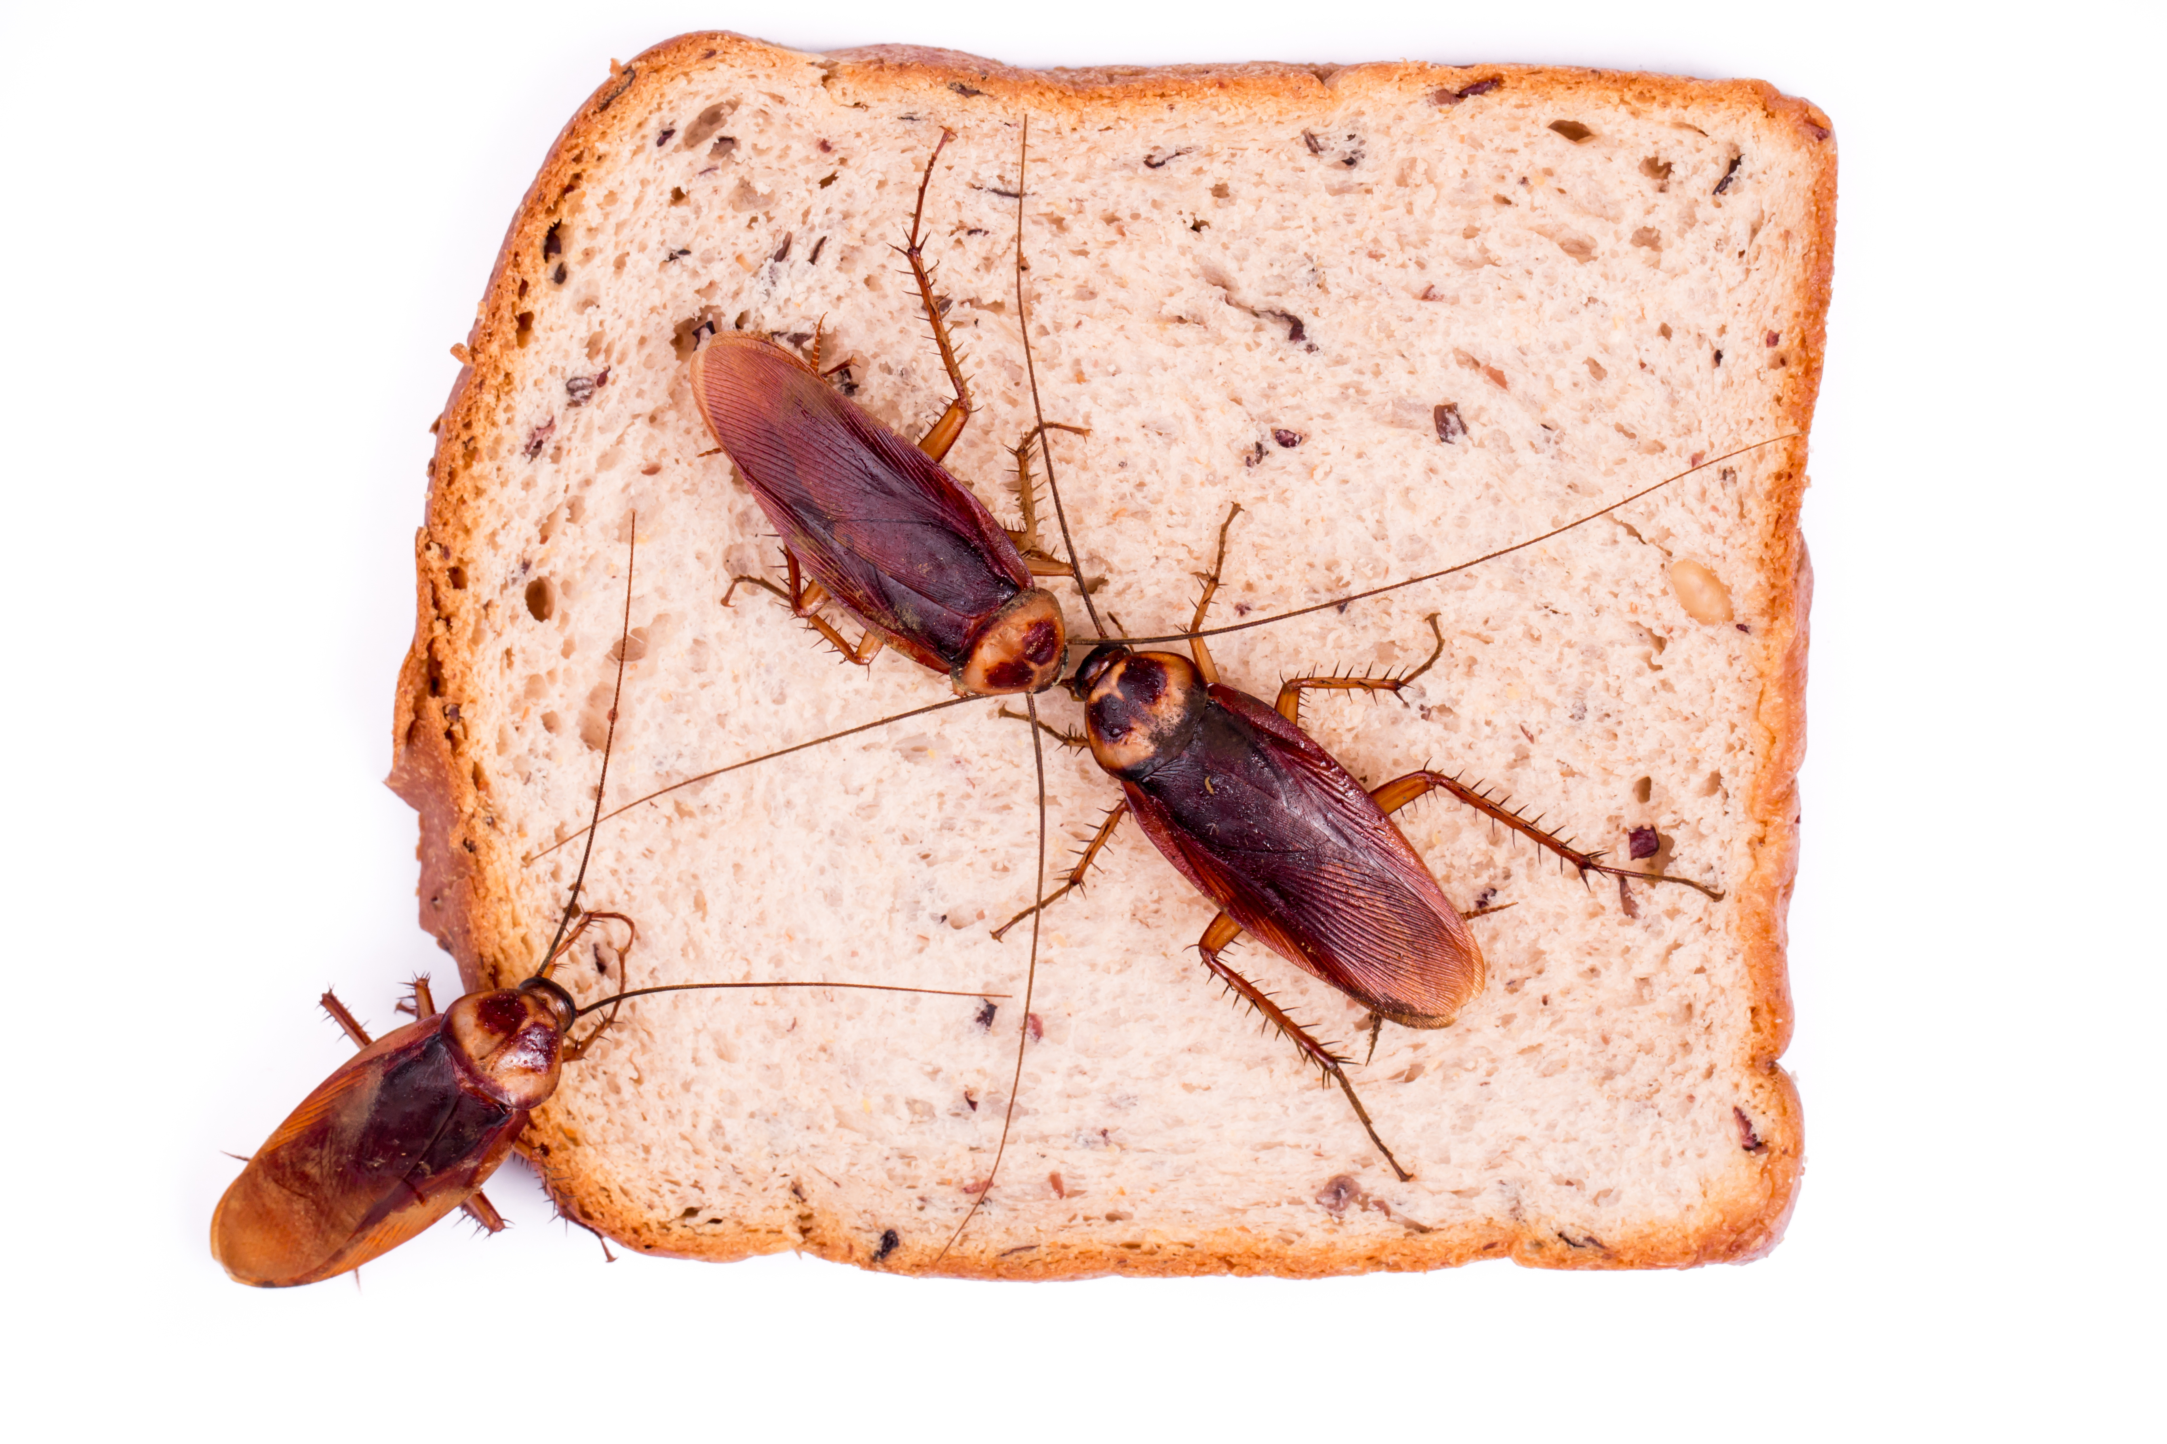
6. Pesticide Applications
Any pesticide application (this includes weed control products, baits and all professional and over-the-counter products) on school property should be made by a licensed commercial or public pesticide applicator, sanctioned by the IPM Coordinator - State laws differ, but this is the safest approach
Pesticide use requires notification,
posting, record keeping
and reporting

Slide 29
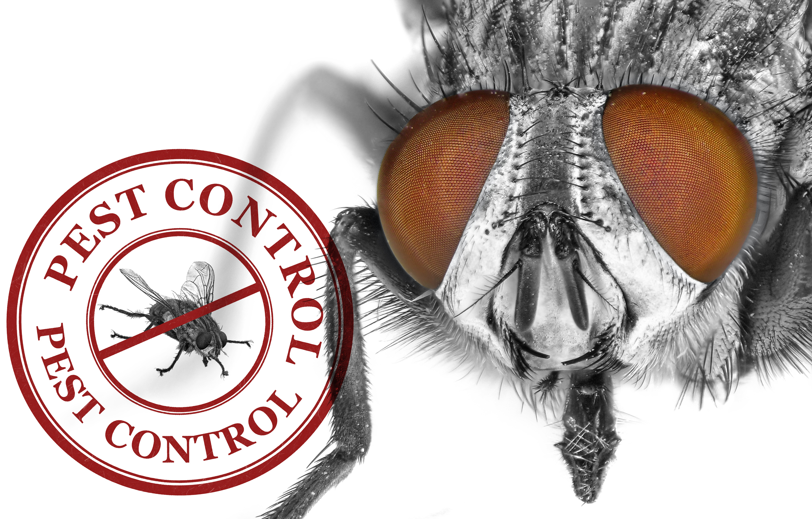
Pesticide Applications
The IPM Coordinator or designee shall keep a copy of the following pesticide product information on file at the school where the application occurred, and at the office of the IPM Coordinator for at least four years following the application date, or longer as state law or district policy requires:
  A copy of the label
  A copy of the Safety Data Sheet
  The brand name and signal word
  US EPA registration number of the product
  The approximate amount and concentration of product applied
  The date and location(s) of the application

Slide 30
Notification and Posting for Non-emergencies
Pesticides should only be used in conjunction with other prevention and pest management methods and only if needed to effectively manage pest-associated risks
Documentation of need should be a pre-requisite to the approval of any application of a pesticide -documentation should remain on file with the IPM Coordinator

Slide 31

Notification and Posting for Non-emergencies
The IPM Coordinator will give notice of a proposed pesticide application to all staff and parents at least 72 hours before the application occurs or in accordance
with state
laws

Slide 32
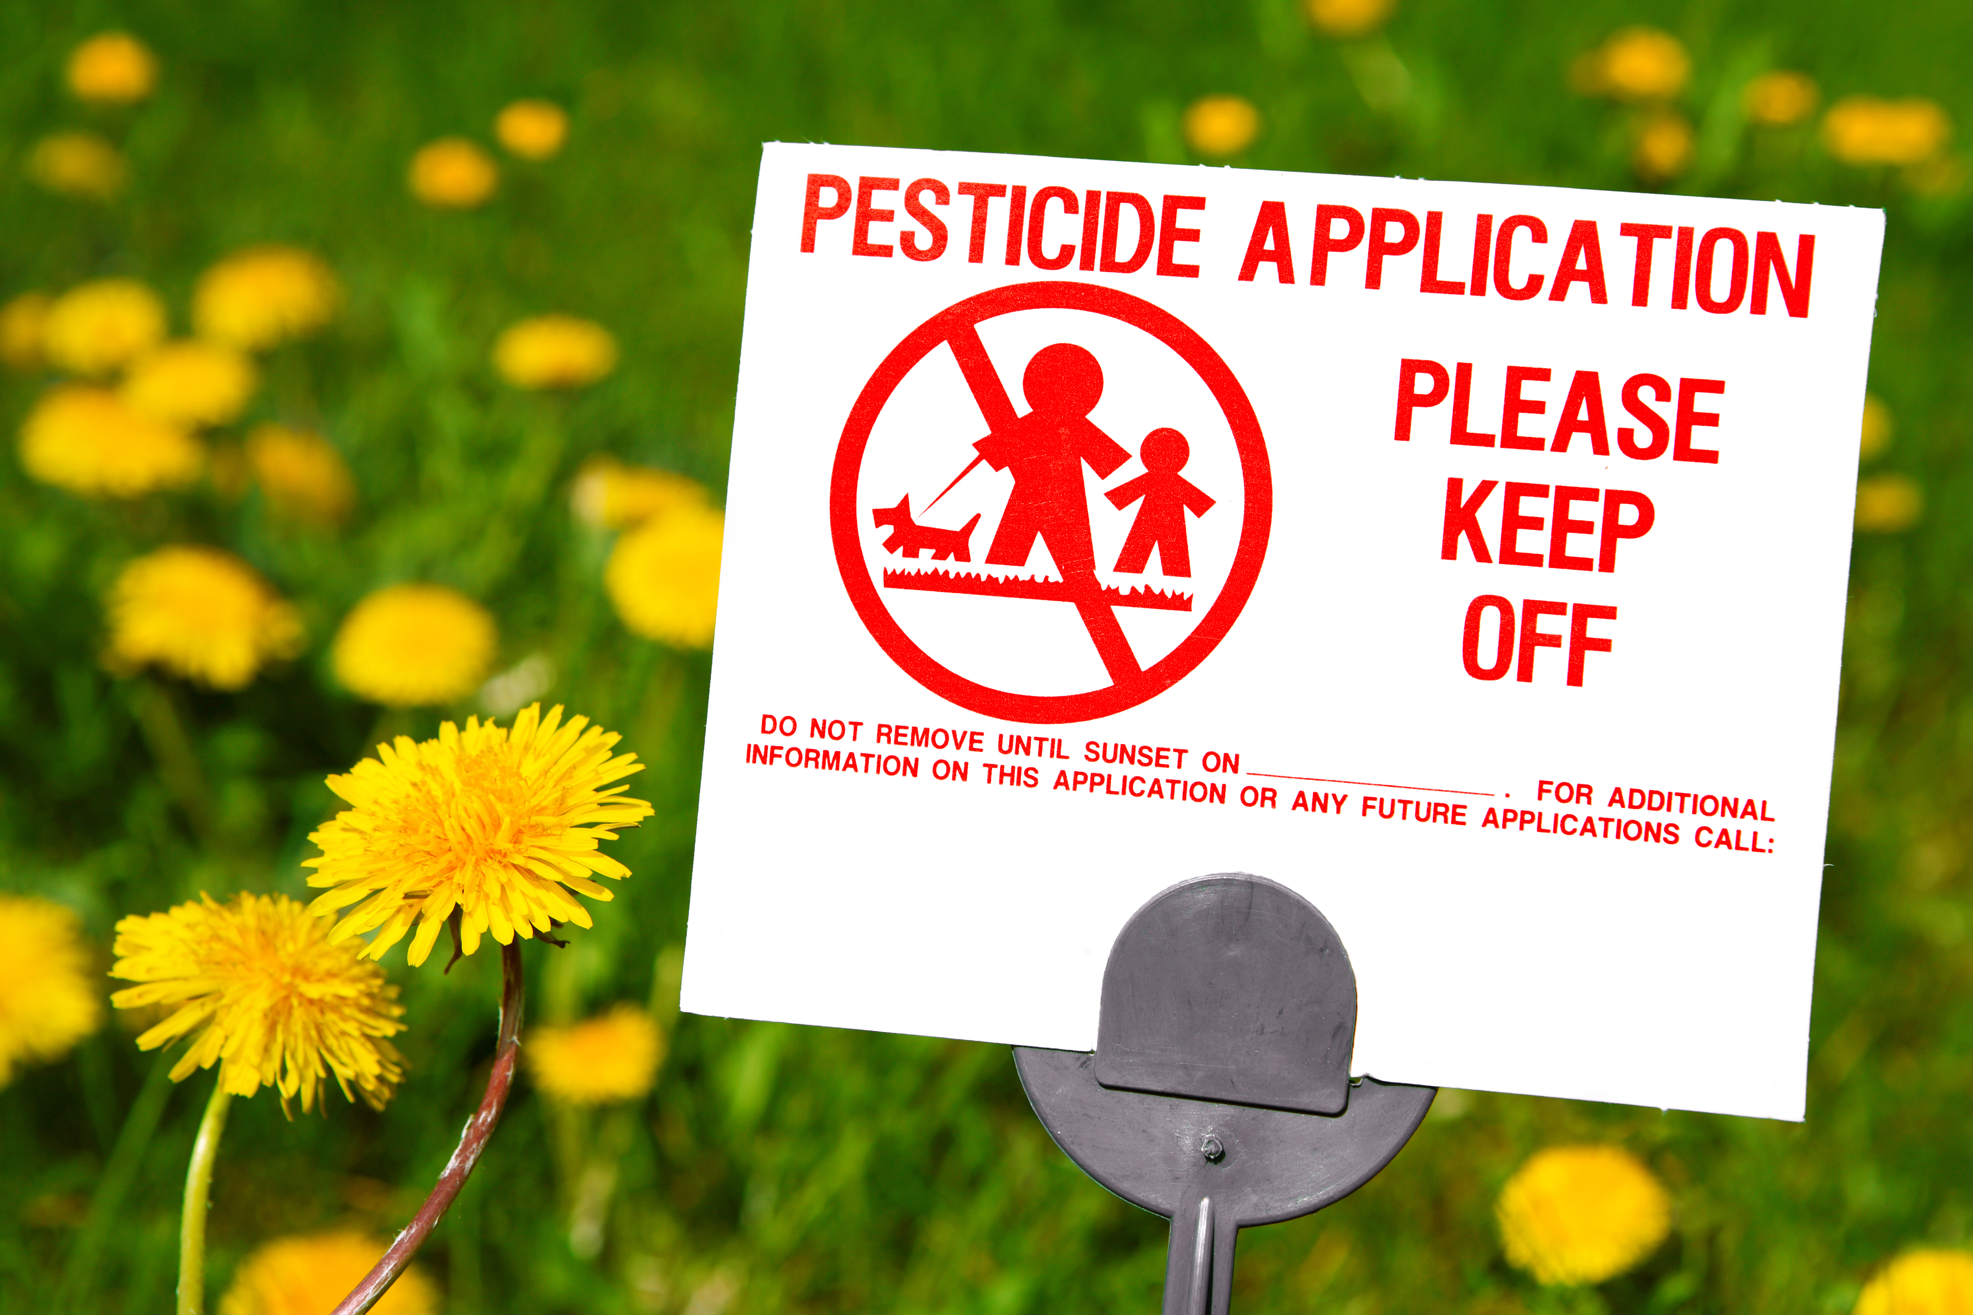
Notification and Posting for Non-emergencies
The notice should identify the trade name of the product, active ingredient, type of pesticide product and formulation, EPA registration number of the product, the expected location of the application, the
expected date of
application, and the
reason for the
application.

Slide 33
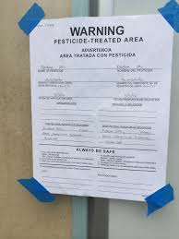
Notification and Posting for Non-emergencies
The IPM Coordinator (or a designee) should
place warning signs around pesticide
application areas beginning 72 hours
before the application occurs and
removed 48 hours after the application
(or in accordance with state law)
A sign should bear the words
“Warning: pesticide-treated area” and give the expected or actual date and time of the application, reentry time, and provide the name and telephone number of a contact person (applicator and/or the IPM Coordinator)
Pesticide application posting -
Shujuan Li, University of Arizona

Slide 34

Notification and Posting for Emergencies
If a pest emergency is declared, the area must be evacuated and cordoned off before taking any other steps

Slide 35

Notification and Posting for Emergencies
If a pest emergency makes it impractical to give a notice before the pesticide application occurs, the IPM Coordinator should send the notice to the school principal no later than 24 hours after the application
The Coordinator or designee should place notification signs around the area as soon as it is practical but no later than at the time the application occurs

Slide 36

Record Keeping of Pesticide Applications
The IPM Coordinator or designee shall keep a copy of emergency pesticide product information on file at the head custodian’s office at the school where the application occurred, and at the office of the IPM Coordinator for the minimum time required by state law following the application date:
  The same information
  should be recorded as
  listed on slide 29

Slide 37
Additional Pesticide Application Information to Record:
The pest condition that prompted the application
The type of application and whether the application proved effective
The pesticide applicator’s license or certification numbers
The name(s) and contact information of the person(s) applying the pesticide
The dates on which notices of the application were given
The dates and times for the placement and removal of warning signs
Copies of all required notices given, including the dates the IPM Coordinator gave the notices

Slide 38
Annual Report of Pesticide Applications
At the beginning of each academic year, the IPM Coordinator should provide an annual report of pesticide applications made the previous year to the superintendent
The report may contain the following:
The brand name, signal word, and U.S. EPA registration number of the products applied
The approximate amount and concentration of products
The location(s) and date(s) of the applications
The prevention or management steps taken and reason for pesticide applications
The type of application and how effective it proved to be

Slide 39
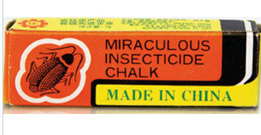
Pesticides
Note: All pesticides used must meet all applicable EPA requirements and be used in strict accordance with label instructions
Illegal pesticides are frequently found in schools, often brought in by staff who have brought them from home (sometimes after having them for many years), or purchased from stores or internet sites
Extreme caution should be used
when items are found as they
may contain high-risk ingredients
Illegal pesticide – Dawn H. Gouge, University of Arizona

Slide 40
Pesticide Selection
Although human and environmental risk is affected by how, when and where pesticides are used, product active ingredients are also an important factor
Consider selecting products that (a) lack a signal word or have the signal word “caution” on the label, (b) do not contain an ingredient classified as a known or probable human carcinogen under the U.S. EPA 1986 Guidelines for Carcinogen Risk Assessment, and (c) do not contain an ingredient classified as carcinogenic or likely to be carcinogenic to humans under the U.S. EPA 2003 Draft Final Guidelines for Carcinogen Risk Assessment

Slide 41
Pesticide Selection
Seek guidance from reliable sources to develop a list of pre-approved pesticides to be used if needed, by properly trained and authorized applicators, for common or expected pest issues
Selected products must be legal for use in your state for the intended purpose according to federal and state regulations
Select products based on human health risk (risk of exposure x toxicity), environmental impacts, and efficacy against the target pest

Slide 42
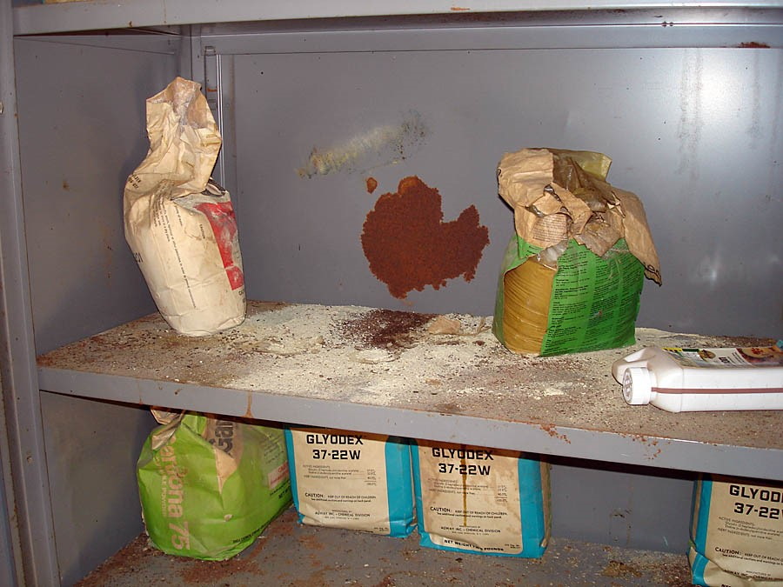
Pesticide Selection
Establish and enforce strict policies to prohibit staff or volunteers from storing or using unauthorized pest control products
If unauthorized products are found use extreme caution before handling them, contact local or state authorities before attempting to remove them, especially if the product is unrecognized, unlabeled,
or in an old, leaking, rusty or
fragile container
Legacy pesticides
contaminating storage area
Jerry Jochim - Monroe
County Community School Corporation

Slide 43
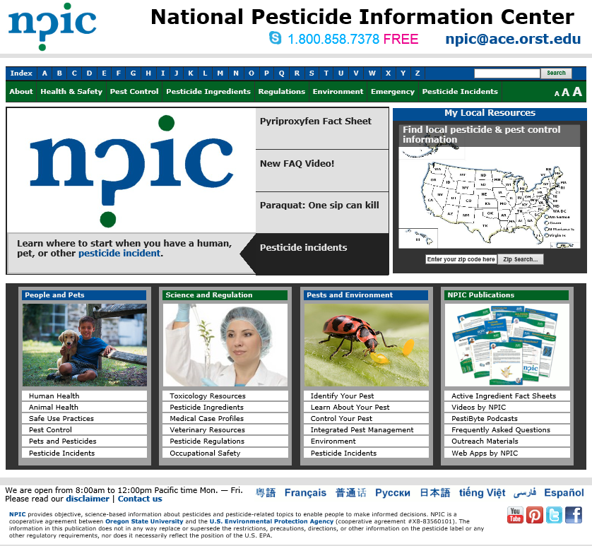
Pesticide Selection
The National Pesticide
Information Center
can be contacted
at 1.800.858.7378
or
http://npic.orst.edu/
for assistance in
determining a
pesticide active
ingredient cancer
classification

Slide 44
References
School IPM Plan Template by Gouge et al. https://extension.arizona.edu/sites/extension.arizona.edu/files/pubs/az1669-2015.pdf
Model Pesticide Safety and IPM Guidance Policy for School Districts by EPA Center of Expertise for School IPM http://www.epa.gov/pestwise/publications/ipm/Model-School-IPM-Policy.pdf
How to Develop an Integrated Pest Management (IPM) Policy and Plan for Your School District. PENN STATE. Retrieved from http://extension.psu.edu/pests/ipm/schools/facilitiesmanagers/resourcespaschools/faq/ipmschoolplan

