Slide 1


Facility Manager IPM PLAN and Policy
Lesson 1 of 3
In-Person Education Module

Slide 2
Learning Objectives
Describe key elements of an IPM policy and plan and their relationship to an IPM program including:
  Writing IPM policies and plans
  Securing formal approval of an IPM policy and plan
  Implementing and maintaining an IPM policy and plan including recordkeeping and evaluation

Slide 3

1. School IPM Policy
Successful transition from a conventional pesticide-based program to an IPM program
Establishes IPM long-term
District commitment
to IPM

Slide 4

Policy Continued
District intent to implement and practice IPM
School board-approved IPM policy

Slide 5

Policy Continued
Implementing pest prevention is important
IPM components include:
Sanitation
Pest exclusion
Habitat modification
Pesticides necessary
based on inspection
and monitoring

Slide 6
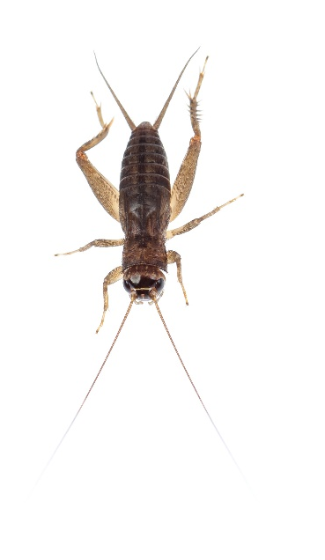
Policy Continued
The policy can include provisions for addressing:
  Clutter
  Sanitation
  Maintenance
The IPM coordinator is
responsible for day-to-day interpretation of the IPM policy
The policy guides development of a detailed IPM plan

Slide 7
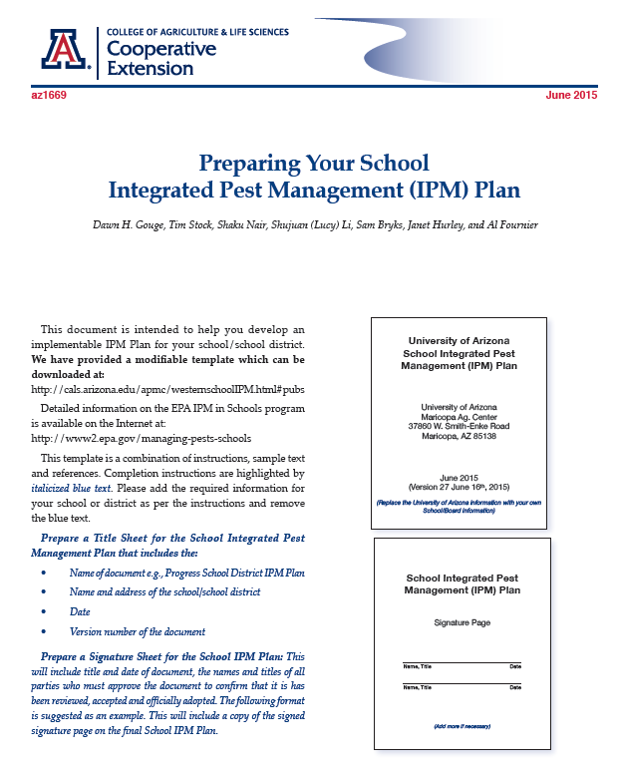
2. IPM Plan Template
The IPM plan is a blueprint detailing how your district or school will manage pests
Guidance document http://extension.arizona.edu/sites/extension.arizona.edu/files/pubs/az1669-2015.pdf
The plan is managed by the IPM
Coordinator
Your plan will be a living
(changing) document updated
annually or more often

Slide 8

Your IPM Plan Should Include:
Your school IPM policy
General information about your district
School IPM coordinator contact information
List of environmental health committee members
Identification and description of common pests and chemical and non-chemical
measures used to manage
those pests

Slide 9

Your IPM Plan Should Include:
Description of your school IPM information flow
A list of pre-approved or preferred pesticide(s)

Slide 10

General Information
School/District name
Address
City
Zip Code
Telephone number
E-mail address
Website
Prepared by
Date prepared

Slide 11

3. The IPM Coordinator
The district should appoint an IPM Coordinator
The IPM Coordinator must be trained to:
Oversee staff
Oversee and coordinate
the activities of the
IPM Committee

Slide 12
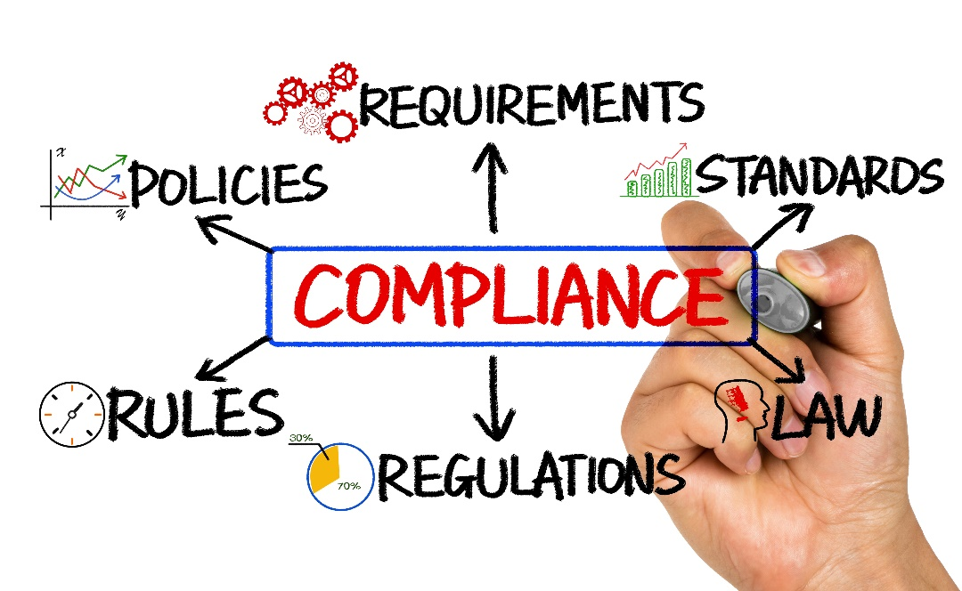
IPM Coordinator Continued
Manage pest control contractors
Communicate with principals and district
administration regarding posting and
notification, recordkeeping and education
Ensure compliance with
the IPM policy and
plan

Slide 13
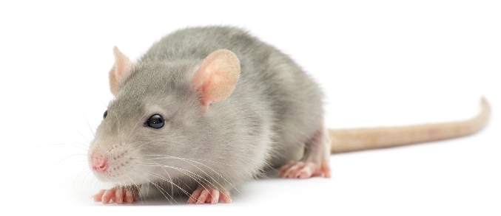
IPM Coordinator Continued
School facility managers, or individuals who have facility management leadership are good candidates for the IPM coordinator role
Initial training and continuing education

Slide 14

4. The IPM Committee
The IPM committee - individuals who have interests or who are involved in activities related to pest management
Environmental health and safety or related committees may be
used
The IPM coordinator
can organize
communications and
meetings

Slide 15
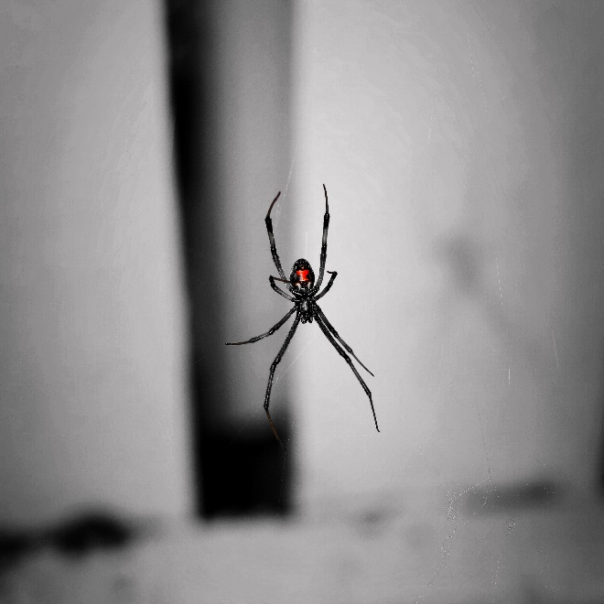
IPM Committee Continued
The committee:
Makes policy recommendations
Provides a forum for
communication and
information exchange
use IPM

Slide 16

IPM Committee Continued
Members can include:
  School nurses
  Food service staff
  Teachers
  Custodians
  School athletic
  department staff
  Landscape and grounds staff
  Superintendent
  Pest management professionals
  PTO/PTA members

Slide 17
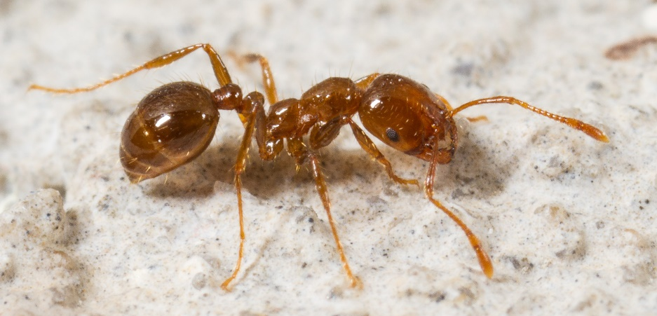
5. Identification and Description of Your School Pest Problem(s)
Pest identification
Inventory pest problems

Slide 18
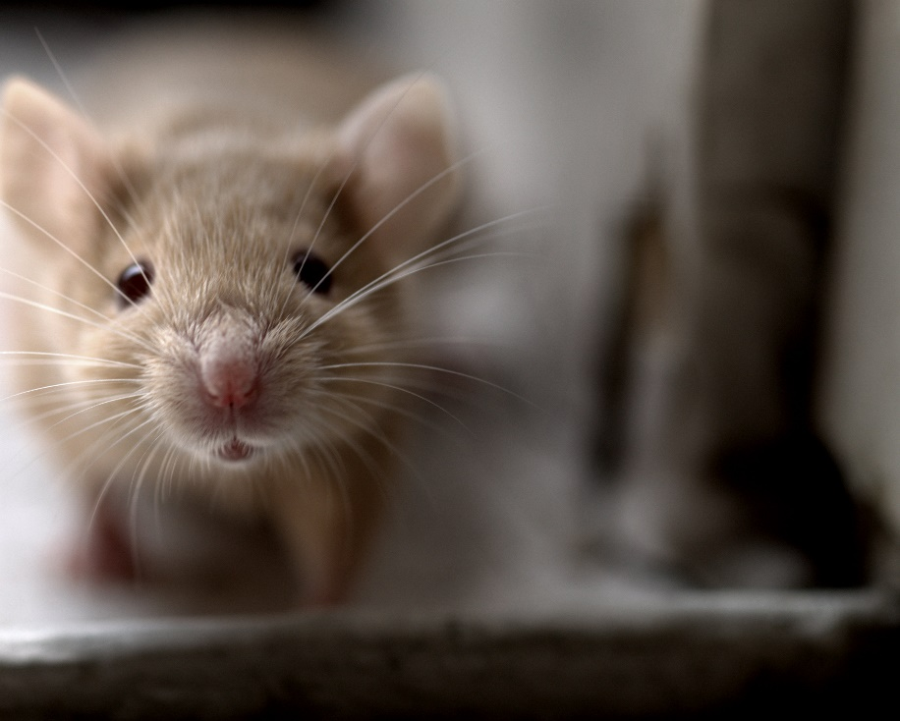
Identification and Description of Your School Pest Problem(s) Continued
Determine the most common pest problem(s)
Ask questions with every pest sighting:
Is it a new or continuing problem?
What specific areas?
What time of year?
Structural deficiencies
or sanitation problems?

Slide 19
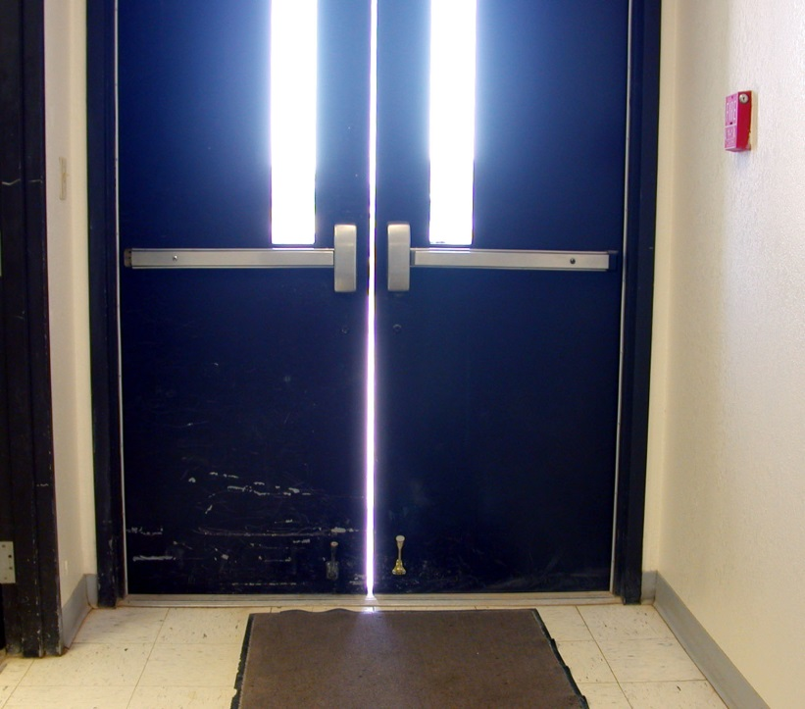
Identification and Description of Your School Pest Problem(s) Continued
The IPM plan should encourage non-pesticide pest management methods
Door in need of vertical sweeps – Dawn H. Gouge, University of Arizona

Slide 20

6. Describe Your School IPM Information Flow
Type of reporting system and information required
Who will be responsible for responding to sanitation and
building repair
problems
Documentation of
pesticide
applications

Slide 21
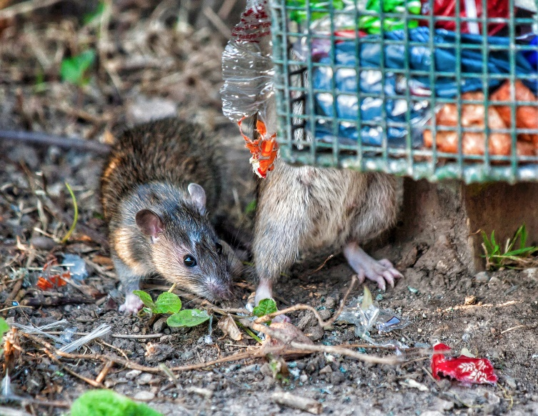
Information Flow Continued
Education plan
Pest management records:
  Pesticide use
  Non-chemical actions
  Service reports
  Pest-sighting logbook
  Posting
  Notification
  Emergency waivers

Slide 22
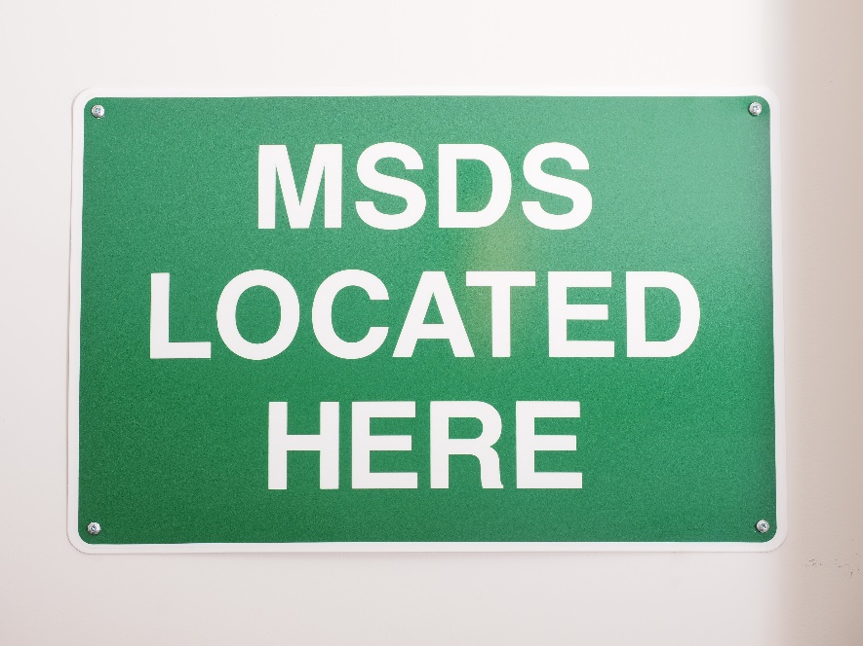

Information Flow Continued
Additional documents:
  Safety Data Sheets (SDSs)
  Pesticide product labels
  Manufacturer
  information
  about inert
  ingredients

Slide 23
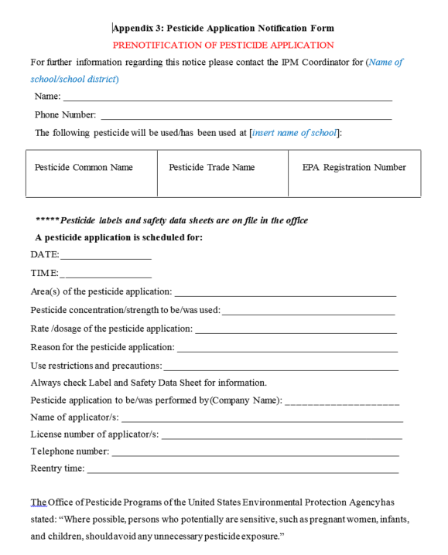
Information Flow Continued - Pesticide Application Notification
Parents and staff notification of pesticide applications
State law
Facility Managers should review
legal requirements as they
write the IPM Plan
Methods of notification

Slide 24
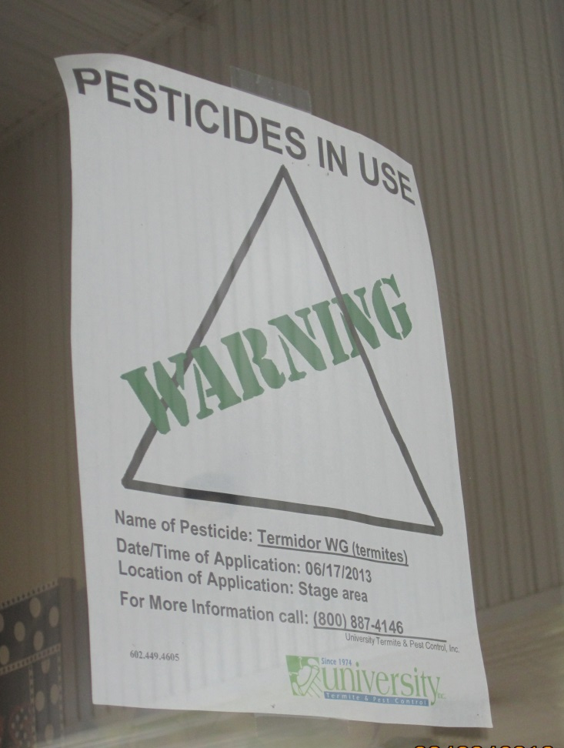
Pesticide Application Notification Continued
Signs should be posted on facility doors and near the site of applications
Pesticides in Use sign posted
– Dawn H. Gouge, University of Arizona

Slide 25
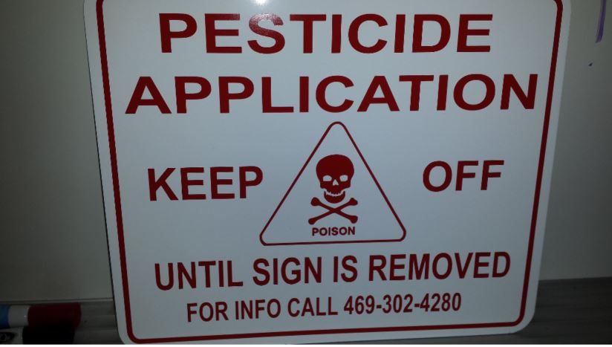
Pesticide Application Notification Continued
Outdoor application areas flagged
Signs
Pesticide Application sign posted
– Janet Hurley, Texas AgriLife Extension

Slide 26
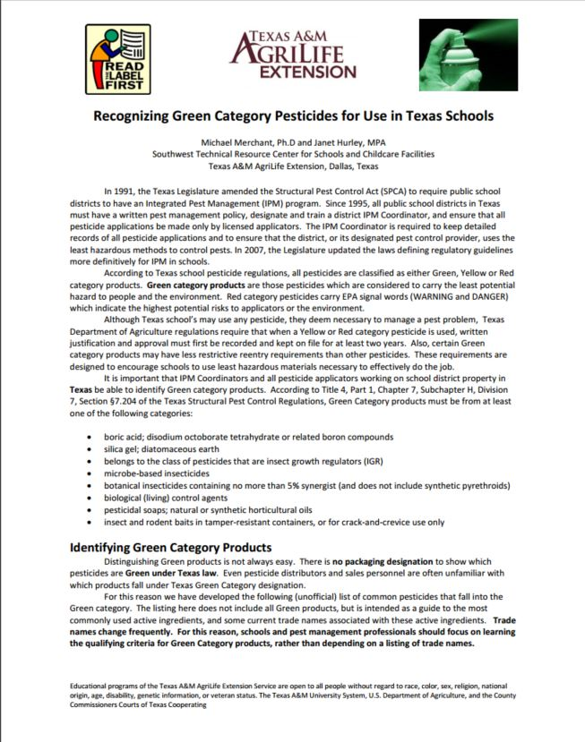
7. Pre-approved or Preferred List of Pesticides
Pesticide guidance
The objective is to
identify low-risk,
effective options
Green Category pesticide guide for schools in Texas
– Janet Hurley, Texas AgriLife Extension

Slide 27
Secure Formal Approval of an IPM Policy and Plan
Document endorsement of the IPM Policy/Plan by:
  The district Environmental Health Committee
  The District Superintendent
  The School Board
  The State Department of Education
  or Tribal Council
  PTO/PTA

Slide 28

Maintain the IPM Policy and Plan
Evaluate IPM plan annually
  Is the IPM plan working?
  What changes are necessary?
  New technology?
  Have federal, state or
  local rules changed?

Slide 29

Additional Documents: Pest-Sighting Logs
Facility Management should keep records of:
Number of pests or indicators of pest activity
Pest logs
Weaknesses in sanitation, cluttering and behavior problems
Logs can be part of an
existing electronic
work-order system

Slide 30
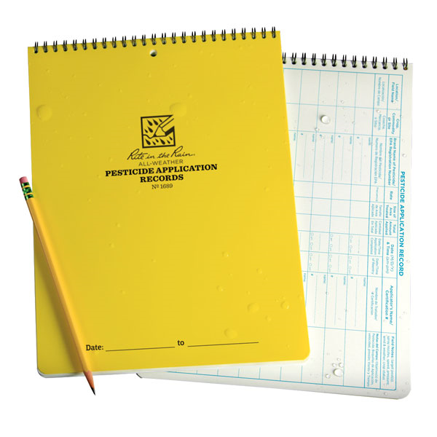
Additional Documents: Pesticide Application Logs
Records of pesticide use shall meet the requirements of applicable regulatory agencies
The objective is to
create records that can
be evaluated
Pesticide application records – Rite in the Rain, JL DARLING LLC, WA

Slide 31
Check In!
In this lesson you learned
How to describe key elements of an IPM Policy and Plan and their relationship to an IPM Program including:
  Writing IPM policies and plans
  Secure formal approval of an IPM policy and plan
  Implementing and maintaining an IPM policy and plan
Next you will learn about other facility manager responsibilities!

Slide 32
Resources
How to Develop an Integrated Pest Management (IPM) Policy and Plan for Your School District. PENN STATE. Retrieved from http://extension.psu.edu/pests/ipm/schools/facilitiesmanagers/resourcespaschools/faq/ipmschoolplan
National Center for Environmental Health. (2009). Healthy Housing Reference Manual. Retrieved from http://www.cdc.gov/nceh/publications/books/housing/figure_cha04.htm
New Jersey Department of Environmental Protection Pesticide Control Program. How to Do… IPM at School A How to Manual for New Jersey Schools. Retrieved from http://www.state.nj.us/dep/enforcement/pcp/bpc/ipm/How_to_Do_IPM.pdf

