Slide 1
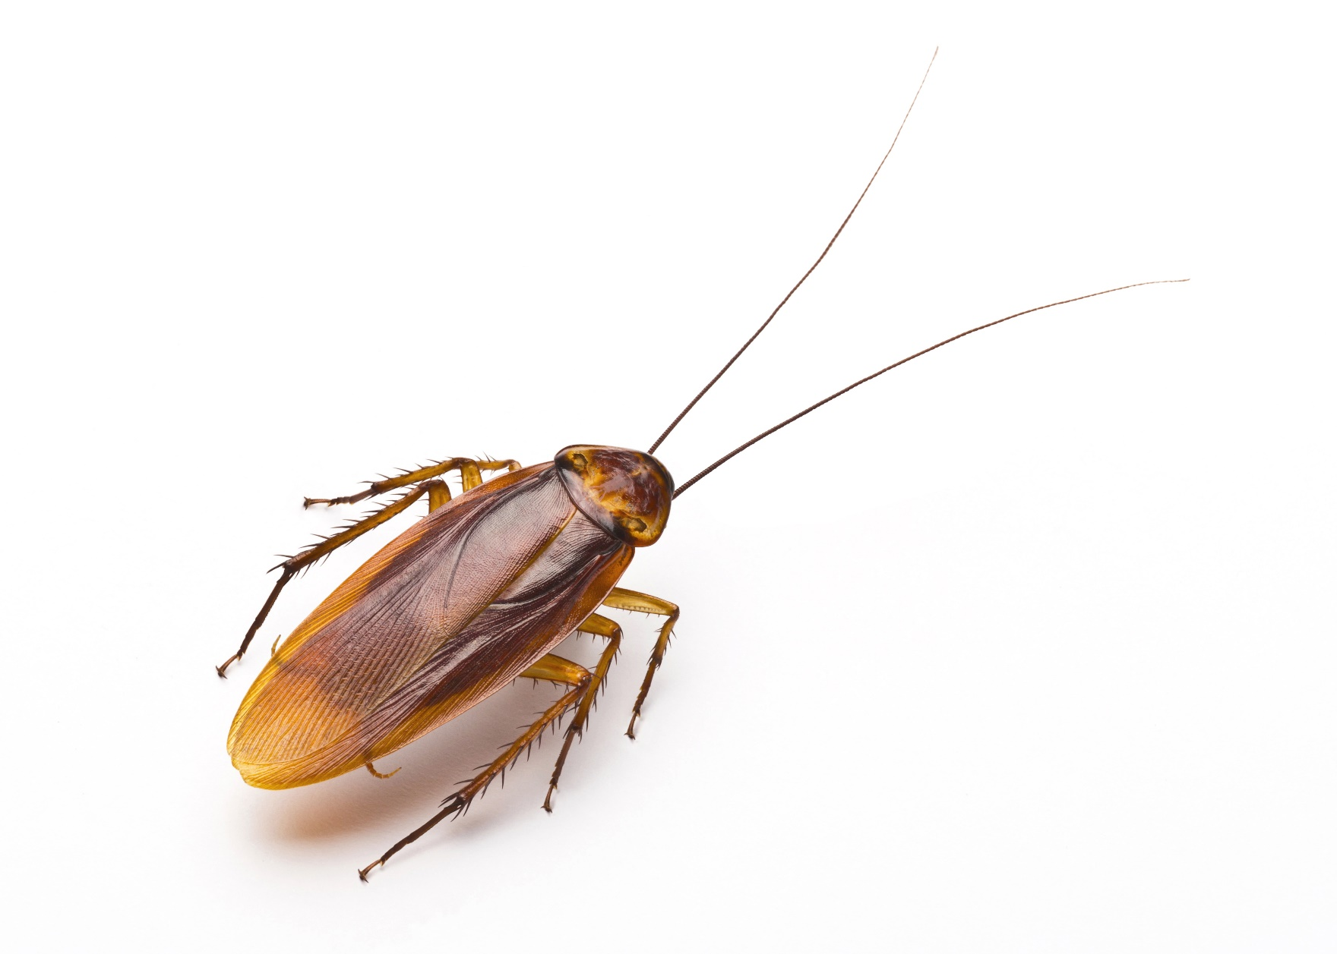
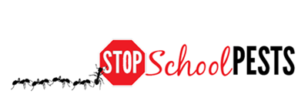
Key pest groups
Lesson 3 of 3
Self-Guided Education Module

Slide 2
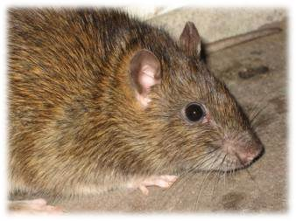
Learning Objectives
How to identify key exterior and landscape pest groups, including:
Biting and stinging pests
Flies
Ants
Cockroaches
Rodents
Wood-destroying insects
Common weeds
Norway rat - Dawn H. Gouge,
University of Arizona

Slide 3
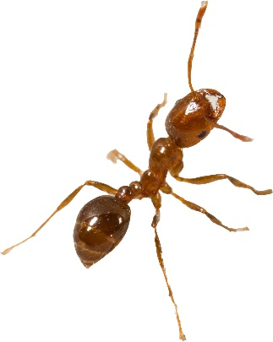
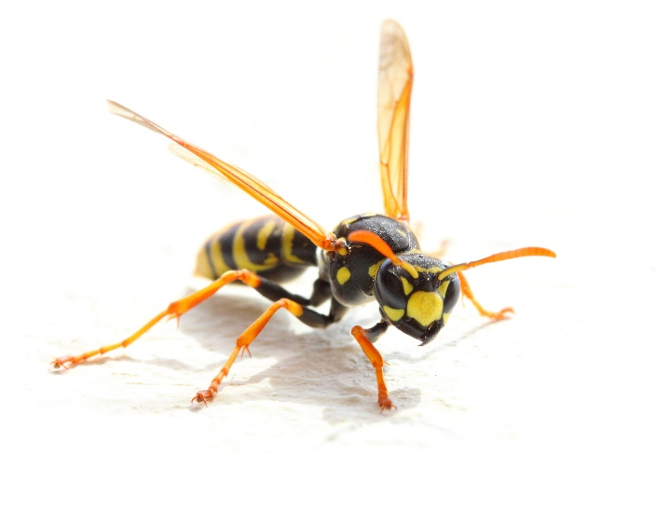
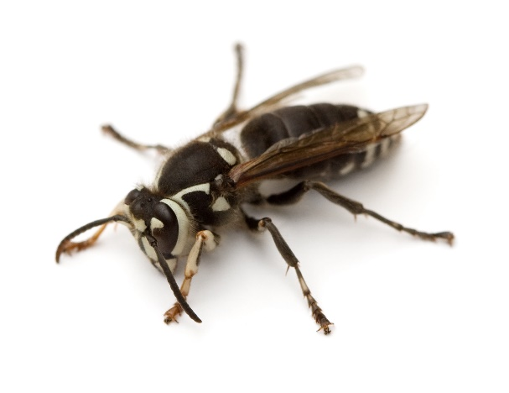
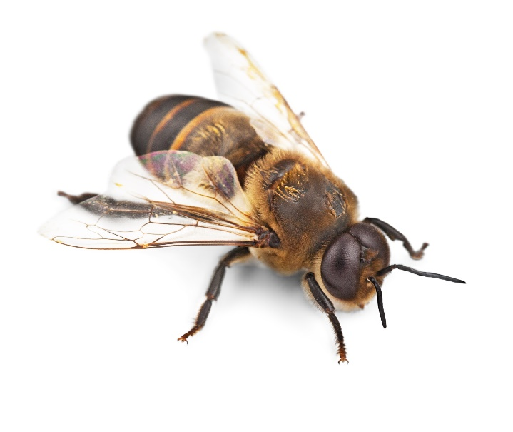
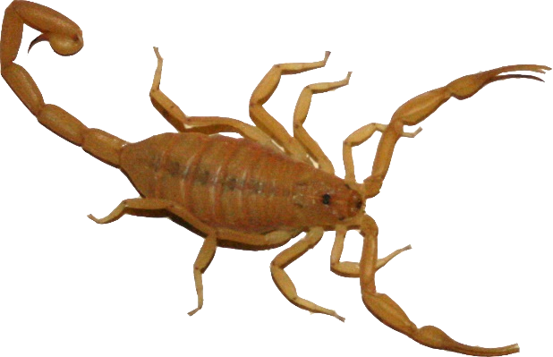
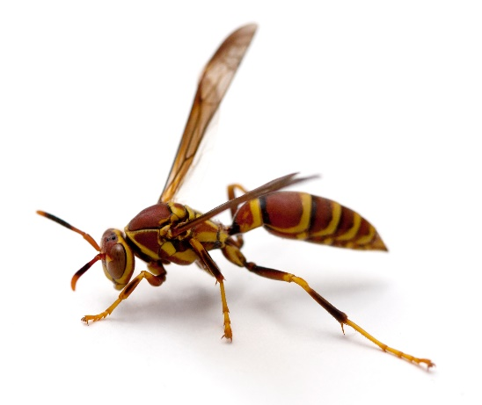
Stinging Pests
Fire ant – Robert LaMorte, University of Arizona
Yellowjacket
Baldfaced hornet
Scorpion – Dawn H. Gouge, University of Arizona
Honey bee
Paper wasp

Slide 4
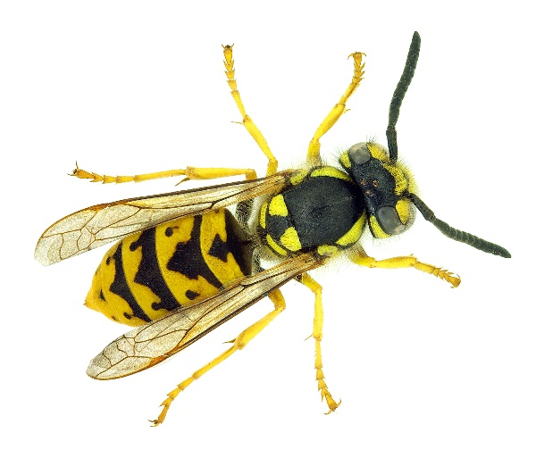
Biting and Stinging Pests
Yellowjackets, hornets and paper wasps are both beneficial and problematic
They are important predators and scavengers, helping to manage pests and recycle organic materials, but they can also sting humans and pets
Yellowjackets and paper wasps can sting repeatedly, while a bee can sting only once
Multiple stings from wasps are common because they aggressively defend their nest when they are disturbed

Slide 5
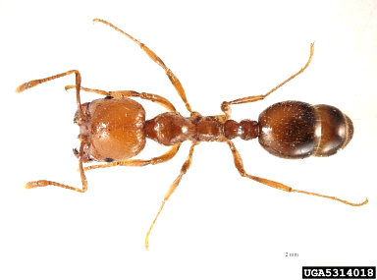
Biting and Stinging Pests Continued
Fire ants are notorious for their stinging behavior, they respond rapidly and aggressively to any disturbance of the colony or to a food source
Fire ants can sting repeatedly
The identifying characteristics of a fire ant colony include an earthen nest and polymorphic workers (workers are obviously a mix of different sizes)
There are native and introduced species of fire ants
Fire Ant -
Pest and Diseases Image Library, bugwood.org

Slide 6
Biting and Stinging Pests Continued
Fire ants are one of very few ants that can pose a serious risk to students and school personnel
They will forage indoors if a food or water source is available, but generally are outdoor challenges largely in turf areas
Red imported fire ants require a specific management plan, ask your local extension agency for tips and advice
Most native species of fire ants can be discouraged by improving turf health, and remediating colonies when necessary using pesticide baits

Slide 7
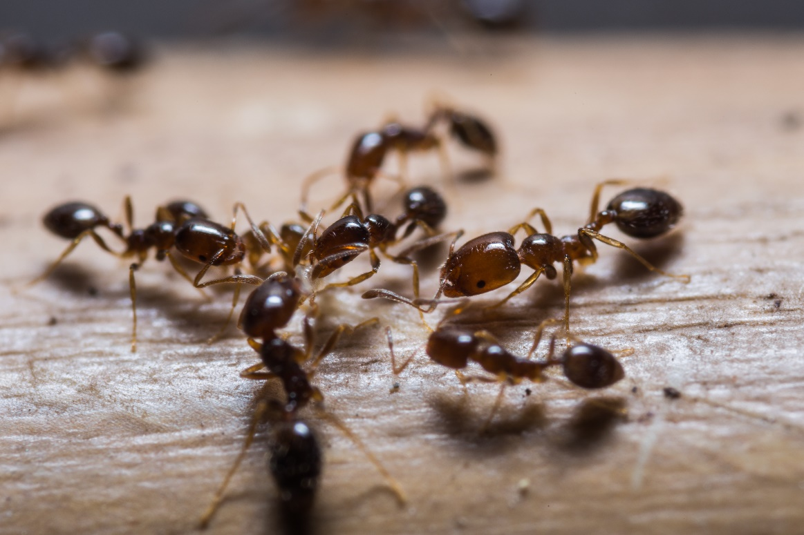
Biting and Stinging Pests Continued
Stings of fire ants, bees and wasps may cause allergic reactions in some individuals, a serious health threat that requires immediate medical attention
Red imported fire ants

Slide 8
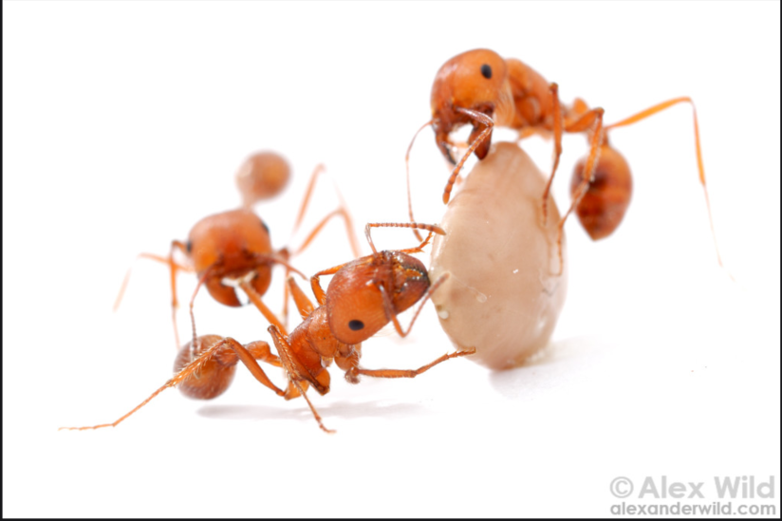
Other Ants
In general, ants become pests when they invade buildings in search of food or shelter
It is often very difficult and not desirable to eliminate most ants from their outside habitat, so management efforts should aim at preventing ants from invading structures
Many species of ants help to aerate the soil and facilitate nutrient recycling
Harvester ants – Alex Wild, alexanderwild.com

Slide 9
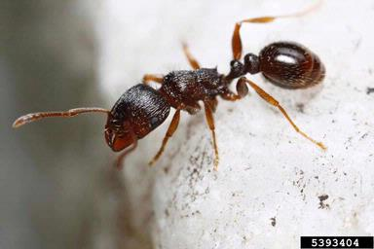
Other Ants
Thus, the first step in managing ants is proper identification, since many types of ants may be beneficial and not cause problems
Additionally identification is critical because most ants differ in their habits, food preferences and require different management strategies for effective control
Pavement Ant -
Joseph Berger, bugwood.org

Slide 10
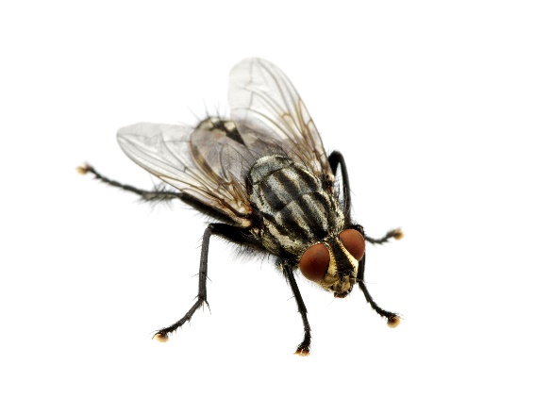
Flies
House flies, dump flies, bottle flies, flesh flies and others that breed in garbage and/or animal feces generally are referred to as filth flies
Filth flies are not aggressive and do not bite
Flies that enter cafeterias and kitchens can carry bacteria and other microbes from garbage and other areas and can contaminate food, utensils and food preparation surfaces and cause foodborne illnesses

Slide 11
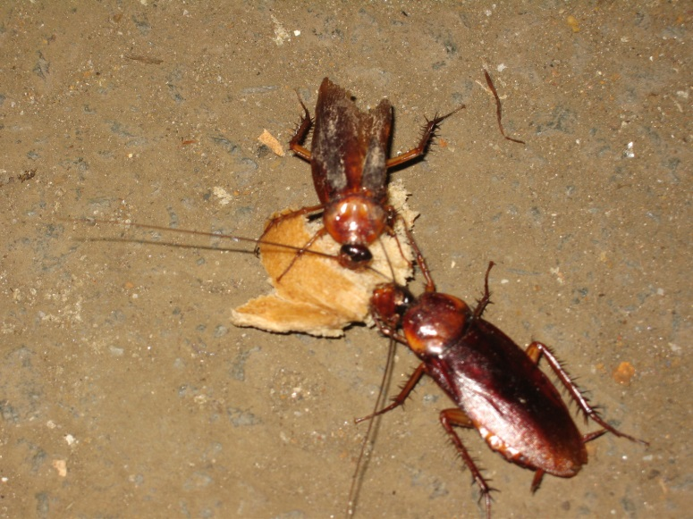
Cockroaches
Except for size and markings, cockroaches are generally similar in appearance: all species are flattened, oval-shaped insects with long legs and antennae
Their heads are tucked under and most have obvious hind “cerci”
The most common are German, brown-banded, American, and oriental cockroaches
American cockroaches – Dawn H. Gouge, University of Arizona

Slide 12
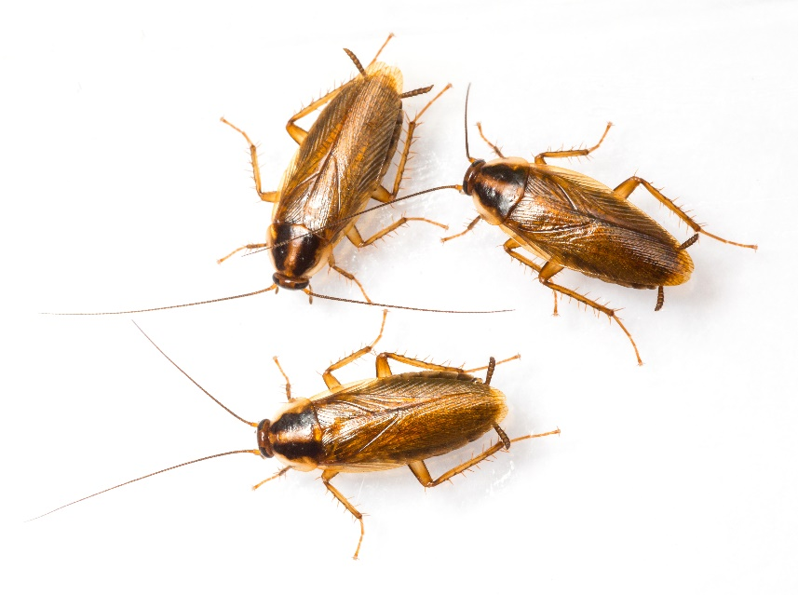
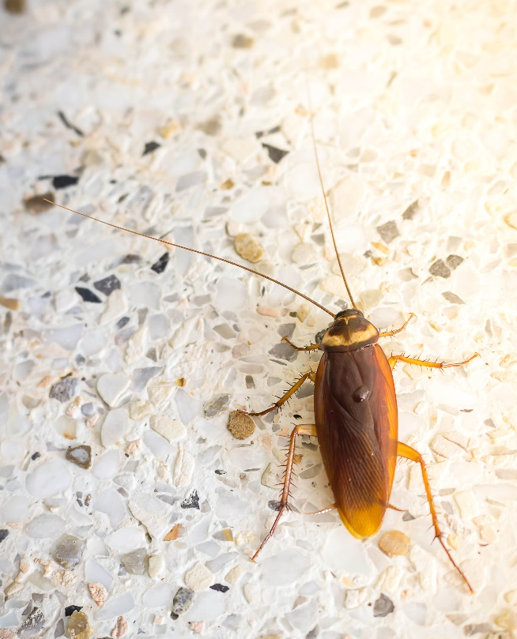
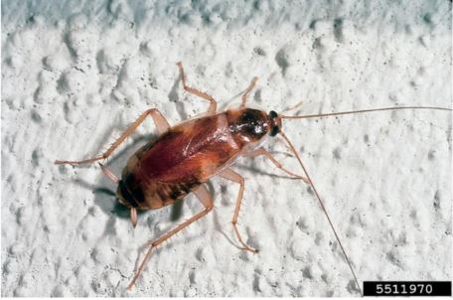
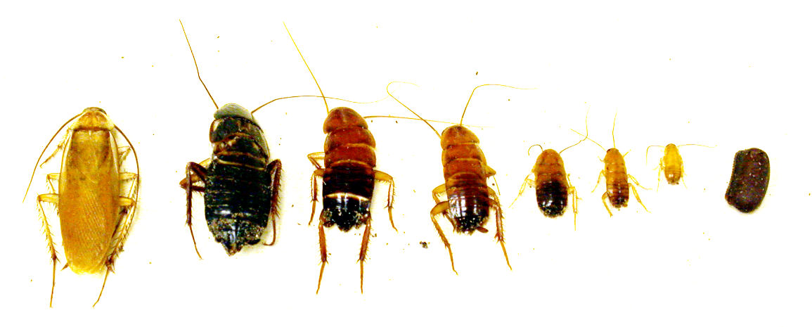
Cockroaches Continued
German cockroaches
American cockroach
Oriental cockroach
Brownbanded cockroach - Kansas Department of Agriculture, Bugwood.org
Turkestan cockroach – Dawn H. Gouge, University of Arizona
Notes:
National Center for Environmental Health, 2009

Slide 13
Cockroaches Continued
In general, cockroaches like to squeeze into warm cracks and crevices, but the places they inhabit differ from one species to another
German cockroaches prefer warm and wet environments like kitchens, while brownbanded cockroaches are most often found in drier classroom and office areas
American and oriental cockroaches are generally found where there is high moisture, such as in sewers, basements and mulch

Slide 14
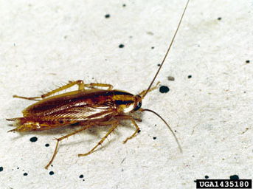
German Cockroaches
German cockroaches produce allergens that can trigger asthma symptoms in sensitive individuals
German Cockroach
Clemson University - USDA Cooperative Extension Slide Series, bugwood.org
Notes:
National Center for Environmental Health, 2009

Slide 15
Rodents
Rats and mice often enter schools and warehouses in search of food and shelter
The most common rodent pests are the commensal rats and mice
They include the roof rat, Norway rat and house mouse
Rats and mice consume or contaminate large quantities of food and damage structures, stored clothing and documents, and can cause a great deal of damage to computer and electrical systems due to their habit of chewing wires

Slide 16
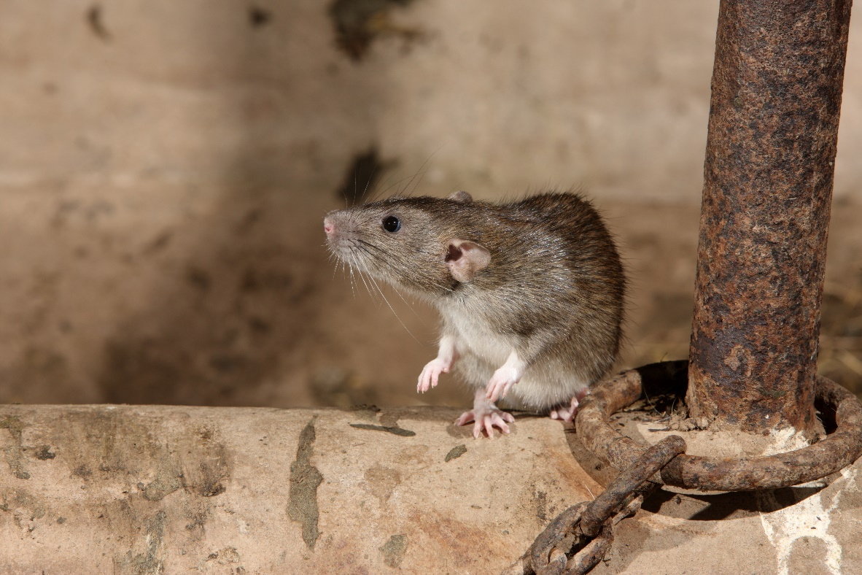
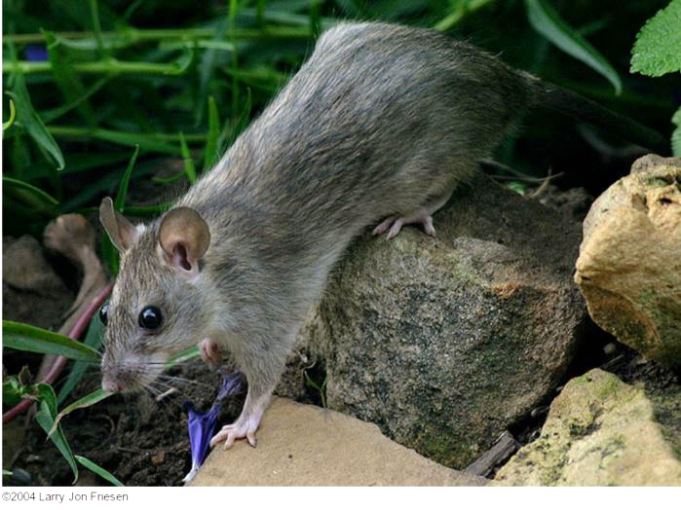
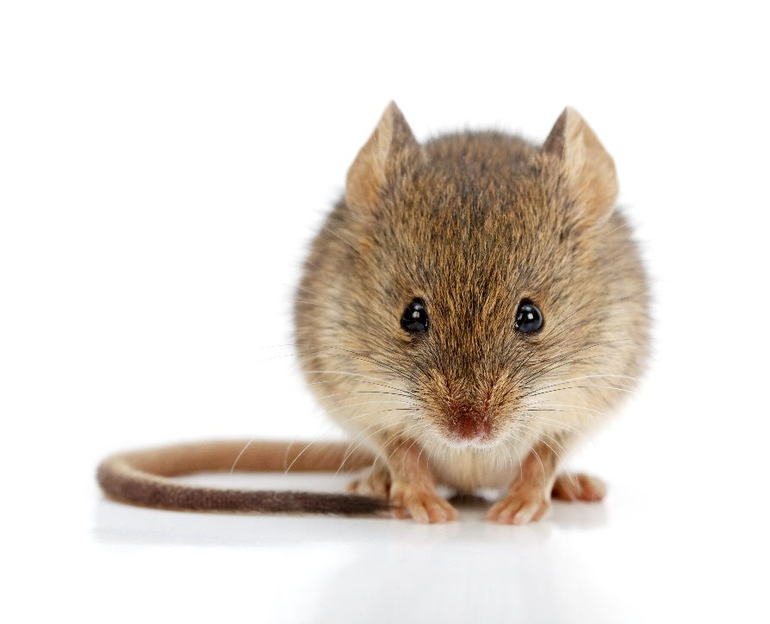
Rodents Continued
Norway rat
Roof rat – Larry Jon Friesen Copyright © 1995-2016 UC Regents
House mouse
Notes:
National Center for Environmental Health, 2009

Slide 17
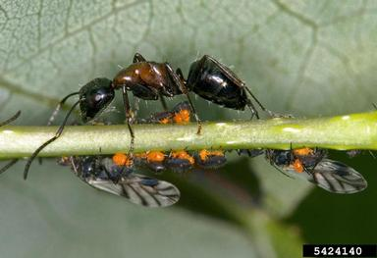
Wood-destroying Insects
Carpenter Ants
Carpenter ants are cavity dwellers
They establish nests in wall voids and spaces in structures usually as satellite colonies associated with larger external colonies associated with tree stumps
Inside they prefer weakened, damp or rotting wood and insulation materials (check for water leaks)
Carpenter ant - David Cappaert, Michigan State University, bugwood.org

Slide 18
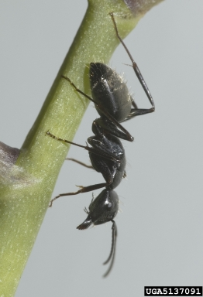
Wood-destroying Insects Continued
Carpenter Ants
Carpenter ants do not actually consume the wood they excavate, they tunnel through it and nest in it
They are large ants and can bite and spray formic acid, but they do not sting
Carpenter ant - Susan Ellis, bugwood.org

Slide 19
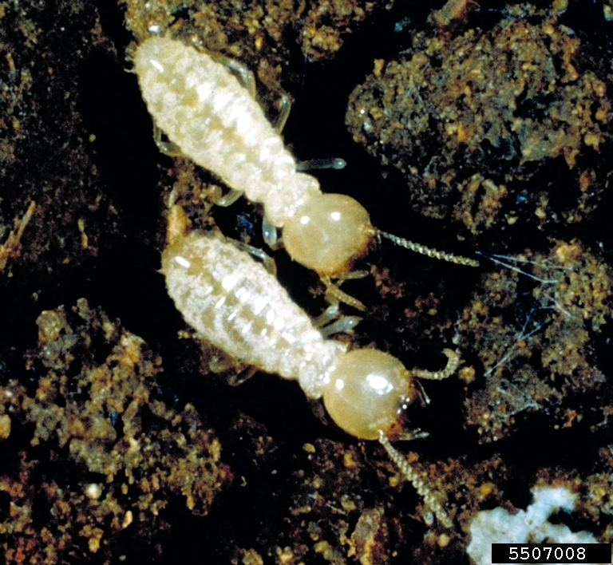
Wood-destroying Insects Continued
Termites
There are several types of termites including dry wood and subterranean
Termites are social insects that live in colonies
An established colony can exist in a building for years and can consist of thousands or millions of members
Eastern subterranean termites - Phil Sloderbeck, Kansas State University, Bugwood.org

Slide 20
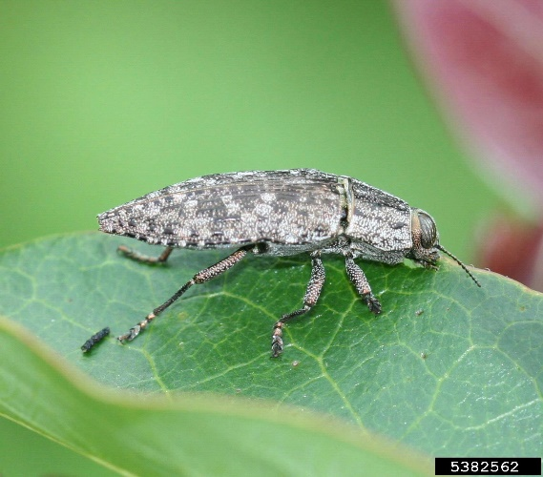
Bark Beetles and Wood Borers
Most often attack weakened, injured or dying trees
Burn or destroy infested wood so surrounding trees are not affected (some survive chipping)
Bark beetles and wood borers bore through the bark of trees - Peeling off a portion of infested bark to reveal the pattern of the beetle galleries (tunnels chewed by adults and larvae) is one way to identify individual beetle species
Metalic wood-boring beetle - Johnny N. Dell, Bugwood.org

Slide 21
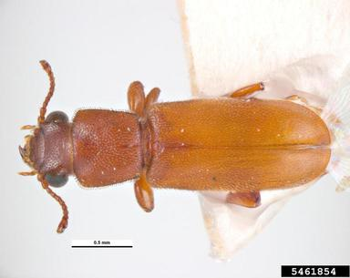
Wood-destroying Insects Continued
Powderpost Beetles
Are wood-boring creatures which can bore in wood products manufactured from hardwoods
As their name suggests, powderpost beetles change the wood they eat to a fine powder or dust
Powderpost beetle
- Pest and Diseases Image Library, bugwood.org
Notes:
www.prevailpest.com

Slide 22
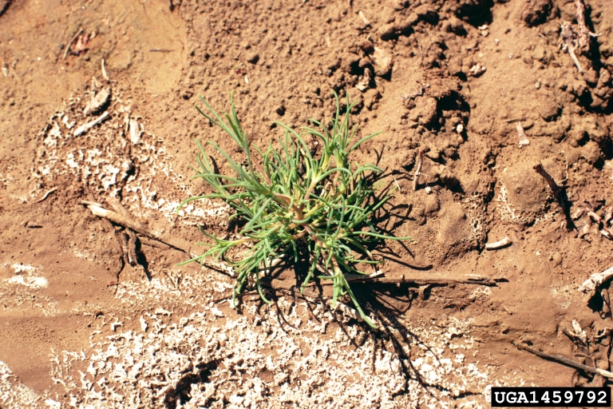
Common Weeds
It is important to accurately identify the most common weed species on your school grounds in order to determine appropriate management methods
Knowing the scientific name of the weed makes it much easier to obtain information from researchers and the scientific literature
Russian-thistle -
Utah State University Archive, Utah State University, bugwood.org

Slide 23
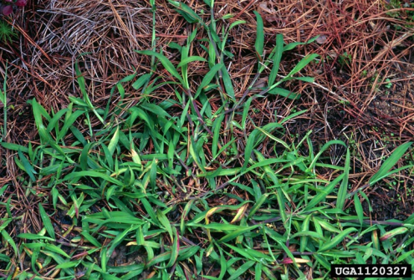
Annual Weeds
Annual weeds are the most common weed group
In general they have a rapid life cycle that requires a minimum of water and nutrients
Some can produce more than 20,000 seeds per plant
Most annual weeds are known as summer annuals, they germinate in spring, grow to maturity during summer, and die by fall or winter
Examples: prostrate spurge, purslane, crabgrass and pigweed
Crab Grass -
James H. Miller & Ted Bodner, Southern Weed Science Society, bugwood.org

Slide 24
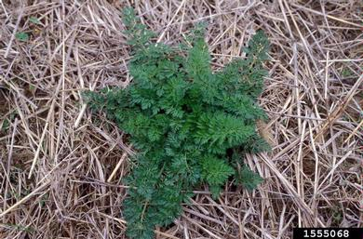
Biennial Weeds
Biennials grow during the spring, summer, and fall of their first year, survive the winter, and flower during the next growing season
Biennials may germinate at any time during the growing season - They usually produce a radial cluster (rosette) of leaves lying close to the soil during the first season
In the second year they produce flower stalks using food stored from the first season’s growth, then they produce seeds, and die
Examples: wild carrot, common mullein, musk thistle
Wild Carrot -
Ohio State Weed Lab Archive, The Ohio State University, bugwood.org

Slide 25
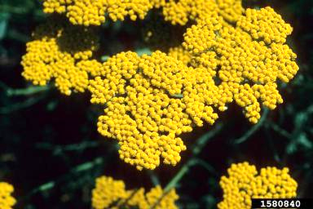
Perennial Weeds
3.
Perennial weeds live more than two years
Perennials spread by seeds and vegetative means such as bulbs, rhizomes, tubers or stolons
Examples: bindweed, plantain, thistle, dock, dandelion, ground ivy, quackgrass, sorrel, clover and yarrow
Yarrow -
John Ruter, University of Georgia, bugwood.org

Slide 26
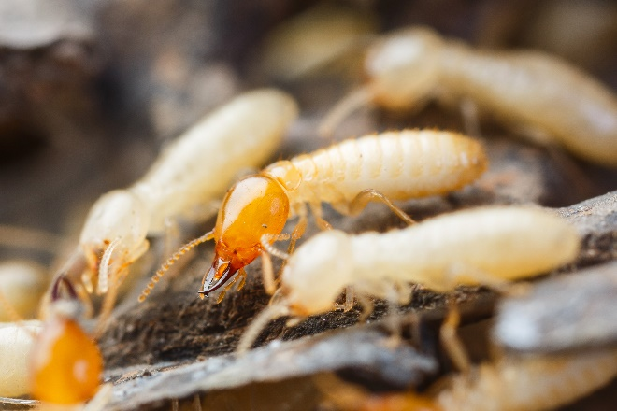
Check In!
In this lesson you learned
Key exterior and landscape pest groups
For information on many other key pests see the IPM Coordinator/Pest Management Professional, school nurse, and Landscape and Grounds education lessons
Congratulations, you have completed the Facility Manager Module!

Slide 27
Resources
Green, T.A., D.H. Gouge, J.A. Hurley, M.L. Lame and M.D. Snyder. (2014). School IPM 2020: A Strategic Plan for Integrated Pest Management in Schools in the United States.
How to Develop an Integrated Pest Management (IPM) Policy and Plan for Your School District. PENN STATE. Retrieved from http://extension.psu.edu/pests/ipm/schools/facilitiesmanagers/resourcespaschools/faq/ipmschoolplan
How to Do… IPM at School A How to Manual for New Jersey schools. New Jersey Department of Environmental Protection Pesticide Control Program http://www.state.nj.us/dep/enforcement/pcp/bpc/ipm/How_to_Do_IPM.pdf
New Jersey Department of Environmental Protection Pesticide Control Program. How to Do… IPM at School A How to Manual for New Jersey Schools. Retrieved from http://www.state.nj.us/dep/enforcement/pcp/bpc/ipm/How_to_Do_IPM.pdf

