Slide 1
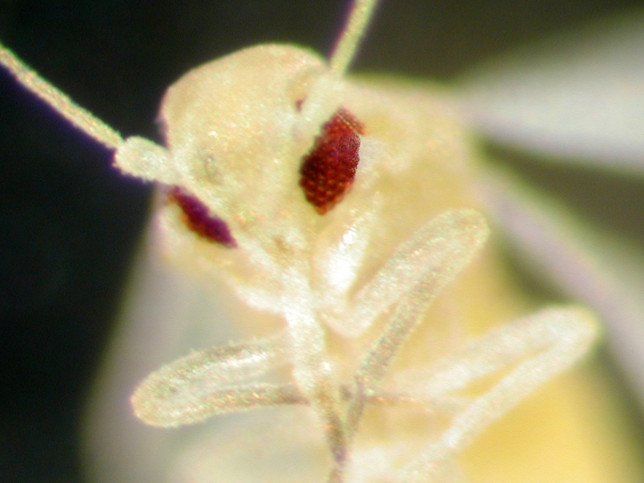

Whiteflies
Catharine Mannion, Ph.D.
University of Florida/IFAS
Tropical Res. and Edu. Center
cmannion@ufl.edu

Slide 2
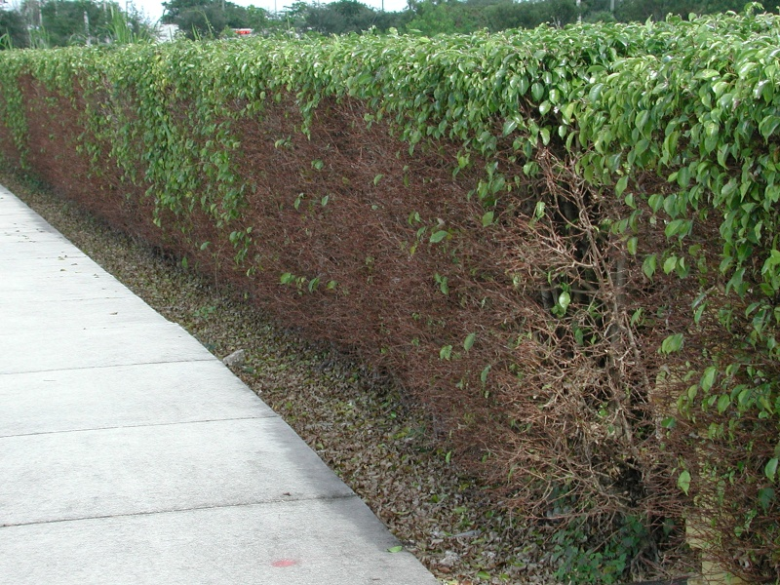
Ficus
Whitefly
Feeds only on ficus
Leaf yellowing
Leaf drop
Dieback
Photo: H. Glenn,, UF/IFAS

Slide 3
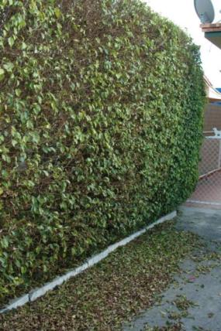
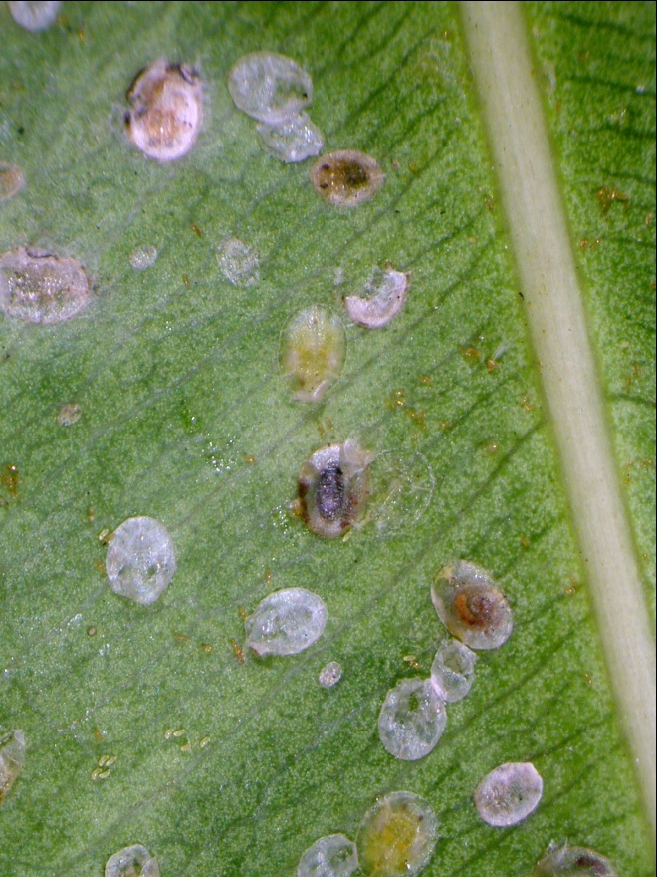
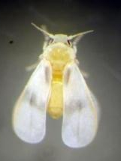
Ficus Whitefly
Singhiella simplex (Hemiptera: Aleyrodidae)
Only feeds on ficus species
Photo: H. Glenn, UF/IFAS
Photo: A. Roda, USDA APHIS

Slide 4
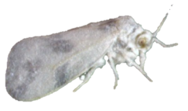
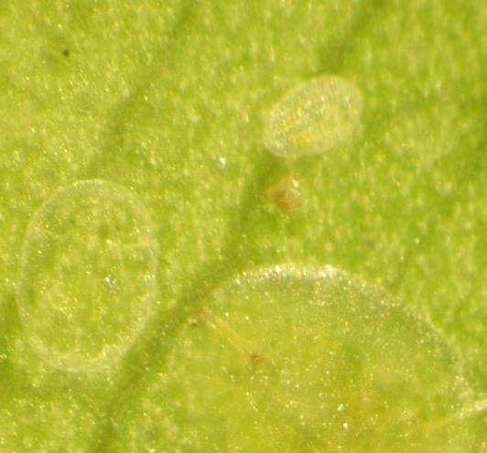
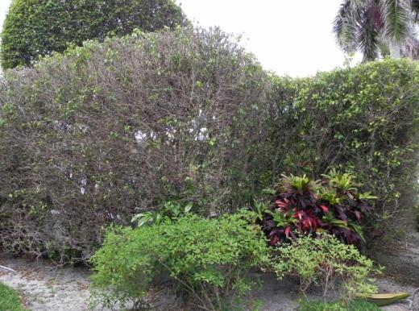
Ficus Whitefly Update
Some whitefly stages difficult to see
Damage is most obvious in late summer and fall
Typically populations go down in the winter
Since last year, this whitefly appears to be worse
Ongoing issues with ficus recovery

Slide 5
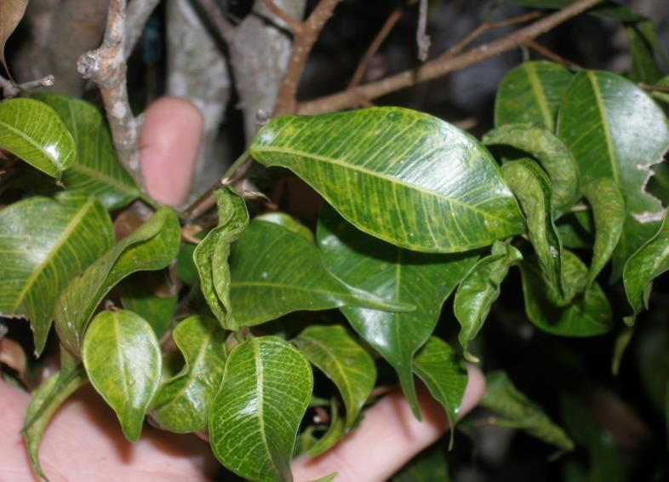
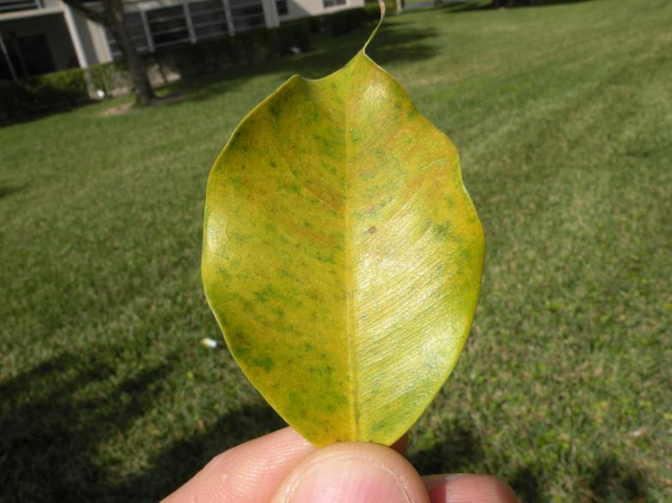
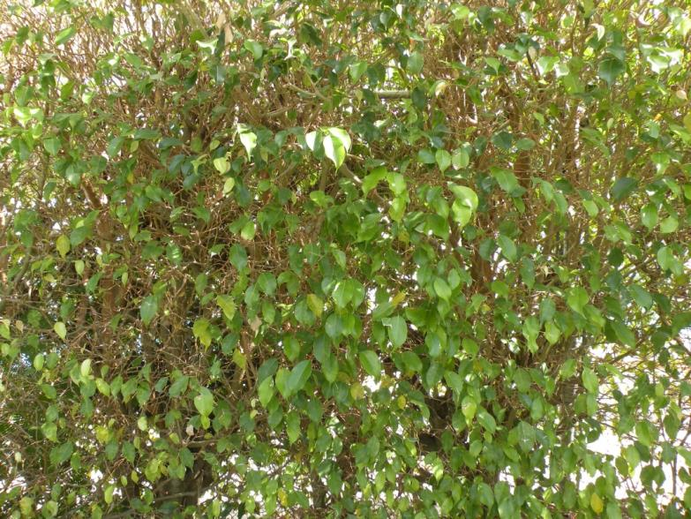
Ficus Whitefly
Only feeds on ficus
Causes leaf yellowing, leaf drop and branch dieback
Photos: W. Schall, Palm Beach County Extension

Slide 6
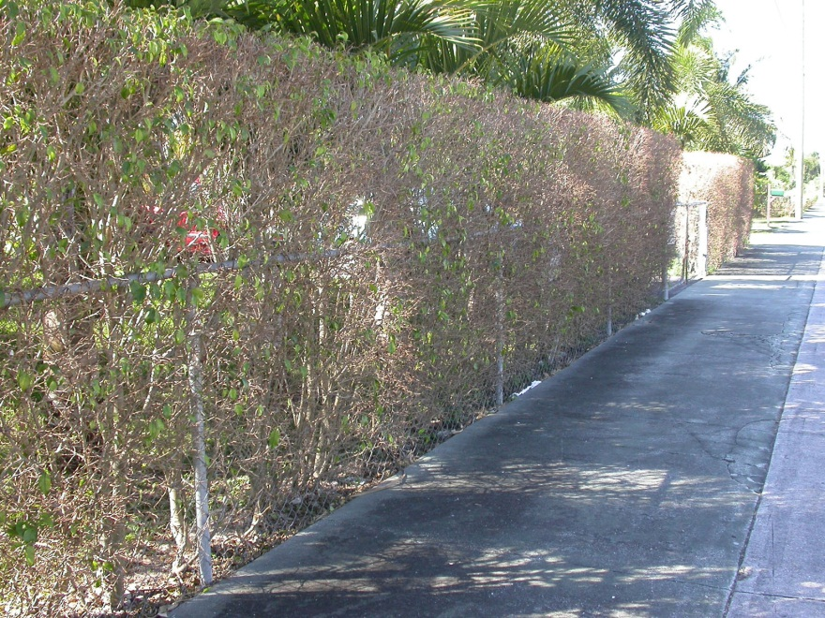
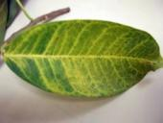
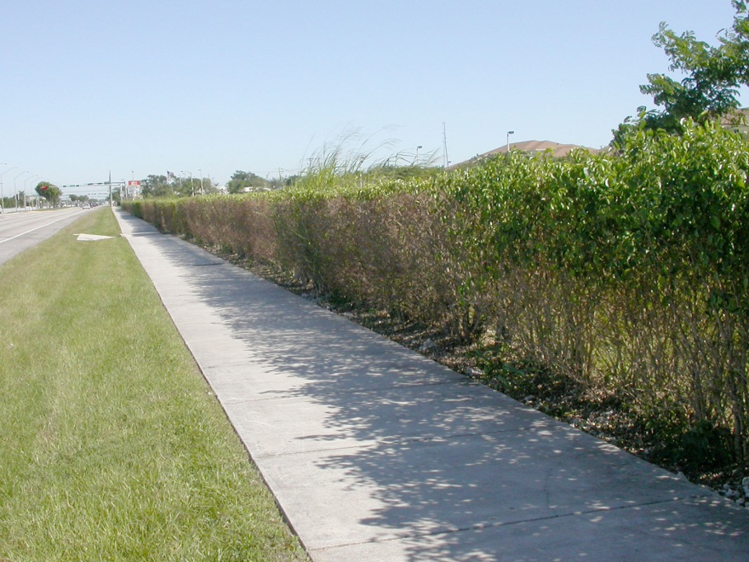
Ficus Whitefly - Damage
Causes leaf yellowing
Leaf drop (severe)
Branch dieback (highly variable)
Photo: H. Glenn, and C. Mannion, UF/IFAS
Photo: H. Glenn, UF/IFAS

Slide 7
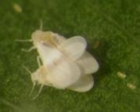
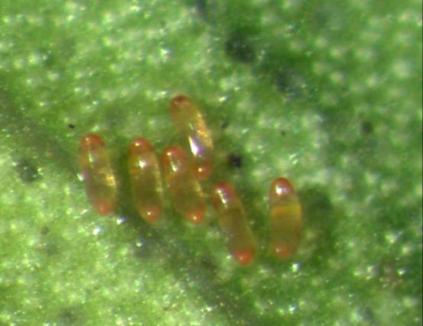
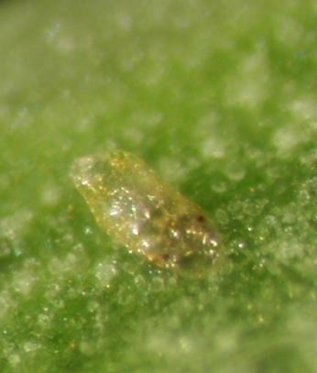
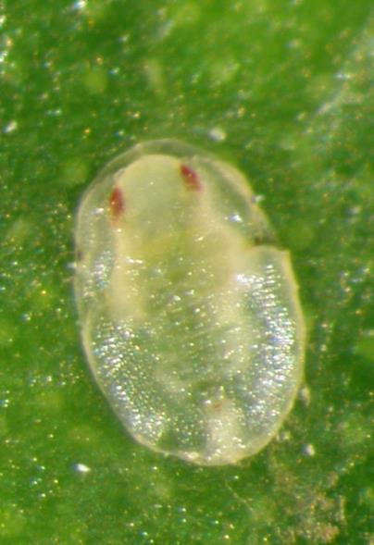
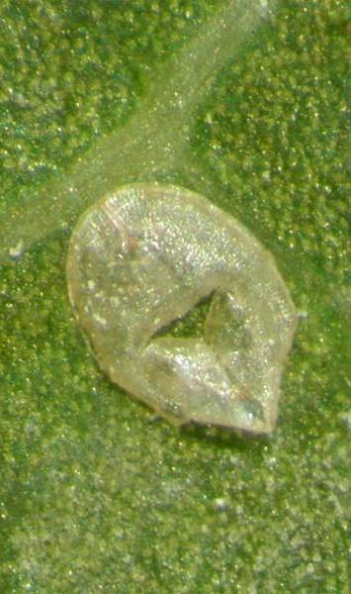
Adult Whitefly
(2-4 days)
Eggs
(10 days)
Crawler
(4.2 days)
2nd-3rd instars
3-4 days each
Pupa
(5.8 days)
Photo: A. Roda, USDA APHIS
Notes:
Photos: Holly Glenn, UF/IFAS
The ficus whitefly was first observed in 2007. It is a typical looking whitefly that feeds only on ficus. The life cycle under laboratory conditions is close to 4 weeks. You can see monthly peaks of adults flying. Generally populations drop during the winter months. Adults only live a few days.

Slide 8
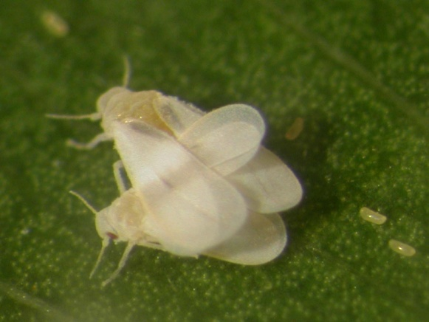
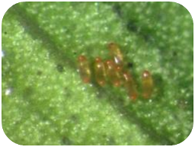
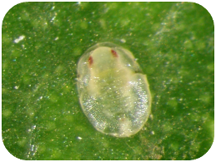
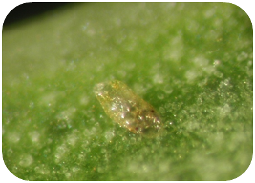
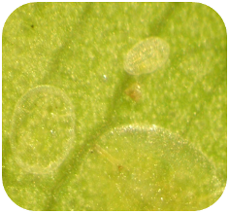
Ficus Whitefly
Life Cycle
Adult Whitefly
(2-4 days)
Eggs
(10 days)
Constant temperature (80º F)
*2nd
4th instar – puparia
(5.8 days)
*3rd
1st instar – crawler
(4.2 days)
2nd-3rd instars – nymphs
2nd instar – 3.7 days; 3rd instar – 3. 3 days
Photo: H. Glenn, UF/IFAS

Slide 9
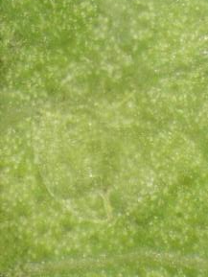
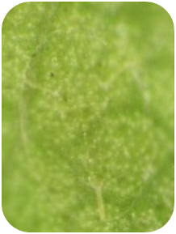
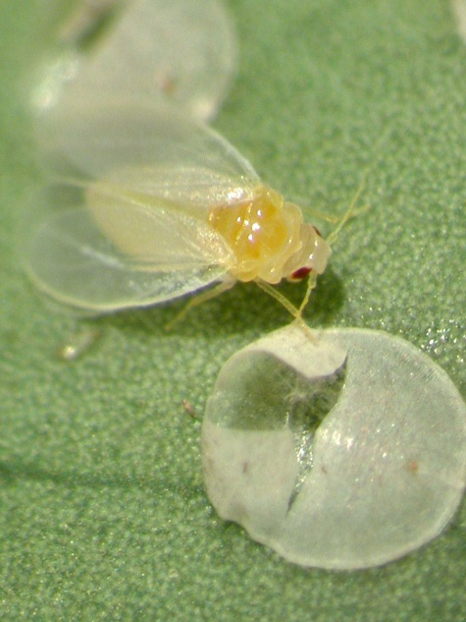
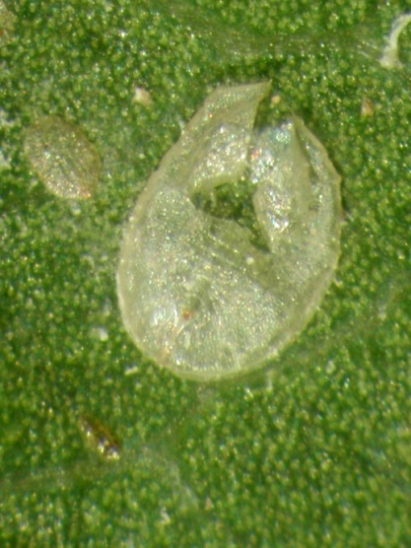
Ficus Whitefly Immature Stages
The immature stages (typically found on the underside of leaves) tend to be flat, oval and can vary in color or transparent
The pupal case is often one of the most visible stages
Photo: H. Glenn, UF/IFAS

Slide 10
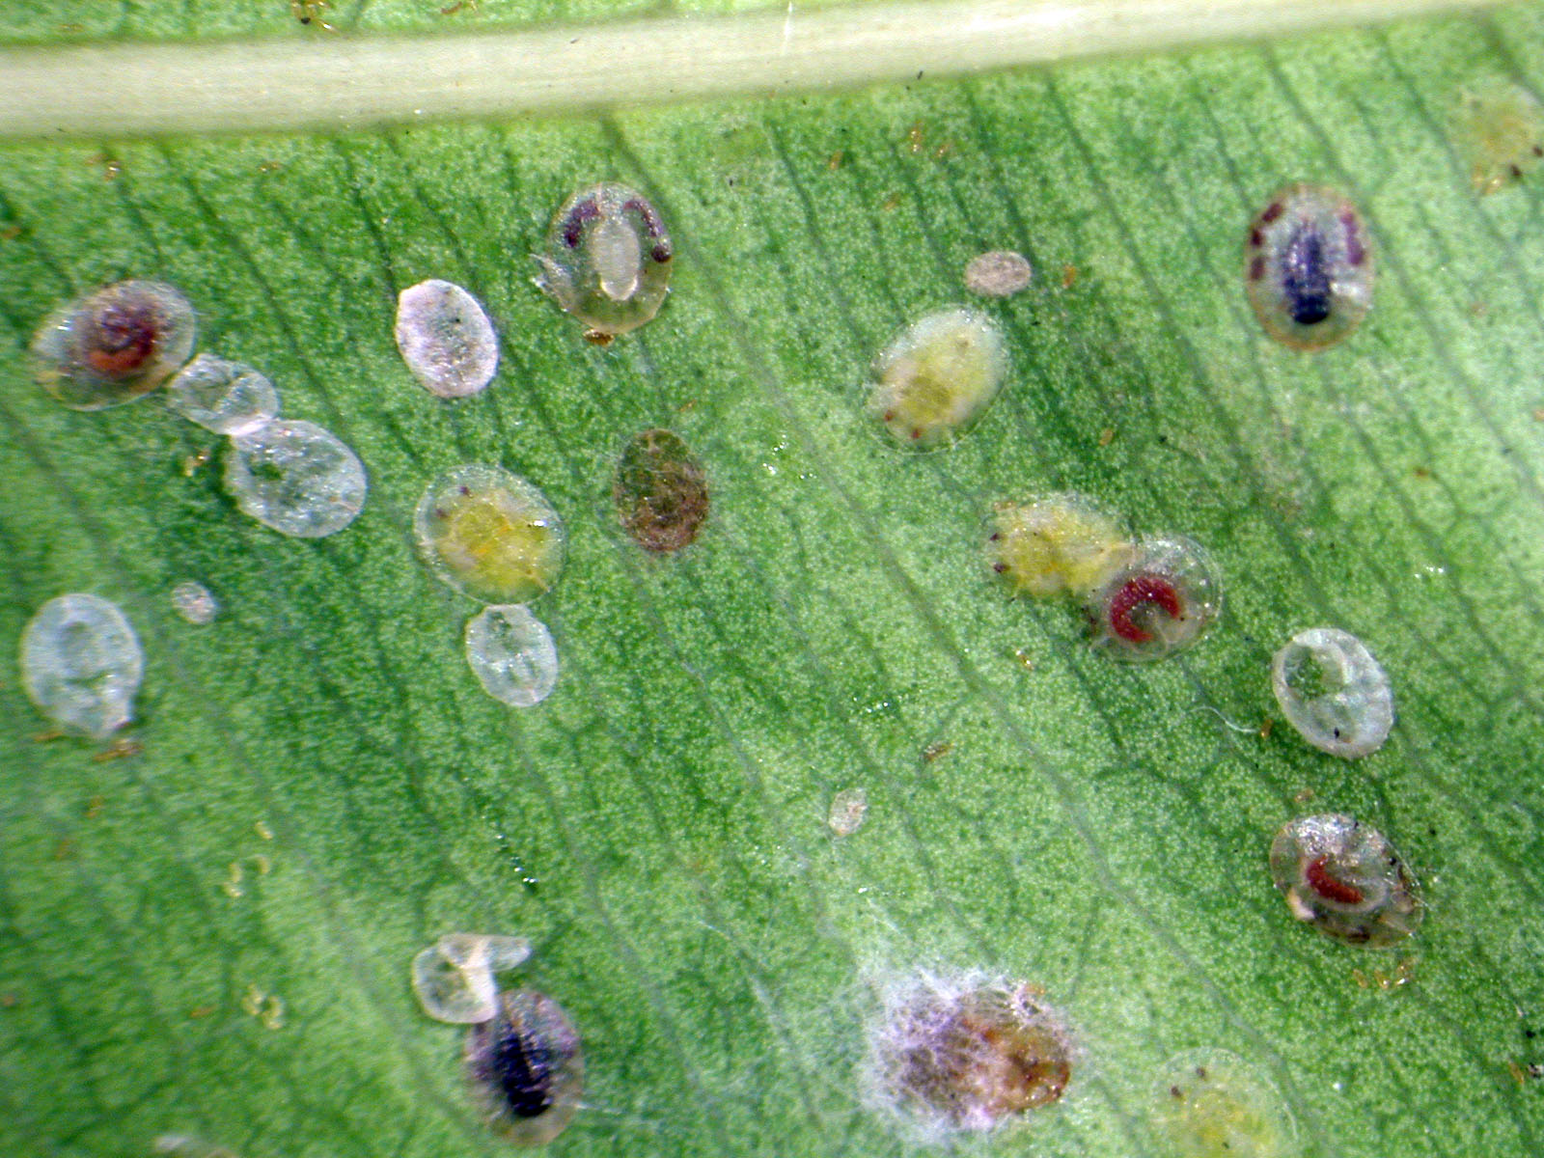

Slide 11
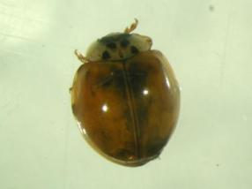
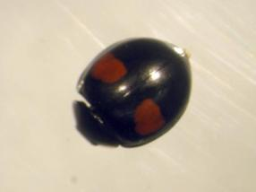
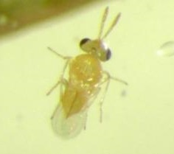
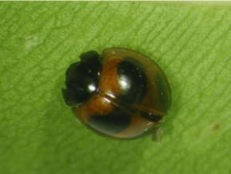
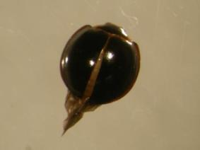
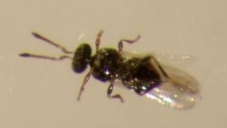
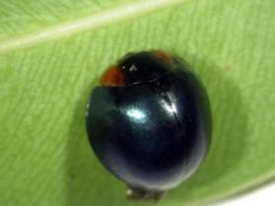
Natural Enemies Observed in the Landscape
Harmonia axyridis
Olla v-nigrum
Exochomus childreni
Chilocorus nigritis
Curinus coeruleus
Encarsia protransvena
Amitus bennetti
Photo: H. Glenn, UF/IFAS

Slide 12
Natural Enemies Observed in the Landscape
Encarsia protransvena
Amitus bennetti
Harmonia axyridis
Olla v-nigrum
Exochomus childreni
Chilocorus nigritis
Curinus coeruleus

Slide 13
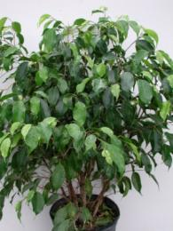
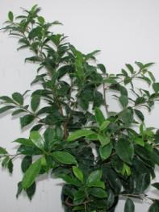
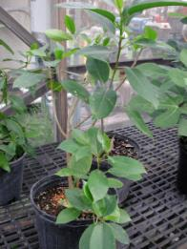
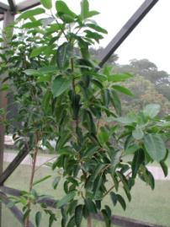
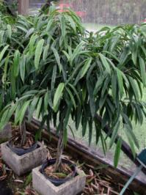
Ficus Hosts
Previously Reported
(other countries)
F. benjamina
F. microcarpa
F. aurea
F. altissima
F. bengalensis
F. maclellandii
Tested
(Florida)
F. benjamina
F. microcarpa
  F. aurea (native)
  F. citrifolia (native)
  F. binnenjikii “Alii”

Slide 14
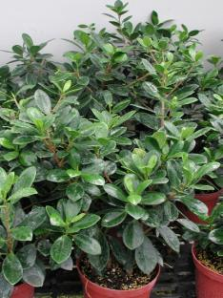
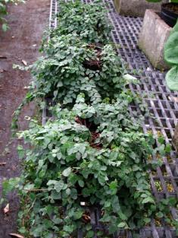
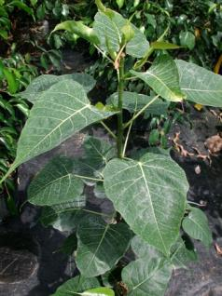
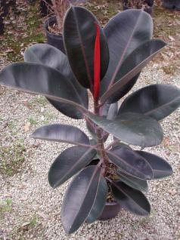
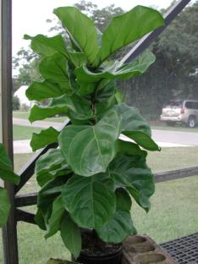
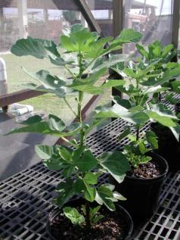
Ficus Hosts
Not Susceptible to the Whitefly
F. microcarpa “Green Island”
F. religiosa
F. carica (edible fig)
F. lyrata
F. pumila (= F. repens)
F. elastica “Burgundy”

Slide 15
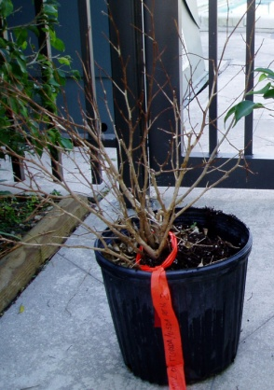
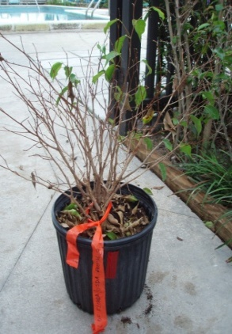
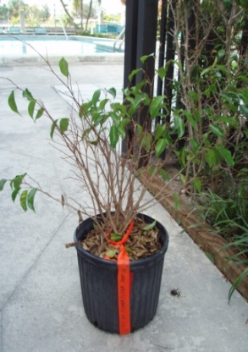



Site | Damage rating (Average ± SE) every 2 weeks
 | Oct 22 | Nov 7 | Nov 20 | Dec 4 | Dec 18 | Jan 3 | Jan 22 | Feb 1 | Feb 14
1 | 5.0 | 5.0 | 4.7 | 3.7 | 3.3 | 2.3 | 2.0 | 1.3 | 1.0
3 | 5.0 | 5.0 | 4.0 | 3.5 | 3.0 | 2.0 | 1.5 | 1.5 | 1.5
5 | 5.0 | 5.0 | 3.5 | 0.6 | 2.0 | 1.0 | 0.5 | terminated | terminated
7 | 5.0 | 5.0 | 5.0 | 4.5 | 4.5 | 4.0 | 3.5 | 3.0 | 2.5
0 (no leaves)
1 (1 -20%)
2 (21 -40%)
3 (41- 60%)
4 (61- 80%)
5 (81 – 100%)

Slide 16


Laboratory Bioassay
Standard petri plate with a small hole placed on a container of water; cutting or leaf placed in the plate with the stem or root placed in the hole

Slide 17
Ficus Whitefly
Life Cycle
Adult Whitefly
(2-4 days)
Eggs
(10 days)
Constant temperature (80º F)
*2nd
4th instar – puparia
(5.8 days)
*3rd
1st instar – crawler
(4.2 days)
Photo: H. Glenn, UF/IFAS
2nd-3rd instars – nymphs
2nd instar – 3.7 days; 3rd instar – 3. 3 days

Slide 18
Effect of Temperature on Length of Life Cycle
(68ºF)
(80.6ºF)
(86ºF)

Slide 19
Effect of Temperature on Egg Hatch
(59ºF)
(68ºF)
(80.6ºF)
(86ºF)

Slide 20



Ficus Whitefly Trapping
Ficus benjamina
Isolated area
Sticky traps for adult whiteflies
Defoliation

Slide 21





June – approx. 100/trap
October – approx. 1600/trap
August – approx. 600/trap
December – approx. 800/trap
Photo: H. Glenn, UF/IFAS

Slide 22

Ficus Whitefly Adult Flight Study
(March 2009 – 2013)
North
5
4
6
3
90’
40
plants
7
2
8
1
South

Slide 23





June 2009
June 2010
June 2011
June 2012
March 2012 – pruned trees to 6 feet

Slide 24




November 2009
November 2010
November 2011
November 2012

Slide 25








East
4
3
2
1
5
6
7
8
West

Slide 26




2
East
1
7
West
8

Slide 27
Ficus Whitefly
Mean Trap Catch
Trap Direction
First signs of defoliation
(8/28)
Freezing
Temperatures

Slide 28

Ficus Whitefly 2009-2013
2009
2010
2011
2012
2013

Slide 29

Percent Defoliation
2009
2010
2011
2012

Slide 30

Ficus Whitefly

Slide 31

Management with Insecticides
Systemic versus contact
Neonicotinoid insecticides
Length of control
3-gal container; F. benjamina
Infested shade house

Slide 32

Soil and Foliar Application of Insecticides

Slide 33






Pest Problems on Ficus
2003 – Ficus thrips
2003 – Leaf gall wasp
2007 – Ficus whitefly
2007 – Fig wax scale outbreaks
2008 – Gall midge
2011 – Bondar’s nesting whitefly
Others (Lobate lac scale; Croton scale)

