Slide 1
Cultural turf management practices
Lesson 2 of 4
In-Person Educational Module

Slide 2
Learning Objectives
Understand cultural turf management practices including:
Mowing
Fertilization
Irrigation
Soil Analysis
Aeration
Overseeding

Slide 3
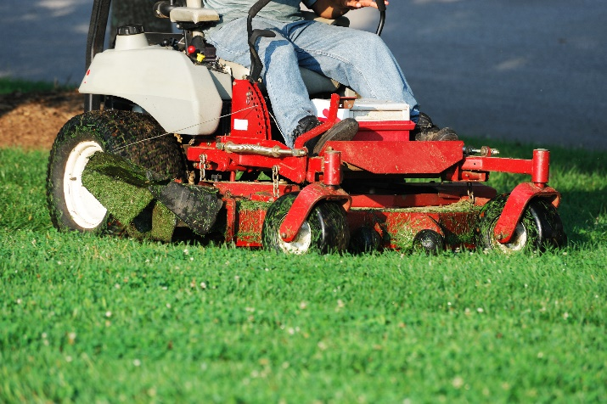
Mowing
Keep mower blades sharp
Minimize scalping, soil compaction, and rutting of playfields by rotating the direction of mowing
Keep mowers in good repair

Slide 4
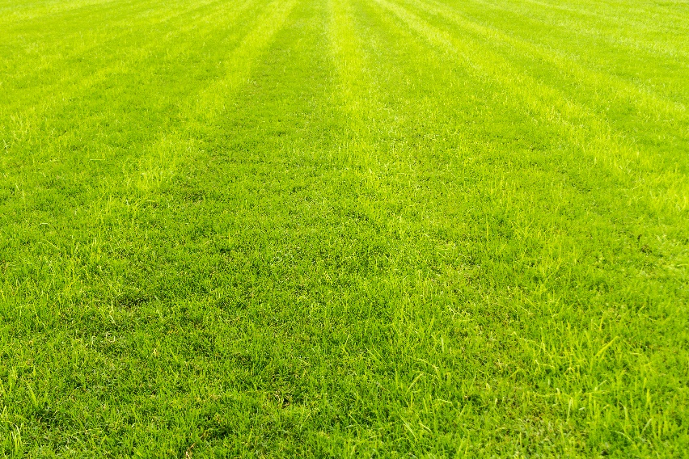
Mowing
The One-Third Rule
To sustain vigorous turf, remove no more than one-third of height of the grass at any one mowing
Mowing height
Mow tall to encourage deeper rooting
Most non-athletic turfgrasses can be mowed to 2 ½ -3 inches

Slide 5
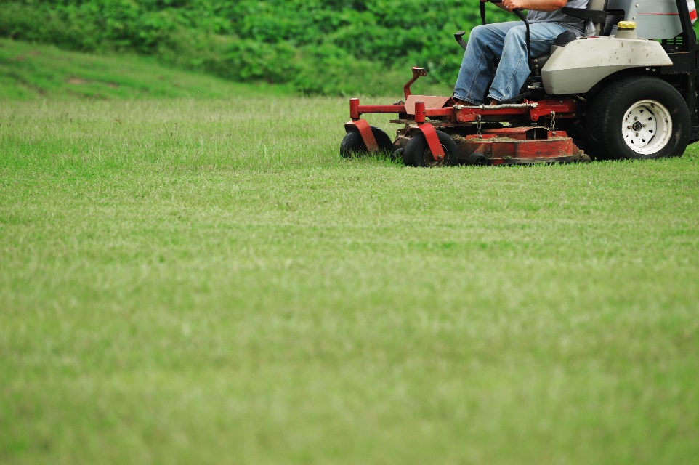
Mowing
To adhere to the 1/3 rule, mow your turf at least once a week
Mow high priority areas such as athletic fields twice a week
Increased mowing frequency will increase turf density, wear tolerance and decrease weeds

Slide 6
Mowing
The one-third rule
6”
4.5”
4”
Height prior to mowing
3”
3”
Height after mowing
2”
1.5”
1”
Alec Kowaleski, Oregon State University
Notes:
Use this if you like… it is my graphic.

Slide 7
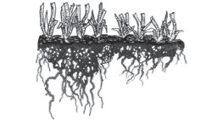
Mowing
High Cut
Low Cut
A lower cut produces shorter roots, less stress tolerance and allows more weed invasion

Slide 8
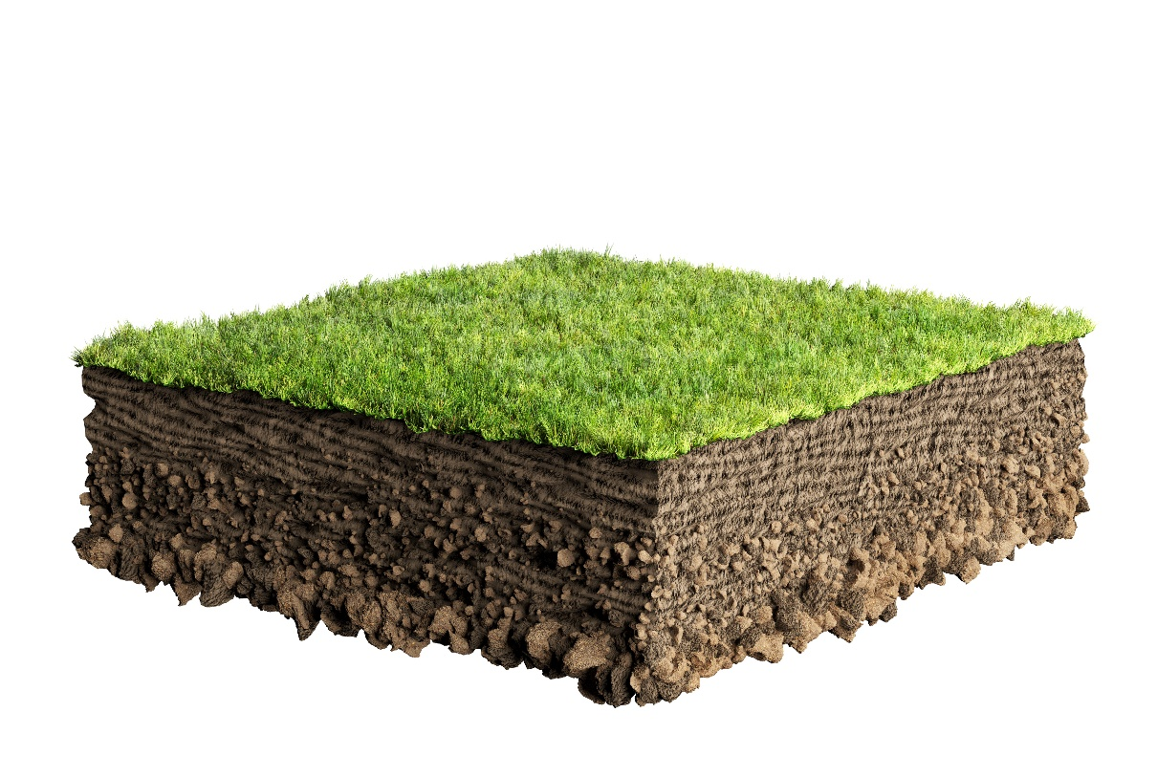
When to Mow
Mow when the lawn is dry
Dry clippings almost never need to be removed
Clippings do not contribute to thatch
Clippings return nutrients to the soil

Slide 9
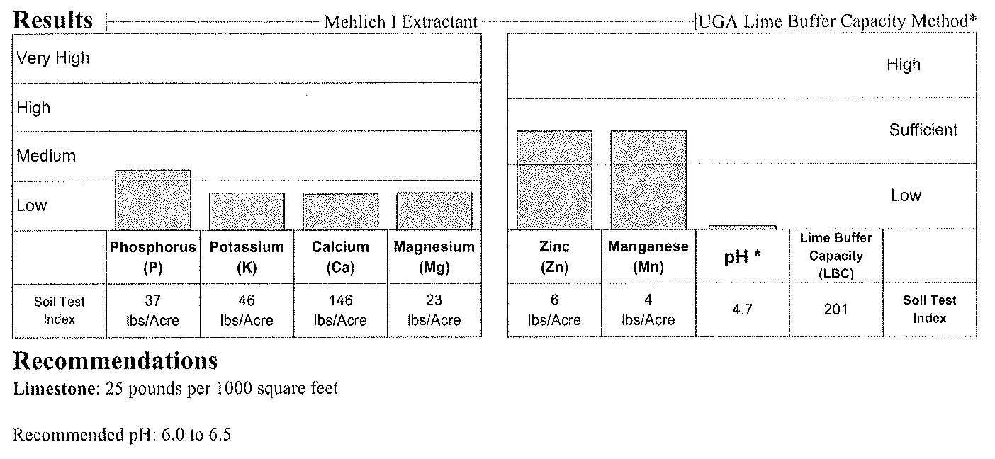
Fertilization
A basic soil test will identify the soil pH/lime requirements, phosphorus, potassium and secondary nutrient deficiencies
Alec Kowaleski, Oregon State University

Slide 10
Fertilization
1.
All grasses require certain nutrients, nitrogen (N), phosphorus (P) and potassium (K)
There are no generic N fertilization recommendations that apply to all situations
Fertilizing with P should be based on a soil test
Fertilizing with N should be based on turfgrasses present, site and use of turf
Use a fertilizer that supplies a 3:2:1 ratio of nitrogen to phosphorus to potassium

Slide 11
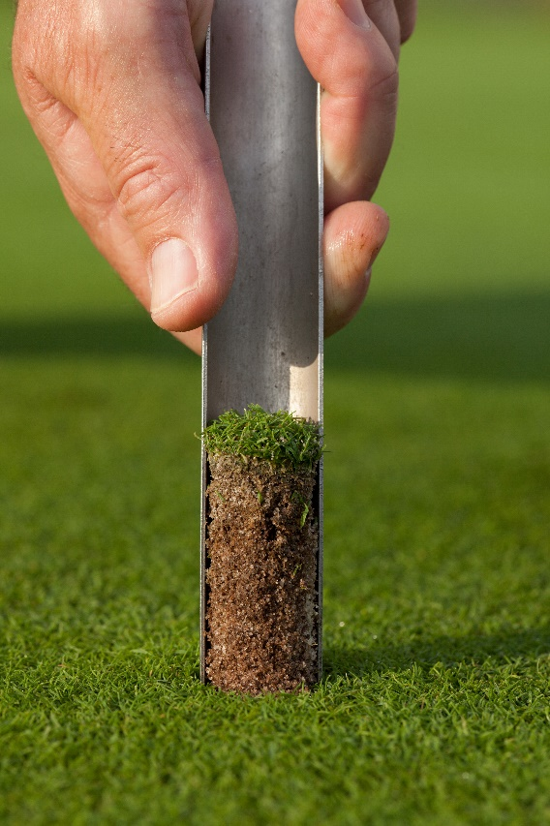
Fertilization
In several states (WA, MN, WI and others), fertilizers containing phosphorus cannot be applied unless a soil test documents a deficiency
Soil test results will provide specifics on the phosphorus rates

Slide 12
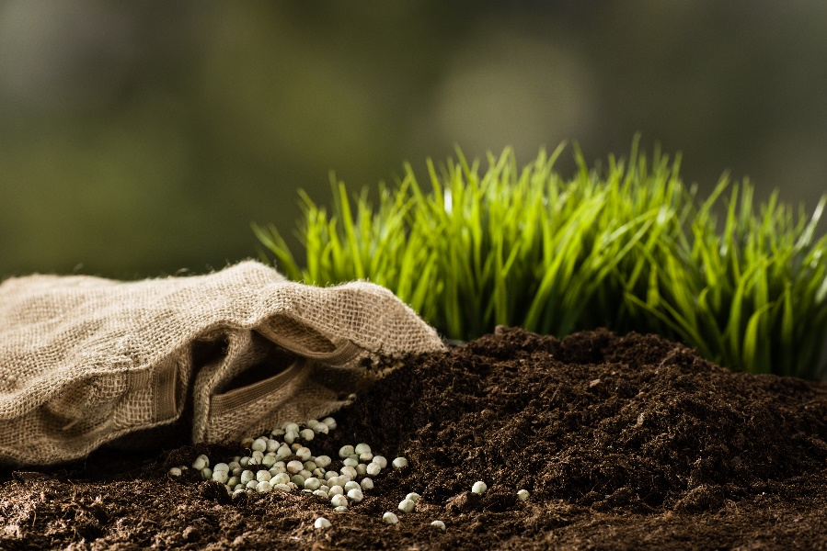
Fertilization
There are two basic forms of nitrogen contained in fertilizer products
Water-soluble nitrogen (WSN)
Slow-release nitrogen (SRN)
Manufactured turf fertilizers are often formulated with a mixture of WSN and SRN

Slide 13
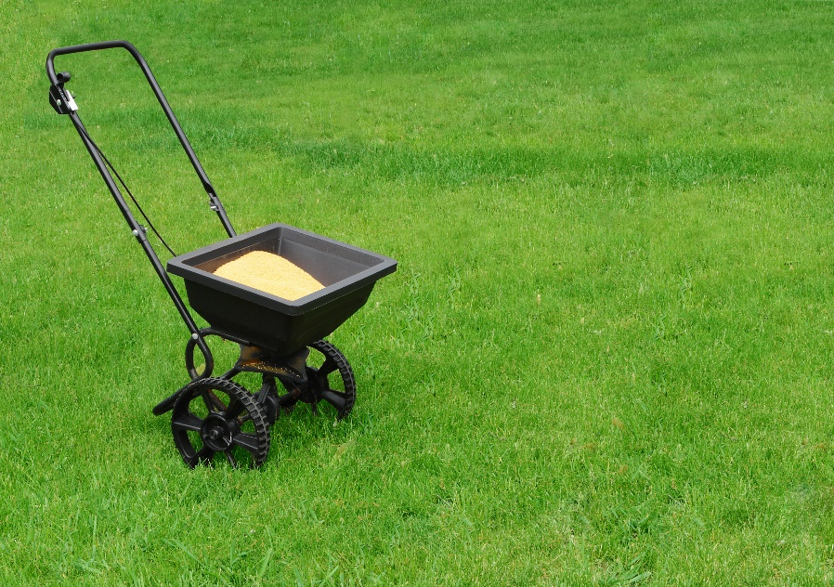
Fertilization
The percentages of WSN and SRN in a fertilizer product will affect the N-release rate
Characteristics of WSN and SRN sources may be considered

Slide 14
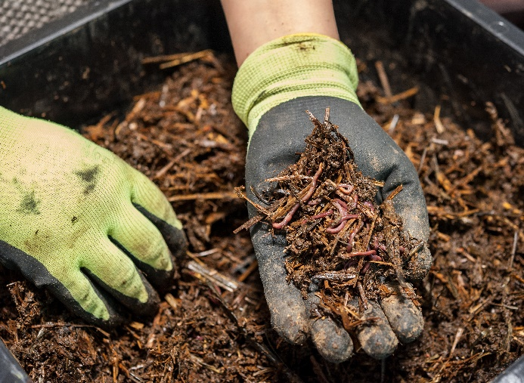
Fertilization
Use the lowest product rate possible
Slow-release fertilizers will:
Prolong the availability of nutrients throughout the growing season
Reduce the risk of water pollution
Compost, should be factored into the fertilization program

Slide 15
When to Use Fertilizer
Timing and rate depends on:
Requirements of the turfgrass species
Expectations for turf quality and turf density
Seasonal limitations and the use of the area
Application rates range 0.5 - 1.5 lbs N per 1,000 ft²
Split applications so that no more than ¼ lb of water-soluble N is applied at one time
A soil test should be the basis for planning fertilization
In high maintenance areas, testing every year will save money on fertilizer, time and other amendments

Slide 16
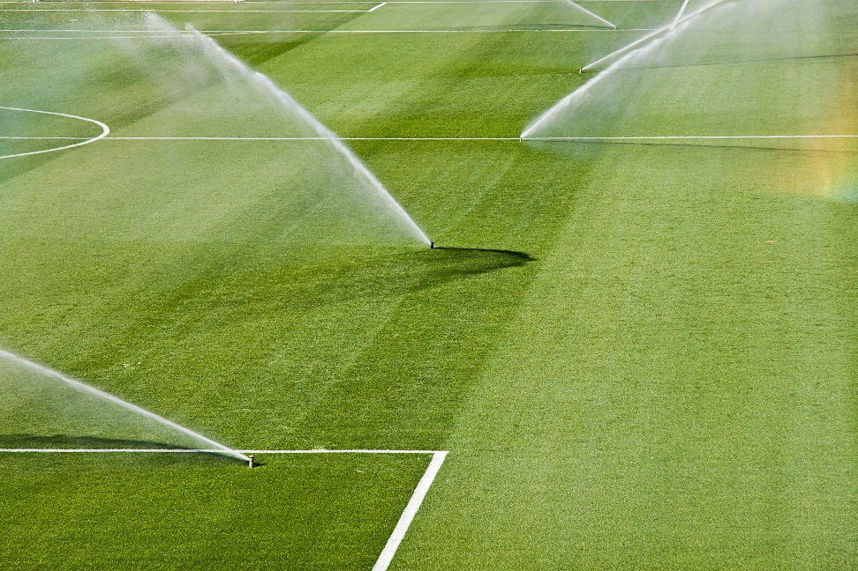
Irrigation Frequency
Water deeply but infrequently
How frequently will depend on soil type, weather conditions, species of grass and the mowing height
Delay irrigation encourages root growth

Slide 17
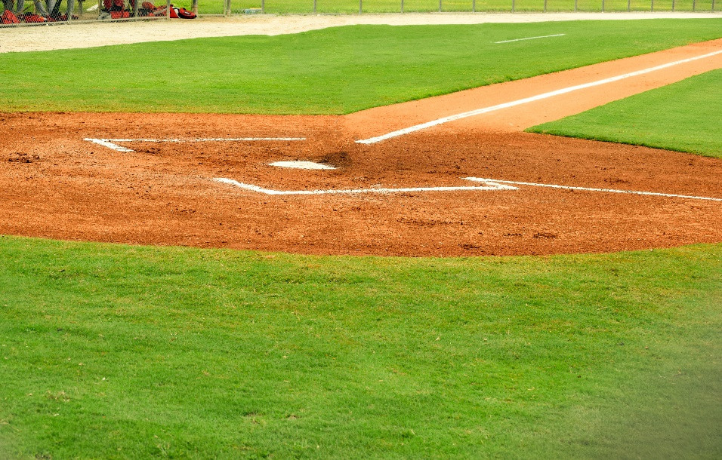
Irrigation Amount
Supplement rainfall (total of one inch per week)
620 gallons of water = one inch of water to 1000 ft² of turf
Overwatering
Reduces root growth
Promotes compaction
Increases disease
Decreases overall wear tolerance

Slide 18
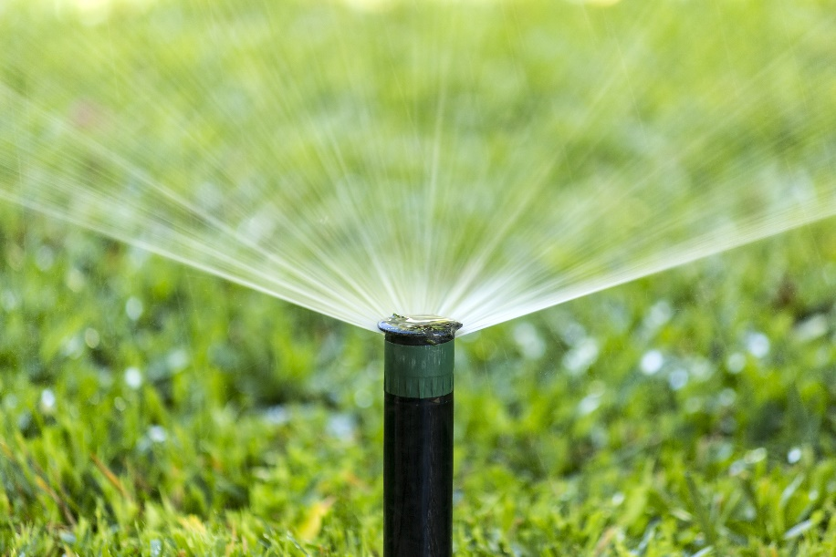
Irrigation Timing
1.
Water turf just before it begins to wilt, signs:
A bluish-green or purplish color to the grass
Rolling or folding blades of grass
Footprints that remain on the lawn for several minutes
Soil that is dry at the soil surface

Slide 19
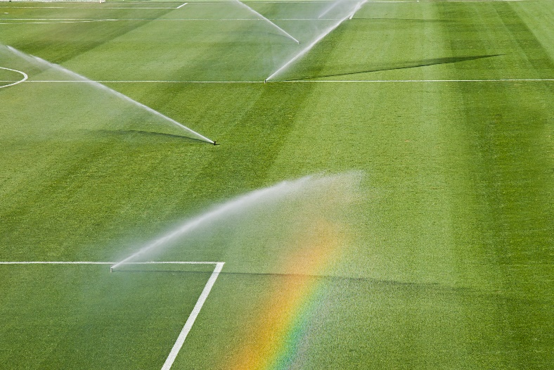
Irrigation Timing Continued
Water turf early in the morning
Extended periods of leaf wetness encourages fungal diseases
Adequate coverage
Drainage

Slide 20
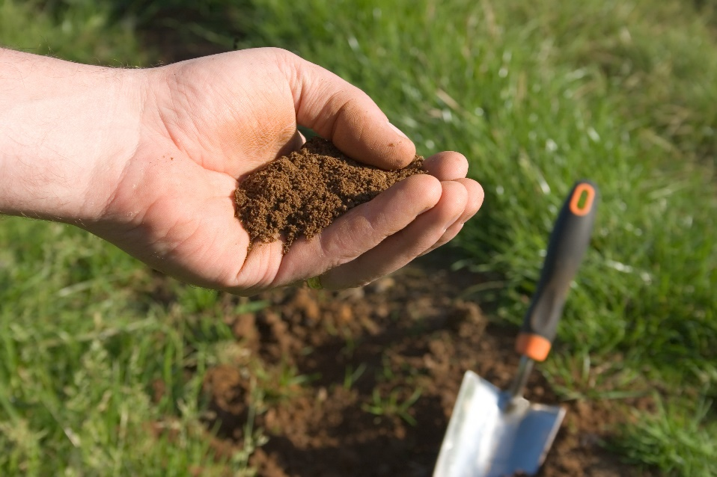
Soil Analysis
An uninformed approach to soil and nutrient management is neither economically viable nor environmentally responsible
Basic soil test results:
Dictate approaches to soil management
Indicate plant health
Influence fertility program
Affect many other aspects of management
Notes:
What kind of tests?

Slide 21
Soil Analysis
Sample soil and conduct chemical and physical soils analysis:
Prior to establishment
Renovation
Assuming management responsibility for a site
Every few years
Notes:
What kind of tests?

Slide 22
Soil Analysis
Soil Chemical Properties | Soil Physical Properties
E.g., pH, fertility, nutrient reserves, heavy metals, salinity | E.g., texture, particle size distribution, percent organic matter
Provides information about the growing conditions Determines fertilizer and pH adjustment needs | Provides information about soil health Helps indicate drainage characteristics and the compatibility of amendments
Notes:
What is liming?

Slide 23
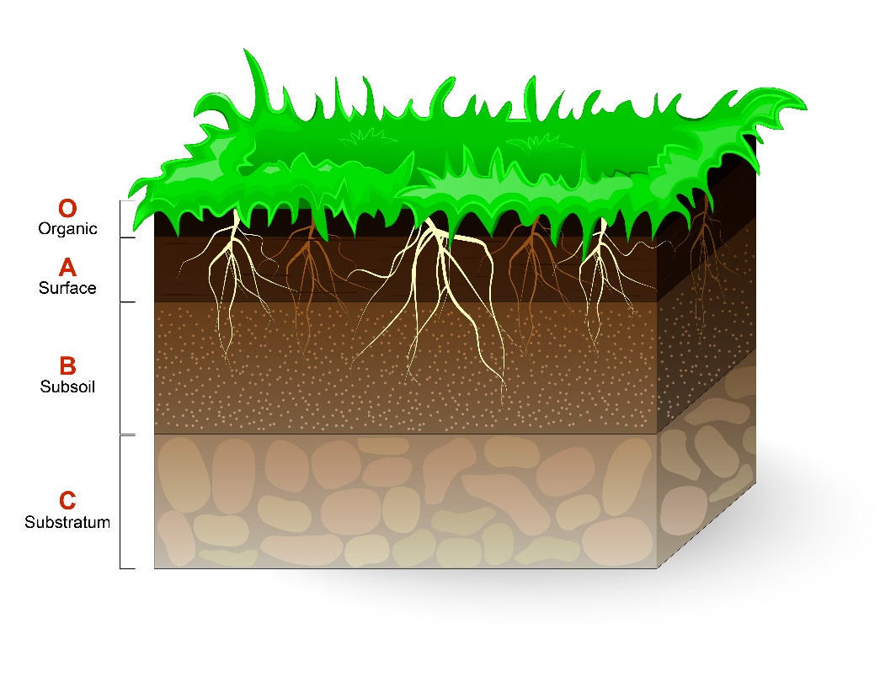
Soil Analysis
For established, healthy turf, conduct soil chemical analyses every three years and monitor pH annually
Test soil conditioners, topdressing materials, composts and other turf amendments separately to ensure suitability
Soil profile

Slide 24
Soil Analysis
Interpreting soil test results
Nutrient critical soil test levels - the extractable nutrient concentration in soil above which improved plant growth or performance is unlikely

Slide 25
Soil Analysis
Nutrient levels are considered sufficient when the concentration is just above the critical soil test level - optimum soil test range

Slide 26
Soil Analysis
When levels are below the optimum range the addition of more nutrients will usually improve turf performance
When soil test levels are in the optimum range turf response to application of that nutrient is unlikely
Do-it-yourself soil test kits or soil test services

Slide 27
Soil Analysis
Factors other than nutrients may limit turfgrass growth
To optimize turf performance and maximize response to fertilizer:
Cultivar selection
Establishment
Irrigation management
Pest and stress management

Slide 28
Interpretation of Soil Test Categories
Results | Interpretation
Very Low | Substantial amounts of additional nutrients required to achieve optimum growth
Low | Moderate amounts of additional nutrients needed to achieve optimum growth
Optimum | Most desirable soil test range on economic and environmental basis
Above optimum | The nutrient is considered more than adequate and will not limit the plants There is the possibility of a negative impact on the turf if nutrients are added
Excessive | This soil test level is independent of plant response and, due to environmental concerns, is only defined for soil test phosphorus (P) No P should be applied and steps should be taken to minimize losses from leaching and runoff

Slide 29
Aeration
Making holes in the turf:
Improves air exchange
Helps water penetrate and drain
Decreases the soil density and organic matter
Soil compaction occurs when lawns are used heavily and the pore spaces collapse
Aeration promotes growth, helps manage thatch buildup and relieves soil compaction

Slide 30
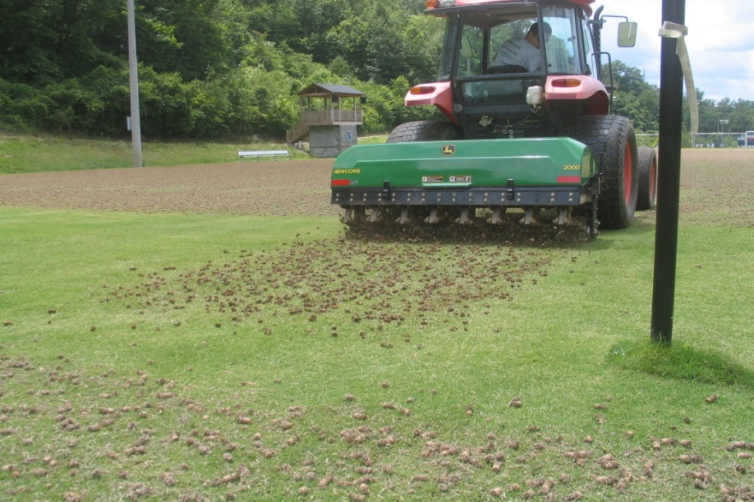
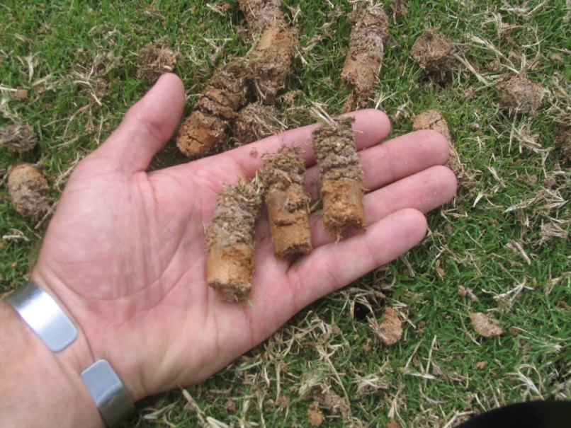
Aeration
Hollow tine core cultivation
This method improves drainage, reduces organic matter and relieves compaction by pulling cores from soil
Aeration of turf - David Kopec, University of Arizona
Notes:
Please use these pictures – they are mine.

Slide 31
Aeration
Pulverize and distribute the cores over the field with a steel drag mat
Great time to overseed
Top dressing with compost and rotating mowing patterns also helps relieve soil compaction

Slide 32
When to Aerate
Soil must be moist enough to allow good penetration but not wet
Irrigate area at least one day before aerating
Time aeration efforts to avoid periods when weeds are producing seed or in high heat conditions

Slide 33
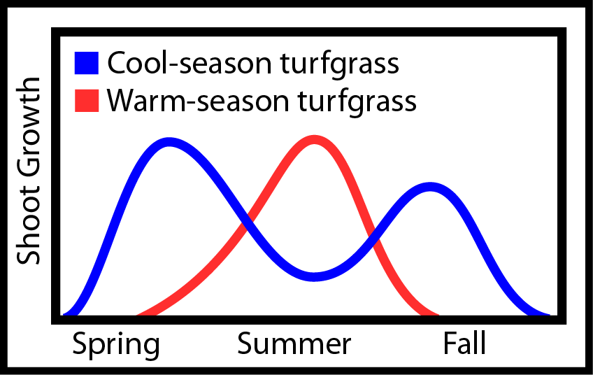
When to Aerate
Aerate practice fields one to three times a year
Aerate lawns once a year
Heavily used turf may require aeration four times a year
Turf shoot growth - Alec Kowaleski, Oregon State University

Slide 34
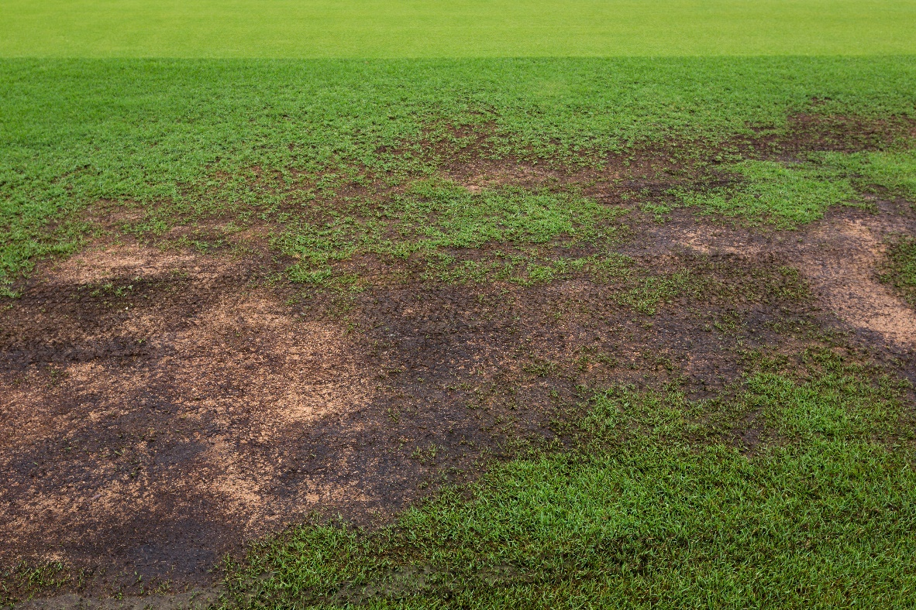
Overseeding
1.
Overseeding generally means:
Introducing more seed of the same grass type into the established turf or
Spreading seed of a different type as environmental conditions change

Slide 35
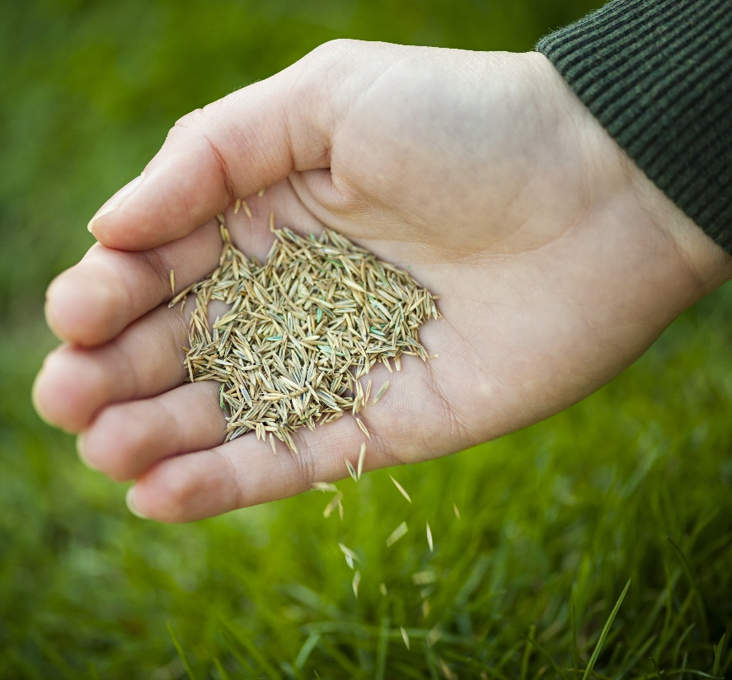
Overseeding
1.
Overseeding helps:
Thicken the turf stand
Avoid excessive compaction
Minimize soil erosion
Prevent weed seed germination
Usually performed using a spreader which may be a drop or rotary design

Slide 36
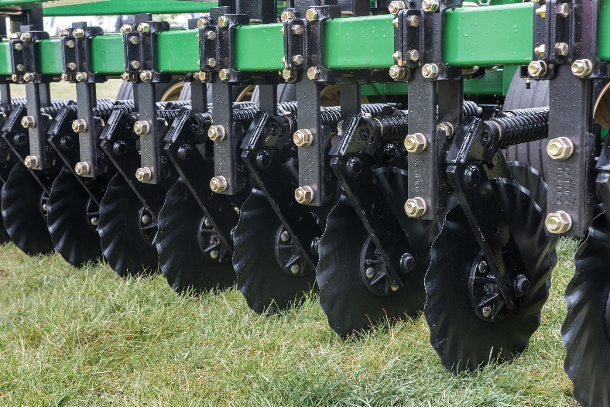
Overseeding
Slit seeding or drilling
Usually a single pass is sufficient
Spot seeding should be done any time there is an open area caused by weed control, turf removal or winter damage, grubs, etc.
Broadcast seeding may be combined with aeration
Spikers, hollow-tine aerifiers or vertical mowers may also aid seedling establishment
Disks of a seeding drill

Slide 37
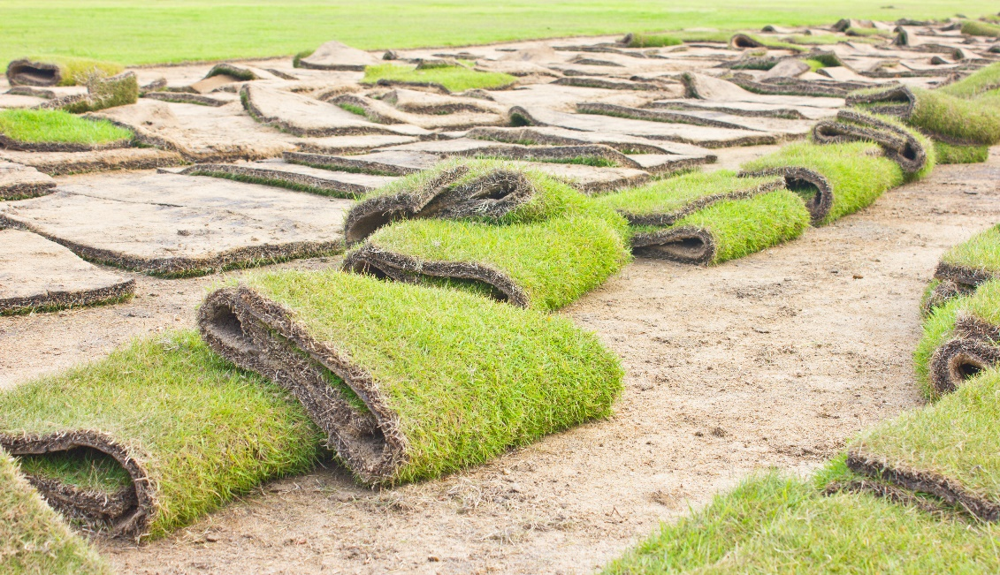
Check In!
This lesson you learned:
Cultural turf management practices including:
Mowing
Fertilization
Irrigation
Soil Analysis
Aeration
Overseeding
Next you will learn more about common turfgrass weeds and insects!

Slide 38
Resource List
Iowa State University. (2010). Plant and Insect Diagnostic Clinic. http://www.ipm.iastate.edu/ipm/info/plant-diseases/turf-grass-rust
Maine Department of Agriculture, Conservation and Forestry. School IPM. http://www.maine.gov/dacf/php/integrated_pest_management/school/index.shtml
Rutgers Cooperative Extension. IPM Report Card for School Grounds: General Requirements. http://entomology.osu.edu/schoolipm/IPMfiles/ReportCardGeneral.pdf
Texas A&M Agrilife Extension. Landscape IPM Module 6. http://schoolipm.tamu.edu/videodvd/
Umass Extension Center for Agriculture. Best Management Practices For Lawn and Landscape Turf. http://extension.umass.edu/turf/sites/turf/files/pdf-doc-ppt/lawn_landscape_BMP_2013_opt.pdf
University of California Agricultural and Natural Resources. (2009). How to Manage Pests. http://www.ipm.ucdavis.edu/PMG/r785100411.html

