Slide 1
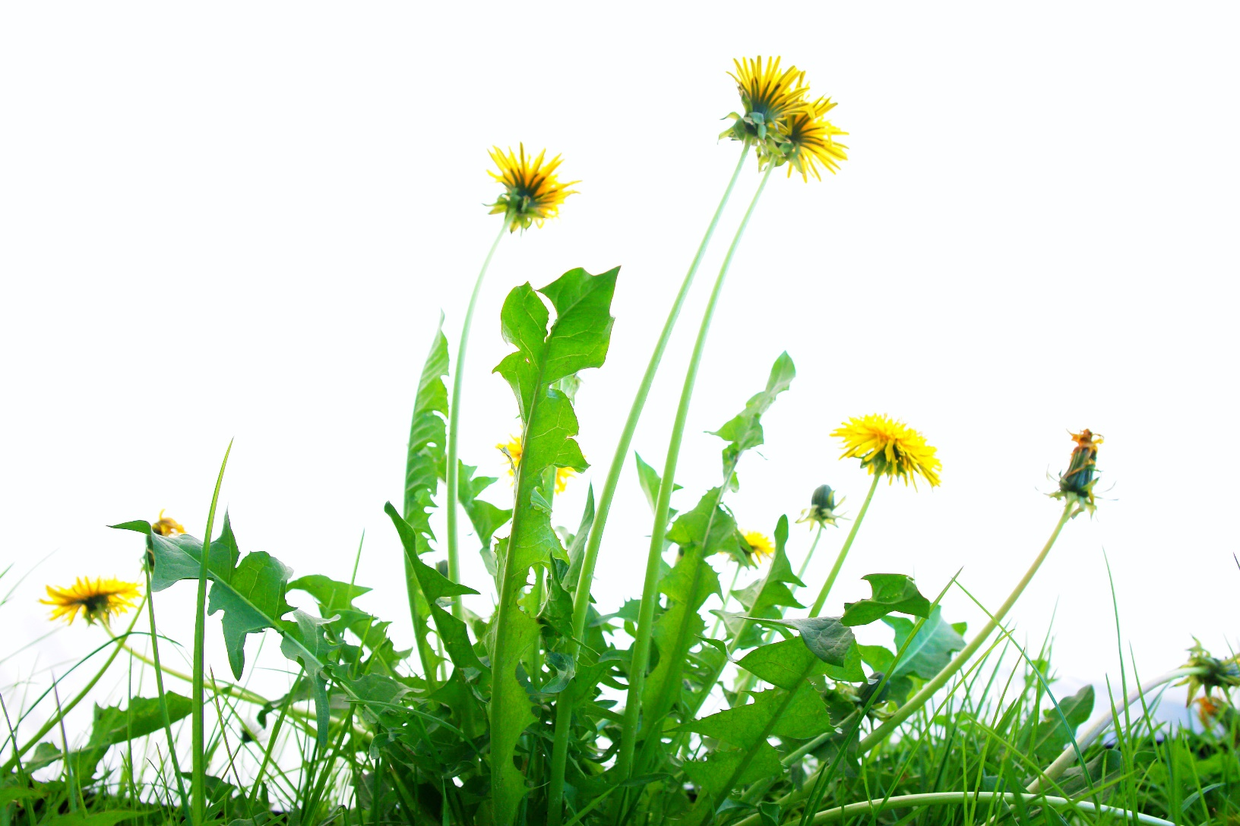
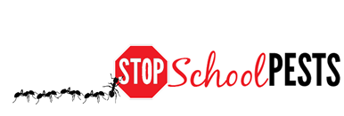
common turfgrass weeds and insects
Lesson 3 of 4
In-Person Educational Module

Slide 2
Learning Objectives
Identify plant species suited for site-specific environmental qualities, pest pressure and use
Identify and describe how to manage common turfgrass weeds
Identify and describe how to manage common turfgrass insect pests
Identify and describe how to manage common turfgrass vertebrate pests

Slide 3
IPM for Lawn and Turfgrass
IPM for lawns and turf includes:
Site assessment
Monitoring
Prevention
Management
Evaluation of practices

Slide 4
Components of an IPM Program on School Grounds
Promoting turfgrass health:
Select grass species
Prepare the site
Cultural care
Consider the use of the turf when selecting cultivars
Notes:
Cultivar? Was cultivator?

Slide 5
Selecting Turfgrass
Select a suitable turfgrass seed mix
Grasses with disease resistance are generally only resistant to one disease
Certain grasses containing endophytes can prevent outbreaks of above-ground insect pests
Select grass types that tolerate the level of play

Slide 6
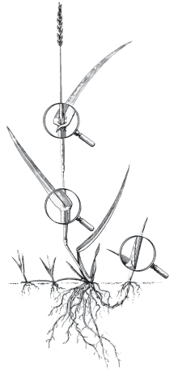
Turfgrass Identification
University of Georgia College of Agricultural and Environmental Sciences
Seedhead
Blade
Roots comprise almost half of the entire grass plant
Ligule
Sheath
Auricles
Node
Midrib
Collar
Stolon
Tiller
Bud Leaf
Crown
Rhizome

Slide 7
Turfgrass Selection
 | Kentucky Bluegrass | Perennial Ryegrasses | Tall Fescue | Fine Fescue
Growth habit | Rhizomatous | Bunch | Bunch | Bunch, some rhizomes
Leaf texture (blade width) | Medium-Fine | Medium | Course | Very Fine
Establishment from seed | Slow | Fast | Medium-Fast | Medium
Seeding rate | 1 to 2 lb./1,000 ft.² | 5 to 9 lb./1,000 ft.² | 5 to 9 lb./1,000 ft.² | 3 to 5 lb./1,000 ft.²
Annual nitrogen fertilizer | 3 to 4 lb./1,000 ft.² | 2 to 4 lb./1,000 ft.² | 2 to 4 lb./1,000 ft.² | 1 to 2 lb./1,000 ft.²
Drought tolerance | Poor | Poor | Some | Some
Shade tolerance (min. 4 hours direct sun) | Poor | Poor | Good | Excellent
Wear tolerance (traffic) | Good | Good | Good | Poor
9

Slide 8
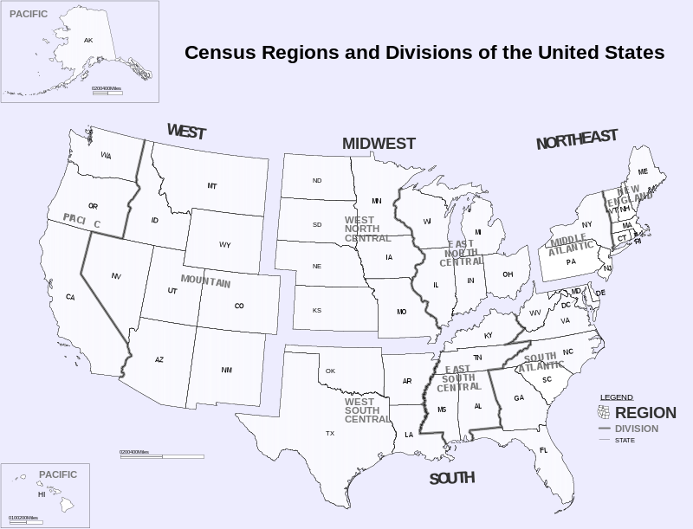
Census Regions and Division of the United States - Inkscape

Slide 9
Examples of Turfgrass Species – North Central
Turfgrass Characteristics
Grass species |  | Preferred environment
Kentucky bluegrass |  | Well drained, sunny areas High nutrient and water requirements
Supina bluegrass |  | Sun to dense shade High nutrient and water requirements
Perennial ryegrass |  | Well drained soils Moderate fertility and water requirement
Tall fescue |  | Well drained soils Open sunny areas. Low fertility requirement
Fine fescue |  | Cool, dry, well drained, shade tolerant, well drained

Slide 10
Examples of Turfgrass Species – Northeastern
Turfgrass Characteristics
Grass species |  | Preferred environment
Kentucky bluegrass |  | Sunny, well drained
Fine fescue |  | Cool, dry, well drained, shade tolerant, well drained
Perennial ryegrass |  | Well drained, moderate fertility
Tall fescue |  | Sun and shade

Slide 11
Examples of Turfgrass Species – Western
Turfgrass Characteristics
Grass species | Preferred environment
Kentucky bluegrass | Sunny, well drained High elevation
Supina bluegrass | Sun to dense shade High nutrient requirements
Bermudagrass (southwestern) | Sunny, tolerates most soil conditions High fertility requirement Low – medium elevation
Perennial ryegrass | Well drained, moderate fertility
Tall fescue | Sun and shade

Slide 12
Examples of Turfgrass Species – Pacific Northwest
Turfgrass Characteristics
Grass species | Preferred environment
Kentucky bluegrass | Sunny, well Drained Recovery – slow in late fall
Fine fescue | Cool, dry, well drained, shade tolerant, well drained
Perennial ryegrass | Well drained, moderate fertility, sunny
Tall fescue | Sun and shade

Slide 13
Examples of Turfgrass Species – Southern
Turfgrass Characteristics
Grass species | Preferred environment
Bermudagrass | Sunny, tolerates most soil conditions
Zoysiagrass | Sun to moderate Shade Recovery is slow
Centipede | Sunny, tolerates low pH conditions
Tall fescue | Sun and shade
Fine fescue | Cool, dry, well drained, shade tolerant, well drained

Slide 14
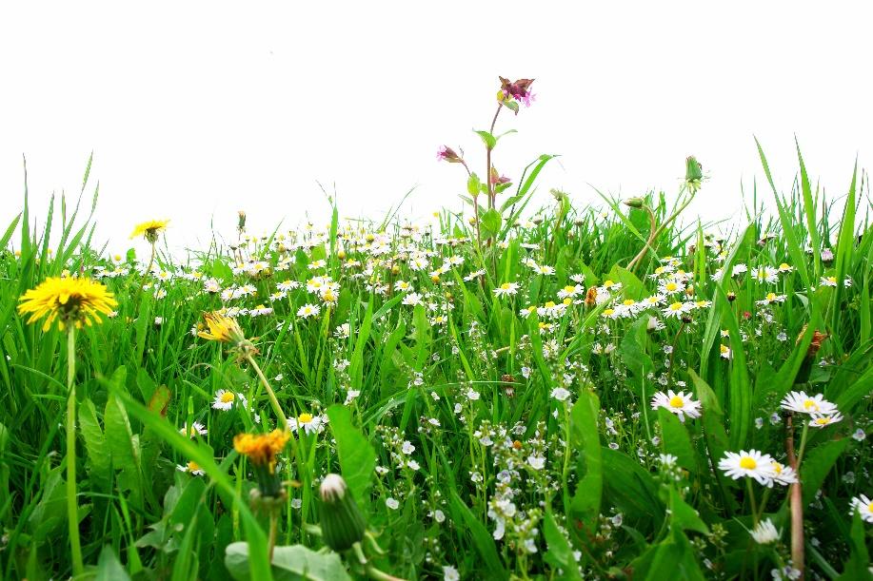
Managing Turf Weeds
Keep turfgrass healthy to out-compete weeds
Use certified seed for overseeding
Soil pH can be a huge factor in turf health
Avoid fertilizer applications when annual weed seeds may be germinating
Establish weed population thresholds by zone
Low visibility, low maintenance zones can tolerate more weeds

Slide 15
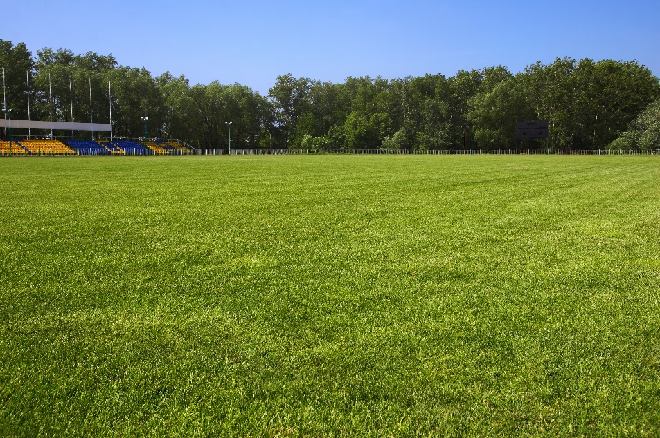
Weed Monitoring: The Transect Method
Randomly choose a series of transects
Walk each transect, stop after 20 paces and record the presence/absence of weeds in a 3x3 foot area
Estimate the percentage of area covered by weeds in each 3x3' sample and calculate the average
Monitor regularly

Slide 16
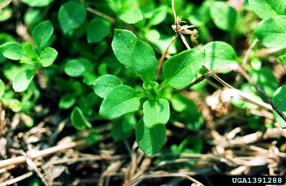
Common Turfgrass Weeds: Northeast
Weeds
Velvetleaf
Common ragweed
Common lambsquarters
Hairy galinsoga
Eastern black nightshade
Common chickweed
Giant foxtail
Yellow foxtail
Large crabgrass
Yellow nutsedge
Common Chickweed
- John D. Byrd, Mississippi State University, bugwood.org

Slide 17
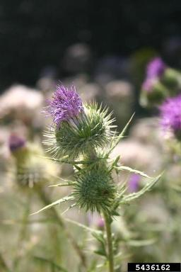
Common Turfgrass Weeds: Midwest
Weeds
Bull thistle
Canada thistle
Carolina geranium
Chicory
Common purslane
Curly dock
Large crabgrass
Mouseear chickweed
Common mallow
Perennial sowthistle
Bull thistle -
Eric Coombs, Oregon Department of Agriculture, bugwood.org

Slide 18
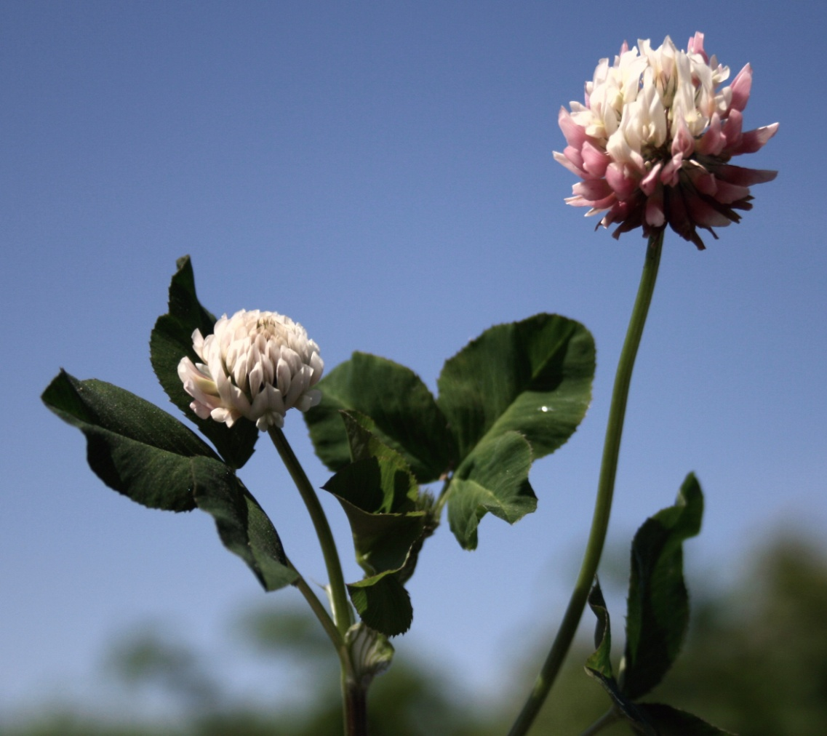
Common Turfgrass Weeds: Pacific Northwest
Weeds
Annual bluegrass
Buttercup
Chickweed
Clover
Crabgrass
White clover
Moss
Plantain
Thistles
Red sorrel
White clover
- Tim Miller, Washington State University

Slide 19
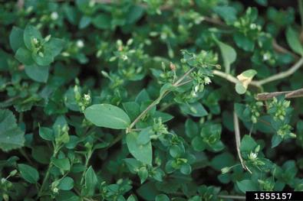
Common Turfgrass Weeds: South
Weeds
Dallisgrass
Bahiagrass
Annual bluegrass
Spurge
Chickweed
Crabgrass
Dandelion
Common chickweed -
Ohio State Weed Lab Archive, The Ohio State University

Slide 20
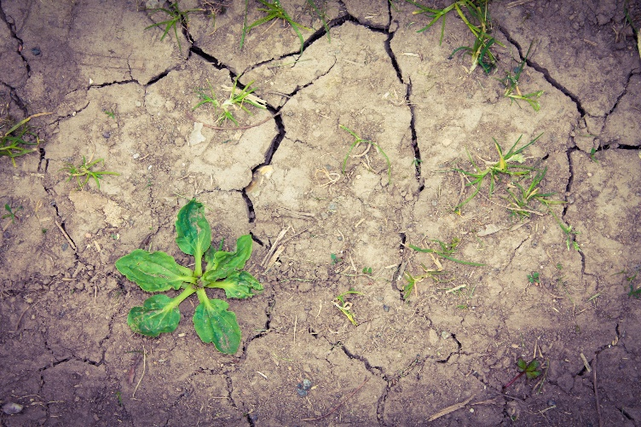
Identify, Monitor, Manage Turfgrass Weeds
Annual Weed Species
Summer annual weeds
Germinate in spring
Mature during summer
Die by fall or winter
Herbicides applied as pre-emergents in the spring
Winter annual weeds
Germinate in the fall and winter
Grow actively in spring
Die by summer
Herbicides applied as pre-emergents in the early fall

Slide 21
Identify, Monitor, Manage Turfgrass Weeds
Biennial weeds
Grow during the spring, summer and fall of their first year
Survive the following winter
Produce seed in the second growing season
Perennial weeds
Live more than two years
Spread by seeds and vegetative means
If herbicides are needed use fall applications of selective broadleaf herbicides

Slide 22
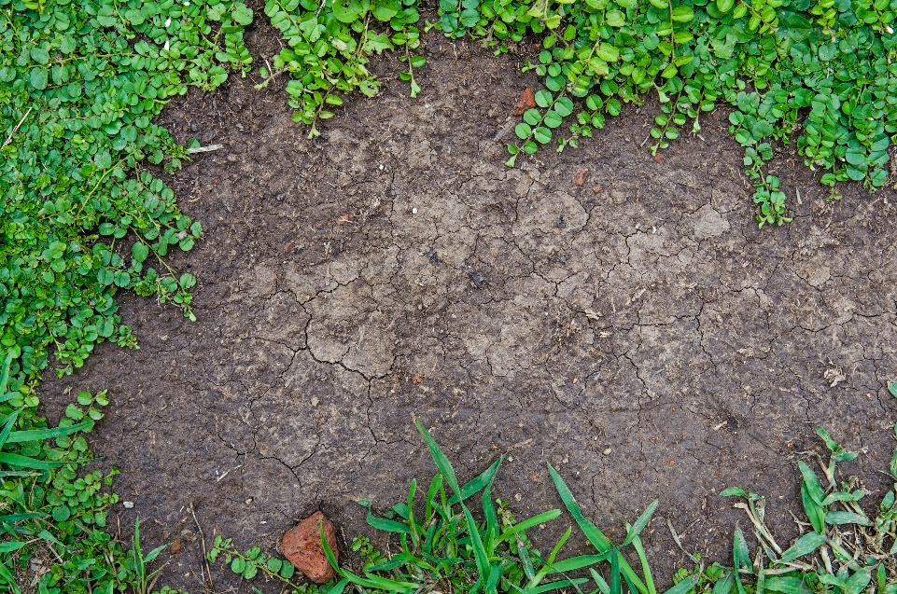
Site Selection and Preparation
Get difficult perennial weeds under control before planting
Irrigate the site before planting to allow weed seeds on site to germinate before grass seed is planted
Poor sites for turfgrasses:
Sites with limited water
Less than four to six hours of direct sunlight
Minimal nutrients

Slide 23
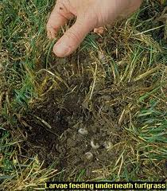
Identifying and Monitoring Turfgrass Insects
Insect pests vary by region
Monitor and record data on pests
Masked chafers (white grubs)
- University of California IPM, http://www.ipm.ucdavis.edu

Slide 24
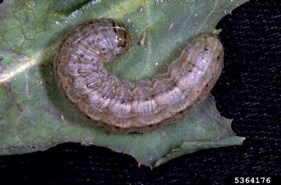
Common Turfgrass Pests: Northeast
Insects
Beetle grubs
Sod webworms
Chinch bugs
Billbugs
Cutworms
Army cutworm
- Frank Peairs, Colorado State University, Bugwood.org

Slide 25
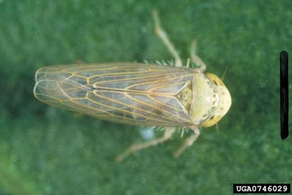
Common Turfgrass Pests: Intermountain West
Insects
Billbugs
Chinch bug
Banks grass mite
Leafhoppers
Beet leafhopper -
G. Oldfield, USDA, Bugwood.org

Slide 26
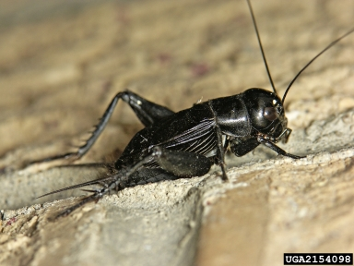
Common Turfgrass Pests: Midwest
Insects
White grubs
Billbugs
Sod webworm
Aphids
Crickets
Field Cricket -
Joseph Berger, Bugwood.org

Slide 27
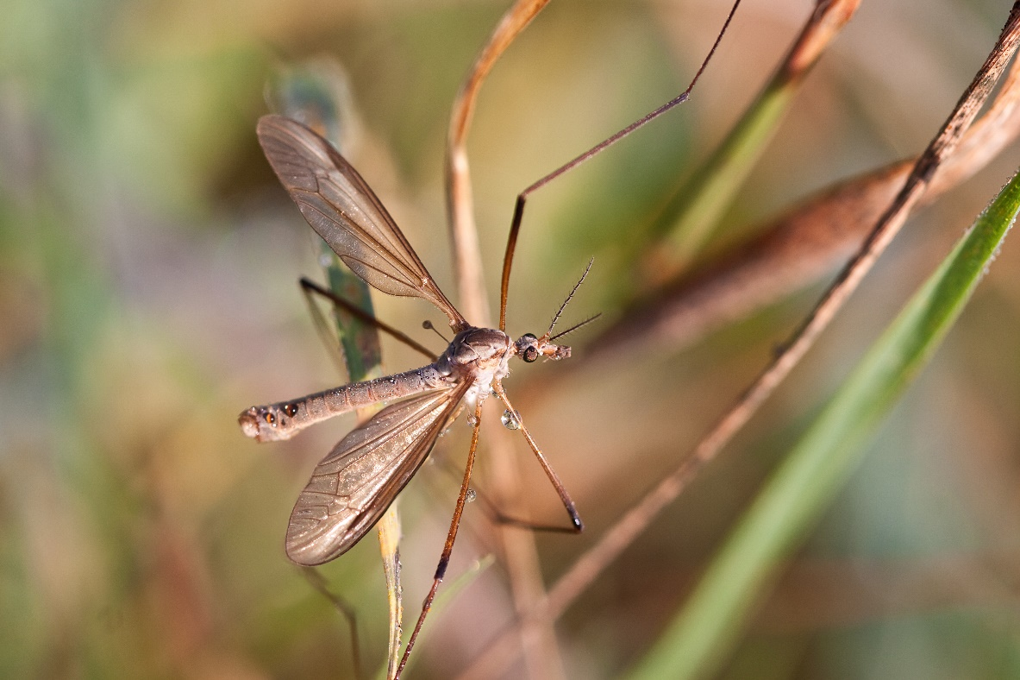
Common Turfgrass Pests: Pacific Northwest
Insects
European cranefly
White grubs
Chinch bug
Billbugs
European cranefly

Slide 28
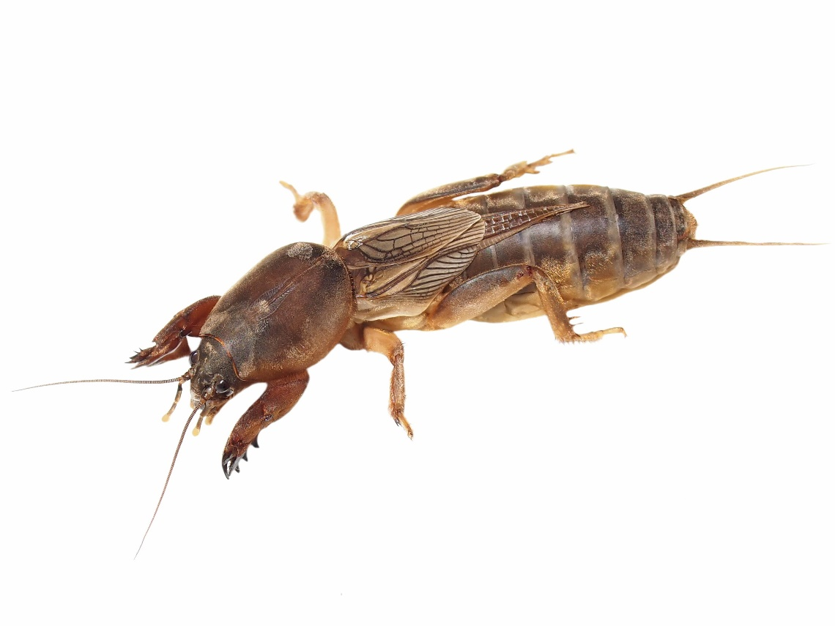
Common Turfgrass Pests: Gulf Coast
Insects
Armyworms
Red imported fire ants
Grasshoppers
Mole crickets
Southern chinch bugs
Tropical sod webworm
White grubs
Mole cricket

Slide 29
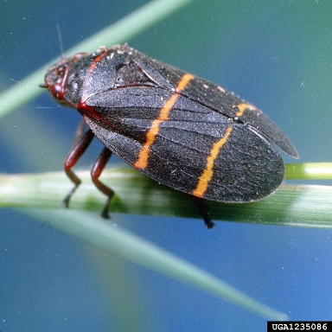
Common Turfgrass Pests: South
Insects
Fire ants
Chinch bugs
Spittlebugs
Sugarcane beetles
Henbit
Spurges
Twolined spittlebug -
Clemson University, USDA Cooperative Extension Slide Series, Bugwood.org

Slide 30
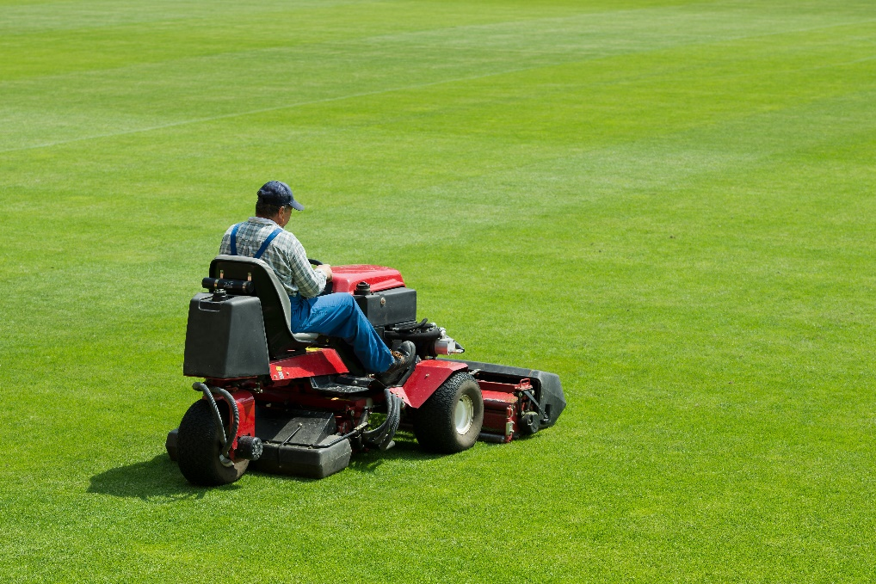
Managing Turfgrass Insect Pests
Healthy turf rarely requires insecticide treatment
Insect pest problems are often limited to small areas of turf that have cultural issues:
pH
Fertility
Drainage
Root growth
Overwatering
Mowing

Slide 31
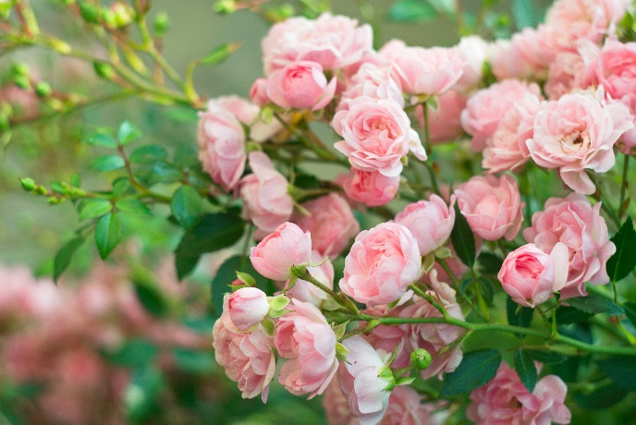
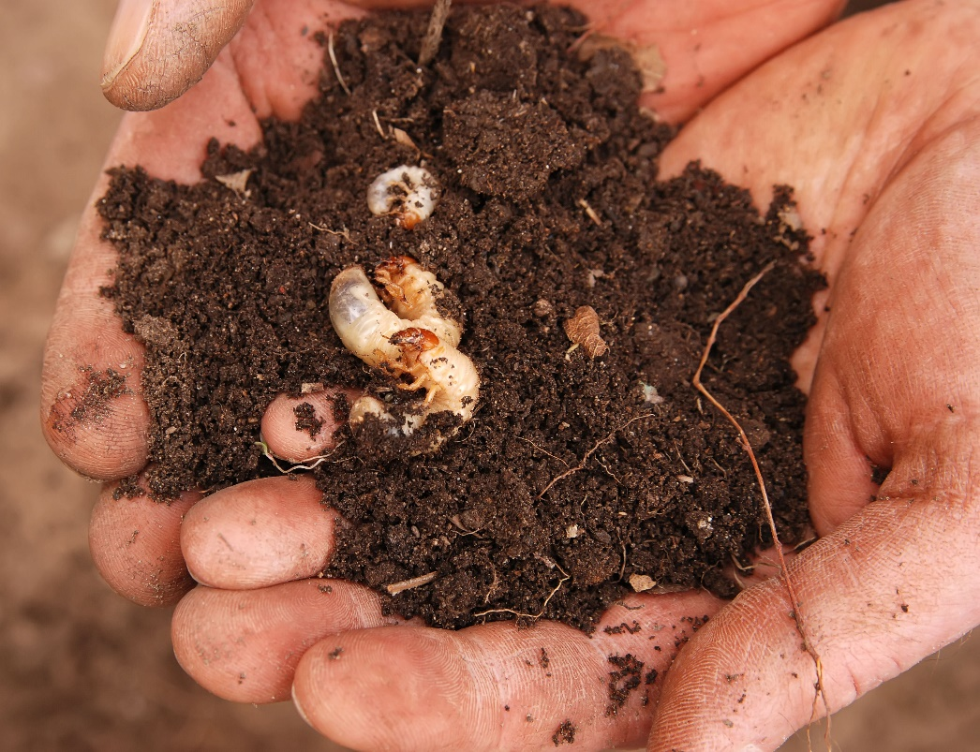
Managing Turfgrass Insect Pests
In regions affected by grubs, avoid planting roses, grapes or oaks
Grub-infested turf suffers root loss, increasing irrigation needs
Avoid excessive night lighting which can attract beetles

Slide 32
Managing Turfgrass Insect Pests
Dethatching reduces chinch bug activity
Consider grass cultivars that contain “endophytes” for areas with chinch bug, billbug, cutworm or sod webworm
If insecticides are needed, irrigate and remove thatch first to draw grubs up
Treat affected spots only

Slide 33
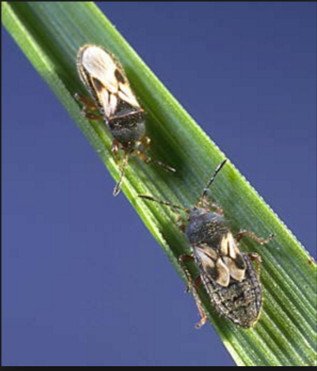
Chinch Bugs
Reach peak populations during high heat
Dry turf is particularly susceptible
Particularly susceptible turf:
Kentucky bluegrass
Perennial and annual ryegrass
Tall and fine fescue
St. Augustine grass
Chinch bugs feed on grass blades and can cause damage at high densities – Ohio State University Extension

Slide 34
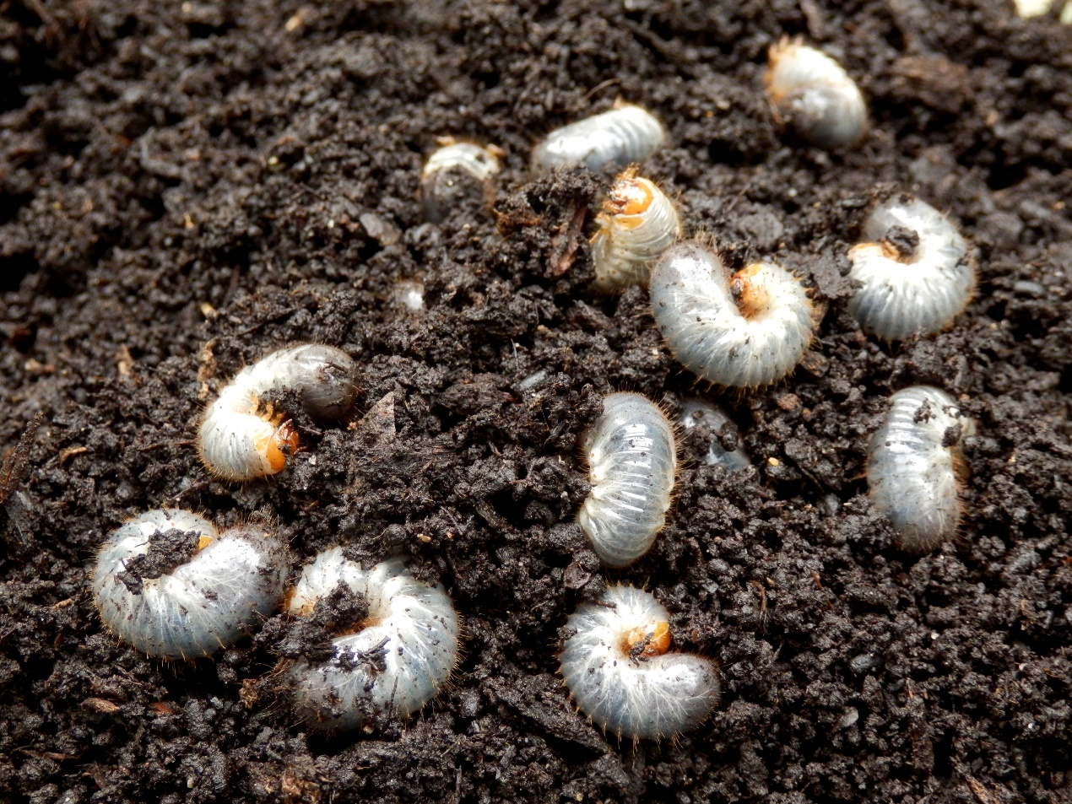
White Grubs
Turf damage can peak in late summer

Slide 35
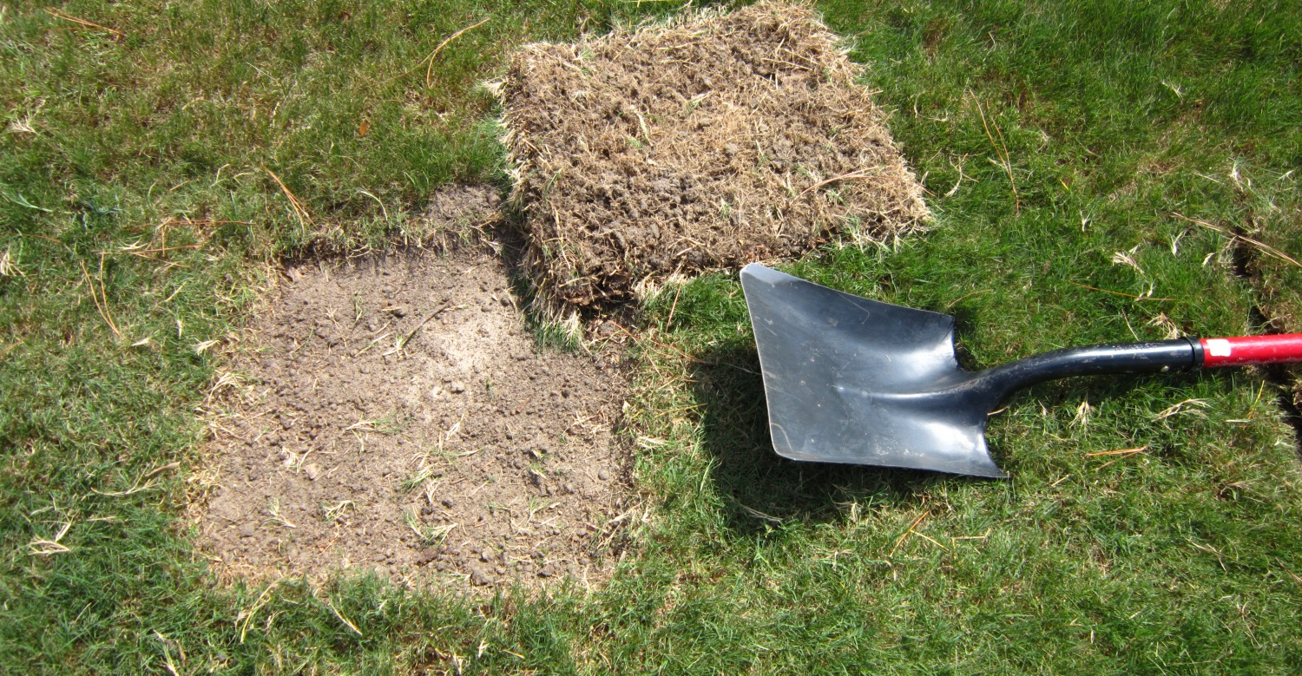
Managing Grubs
Use a shovel to determine the number of grubs per square foot before initiating any treatment
Establish action threshold levels
Square foot of turf removed – David Shetler, Ohio State University

Slide 36
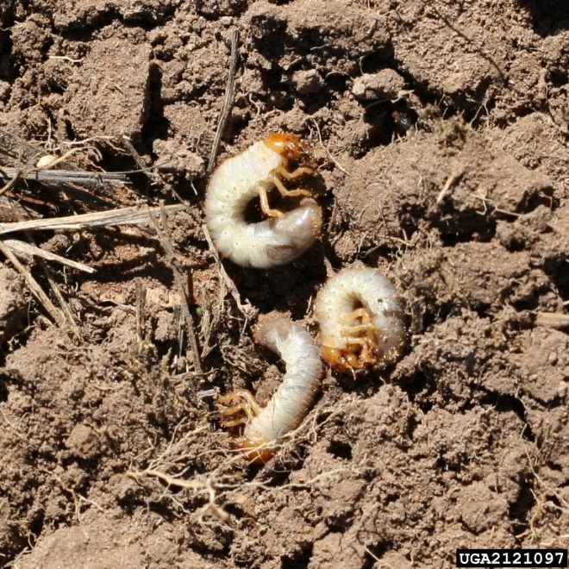
White Grubs
White grubs are typically one of the following species:
Japanese beetle
June beetle
European chafer
Asian garden beetle
Oriental beetle
Asiatic garden beetle
Northern masked chafer
Black turfgrass ataenius beetle
May-June beetle white grubs -
Steven Katovich, USDA Forest Service, Bugwood.org
Creative Commons License

Slide 37
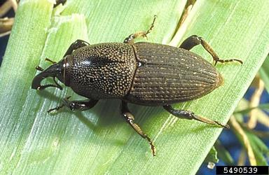
Billbug
Billbug larvae tunnel through plants while feeding on the stem
Late June through early August
Signs of damage include spotty, straw-colored patches of grass scattered throughout the lawn
Billbug -
David Shetlar, Ohio State University, Bugwood.org

Slide 38
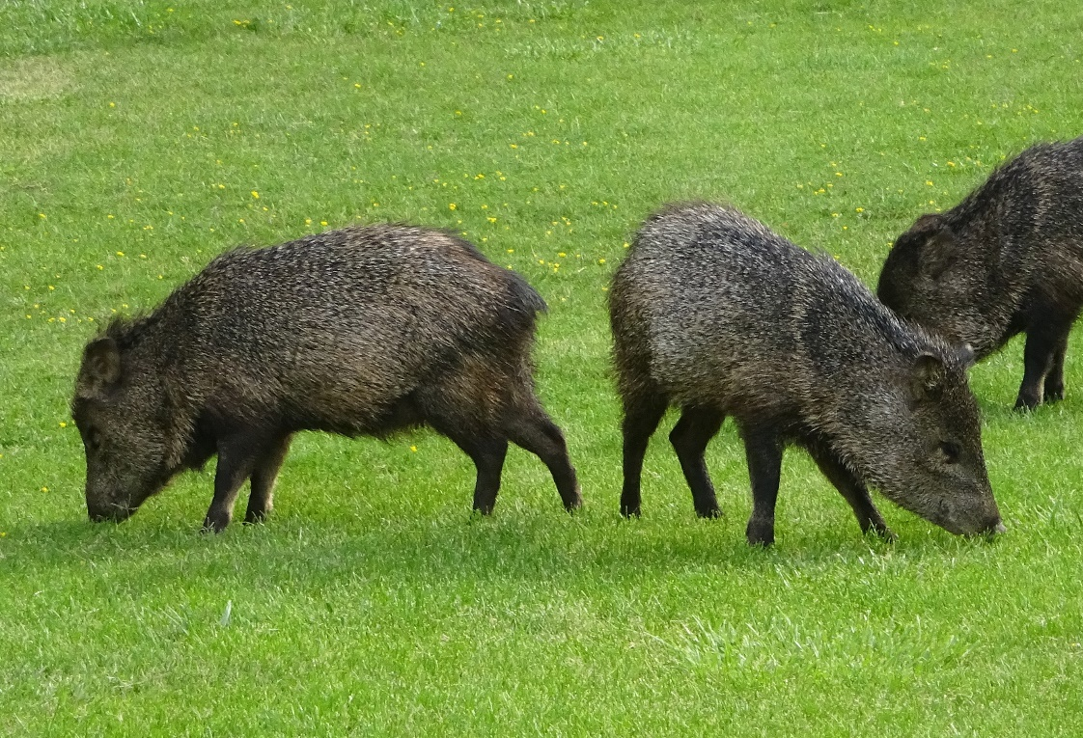
Identifying Turfgrass Vertebrates
Pocket gophers
Prairie dogs
Meadow voles
Moles
Rabbits and hares
Ground squirrels
Deer
Collared peccary (Javelina)
Javelina
Notes:
European Crane fly removed as it is not a vertebrate

Slide 39
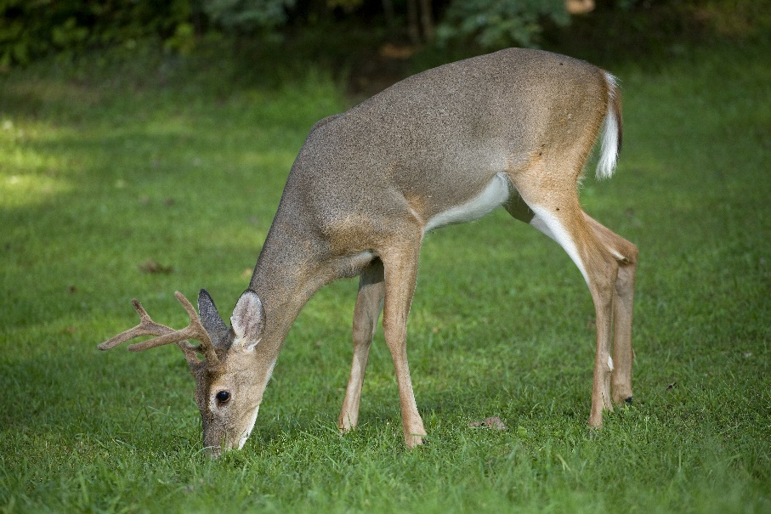
Monitoring and Managing Turfgrass Vertebrate Pests
Vertebrate pests can harm turfgrass looking for pests to eat
Monitor for signs of vertebrate activity

Slide 40
Check In!
This lesson you learned:
How to identify plant species suited for a site’s environmental qualities, pest pressures and use
How to identify and describe how to manage common turfgrass weeds
How to identify and describe how to manage common turfgrass insect pests
How to identify and describe how to manage common turfgrass vertebrate pests
Next you will learn about common turfgrass diseases!

Slide 41
Resources
Insect Images. (2010). Lawn and Turf. Retrieved from http://www.bugwood.org/
Iowa State University. (2010). Plant and Insect Diagnostic Clinic. Retrieved from http://www.ipm.iastate.edu/ipm/info/plant-diseases/turf-grass-rust
Maine Department of Agriculture, Conservation and Forestry. School IPM. Retrieved from http://www.maine.gov/dacf/php/integrated_pest_management/school/index.shtml
Rutgers Cooperative Extension. IPM Report Card for School Grounds: General Requirements. Retrieved from http://entomology.osu.edu/schoolipm/IPMfiles/ReportCardGeneral.pdf
Texas A&M Agrilife Extension. Landscape IPM Module 6. Retrieved from http://schoolipm.tamu.edu/videodvd/
Umass Extension Center for Agriculture. Best Management Practices For Lawn and Landscape Turf. Retrieved from http://extension.umass.edu/turf/sites/turf/files/pdf-doc-ppt/lawn_landscape_BMP_2013_opt.pdf
University of California Agricultural and Natural Resources. (2009). How to Manage Pests. Retrieved from http://www.ipm.ucdavis.edu/PMG/r785100411.html

