Slide 1

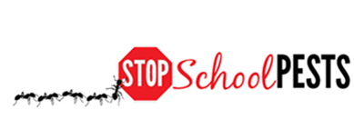
IPM FOR Maintenance staff
In-Person Education Module
Lesson 1 of 1

Slide 2

Learning Objectives
Explain the importance of routine, proactive building and facilities maintenance to maintain structural integrity and prevent pest entry and pest conducive conditions
Explain the
importance of timely work order follow-up

Slide 3

Learning Objectives
Describe the key elements of sanitation (clean environment) and exclusion, (habitat prevention) including: strategies, tactics, and tools
Describe the key elements of inspection and monitoring, including what to look for, where to look, tools used, and frequency
Explain the importance of effective communication, education, and cooperation between school staff

Slide 4
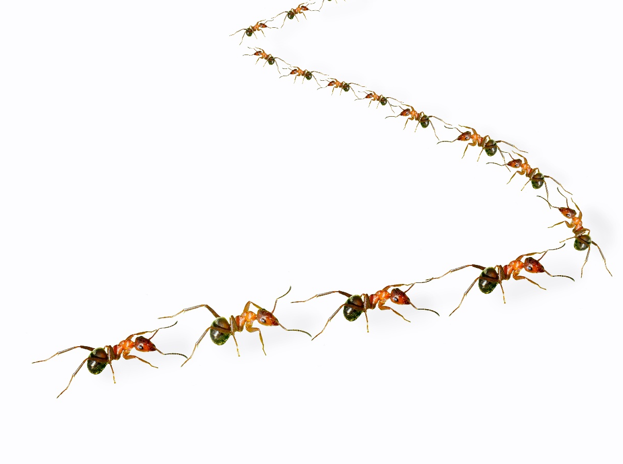
What is IPM?
IPM = Integrated (Intelligent) Pest Management
A sensible, environmentally friendly, and effective way to solve pest problems

Slide 5
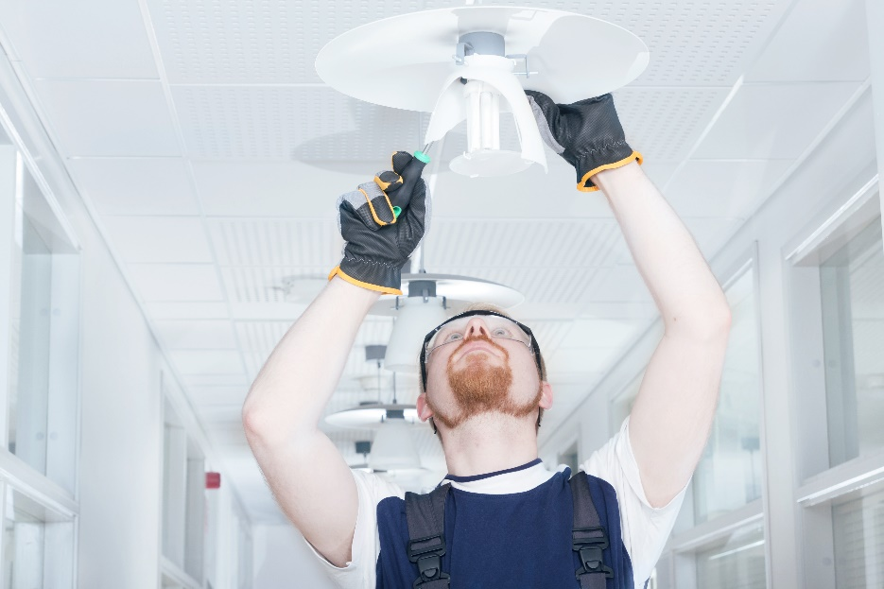
Maintenance Staff and IPM
Maintenance
responsibilities
Emergency
responses daily
Landscaping and grounds

Slide 6
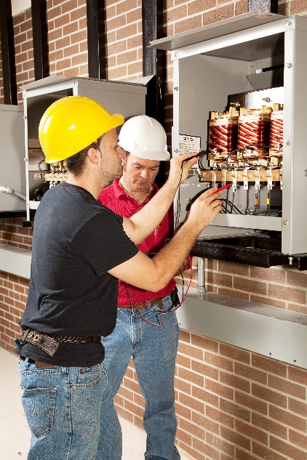
Maintenance Staff and IPM
Why be involved in school IPM?
Maintenance staff are among the
most important people in a school IPM program
  staff members regularly see every part of the school
  perform tasks to maintain a healthy learning environment
  maintain the school to help keep pests out and reduce pest and pest management associated risks

Slide 7

Pests Love To Go To School!
Schools are great places for certain pests
Some find everything they
need to survive
  Food
  Water
  Shelter

Slide 8
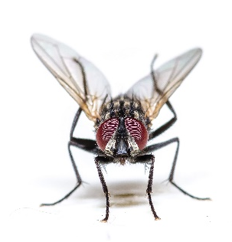

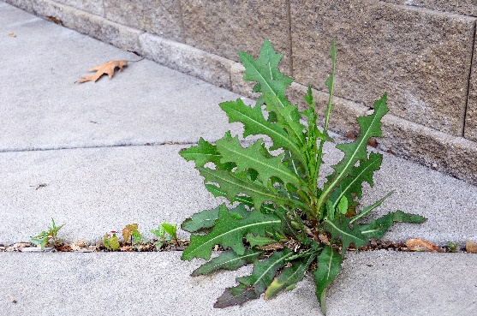
Pests in schools
Awareness of common pests
Problematic pests in schools:
  Animal pests
  Plant pests

Slide 9
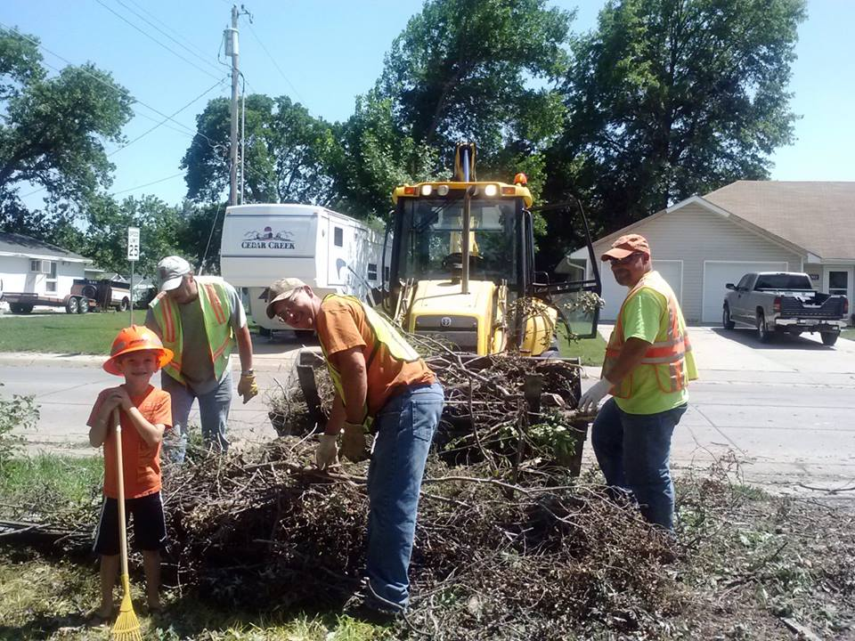
1.
IPM is Not an Additional Item on Your to-do List
Maintenance is a demanding job
IPM does not add to your responsibilities!
IPM
IPM is everyone’s job
Maintenance staff with young helper, moving debris from fallen tree - Jason Moore, Street Superintendent, City of Beatrice, Nebraska

Slide 10
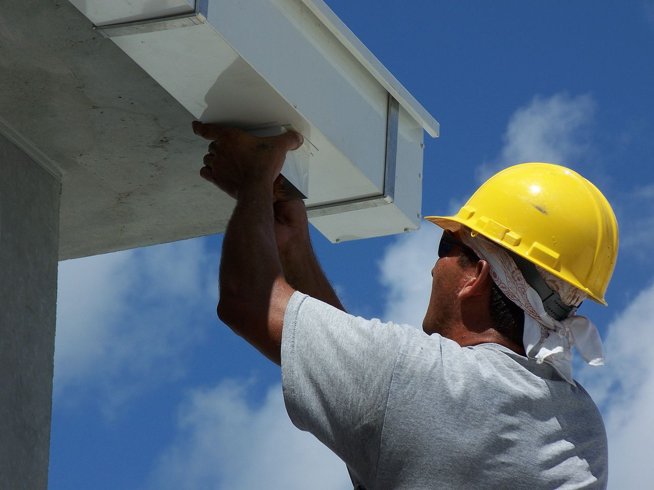
Maintenance Staff and IPM
Maintenance staff actually implement IPM as they go about their regular daily duties
Maintenance staff installing a rain gutter on a building - Ethoseo from Wikimedia commons

Slide 11
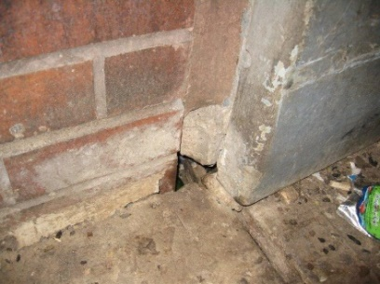
Maintenance Staff and IPM
Routine, proactive maintenance
  Maintain structural integrity
  Prevent pest entry and pest conducive conditions
Gaps in foundation provide access to pests such as rodents - Dawn H. Gouge, University of Arizona

Slide 12
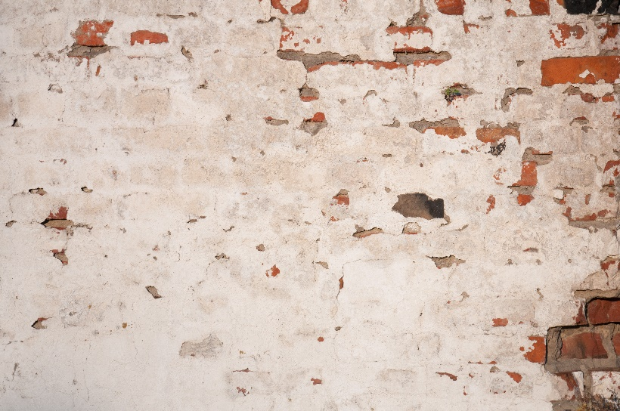
Routine, Proactive Maintenance
Maintain structural integrity of buildings
Structural integrity
Regular monitoring of buildings
Perform structural repairs
as soon as possible
Gaps in wall plaster can lead to moisture retention and weakening

Slide 13
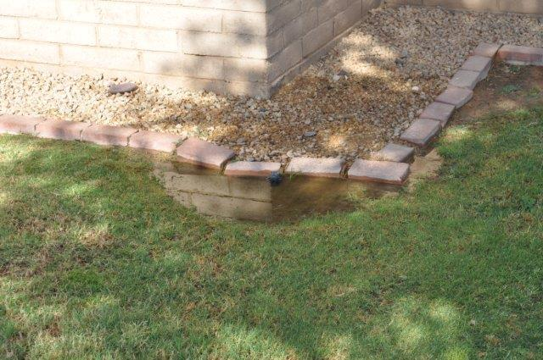
Routine, Proactive Maintenance
Maintain structural integrity of buildings
Moisture management
Avoid moisture accumulation in and around the buildings
Waterproofing using
quality materials
Avoid water accumulation around building foundation – Shaku Nair, University of Arizona

Slide 14
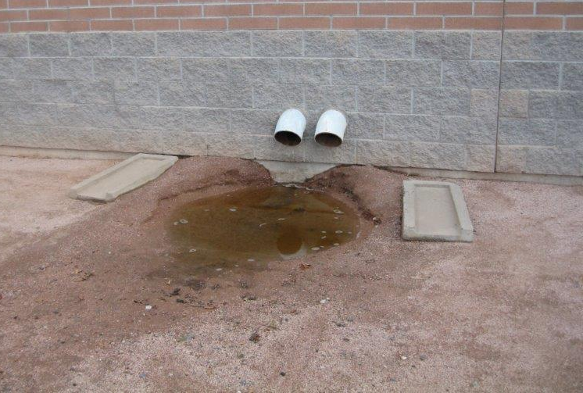
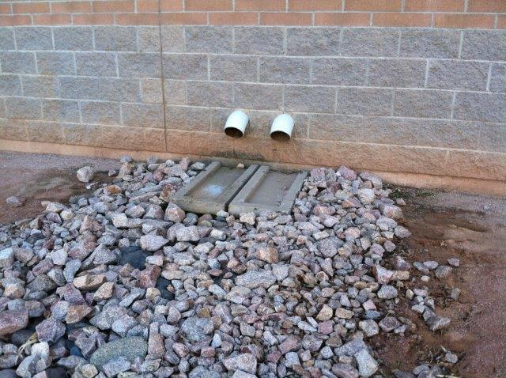
Routine, Proactive Maintenance
Maintain structural integrity of buildings
Incorrect placement of splash-guards (left) leads to puddling of water near building foundation and soil erosion
– Shaku Nair, University of Arizona

Slide 15
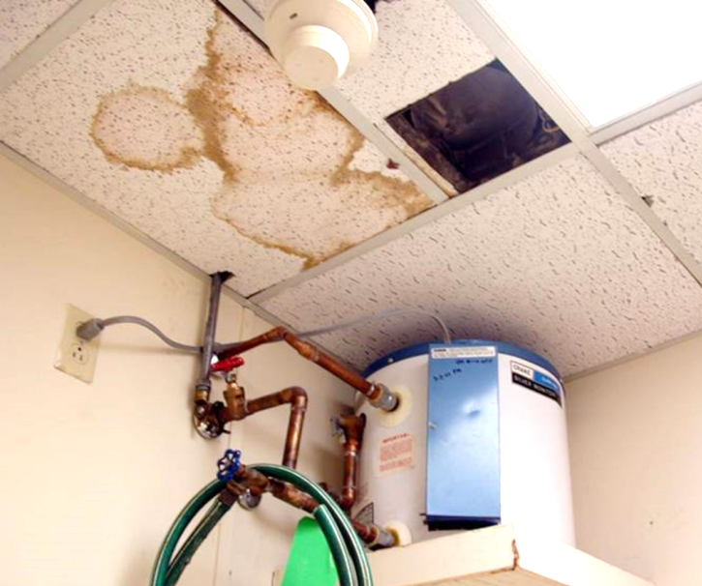
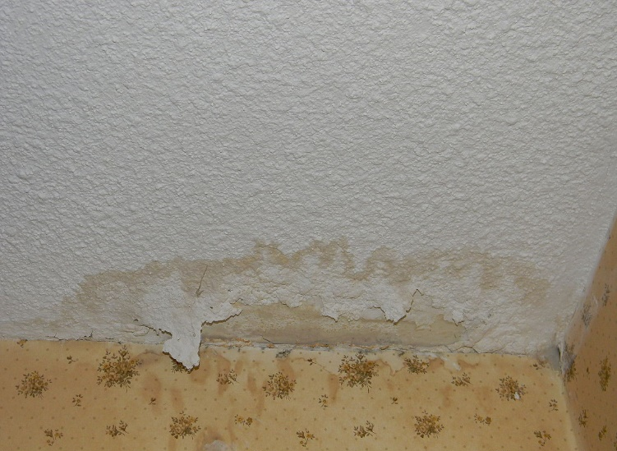
Routine, Proactive Maintenance
Water leaks
Indicate faulty plumbing, damaged roofs, etc.
Attract mold, carpenter ants, termites, flies, and rodents
Weaken structures and lead to other problems
Repair water leaks promptly – Dawn H. Gouge, University of Arizona
Drywall water damage
- Herbert Bernstein, WikiMedia Commons

Slide 16
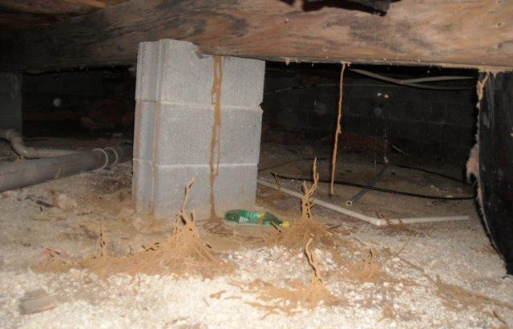
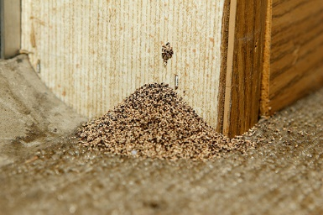
Routine, Proactive Maintenance
Maintain structural integrity of buildings
Structural pests attracted to water damaged wood include: termites, wood-destroying beetles, and mold
Monitor for pest activity
Sign of western drywood termite damage - Kevin (ibkev2002), Flickr
Subterranean termite shelter tubes in a basement
- Larry Ralph Jr., Indiancrawlspacerepair

Slide 17
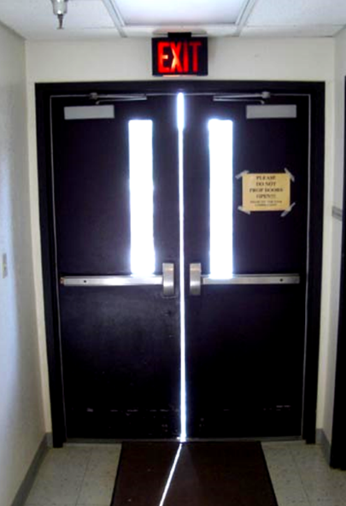
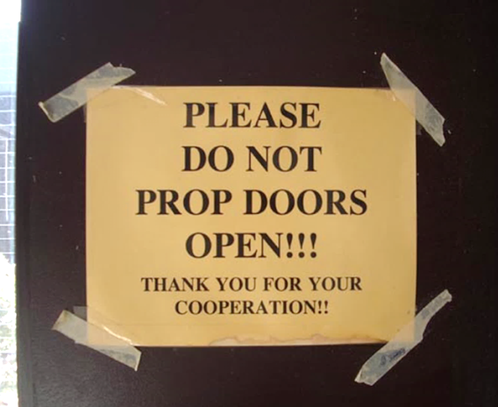
Routine, Proactive Maintenance
Prevent pest entry
Seal your buildings
Vertical and horizontal gaps
Avoid propping doors open
  Door sweeps can cut pest complaints by 65%
Even if this door is not propped open, the vertical gap gives easy entry to flying and crawling pests – Dawn H. Gouge, University of Arizona

Slide 18
Routine, Proactive Maintenance
Prevent pest entry
Check escutcheon plates (pipe collars)
Seal around pipe-chases and conduits
Loose escutcheon plates – Dawn H. Gouge, University of Arizona
Gap in drop ceiling - Janet Hurley, Texas AgriLife Extension

Slide 19
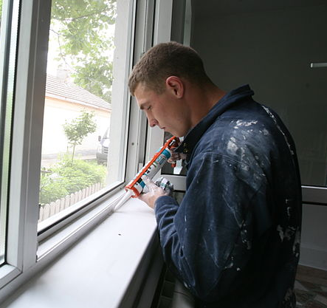
Routine, Proactive Maintenance
Sealing gaps
Use high quality silicon based (elastomeric) sealants
Sealing gaps around window frames keeps pests out and reduces heating/cooling expenses -WikiMedia Commons
Gaps in wall at pipe entry points Gaps have been sealed
- J. G. Kaufmann, WikiMedia Commons

Slide 20
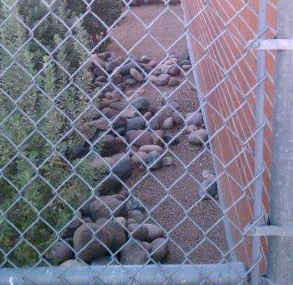
Routine, Proactive Maintenance
Prevent pest entry
Seal around windows, doors, gaps, wall penetrations
Eliminate unscreened access
Ensure air doors are set
Create space around your buildings
Ensure that access panels are not left open – Jerry Jochim, Monroe County Community School Corporation
Ensure space between vegetation and building – Dawn H. Gouge, University of Arizona

Slide 21
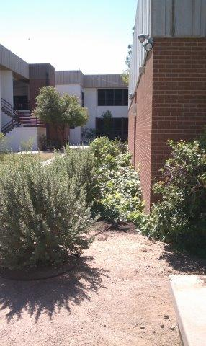
4.
Routine, Proactive Maintenance
Prune away from buildings
Tree limbs pruned at least six feet away
Remove vines climbing on buildings
Remove groundcover next to buildings
These shrubs need trimming
and pruning – Dawn H. Gouge, University of Arizona

Slide 22
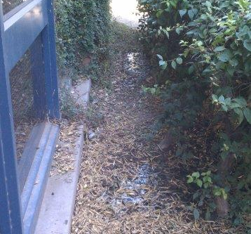
Routine, Proactive Maintenance
Avoid pest conducive conditions
Clean debris out of external drainage catch areas
Prevent debris and moisture from accumulating near building walls and foundations
Grate and drain covers should be removed and cleaned out periodically – Dawn H. Gouge, University of Arizona
Pests such as rodents and flies are attracted to moist organic matter – Marc Lame, Indiana University

Slide 23
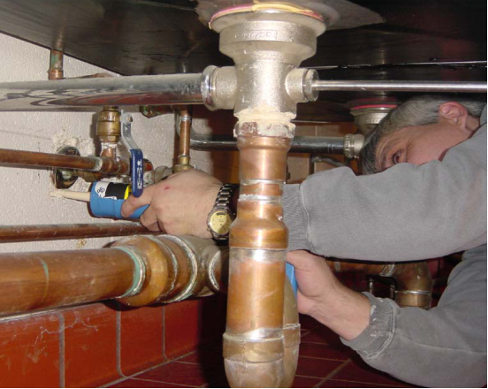
Routine, Proactive Maintenance
Avoid pest conducive conditions
Pests such as cockroaches spend daytime hours harboring in cracks and crevices
Reduce harborage sites, especially in areas with food
Sealing around escutcheon plates – Jerry Jochim, Monroe County Community School Corporation

Slide 24
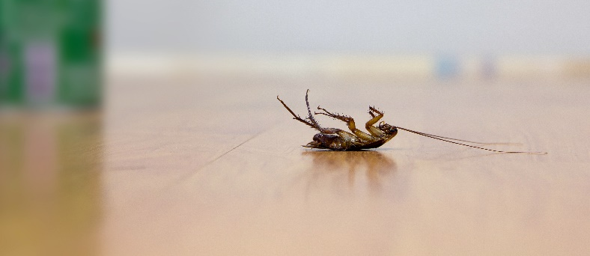
Routine, Proactive Maintenance
When Using Pesticides
A pesticide applicator license may be required for applicators on school property
Consider local, state, and federal laws
Be aware of allowable products and proper notifications

Slide 25
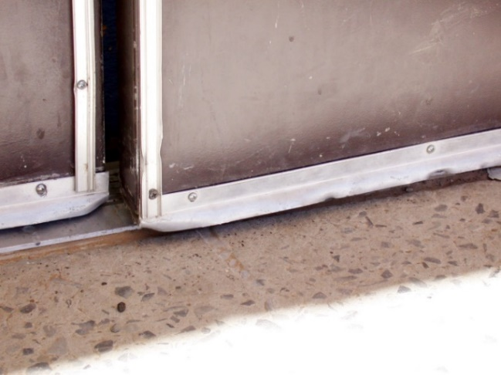
Timely Work Order Follow-Up
Enforce timely responses to pest problems related to building repairs
A small fix can avoid a big problem
Repeated reporting is a waste of staff time
Centralize reports and track
resolution times and costs
Use work-order systems
Ensure doors close completely to keep pests out – Dawn H. Gouge, University of Arizona

Slide 26
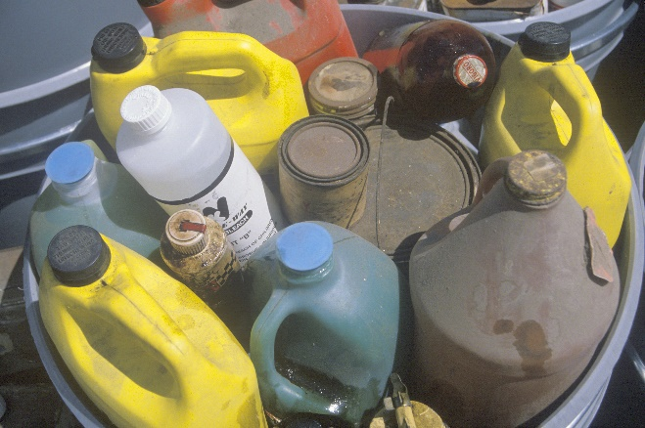
Key Elements of Sanitation and Exclusion
Sanitation and exclusion are basic steps in IPM
Sanitation involves cleaning, including the removal of hazardous wastes
Proper disposal of
garbage and other
wastes
Joseph Sohm, Shutterstock.com

Slide 27
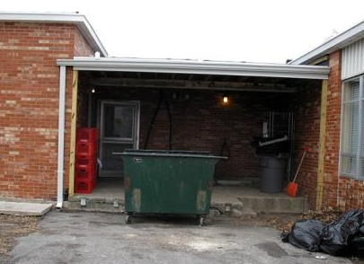
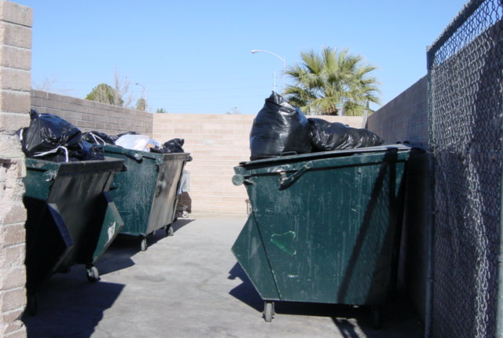
Key Elements of Sanitation and Exclusion
Waste management is an important part of sanitation
    Ensure dumpsters are:
      clean, covered, and well maintained
      placed on a concrete or asphalt surface
      placed 20-30 feet from building entryways
    Areas around the dumpster should be kept free of debris
Dawn H. Gouge, University of Arizona
This dumpster is too close
to the kitchen entryway
Good placement of dumpsters, in separate enclosed area, but lids should be closed

Slide 28
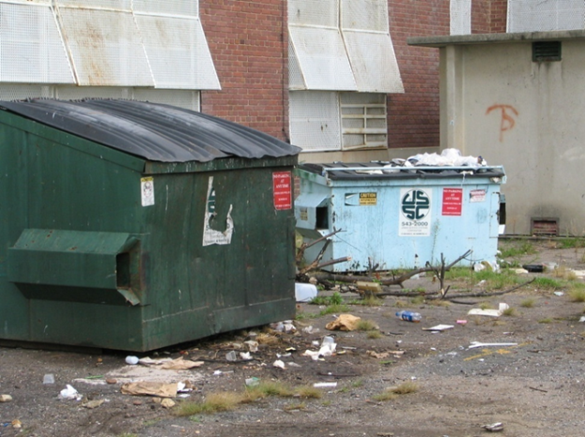
1.
Key Elements of Sanitation and Exclusion
Waste management
Your dumpster capacity should be sufficient
Emptied weekly
Monitor for resident
dumpster pests
Poorly managed dumpsters
and dumpster area – Marc Lame, Indiana University
Notes:
Objective 1

Slide 29
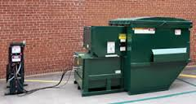
1.
Key Elements of Sanitation and Exclusion
Waste management
Rotate out dirty dumpsters for clean ones
Dumpsters should be emptied at least weekly
Consider sealed, leak-proof, self-contained compactors, available in many sizes – Shaku Nair, University of Arizona

Slide 30
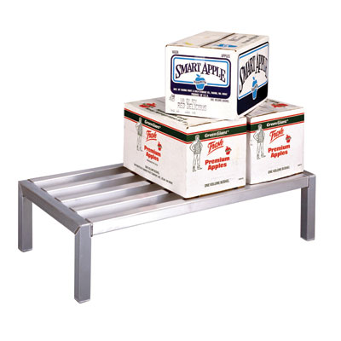
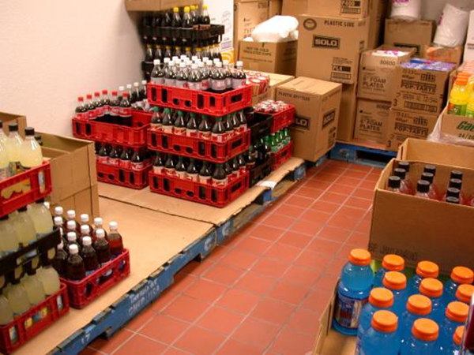
Key Elements of Sanitation and Exclusion
Proper storage of supplies and materials helps to:
prevent pest-conducive conditions
permit proper cleaning and inspection
Aluminum dunnage racks are ideal, as you can see and clean beneath them
Cardboard covered wooden pallets are pest prone
- Dawn H. Gouge, University of Arizona

Slide 31
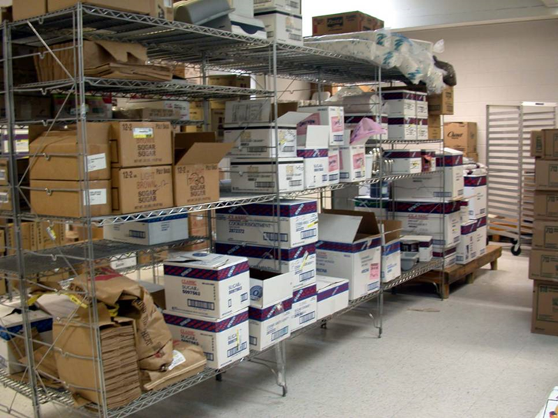
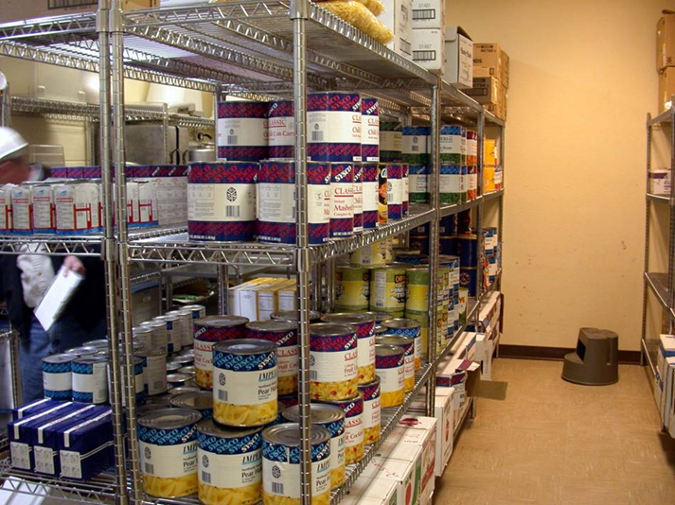
Pest Exclusion Strategies/Tactics
Cardboard boxes provide excellent pest harborage
Kitchen pantry, before and after
cardboard removal (inspect, date and organize supplies as they arrive) - Marc Lame, Indiana University

Slide 32
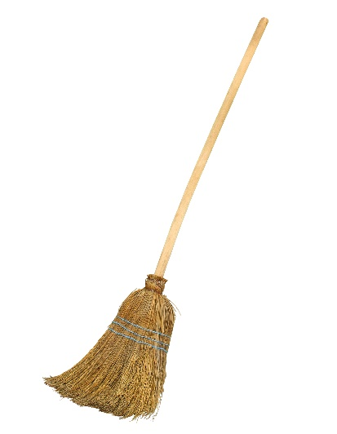
Equipment cleaning
Keep cleaning equipment in good and clean working condition
Hang brooms 6 inches off the vertical wall
Food can accumulate in:
  garbage receptacles
  brooms, dusters, and brushes
  mops and buckets
    vacuum cleaners,
    polishers, scrubbers
Natural fiber brooms are difficult to clean,
select cleaning tools that are easy to maintain

Slide 33
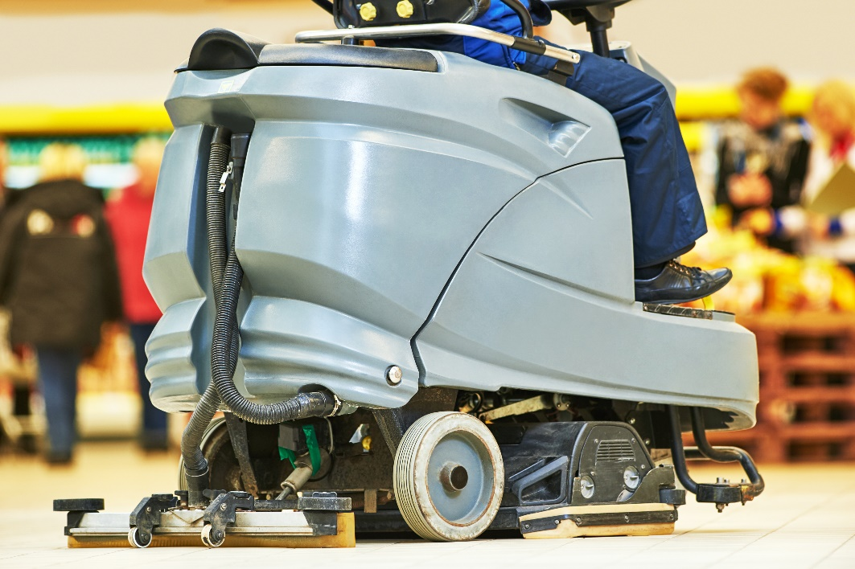
Cleaning Equipment Maintenance and Storage
Empty
Vacuum cleaners, floor scrubbers, and other equipment before storing
Wipe Down, Wash, and Rinse

Slide 34
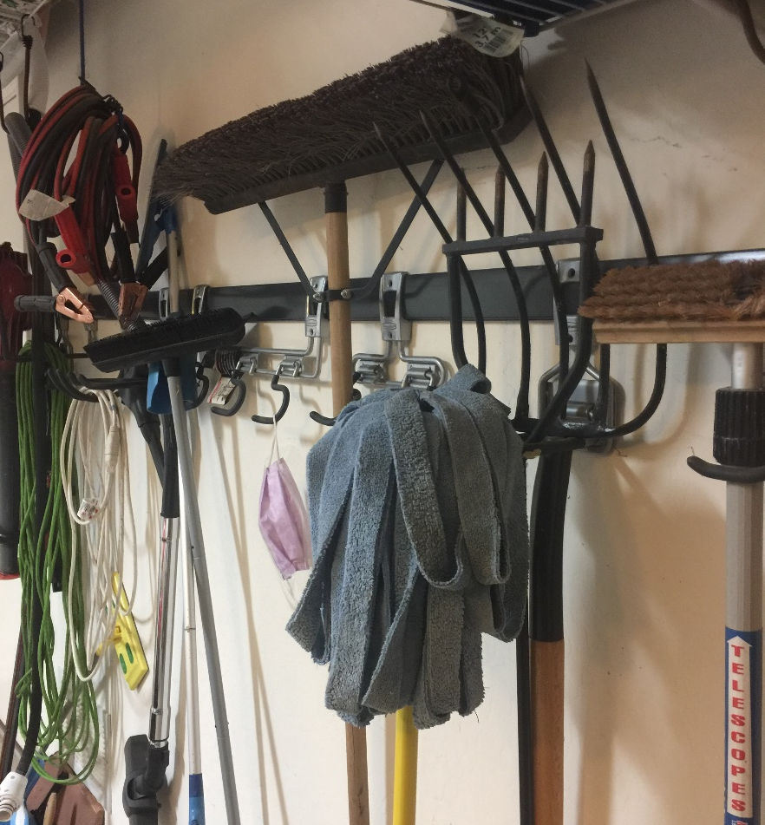
Cleaning Equipment Maintenance and Storage
Storage
Store items on off-the-floor racks, and away from the vertical wall
Store in transparent plastic
totes or on wire shelving
Store equipment off the floor and in a
manner that will allow it to dry rapidly – Dawn H. Gouge, University of Arizona

Slide 35

Thorough cleaning procedures
Keep yourself safe, clean, and hygienic!
Wash hands

Slide 36
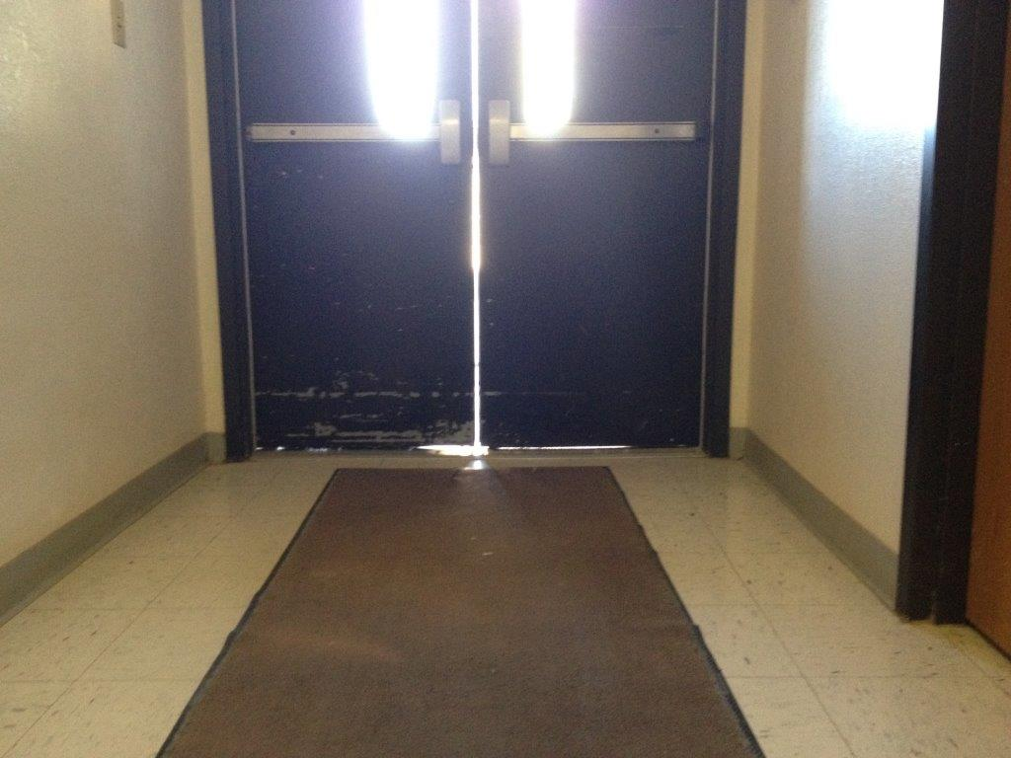
Pest exclusion - denying pests access to food, water and shelter
Key Elements of Sanitation and Exclusion
Find a pest - search for points of entry
Door-sweeps and weather
stripping
Hitchhikers in deliveries
This door needs new door-sweeps, vertical and horizontal – Dawn H. Gouge, University of Arizona

Slide 37
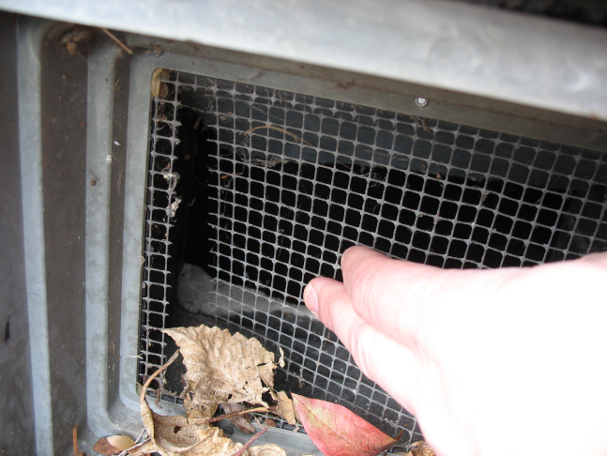
Pest Exclusion Strategies/Tactics
Replace worn door-sweeps
Seal gaps, cracks, and crevices
Cover windows and vents with wire mesh
Torn wire mesh on a vent – Jerry Jochim, Monroe County Community School Corporation

Slide 38
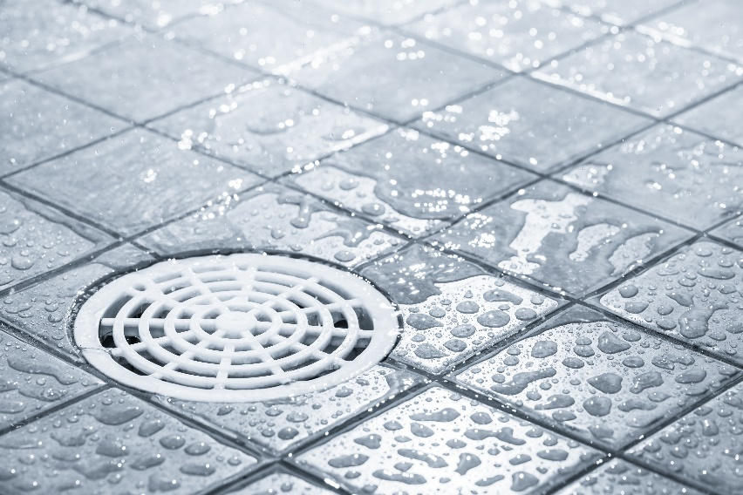
3.
Pest Exclusion Strategies/Tactics
P-traps in drains
Dry P-traps create access to buildings from the sewer
Inspect drains periodically to prevent P-traps from drying out

Slide 39
Pest Exclusion Strategies/Tactics
Avoid propping doors
Close gaps
Avoid clutter, both inside and outside, especially near external doorways
This door should be closed
Jerry Jochim, Monroe County Community School Corporation
This space needs de-cluttering!

Slide 40
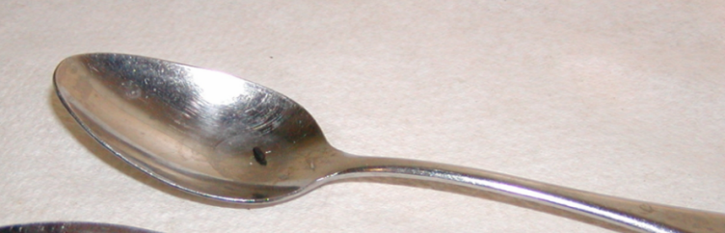
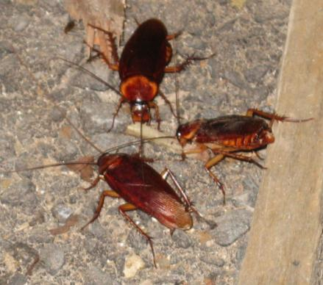
2.
Key Elements of Inspection and Monitoring
Regular inspection and monitoring
What to look for:
Pests
Signs of pests
Pest conducive
conditions
Mouse poop on a spoon
Dawn H. Gouge, University of Arizona
Cockroaches feeding on crumbs

Slide 41
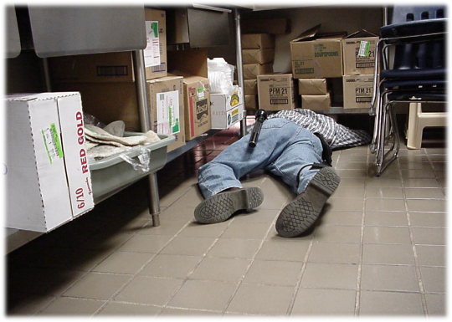
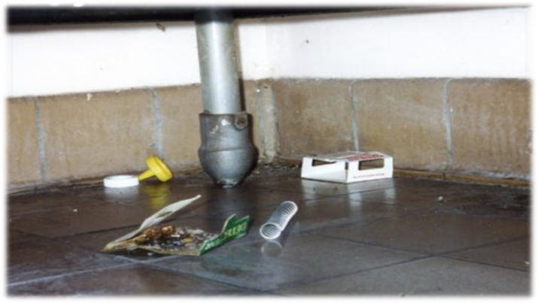
2.
Key Elements of Inspection and Monitoring
Where to look:
Dark corners
Hard-to-reach areas
Undisturbed
Warm and/or wet places
Food storage and/or
preparation areas
Waste collection containers/
areas
Suspended ceilings
Regular, careful inspection helps to keep pests and pest-conducive conditions under control rapidly and efficiently – Dawn H. Gouge, University of Arizona

Slide 42
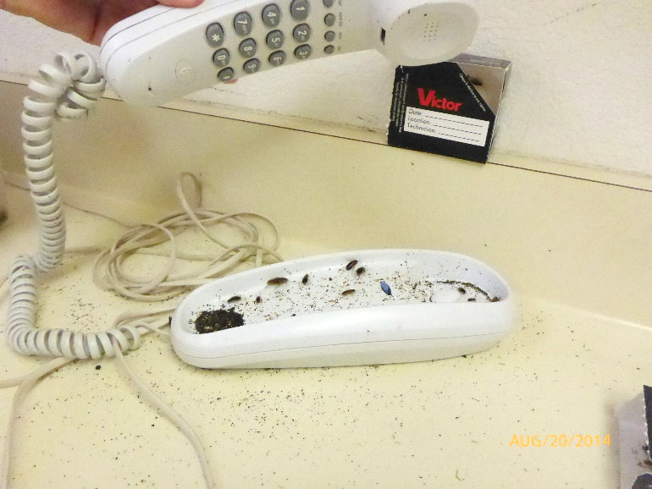
2.
Key Elements of Inspection and Monitoring
Where to look:
Warm walls with penetrations
Compressor motor voids in equipment
Unsealed floors and
floor to wall junctures
Undisturbed containers
Cardboard boxes
Clutter
German cockroaches in telephone in heavily infested teachers lounge – Dawn H. Gouge, University of Arizona

Slide 43

3.
Key Elements of Inspection and Monitoring
Communicate in writing to IPM Coordinators and others about pest issues
Record date, time, location and:
If actual pests have been spotted
Signs (evidence) of pests
Pest-conducive
conditions

Slide 44
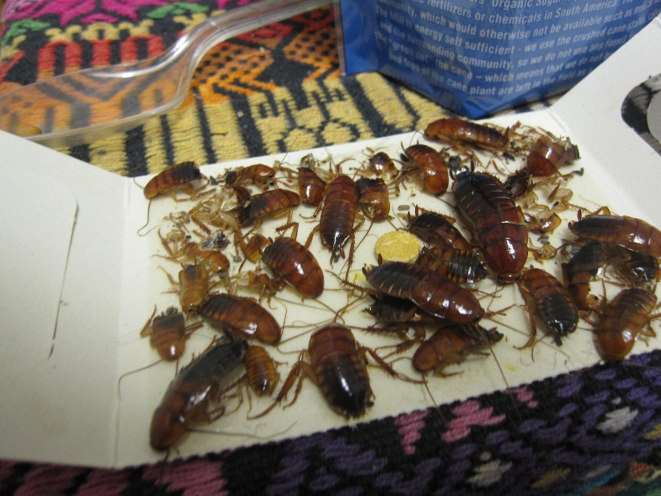

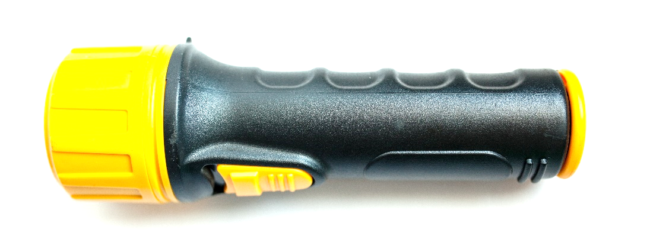
2.
Key Elements of Inspection and Monitoring
Tools:
Monitoring traps
Bright flashlight
Hand lens
Turkestan cockroaches on monitoring trap in teachers lounge – Dawn H. Gouge, University of Arizona

Slide 45
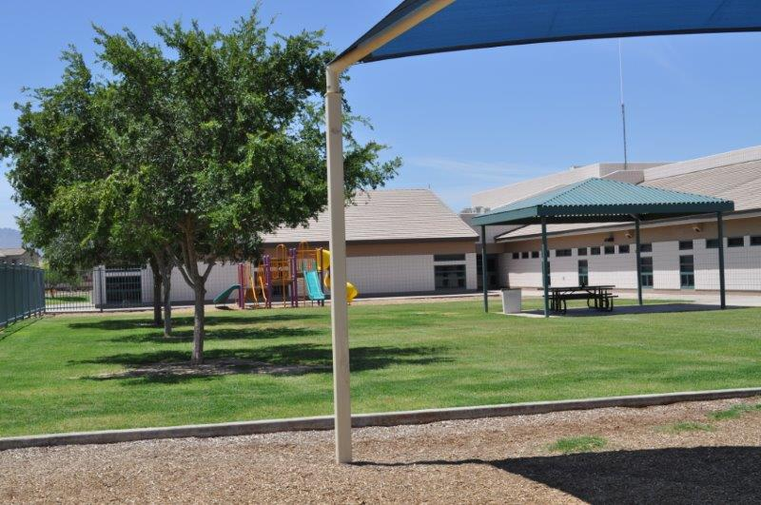
Maintenance Staff and IPM
Clean and well-maintained school premises are essential for the health and well-being of all people who learn, play or work in the area – Dawn H. Gouge, University of Arizona

Slide 46
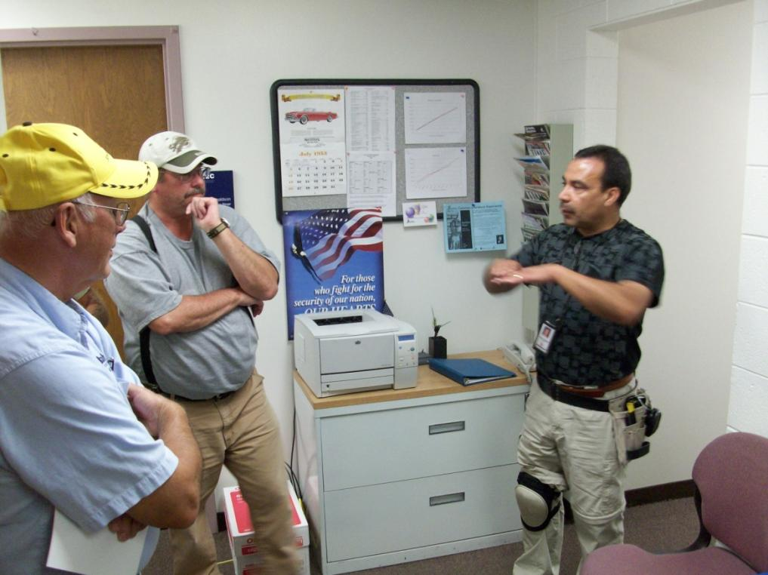
Effective Communication
Maintenance staff know more about the school premises than most other staff
Get to know lead front-line staff, contractors, etc.
Communicate and
educate your peers
Ricardo Zubiate teaching Salt Lake City School District Staff - Marc Lame, Indiana University

Slide 47

Effective Communication
Learn more about IPM
Ask questions
Discuss IPM and its advantages with your colleagues
Implementing IPM is easier with group support
Set an example
Dr. Robert Corrigan, RMC Pest Management Consulting teaching - Mary Grisier, EPA Region 9

Slide 48

Maintenance Staff and IPM
“I am proud of
what I do to make my
school a better place
to learn and work”
Dan Vezie, Maricopa Unified School District, AZ
Dan Vezie, Maricopa Unified School District receiving a recognition award – Shujuan Li, University of Arizona

Slide 49

Check In!
In this lesson you learned:
The importance of routine, proactive maintenance to maintain structural integrity and prevent pest entry and pest conducive conditions
The importance of timely work order follow-up
Key elements of sanitation and exclusion, including: strategies, tactics and tools
Key elements of inspection and monitoring, including: what to look for, where to look, tools used and frequency
The importance of effective communication, education, and cooperation between school staff
  Congratulations, you have completed the School IPM for Maintenance Staff Module!

Slide 50
Resources
Picture tour: IPM in Action – Safer Pest Control Project http://www.spcpweb.org/factsheets/IPM_Picture_Tour_w_cover.pdf
Get tough on pests in school facilities – NC State Cooperative Extension http://schoolipm.ncsu.edu/documents/Custodial_and_Maintenance_staff.pdf
School IPM for maintenance and grounds staff – IPM Institute http://schoolipm.ncsu.edu/documents/Custodial_and_Maintenance_staff.pdf
CA Dept. of Pesticide Regulation – IPM for Maintenance and Operations staff http://apps.cdpr.ca.gov/schoolipm/mo_staff/main.cfm
Implementing and IPM Program for Schools and Child care facilities – NC State University http://schoolipm.ncsu.edu/documents/Manual-Chapter2.pdf
Indoor and outdoor school IPM strategies http://www.extension.org/pages/20416/indoor-and-outdoor-school-ipm-strategies#.VNLCCy5kSpc

