Slide 1
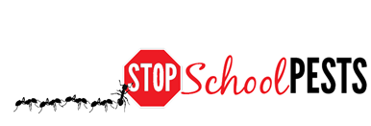
School IPM FOR Nurses
Nurse Gloria
Dielshneider
Self-Guided Education Module
Lesson 2 of 2

Slide 2
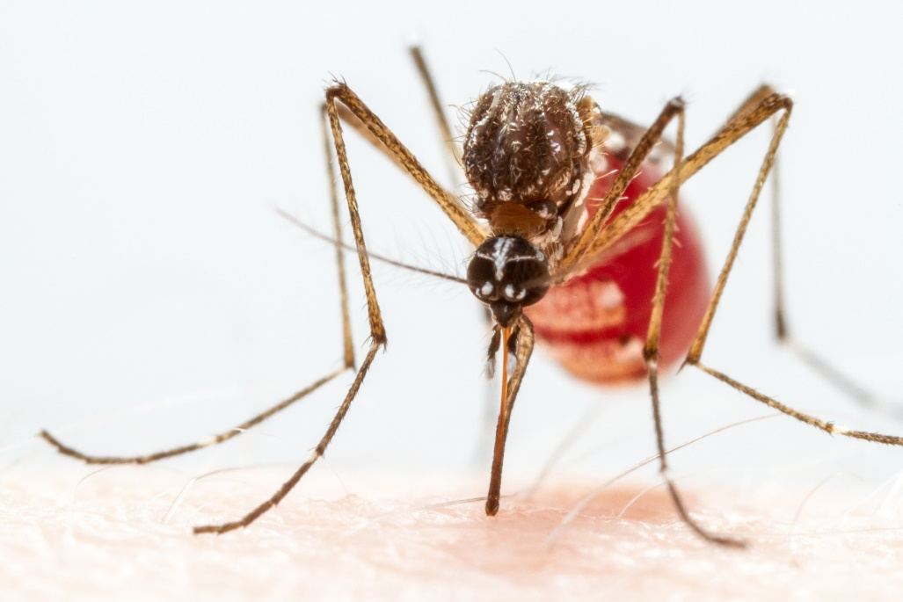
Learning Objectives – Learning Lesson 1
Identify health risks associated with common pests:
    Bed bugs
    Head lice
    Scabies mites
    Fleas
    Honey bees
    Stinging wasps
    Fire ants
    Spider and scorpions
    Mosquitoes
    Bats and rabies
    Ticks
    Stinging caterpillars
    Ringworm
    Venomous snakes
    Commensal rodents
Yellow fever
mosquito

Slide 3
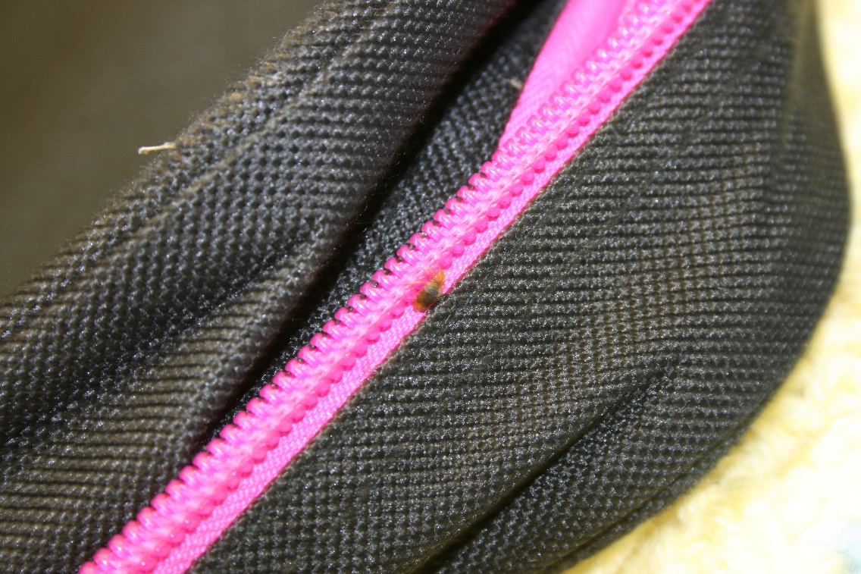
Learning Objectives – Learning Lesson 2
Understand appropriate personal hygiene and facility sanitation measures to help prevent or reduce the spread of: bed bugs, head lice, scabies mites, and ringworm
Recognize common pesticide poisoning symptoms
Bed bug on backpack –
Dawn H. Gouge, University of Arizona

Slide 4
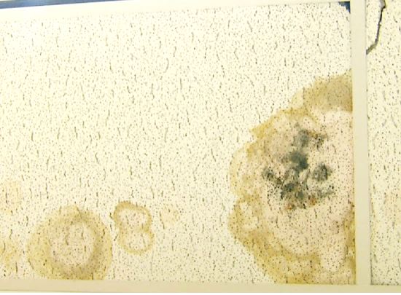
Learning Objectives - Learning Lesson 2
Identify allergy and asthma triggers in classrooms, including:
    Mice
    Class pets
    Mold
    Cockroaches
    Give examples of
    chemical sensitivity
    issues for children
    and young adults
Mold on ceiling tile - Dawn H. Gouge, University of Arizona

Slide 5
Learning Objectives - Learning Lesson 2
Give examples of emergency hotlines and resources, i.e. American Association of Poison Control Center and National Pesticide Information Center
Describe best practices or procedures for notifying parents and/or providing them with guidance to minimize the spread of bed bugs
Describe appropriate measures to help prevent and/or reduce encounters with mosquitoes, ticks, and stinging insects (fire ants, wasps, honey bees) on school grounds
Describe sanitation measures for norovirus and flu

Slide 6
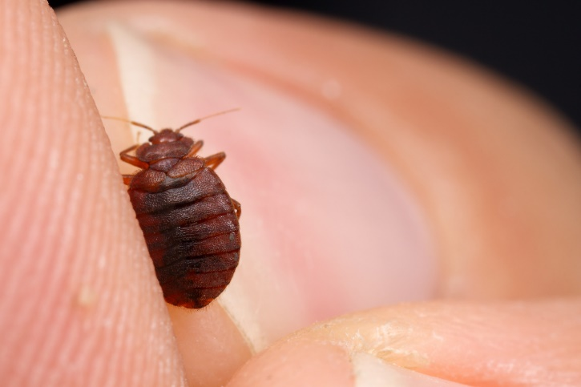
1. 1. 1.
Hygiene and Sanitation
Bed bugs, head lice, scabies
mites, and ringworm are
communicable
Bed bugs
  Students with bed bugs should not be excluded from school, bed bugs take months to remediate and some families do not have the resources to ever eradicate them
  Students may bring or be provided with clean clothing and a back-pack for use in school, thus avoiding roving bed bug issues in class
  Items from home should be double-bagged in large capacity zip-lock bags or similar air-tight containers
Bed bug – Alex Wild,
alexanderwild.com

Slide 7
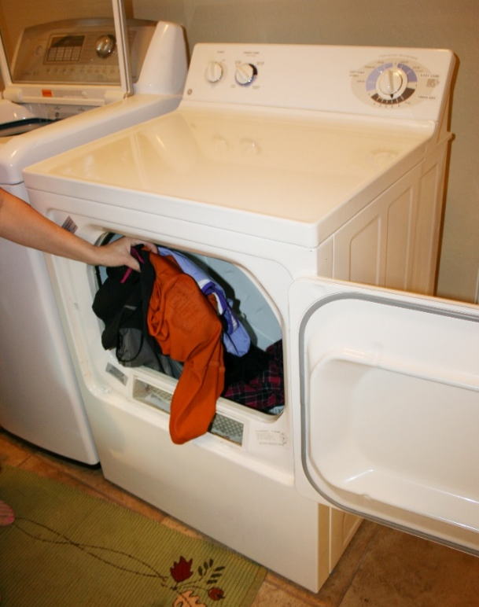
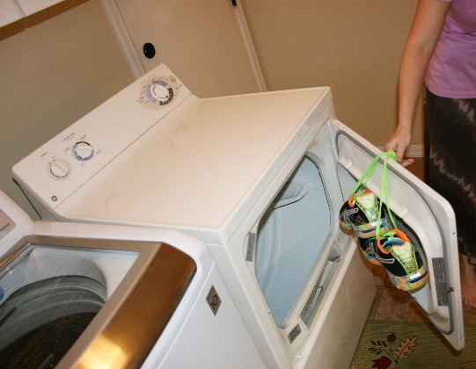
Hygiene and Sanitation
  Discourage bedding and articles
  from home being brought in
  Students changing at school should
  do so in an area that can be
  cleaned daily
  Washing does not kill bed bugs,
  drying in a clothes dryer does
  Items that can not be washed may be
  placed in a freezer for 4 days
  Normal hard surface cleaning and
  vacuuming should be undertaken
Bed bugs, head lice
and scabies mites are
all killed in a clothes dryer
– Robert LaMorte,
University of Arizona

Slide 8

1. 1. 1.
Hygiene and Sanitation
Head lice
  Students with head lice should
  not be excluded from school,
  head lice will not readily transfer
  between students unless they
  have direct head-to-head contact
  No-nit policies are pointless and
  cost schools funding they cannot do
  without
  Head-checks are valuable opportunities for the nurse to
  interact with students
Nurse checking for head lice

Slide 9
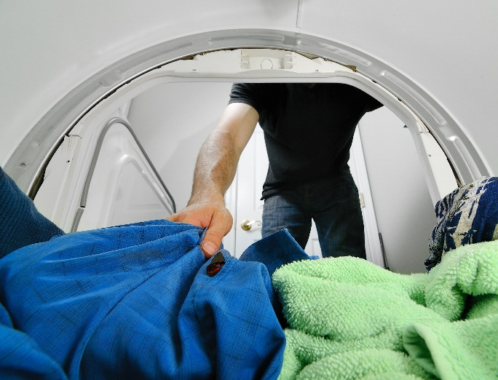
1. 1. 1.
Hygiene and Sanitation
  Discourage bedding and articles from home being brought into school
  Students with head lice using knap-mats or cots should not share the items with others
  Chronic infestations can be a sign of
  neglect
  Clothes dryers will kill all stages of lice
  Lice can not survive for long off the
  host, all will die in less than 2 days
  Normal hard surface cleaning
  and vacuuming should be undertaken
Clothes dryers kill lice

Slide 10
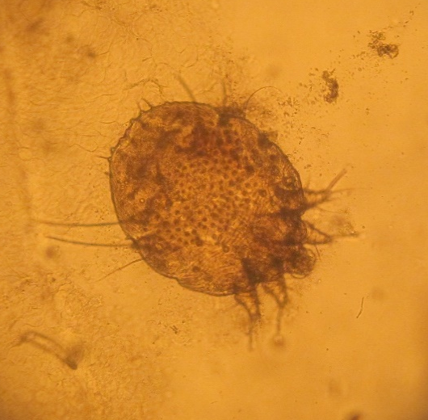
Hygiene and Sanitation
Scabies mite
Scabies mites
  Students with suspected scabies should be referred to a doctor, only a skin scrape can confirm scabies
  Scabies is contracted as a result of direct skin-to-skin contact, prolonged physical contact increases the chances of mite transfer
  After the initial treatment, students can return to school
  Scabies mites die rapidly off the host, and all life stages will be dead within 72 hours at normal room temperatures
  If a room is left unoccupied, but unheated in the winter, mites can remain viable for longer

Slide 11
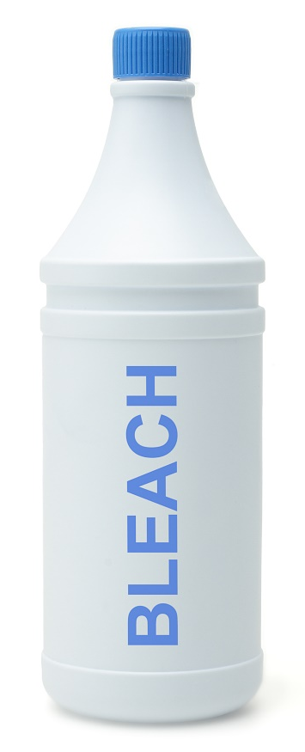
1. 1. 1.
Hygiene and Sanitation
  Clothes drying will kill mites on clothing or bedding
  Immunocompromised individuals should not be around anyone with scabies
  A person with crusted (Norwegian) scabies
  should not be in school as they can spread
  the infestation by brief skin-to-skin contact
  or by exposure to bedding, clothing, or
  even furniture that he/she has used
  Normal hard surface cleaning and
  vacuuming should be undertaken

Slide 12
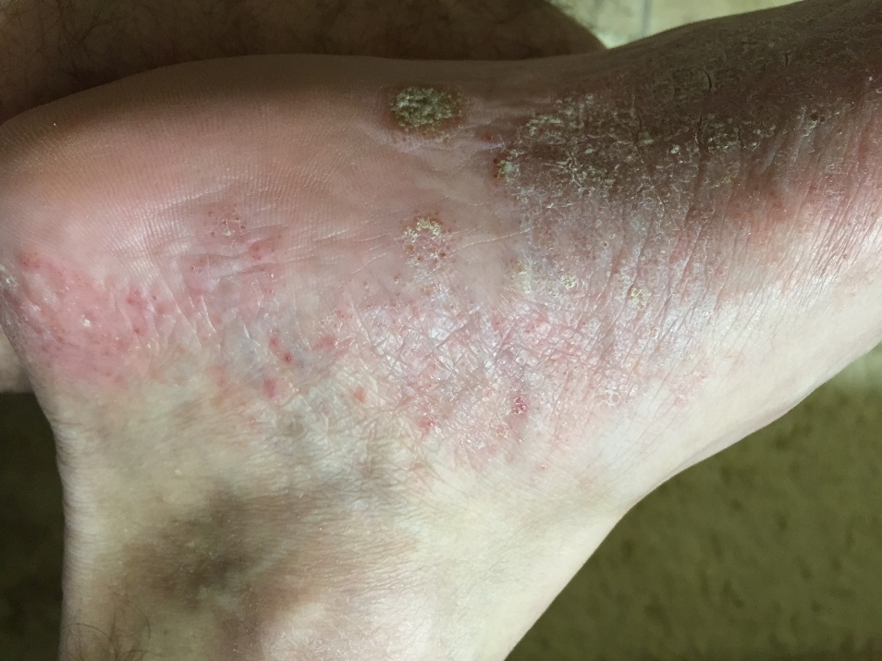
1. 1. 1.
Hygiene and Sanitation
Ringworm
  Students with suspected ringworm should be referred to a doctor, only lesion scraping or nail clipping analysis can confirm ringworm
  Fungal ringworm can
  persist on skin, hard
  surfaces, and on items
  such as clothing,
  towels, furniture and
  bedding
  Fungal spores can survive
  over a year
Ringworm infection –
Dawn H. Gouge, University of Arizona

Slide 13

Hygiene and Sanitation
  Ringworm is contracted both by direct contact with an infected person, and an indirect contact via fomites
  Students should not participate in contact sports until treatment has been successful
  The spores of this fungus can remain viable on hard surfaces, particularly moist ones like shower stalls, locker rooms, pool areas etc.
  Wearing of sandals or slides in
  showers and locker rooms should
  be encouraged
  Discourage sharing of towels and
  clothing

Slide 14
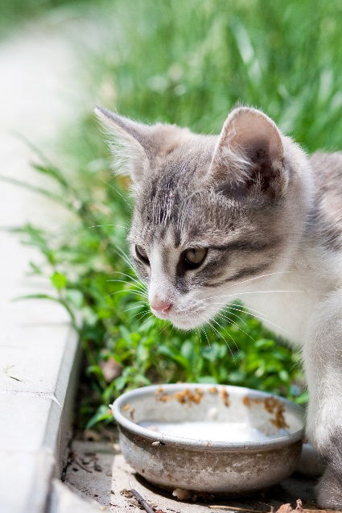
1. 1. 1.
Hygiene and Sanitation
  Most commonly people can treat
  infections with topical over-the-counter medications, but people who have
  extensive or recurrent infections may require systemic antifungal therapy
  Affected animals should be removed from school
  Feeding and housing of unmaintained feral cats or dogs should not be tolerated on campus, campus animals must be spayed/neutered, vaccinated and maintained in good health

Slide 15
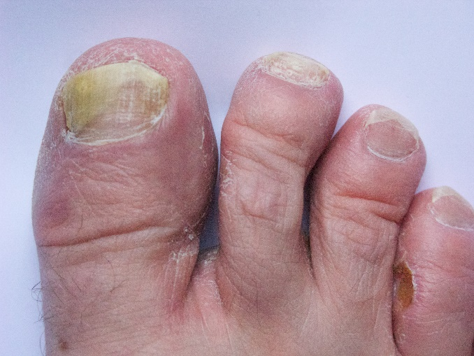
1. 1. 1.
Hygiene and Sanitation
  Immunocompromised individuals should not be around anyone or any animal with ringworm
  The spores of this fungus can be killed with common disinfectants like diluted chlorine bleach (1/4 c per gallon water), benzalkonium chloride, and others
  All hard surfaces should be cleaned accordingly and carpeted areas vacuumed
  Ringworm spores are very
  light so vacuuming is
  very effective at removing
  spores
Infected toe nails

Slide 16

1. 1. 1.
Pesticide Poisoning Symptoms
If a person is exposed to a pesticide:
  Call 911
  Safely remove the person from the source of exposure as quickly as possible
  Remove contaminated personal protective equipment (PPE) and affected clothing
  Rinse or shower thoroughly (but gently) to remove any contaminant from the skin, hair, and eyes
  Ask for information about what the person was using or working around and how they were exposed (inhalation, ingestion, skin exposure, eye exposure, etc.)

Slide 17
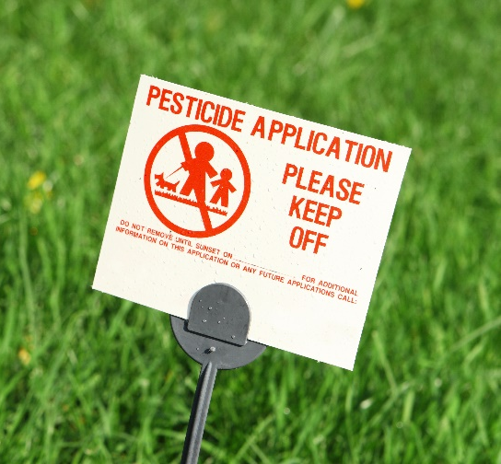
1. 1. 1.
Pesticide Poisoning Symptoms
It is important to know how to determine
if a person has had a pesticide exposure,
and recognize the general poisoning signs
A pesticide exposure is when a pesticide gets on or in a person
  Oral (ingestion of a pesticide e.g., through drinking, eating, or smoking contaminated items)
  Inhalation (breathing in a pesticide e.g., because of pesticide drift, faulty respirator, or failure to use PPE)
  Ocular (getting pesticide in your eyes e.g., due to splashes, or equipment failure)
  Dermal (getting pesticide on your skin e.g., due to splashes or failure to use PPE)

Slide 18
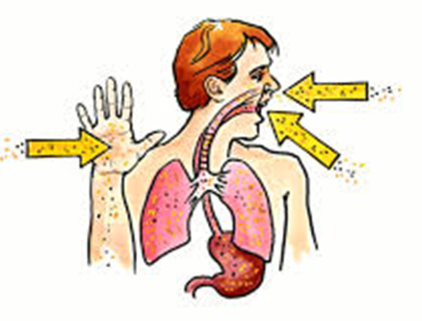
Pesticide Poisoning Symptoms
97% of all body exposure is via dermal exposure, simply wearing gloves can reduce exposure greatly
If the skin or eyes are exposed to a pesticide, flood the skin or eyes with clean, lukewarm water for at least 15 minutes
Remove all contaminated clothing, shower or immerse body if enough clean water is available, showering is better
Gently wash skin and hair with a
mild detergent
Dry and loosely dress only if clean
uncontaminated clothing is available
If skin is burned, cover in a loose,
clean, dry cloth or bandage
Pesticide routs of exposure – NPIC,
http://npic.orst.edu/capro/exposure.html

Slide 19
Pesticide Poisoning Symptoms
If the pesticide has been in the mouth or swallowed, rinse the mouth with plenty of water, drink large amounts of water or milk up to 1 quart
Induce vomiting only if the pesticide label instructions indicate the need
If the pesticide has been inhaled, get to fresh air
Gather labeling, Safety Data Sheet (SDS) and additional information about the pesticide or pesticides involved (applicators are required to carry labels and SDSs)
Warn people about the risk and/or contaminated areas

Slide 20

Pesticide Poisoning Symptoms
An individuals susceptibility is unique and affected by
  Health condition (individuals may have compromised health, pregnancy, injury, etc.)
  Age (children and elderly are more vulnerable to toxic injury)
  Body weight (smaller people
  are more vulnerable)
  Lifestyle choices (individuals
  may smoke, use illicit drugs, etc.)

Slide 21
Pesticide Poisoning Symptoms
Acute poisoning occurs after exposure to a single dose of pesticide, typically with in 24 hours
  Effects may be sudden and dramatic
  Effects may be delayed and less obvious
Chronic poisoning occurs as a result of repeated, doses of a pesticide over a long period of time
  Nervousness/anxiety, slowed reflexes, irritability, or a decline in health and reproductive ability

Slide 22
Pesticide Poisoning Symptoms
Pesticide poisoning symptoms can be similar to those of other illnesses and poisonings
The pesticide applicator should provide medical staff with pesticide labeling and SDS documents
Each chemical family (i.e., organophosphates, carbamates, synthetic pyrethroids, etc.) can attack the human body in a different way
The most commonly used pesticides on school campuses are synthetic pyrethroids
A full occupational and exposure history will aid in diagnosing pesticide poisonings

Slide 23

Pesticide Poisoning Symptoms
Mild Poisoning or Early Symptoms of Acute Poisoning headache, fatigue, weakness, dizziness, restlessness, nervousness, perspiration, nausea, diarrhea, loss of appetite, loss of weight, thirst, moodiness, soreness in joints, skin
irritation, eye irritation,
irritation of the nose
and throat

Slide 24

Pesticide Poisoning Symptoms
Moderate Poisoning or Early Symptoms of Acute Poisoning nausea, diarrhea, excessive saliva, stomach cramps, excessive perspiration, trembling, no muscle coordination,
muscle twitches, extreme weakness,
mental confusion, blurred vision,
difficulty breathing, cough,
rapid pulse, flushed or yellow skin,
weeping

Slide 25

Pesticide Poisoning Symptoms
Severe or Acute Poisoning fever, intense thirst, increased rate of breathing, vomiting, uncontrollable muscle twitches, pinpoint pupils, convulsions, inability to breathe, unconsciousness
Death can result
Pinpoint eye pupil

Slide 26
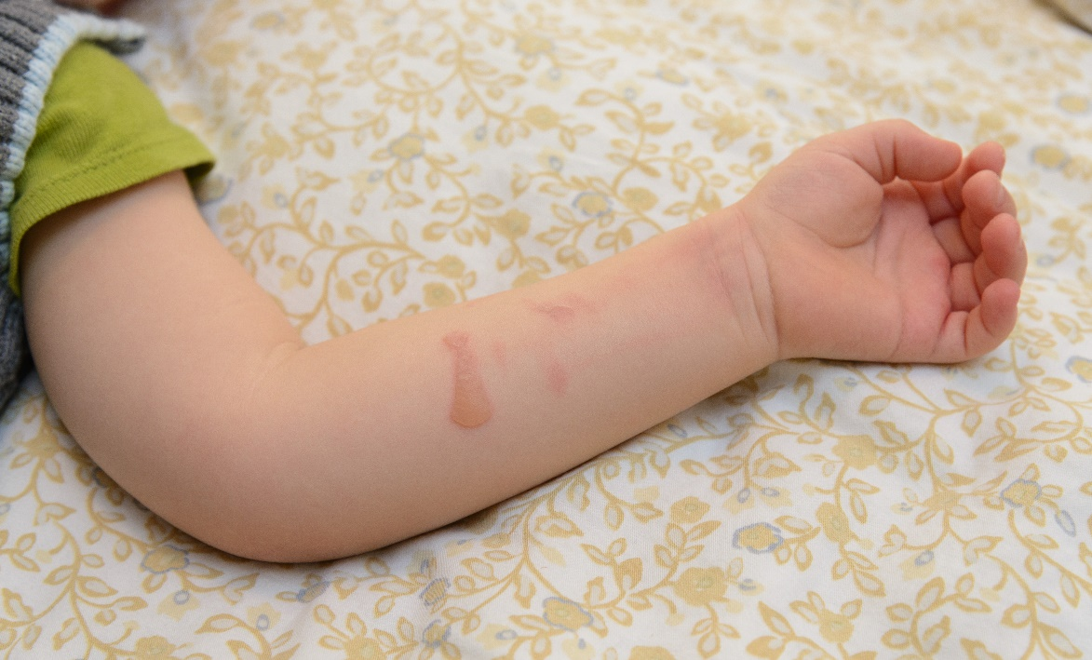
Pesticide Poisoning Symptoms
External irritants may cause redness, blisters, rash, and/or burns on skin, and swelling, a stinging sensation, and/or burns in eyes, nose, mouth and throat
Chemical burns on
a child’s arm

Slide 27

Pesticide Poisoning Symptoms
Anaphylactic shock Call 911
A serious, potentially life-threatening allergic response
Often begins with severe itching of the eyes or face, within minutes, progress to more serious symptoms
Symptoms include swelling, hives, breathing difficulties, abdominal pain, cramps, vomiting, diarrhea, lowered blood pressure, shock, and ultimately unconsciousness and death
Seek emergency medical attention immediately

Slide 28
Pesticide Poisoning Symptoms
Pyrethrin and pyrethroid pesticides are very common; exposure to liquid forms of these pesticides can cause the following symptoms:
  Skin and/or eye irritation
  Sensitivity to sound and touch
  Abnormal facial sensations and general skin sensation of prickling, tingling or creeping on skin and numbness
  Headache
  Dizziness
  Nausea and vomiting
  Diarrhea
  Hypersalivation
  Fatigue
  Fatigue
  Pulmonary edema
  Muscle twitching
  Seizures (more toxic cyano pyrethroids e.g., Deltamethrin)
  This is not a fully comprehensive list

Slide 29
Pesticide Poisoning Symptoms –Parts of the Body Absorb Chemicals Differently
Scalp 32%
Forehead 36%
Armpit 64%
Ear Canal 40%
Forearm 9%
Abdomen 18%
Palm 12%
Back of Hand 21%
Genital Area 100%
Percent parathion dose
absorbed through skin
after 24 hours
Maibach 1974
Ball of Foot 13%

Slide 30
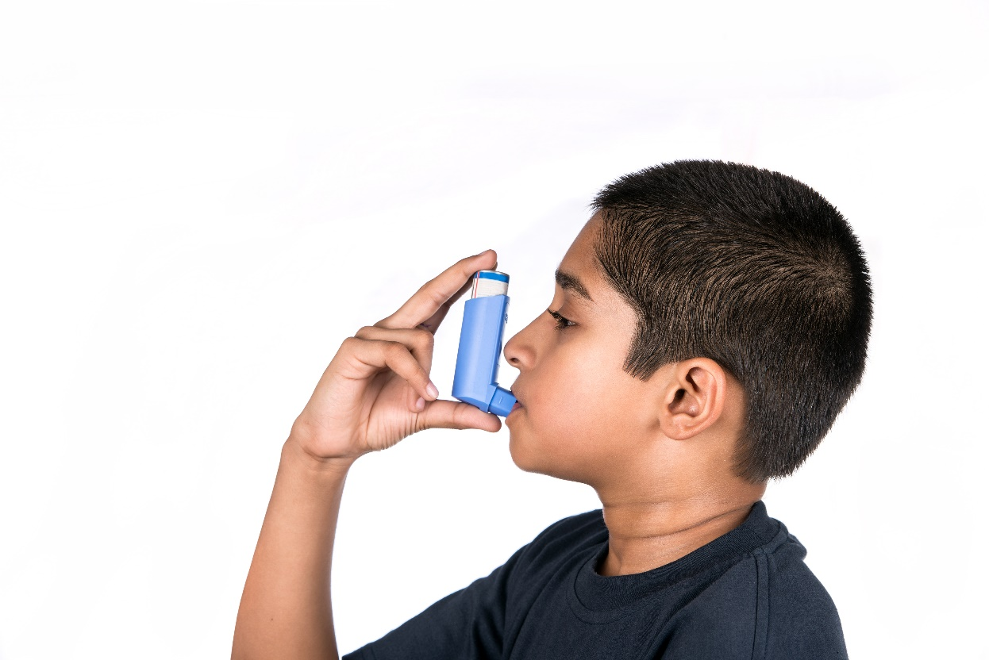
Allergy and Asthma Triggers
6 out of 10 people asthmatics have allergic asthma triggered by exposure to allergens in the air
Asthma is the leading cause of school absences
Students sensitive to the allergens are significantly impacted, and for the
25 million Americans
diagnosed with asthma,
the impacts go well beyond
test scores
It is important to identify
allergen sources in classrooms,
and eliminate them as much
as possible
Asthmatic child using
rescue inhaler

Slide 31

1. 1. 1.
Allergy and Asthma Triggers
The most significant pest related allergens include: animal dander, dust mites, mice, mold, and cockroaches
Animal dander (birds, cats, dogs, other small mammals)
  20-30% of asthmatics have pet dander allergies
  Feral animals should not be allowed into classrooms, even if students are not present
  Vaccinated pets may be brought
  in for a variety of reasons, but
  not if students with allergies will
  be present before the room can
  be cleaned (using HEPA vacuum filters)

Slide 32
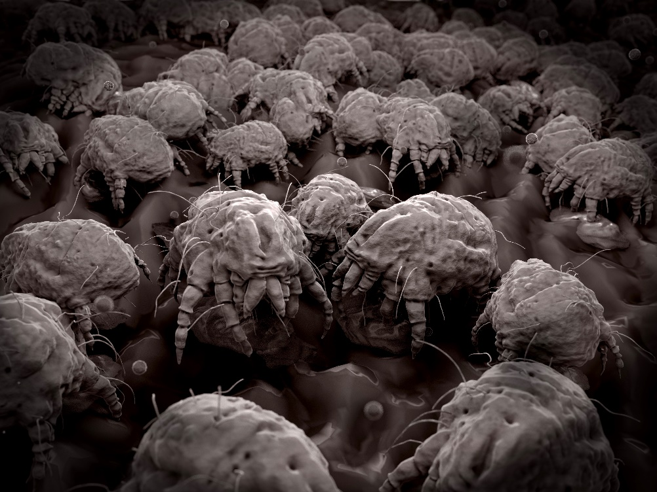
1. 1. 1.
Allergy and Asthma Triggers
Dust mites
  Over 85% of asthmatics are sensitive to dust mite allergens
  Eliminate or reduce carpeting
  Reduce clutter so surface
  cleaning can be
  maximized
  Humidifiers/vaporizers
  should not be used,
  humidity should remain
  lower than 50%
Dust mites

Slide 33

1. 1. 1.
Allergy and Asthma Triggers
Mice
  Mouse urine is often the biggest source of allergens
  35% of asthmatics are sensitive to mouse allergens
  School nurses can advocate for:
    Buildings to be pest-proofed against rodents
    Prompt reporting of moisture problems such as leaks
    Continuous, all-year-round rodent monitoring
    Prompt reporting of rodent signs
    and action taken
    Trapped rodents should be
    removed promptly
    Deep-cleaning of rodent
    activity zones
House mouse

Slide 34
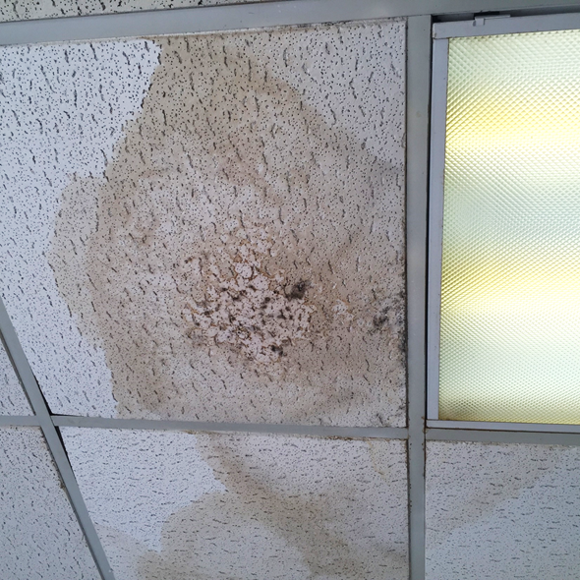
1. 1. 1.
Allergy and Asthma Triggers
There are many types of molds, but only a few dozen cause allergic reactions
School nurses can
advocate for:
  Indoor humidity levels
  below 45 percent
  Prompt reporting of
  visible mold issues in
  the school building
Mold on ceiling tile –
Dawn H. Gouge, University of Arizona

Slide 35
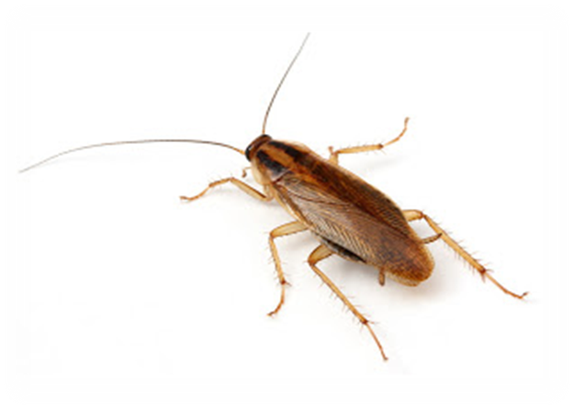
1. 1. 1.
Allergy and Asthma Triggers
The German cockroach is the most prevalent indoor cockroach
23-60% of asthmatics are sensitive to German cockroach allergens
Just 8 units of allergen is sufficient to trigger an asthma attack and 1 female
cockroach can produce
more than 1500 units
per day
German cockroach

Slide 36
1. 1. 1.
Allergy and Asthma Triggers
School nurses can advocate for good management practices than minimize opportunities for indoor cockroaches:
  Keep food and garbage in containers with tight lids
  Never leave food, including pet food, garbage or dirty dishes out overnight
  Clean up all food crumbs and spilled drinks right away
  Store food in tight containers or storage jars
  Keep counters, sinks, stove, tables, microwaves, and floors clean

Slide 37
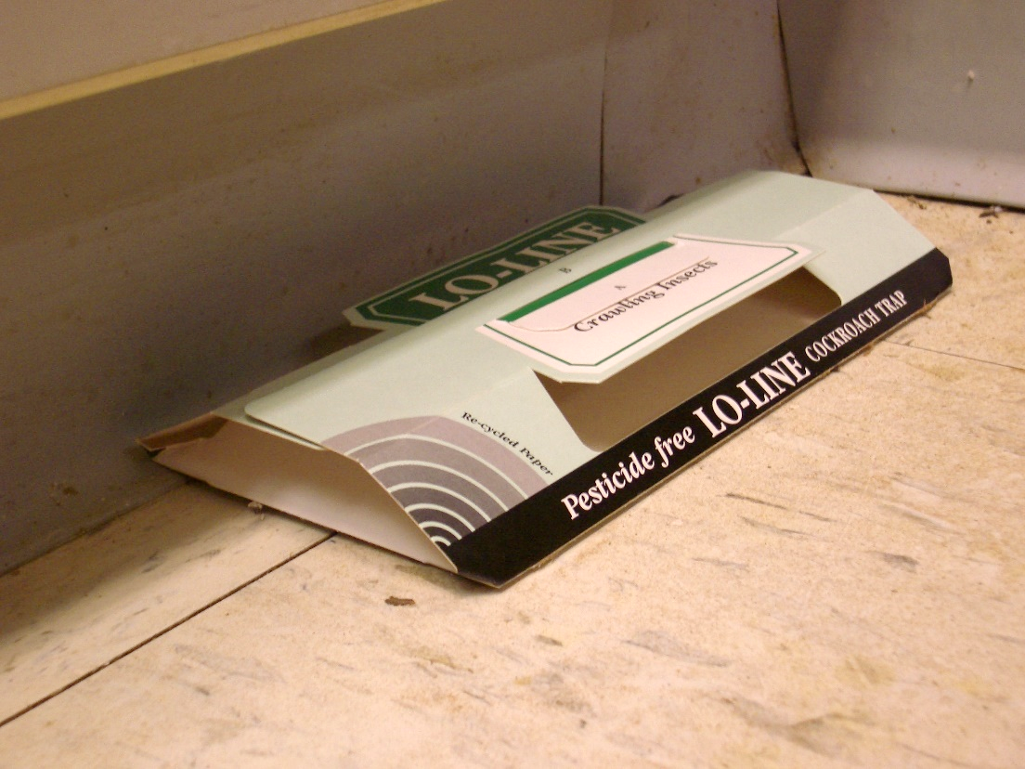
1. 1. 1.
Allergy and Asthma Triggers
  Vacuum or mop floors after food
  Fix leaky faucets, drain pipes, and other moisture problems
  Get rid of clutter
  Get rid of cardboard
  boxes immediately
  Plug up cracks between
  the wall and floor,
  where cockroaches
  can harbor
  Promote insect
  monitoring
Insect monitoring trap –
Dawn H. Gouge, University of Arizona

Slide 38

1. 1. 1.
Allergy and Asthma Triggers
Class pets can trigger symptoms for students sensitive to their specific allergens
Allergy sensitivities to birds and small mammals is common
Allergy sensitivities to pet bedding, media, and food items can also pose risks
e.g., animals fed on Timothy Hay can
trigger very commonly occurring
grass allergies
Class bunny eating Timothy grass

Slide 39

1. 1. 1.
Allergy and Asthma Triggers
Districts should have a class pet policy or rules, and it is recommended to include the provision that pets are to be cleaned out by the responsible teacher, and the school nurse consulted prior to housing an animal in a classroom
Class chick embryology study

Slide 40
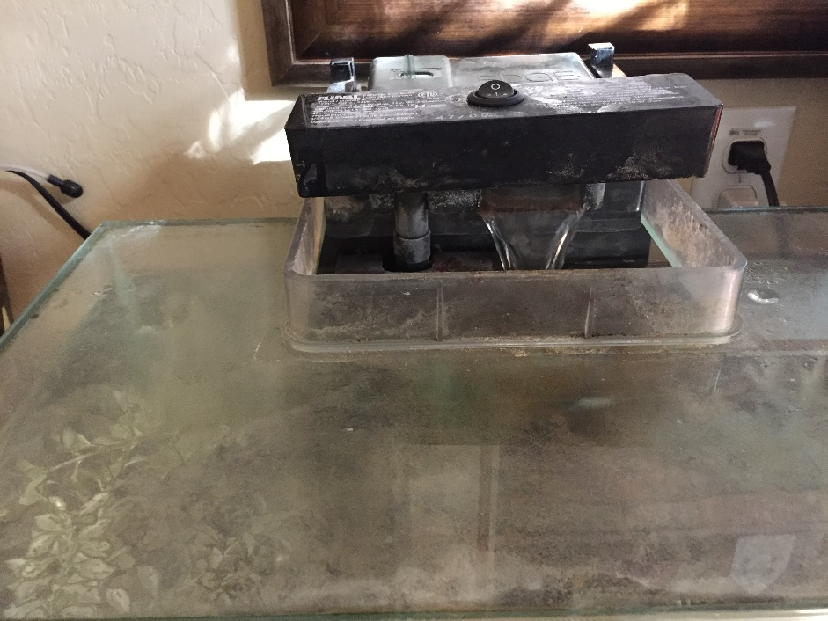
1. 1. 1.
Allergy and Asthma Triggers
Fish tanks and aquatic habitats can support mold growth
Pet foods stored incorrectly (out of air-tight containers) can serve
as pest food as
opposed to pet food
White fungal growth on a fish tank
– Dawn H. Gouge, University of Arizona

Slide 41

1. 1. 1.
Chemical Sensitivity
Chemicals Sensitivity is defined as an adverse reaction(s) to ambient doses of toxic chemicals contained in air, food, and water
The sensitive person presents with multi-system complaints depending on the tissues or organs involved, the pharmacological nature of the exposure, the susceptibility of the exposed person, and the presence of other body stressors

Slide 42

1. 1. 1.
Chemical Sensitivity
Multiple chemical sensitivity (MCS) is a medical condition and recognized as a disabling condition by the Social Security Administration and the Department of Housing and Urban Development
MCS is covered under the
Americans with Disabilities Act
which means schools must
provide reasonable
accommodations to people
with MCS

Slide 43
Chemical Sensitivity
This is not a comprehensive list
Most sufferers complain of at least several of the following:
  Burning, stinging eyes
  Wheezing, breathlessness nausea
  Poor memory and concentration
  Sensitivity to light and noise
  Extreme fatigue
  Headaches
  Migraine
  Vertigo
  Dizziness
  Rhinitis
  Sore throat
  Cough
  Sinus problems
  Skin rashes
  Pruritus
  Sleeping problems
  Digestive upset
  Muscle and joint pain

Slide 44

Chemical Sensitivity
The main mechanism for chemical sensitivity is the failure of the body’s enzyme detoxification pathways to adequately clear chemical compounds - both immune and non-immune processes have been involved
The rise in asthma, chronic fatigue syndrome, Attention Deficit Disorder, and
second-hand smoke lung disease
are all examples of chemical
sensitivity
Notes:
http://accessnewage.com/articles/health/chemical.htm

Slide 45
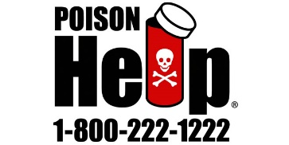

1. 1. 1.
Emergency Hotlines and Resources
American Association of Poison
Control Center (AAPCC)
  In the U.S. call 1-800-222-1222
  http://www.aapcc.org
National Pesticide Information Center (NPIC)
  http://npic.orst.edu
  npic@ace.orst.edu
  1-800-858-7378
  Information in English
  and Spanish

Slide 46
1. 1. 1.
Best Practices for Notifying and Educating Parents About Bed Bugs
Bed bugs are showing up in schools and talking about it may be a challenge, but parents and staff will panic less if they hear about the possibility of it happening before it actually does
Let parents know that your school district is aware that an increasing number of families are battling bed bugs at home
A well communicated school district bed bug policy is extremely important
Communicating instructions on how to send students to school free of bed bugs is extremely helpful

Slide 47
1. 1. 1.
Best Practices for Notifying and Educating Parents About Bed Bugs
  Some states require the notification of parents and staff if an infestation is found (multiple bed bugs reproducing in an area), a single roving bed bug is not an infestation
  Bed bug training presentation http://www2.epa.gov/sites/production/files/documents/BB_in_Schools_May_2012.pdf
  Action Plan for schools http://www.vdacs.virginia.gov/pesticides/pdffiles/bb-schools1.pdf
  Bed bug resources for schools http://www.maine.gov/dhhs/mecdc/infectious-disease/epi/bedbugs/
  Bed bug information kit for schools http://www.uft.org/files/attachments/doe-bed-bug-info-kit-feb-2011.pdf

Slide 48
1. 1. 1.
Reducing Encounters with Disease Vectors on School Grounds
Mosquitoes
  Report standing water that takes longer than 4 days to drain
  Encourage students to wear light colored clothing with loose fitting long-sleeves, long pants and socks if outside before dawn or at dusk
  Encourage students to apply insect repellant even if they will be outside for a short period of time
  For help selecting an insect or tick repellant go to the EPA search page: https://www.epa.gov/insect-repellents/find-insect-repellent-right-you#searchform

Slide 49
1. 1. 1.
Reducing Encounters with Disease Vectors on School Grounds
Ticks
  Remove ticks immediately with no delay
  If students will be visiting areas where ticks are prevalent encourage them to wear protective clothing and a repellent rated for ticks
  Information on tick species distribution, diseases, life cycle and best practices can be found at: https://www.ncipmc.org/action/alerts/ticks.pdf
  IPM tick action plans can be found at: http://www.extension.org/pages/24666/ipm-action-plan-for-eastern-us-ticks#.VPJe9o05Cos

Slide 50
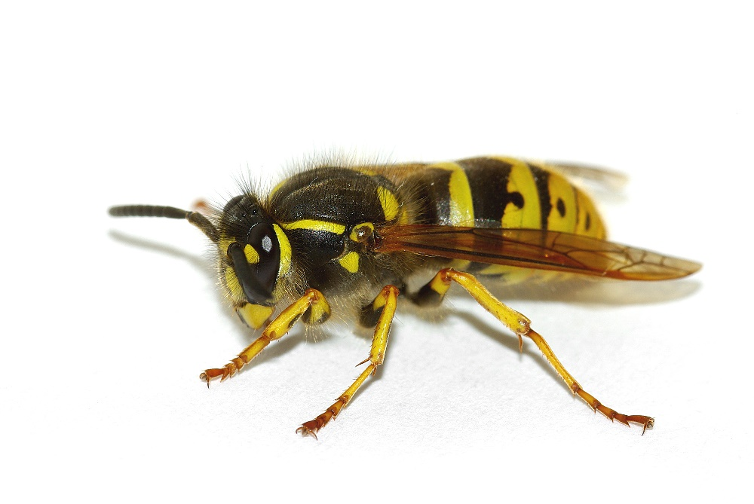
1. 1. 1.
Reducing Encounters with Stinging Insects on School Grounds
Some stinging insects require urgent removal or control
Stinging insects
  Strongly scented products attract bees and wasps
  Strong sweat smells agitate some stinging insects
  Encourage sting sensitive students to wear light colored clothing, with long
  sleeves and long plants
German yellowjacket

Slide 51
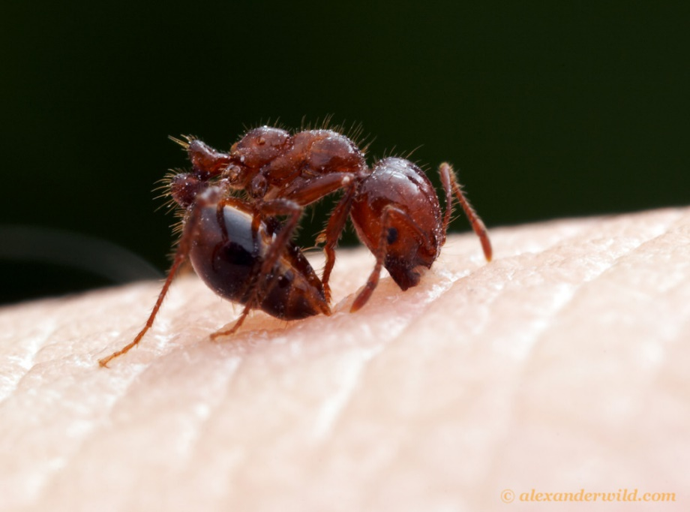
1. 1. 1.
Reducing Encounters with Stinging Insects on School Grounds
  Avoid soda and sugary drinks outside
  If outside, keep food and drinks containerized, consume carefully, and wrap waste up before disposing in a refuse container
  If drinking outside use
  a cup rather than a can
  Don’t allow students to
  go barefoot, some
  wasps and fire ants
  nest in the ground
Red imported fire ant
– Alexanderwild.com

Slide 52
1. 1. 1.
Sanitation Measures for Norovirus and Flu
Cleaning removes pathogens, dirt, and impurities from surfaces or objects
  Using soap (or detergent) and water physically removes pathogens from surfaces but does not necessarily kill them
Disinfecting kills pathogens on surfaces or objects
  Using chemicals to kill pathogens does not necessarily remove dirt
Sanitizing lowers the number of pathogens on surfaces or objects to a safe level (according to public health standards or requirements)
  May include cleaning and/or disinfecting to lower infection risks

Slide 53
1. 1. 1.
Sanitation and Antimicrobials
Sanitation uses an antimicrobial agent on objects, surfaces or living tissue to reduce the number of disease-causing organisms to non-threatening levels, sanitizing does not affect some spores and viruses
Disinfection uses antimicrobial agents on non-living objects or surfaces to destroy or inactivate microorganisms, but disinfectants may not kill all bacteria, viruses, fungi and spores
Sterilization is using chemicals, temperature, gas and/or pressure to kill or inactivate all disease-causing bacteria, spores, fungi and viruses

Slide 54

Sanitation Measures for Norovirus and Flu
The influenza virus can survive in an infectious form on environmental surfaces for 2 to 8 hours after being deposited on the surface
The influenza virus is destroyed by heat (167-212°F), and chemical germicides including: chlorine, hydrogen peroxide, detergents (soap), iodophors (iodine-based antiseptics), and alcohols if used
at proper concentrations for a
sufficient length of time

Slide 55
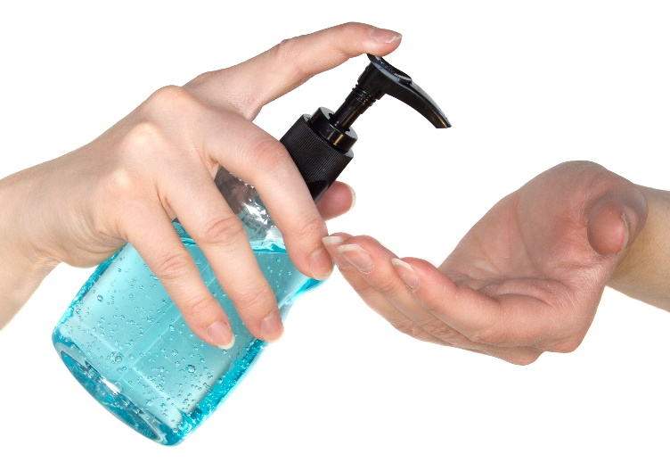
1. 1. 1.
Sanitation Measures for Norovirus and Flu
Wipes or gels with alcohol in them can be used to clean hands, gels should be rubbed into hands until they are dry
The virus can be spread when a person touches something that is contaminated then touches his or her eyes, nose, or mouth
Droplets from a cough or sneeze of an infected person move through the air and contaminate surfaces

Slide 56

1. 1. 1.
Sanitation Measures for Norovirus and Flu
Tissues and other disposable items used by an infected person must be thrown in the trash or bagged until they can be disposed of
Persons touching used tissues and similar waste should wash their hands with soap and water
It is important to keep surfaces clean by
wiping them down with a disinfectant
according to
directions on the product label

Slide 57
1. 1. 1.
Sanitation Measures for Norovirus and Flu
Wash surfaces with a general household cleaner to remove dirt and organic matter before disinfecting
Always follow label directions on cleaning products and disinfectants, they can cause injury if not used correctly
Rinse with water as instructed
Use an EPA-registered disinfectant to kill pathogens, ensuring that the label states that EPA has approved the product for effectiveness against influenza A virus

Slide 58
1. 1. 1.
Sanitation Measures for Norovirus and Flu
There are a variety of hydrogen peroxide options, including Clorox Healthcare, that are effective at killing Norovirus
These products can be used as a substitute for bleach-based products
EPA Registered Antimicrobial Products Effective Against Norovirus: https://www.epa.gov/sites/production/files/2016-06/documents/list_g_norovirus.pdf

Slide 59
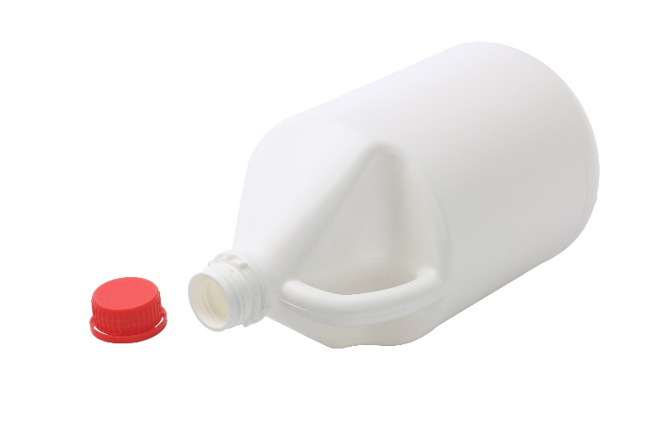
1. 1. 1.
Sanitation Measures for Norovirus and Flu
If an EPA-registered disinfectant is not available, use a fresh chlorine bleach solution:
  Add 1 tablespoon of bleach to 1 quart (4 cups) of water or ¼ cup of bleach to 1 gallon (16 cups) of water
  Apply the solution to the surface with a cloth
  Let it stand for 3 to 5 minutes
  Rinse the surface with clean water

Slide 60
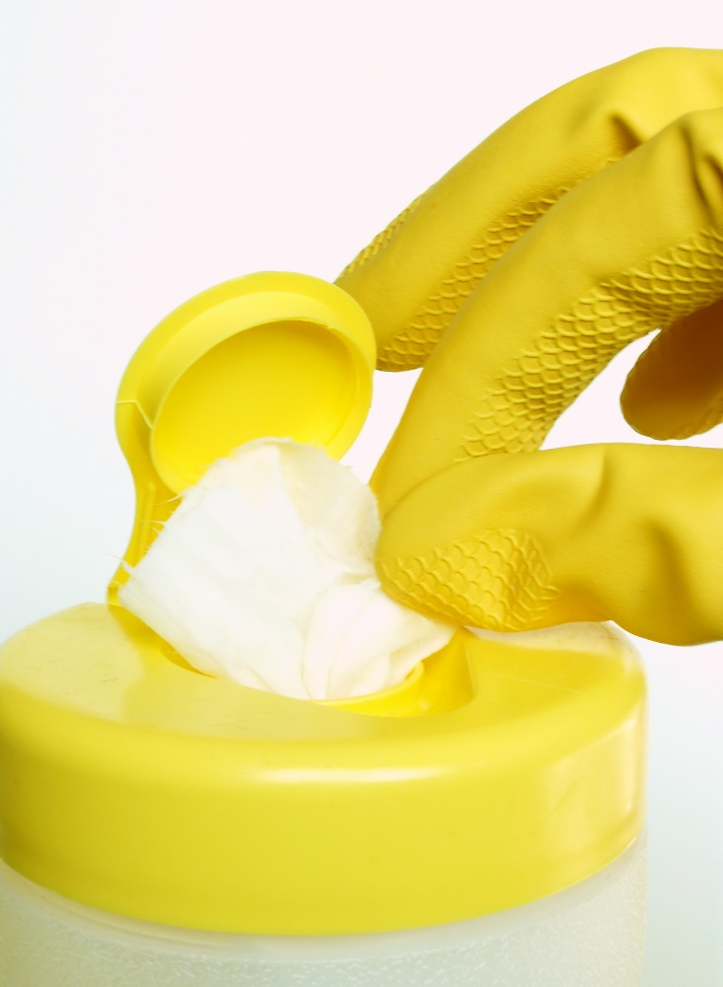
1. 1. 1.
Sanitation Measures for Norovirus and Flu
Disinfections usually require the
product to remain on the surface
for a certain period of time
Use disinfecting wipes on
electronic items that are
touched often, such as phones
and computers

Slide 61
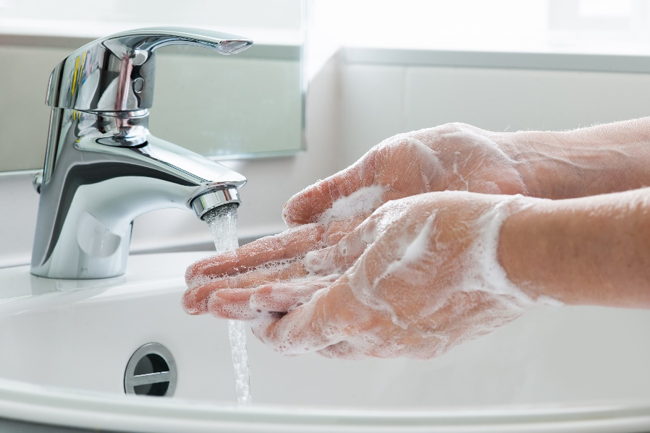
1. 1. 1.
Sanitation Measures for Norovirus and Flu
Special considerations for norovirus:
  Noroviruses can be found in vomit or stool even before a person starts to feel sick, and for 2 weeks or more after symptoms abate
  Hand washing is critically important
  Alcohol-based hand sanitizers
  can be used in addition to
  hand washing, but not as
  a substitute for
  washing with soap
  and water

Slide 62
1. 1. 1.
Sanitation Measures for Norovirus and Flu
Norovirus is the leading cause of disease outbreaks from contaminated food in the U.S.
Sick staff or those caring for others who are sick, should not prepare food for at least 3 days after symptoms stop
Infected food workers cause 70% of reported norovirus outbreaks from contaminated food
Norovirus is very contagious, and outbreaks can occur anywhere people gather or food is served

Slide 63
1. 1. 1.
Sanitation Measures for Norovirus and Flu
Many disinfectant wipes are registered pesticides designed to kill microbes
  It is inappropriate to ask students to clean desks and surfaces with disinfectant wipes
  If children are allowed to handle disinfectant wipes or breathe in the chemicals, this is a breach of Federal Law
  Surface disinfectant wipes are not hand wipes
Many labels clearly state
“KEEP OUT OF REACH OF CHILDREN”

Slide 64
Check In!
In this lesson you learned to:
Understand appropriate personal hygiene and facility sanitation measures to help limit the spread of: communicable pests
Recognize common pesticide poisoning symptoms
Identify pest related allergy and asthma triggers in classrooms
    Give examples of chemical sensitivity issues
Give examples of emergency hotlines and resources
Describe best practices or procedures for notifying parents and/or providing them with guidance to minimize the spread of bed bugs
Describe appropriate measures to help prevent and/or reduce encounters with disease vectors and stinging insects
Describe sanitation measures for norovirus and flu

Slide 65
Resources
  Pesticide Safety Education Program (PESP), Cornell University Cooperative Extension. http://psep.cce.cornell.edu/Tutorials/core-tutorial/module09/index.aspx
  http://pest.ca.uky.edu/EXT/ukgh/Exposure.pdf
http://medicine.missouri.edu/ent/uploads/Dustmites-USNEWS.pdf
Pesticideinfo.org See: Recognition and Management of Pesticide Poisonings, 5th edition, U.S. EPA, Chapter 8, page 88 for treatment information
http://accessnewage.com/articles/health/chemical.htm
https://www.health.ny.gov/environmental/workplace/pesticide_poisoning_
registry/pesticide_poisoning_registry_presentation.htm
http://www2.epa.gov/sites/production/files/documents/BB_in_Schools_
May_2012.pdf
Action Plan for schools http://www.vdacs.virginia.gov/pesticides/pdffiles/bb-schools1.pdf
Bed bug resources for schools http://www.maine.gov/dhhs/mecdc/infectious-disease/epi/bedbugs/
Bed bug information kit for schools http://www.uft.org/files/attachments/doe-bed-bug-info-kit-feb-2011.pdf

Slide 66
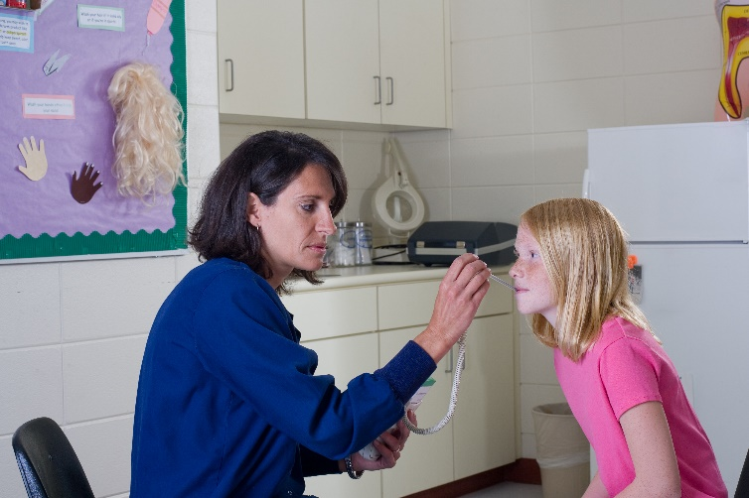
Resources
  Pesticide Safety Education Program (PESP), Cornell University Cooperative Extension. http://psep.cce.cornell.edu/Tutorials/core-tutorial/module09/index.aspx
  http://www.cdc.gov/ticks/avoid/in_the_yard.html
  http://pest.ca.uky.edu/EXT/ukgh/Exposure.pdf
  http://www.webmd.com/asthma/allergic-asthma-treatments
  http://annmreid.hubpages.com/hub/How-to-Avoid-Bee-and-Wasp-Stings
  CDC Novel H1N1 Flu (Swine Flu) and You http://www.cdc.gov/flu/school/cleaning.htm
Thank you for the
important work
you do!

