Slide 1
Stop school pests
Building sustainable school IPM inside and out:
Developing and implementing
standardized training materials and
IPM proficiency exams for certification
Technical Lead: Sherry Glick, EPA; Project Officer: Cara Finn, EPA
Co-PIs: Dawn H. Gouge (University of Arizona), Tom Green (IPM Institute of North America), Al Fournier (University of Arizona), Lucy Li (University of Arizona),
Shaku Nair (University of Arizona), Dave Kopec (University of Arizona),
Ursula Schuch (University of Arizona), Paul Baker (University of Arizona),
Kai Umeda (University of Arizona), Carrie Foss (Washington State University),
Tim Stock (Oregon State University), Susan T. Ratcliffe (University of Illinois)
Project period:
Feb 2014 – Jan 2016

Slide 2
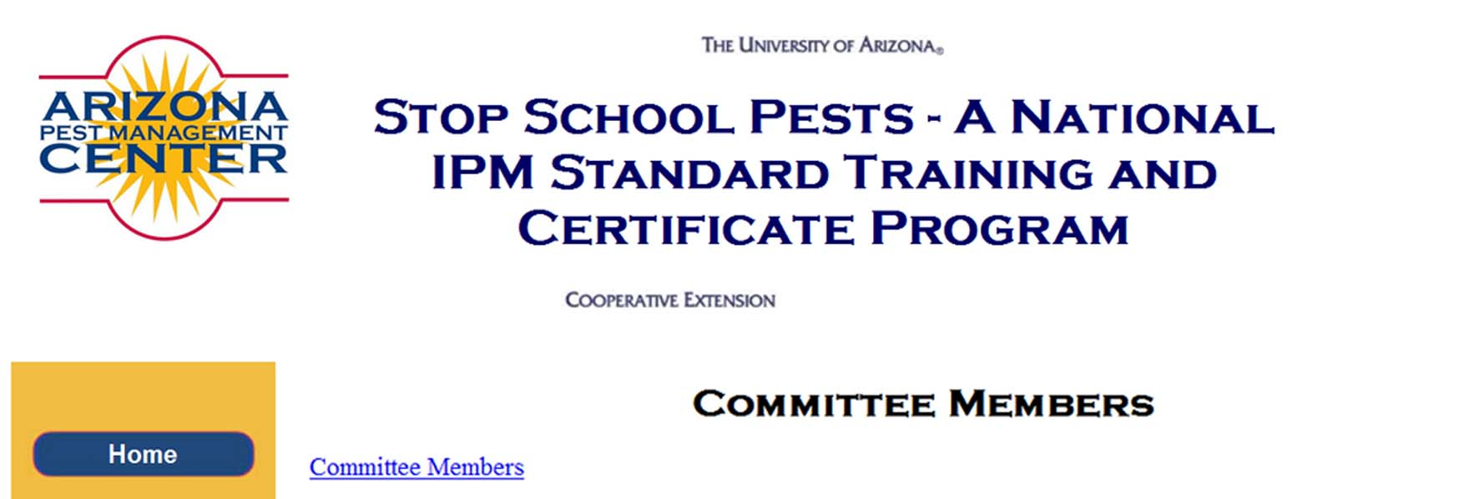
Full team
http://cals.arizona.edu/apmc/docs/All-Hands-Members-021215.pdf
Collaborations: 2 federal agencies
23 academic faculty 4 school management staff
11 state lead staff 2 tribal representatives
8 advocacy agency staff members
4 industry reps

Slide 3
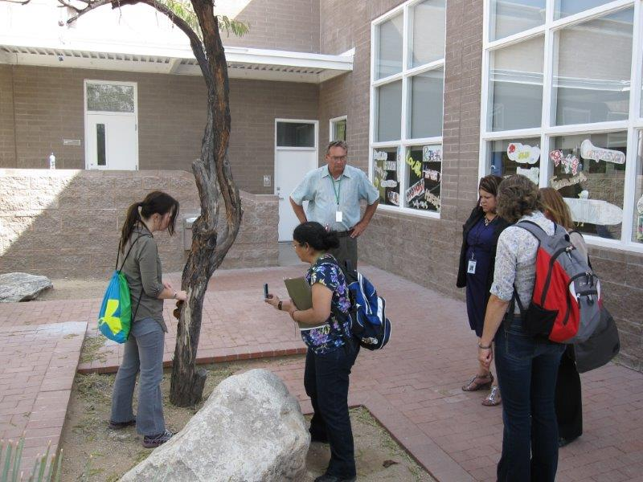
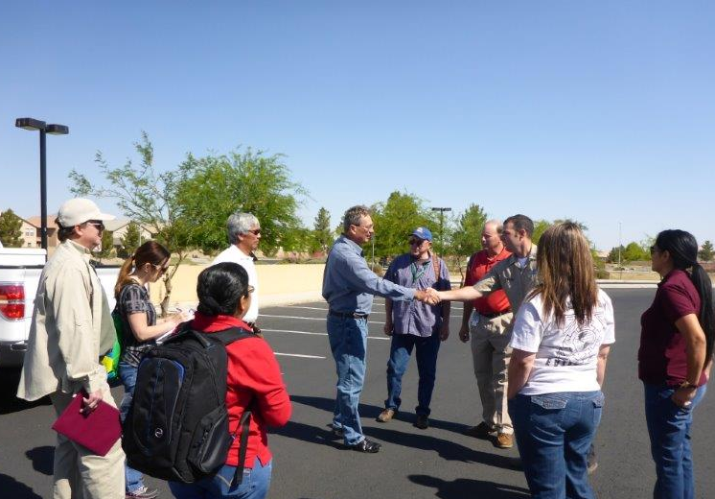
Objectives:
To (1) increase adoption of verifiable IPM in K-12 schools, (2) reduce pest complaints, and pest management risks, by implementing a comprehensive, national training and certification program for key roles in the school community.

Slide 4
Objectives:
Education: one of the earliest steps in the implementation process.
Increases awareness.
Improves knowledge and understanding.
Leverages community involvement and further investment.
Forges connections between subject experts and practitioners.
Maximizes impacts resulting from activities, resources developed and evaluation exercises.

Slide 5
Project materials
Training materials will be:
housed on-line for self-guided viewing.
posted as free-to-access downloadable as fully modifiable PowerPoints for in-class use.
Facility managers and pest management technicians can take an exam through the National Pest Management Association and receive Quality Pro for Schools certification.
Other roles passing a proficiency exam will be allowed to print a certificate.

Slide 6
Approach
Online IPM training resources (Year 1)
The national 2020 school IPM implementation team have identified nine key stakeholder groups related to school IPM.
Introduction to IPM (All hands)
Facility Manager
Maintenance Staff
Administrative Staff
Teacher
Food Service Staff
Custodial Staff
Landscape and Grounds Staff
School Nurse
Technician/PMP

Slide 7
Approach
Online IPM training resources (Year 1)
Learning objectives for the All-hands and the 9 key roles established by developmental committee.
Feedback from review committee incorporated.
Feedback from stakeholder groups incorporated.
Learning objectives were weighted based on job responsibilities by stakeholder groups.
Training materials were developed based on the learning objectives.
Exam questions will be written based on weighted learning objectives in year 2.

Slide 8
Approach
Online IPM training resources (Year 1)
Three kinds of groups
1) Development committee
Responsible for the preparation of learning objectives, and each of the modules using existing and newly developed materials, including presentations (PowerPoint, Prezi, video recordings, etc.), lecture notes, practicum exercises and experiential learning exercises.

Slide 9
Approach
Online IPM training resources (Year 1)
2) Review Committee
A multi-disciplinary alliance including technical subject experts, translational scientists, industry representatives, education specialists, school facility managers and experts in regulation and social science adoption and diffusion.
Responsible for critical review and modification.

Slide 10
Approach
Online IPM training resources (Year 1)
3) National network of experts and stakeholders
Review all completed materials, help with piloting and providing feedback.

Slide 11
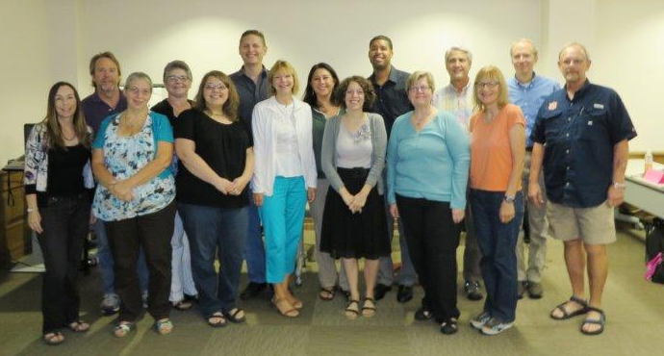
Approach
National 2020 school IPM implementation team meeting (Year 1)
Dallas, TX, September 23-25, 2014.
Team members, partnering with EPA IPM Center of Excellence.

Slide 12
Approach
All materials “field tested” and refined pursuant to trainer/trainee feedback to ensure high quality.
Adaptable to meet region-specific needs.
Buy-in from a broad group of change agents working towards school IPM 2020.

Slide 13
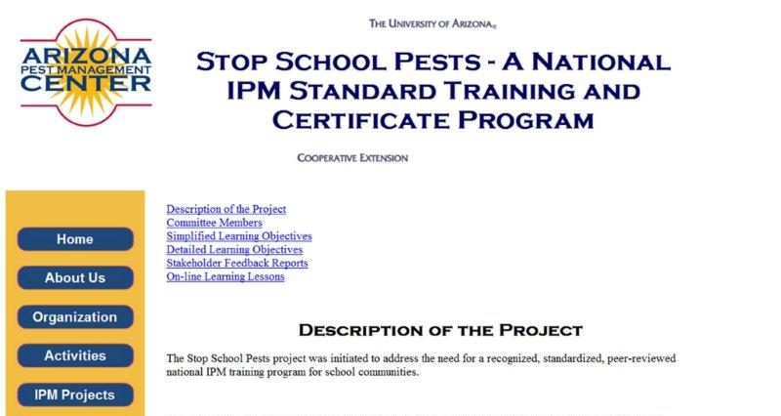
Current status
All completed materials have been placed online at http://cals.arizona.edu/apmc/StopSchoolPests.html

Slide 14
Learning Objectives
Example-Module 1: Introduction to School IPM
Learning Lesson 1: WHAT is IPM:
Describe IPM in understandable terms.
Describe how IPM reduces the risks of pests and pesticides.
Explain the benefits of IPM in schools and other sensitive environments.
Identify the key elements of IPM.
Learning Lesson 2: WHY do IPM:
Identify health, environmental, and economic risks of pests associated with buildings and grounds.
Identify health, environmental, and economic risks of pesticides associated with buildings and grounds.

Slide 15
Learning Objectives
Example-Module 1: Introduction to School IPM
Learning Lesson 3: WHO does IPM:
Identify the important roles and responsibilities of the school IPM team.
Learning Lesson 4: HOW to do IPM:
Explain basic pest monitoring, inspecting and reporting.
Identify pest-conducive conditions and pest-vulnerable areas. Identify corrective actions.
Identify key pest groups and signs of pest infestations in buildings and on grounds.
Explain how to keep pests out of facilities.

Slide 16
Feedback on Learning Objectives from Stakeholders
Example: School Custodians
85% feel confident they know enough about IPM
82% would like to know more
76% think IPM training/certification is necessary, 17% did not.
Training is necessary because:
this affects the health and welfare of our students and staff
I believe that most people do not have a good understanding of the requirements of IPM
Only to an extent. IPM Awareness training should be all that is required!!!!!!!
I believe that an ongoing training in IPM is a must-have. Like people say, if you don't use it, you lose it. ……

Slide 17
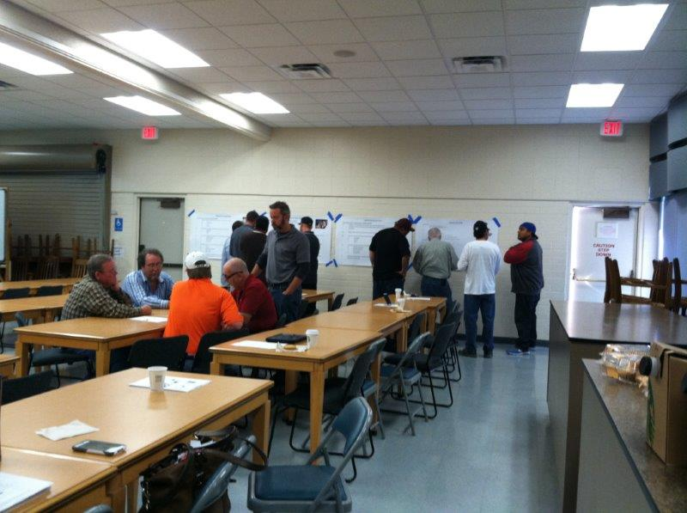
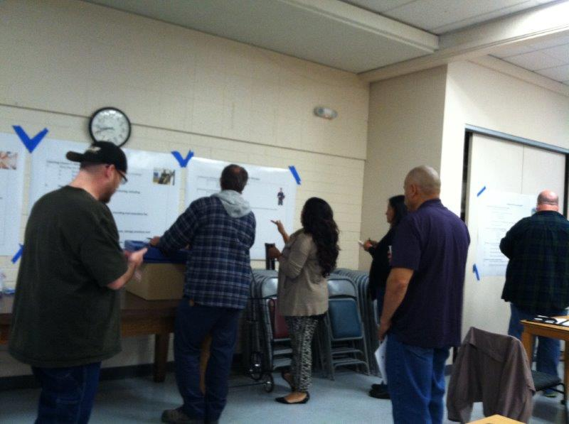
Stop School Pests event, Phoenix AZ. March 3rd 2015.
School IPM partners review and weight individual learning objectives. These weights will be used in preparing exams.

Slide 18
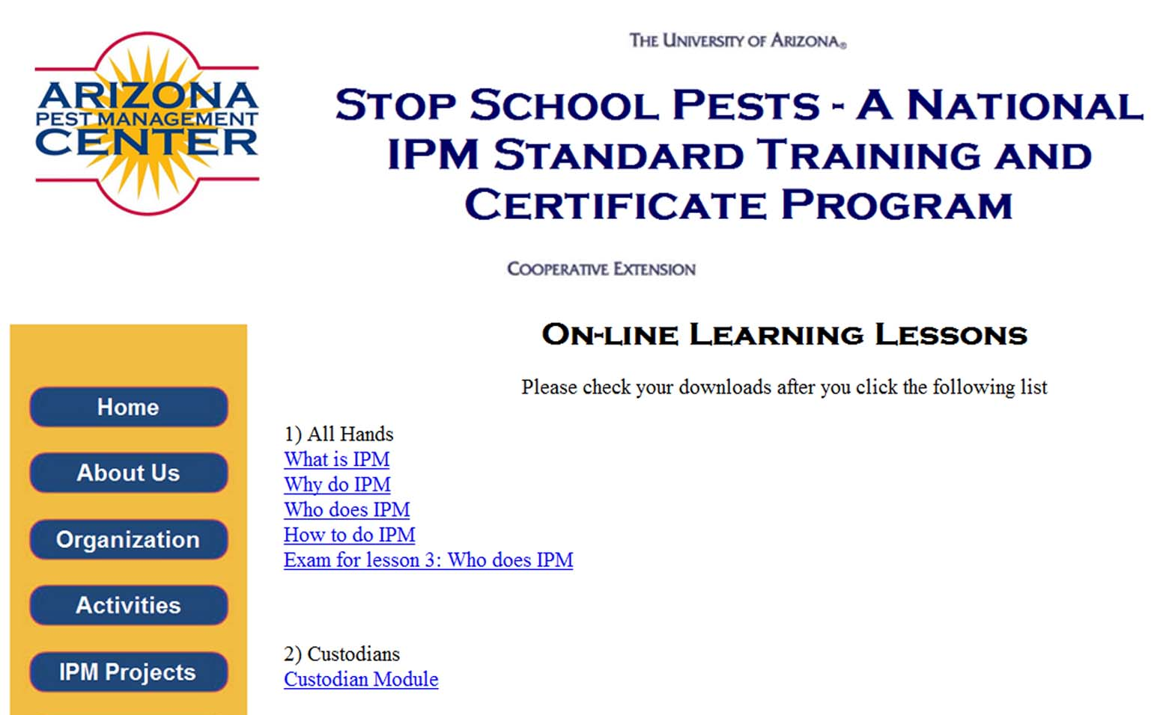
Current status
Online training modules will be available to stakeholders or any individual seeking multimedia presentations they can view and study from any location.
On-line materials will be housed as part of the iSchool Pest Management project resources.

Slide 19
Modules
View online
Download

Slide 20
Modules – view online
http://extension.arizona.edu/training/ipm/Teacher1/

Slide 21
Pilot testing of modules
Training materials have been piloted in Nebraska, Colorado, Texas, and Arizona.
www.imgarcade.com

Slide 22
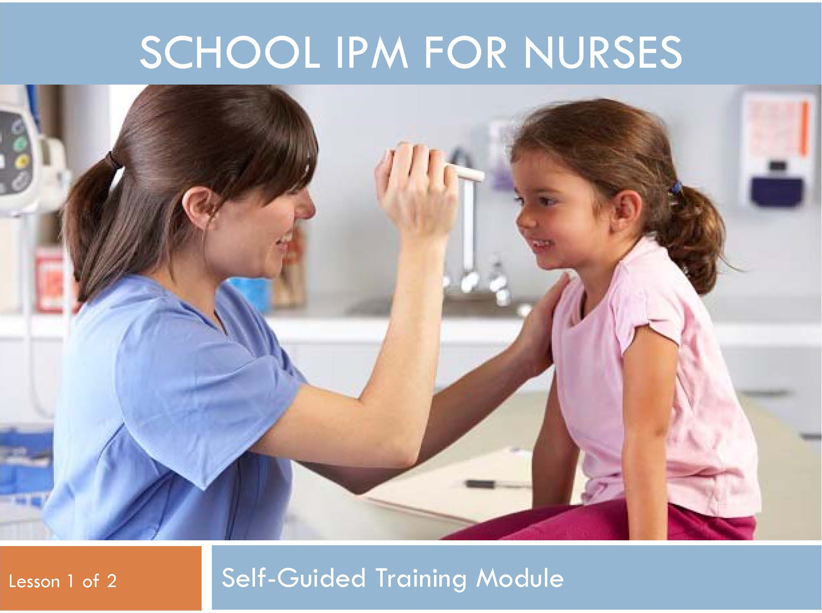
Pilot testing of modules
School nurse module piloted in Arizona: Feb 2015.
“I have been a school nurse for 25 years and I cannot believe I learned so much helpful information in just 1 hour”: Nurse Mary Griffin, Apache Junction Unified School District, AZ.

Slide 23
Approach
Advanced IPM certification for individuals who practice high-level IPM in schools (Year 2)
Certification options will be available for
IPM Technician/PMP
Facility Manager In collaboration with the National Pest Management Association

Slide 24
Approach
Advanced IPM certification for individuals who practice high-level IPM in schools (Year 2)
The certification program will focus specifically on advanced IPM.
Will address an underserved audience, including facility managers and school based staff critical to IPM success.
Building on successful model of the National Pest Management Association – Quality Pro for schools.

Slide 25
Exams
Administrators, grounds staff, custodians, maintenance staff, nurses, food service staff and teachers can earn a certificate through the completion of training and passing a proficiency exam.
Throughout learning lessons, check points will guide and assist participants toward learning objective components in preparation for the quiz/exam.

Slide 26
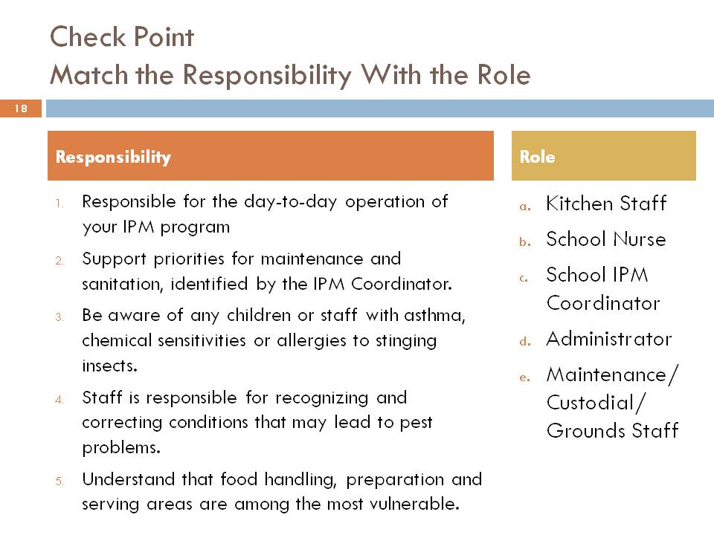

Slide 27
Approach
Piloting training and certification materials and procedures (Year 2)
Training modules and certification exams will be piloted in 6 states and in partnership with 4 Tribes.
20 trainers new to school IPM will pilot the downloadable training materials.
A minimum of 1200 school staff, serving 1.8 million students will receive on-site training at school locations from experienced school IPM educators.

Slide 28
Approach
Piloting training and certification materials and procedures (Year 2)
200 school staff will review the online training modules, and 200 school staff volunteers will be subject to the appropriate certification (at least 20 individuals per category) after either face-to-face trainings or reviewing online modules.

Slide 29
Sustainability and growth
Consensus content fosters broad buy-in and use.
Adaptable by trainers for in-class training events, and meeting region-specific needs.
Builds appreciable value to create and sustain support from participants and sponsors.
Incentives for school districts to enroll all staff.
Links to continuing education credits (CEs)/recognition/award programs both internal to districts and external.

Slide 30
Sustainability and growth
Supports and encourages train-the-trainer opportunities.
Educators will learn how to use IPM to teach the common core standards and STEM.
Participation delivers multiple benefits including pest and pesticide risk reduction, and improved food safety, fire safety, energy conservation and employee satisfaction!

Slide 31
Outreach and marketing
Organizations including PTA/PTO, school business officials association, school facility manager associations, US EPA, state lead agencies and others recruited to assist with outreach and to provide opportunities for training in conjunction with their events.
National Pest Management Association will provide technician certification.
National IPM Working Group with more than 225 members will be provided with resources and recruited to do outreach to school districts, pest managements professionals and land care professionals that they work with.

Slide 32
Some of the many collaborating organizations

