Slide 1

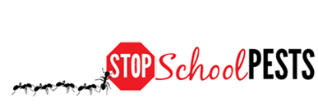
TEACHING IPM (Using IPM as a Curriculum Element)
Self-Guided Education Module
Lesson 2 of 2

Slide 2

Learning Objectives
Describe how an IPM curriculum meets common core requirements for biology, biodiversity, ecology,
evolution, problem solving,
teamwork, etc.
Describe a lesson plan that
incorporates IPM into
science-related curriculum
Classroom educator training and lesson plan – Rebecca Baldwin, University of Florida
http://entnemdept.ufl.edu/bug_club/BBBB%20Articulate%20Published%202012/player.html

Slide 3
What is IPM?
IPM focuses on investigating, discovering and fixing the fundamental reasons why pests are a problem - IPM is a sensible, science based, environment-friendly, and effective way to solve pest problems
IPM involves an active investigation and problem solving process
Ultimately pests are managed by the most cost-effective and sustainable means, and always with the least possible risk to people, property and the environment

Slide 4
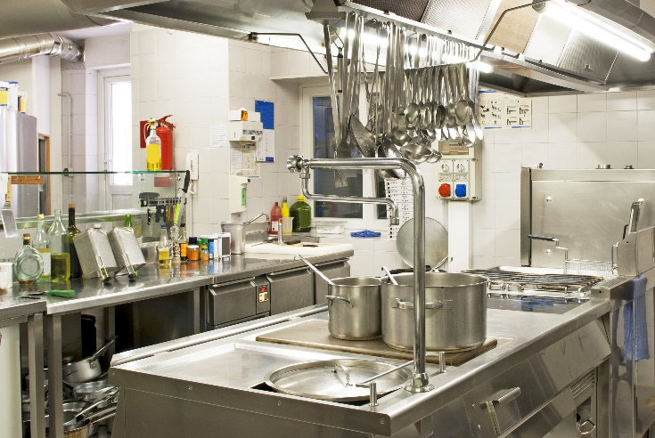
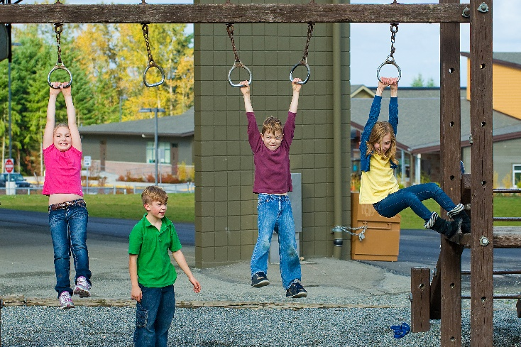
1.
IPM = Integrated (Intelligent) Pest Management
IPM does not rely on one single method to control pests but uses a combination of methods that are:
  Location specific
  Dynamic, can be changed
  to suit the situation
  Low risk
  Cost effective
IPM works indoors and outdoors

Slide 5
1.
IPM = Integrated (Intelligent) Pest Management
IPM is a pollution prevention strategy - Pesticides are used judiciously only when required, and applied in a manner that minimizes non-target exposure and environmental impact
IPM is a risk reduction strategy - The least hazardous approaches are used to reduce pests
IPM is a pesticide resistance strategy - Pesticides are used responsibly and rotated so pests are not exposed to heavy selection pressures

Slide 6
Why Include IPM in Your Curriculum?
IPM helps students realize the importance of protecting themselves and their environment
IPM gives everyone a role to play in school and at home
IPM helps students appreciate all jobs involved in creating a safe and healthy learning environment
IPM teaches sharing, teamwork and respect for the Earth and life around us
IPM is a real world problem solving process
IPM is common sense!

Slide 7
IPM in Your Curriculum
Common core requirements
“Building on the best of existing state standards, the Common Core State Standards provide clear and consistent learning goals to help prepare students for college, career, and life. The standards clearly demonstrate what students are expected to learn at each grade level, so that every parent and teacher can understand and support their learning.”
http://www.corestandards.org/read-the-standards/

Slide 8

IPM in Your Curriculum
Does IPM fit common core requirements?
Yes! IPM can give students exposure to a broad range of subjects and concepts in science, and can be linked to math, language, arts and social studies

Slide 9

1.
IPM in Your Curriculum
IPM involves:
Biology
Environmental Science
Chemistry
Math
Economics
Psychology
Ecology
While learning IPM concepts, children gain lessons in all the above subjects and more

Slide 10

1.
IPM in Your Curriculum
Key elements of IPM
Monitoring and inspection
Proper identification
Establishing thresholds
Preventing pests
Action (least-risk)
Keeping records
Education, communication
Constant evaluation (including resource management and budgeting)

Slide 11
IPM in Your Curriculum
Key elements of IPM
Subjects/skills involved
Monitoring and inspection
Proper identification
Establishing thresholds
Preventing pests, resource management
Action (least-risk)
Keeping records
Education, communication
Constant evaluation
Observation and analysis
Biology, biodiversity, logic
Math, logic
Biology, environmental science, engineering
Science based decision-making
Documentation
Writing, speaking, art
Self-improvement, analysis

Slide 12
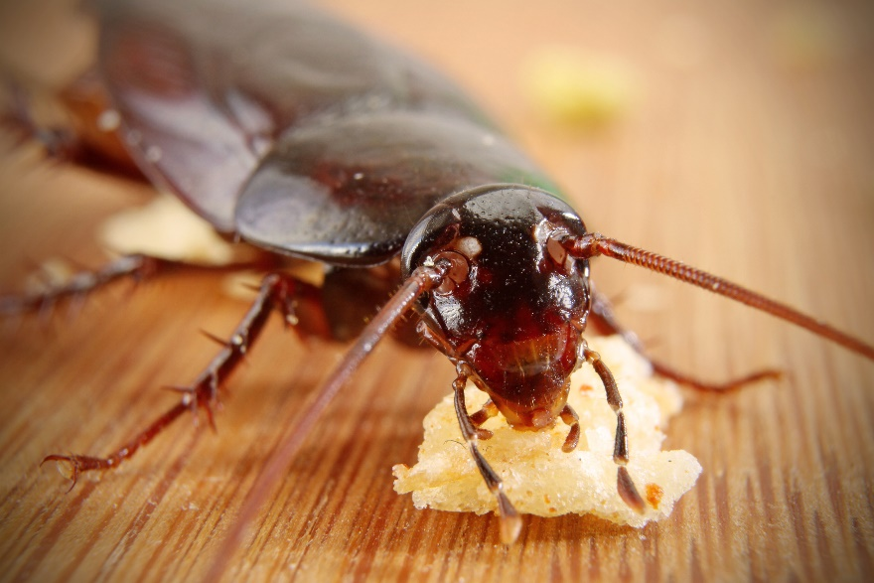
IPM in Your Curriculum: Biology
Pests are biological entities, each adapted to thrive given resources and supportive conditions
Discussion point: how do biotic and abiotic conditions affect animals and plants?
What do pests need to
survive?
  Food
  Water
  Shelter

Slide 13

IPM in Your Curriculum: Biology
Example 1: A class outline for Grades K-2 students:
  What are the different animals and plants you see at school? Describe and identify the different forms of life in and around your school?
  Where can you find them? What and how do they eat? What and how do they drink?
  How are they beneficial?
  Can they be harmful?
  Ask students to characterize and draw
  their own fictitious insects, and class them
  as beneficial, as pests or both

Slide 14

IPM in Your Curriculum: Biology, Problem-solving
Example 2: A class outline for Grades K-2 students:
  Explain different insect life cycles to students with pictures
  Provide students with cut-outs or pictures of different life stages of different insects
  Have them find all life stages of their insect and put them in the correct developmental order
  Discuss where the insects are found (indoors/outdoors)
  and what they do

Slide 15

IPM in Your Curriculum: Biology/Biodiversity
Example 3: A class outline for Grades 6-8 students:
  Place sticky monitoring traps around the school 4 weeks prior to class
  Have the students explore the school and look at the trap catches making lists of pests you find in different locations (investigate the species biology and ecology)
  Have the students describe the resources available to each pest in the locations they were found
  Discuss why different pests are found in
  different locations (life cycle requirements)
  How can this information be used to help
  manage them?

Slide 16
IPM in Your Curriculum: Biology/Evolution
Example 4: A class outline for Grades 6-8 students:
  List different pests found in your school environment (weeds, insects, spiders, scorpions, rodents)
  Where are each of them found (habitat)?
  How do they reproduce (sexual, asexual)?
  Introduce the concept of r vs. K strategy (reproductive vs. carrying capacity)
  What are the adaptations that help each of them survive in their habitat? Discuss the concepts of evolution
  Discuss the concepts of pesticide resistance

Slide 17
IPM in Your Curriculum: Problem-Solving
Example 5: A class outline for Grades 6-8 students:
  Problem: Set up a fruit fly infestation in a classroom where fruits were brought in and allowed to attract and support fruit flies (fruit flies can be purchased on-line or in many pet supply shops)
  Solution: Students learn about the life cycle and habitat needs of fruit flies, and why they thrive
  Approach: The students may experiment to determine what allowed the fruit flies to breed in the classroom - Discuss how the fly infestation might have been avoided and how it should be controlled - Compare relative costs and risks associated with proactive versus reactive approaches

Slide 18
IPM in Your Curriculum: Problem Solving
Example 5 continued: A class outline for Grades 6-8 students:
  Approach: All garbage was promptly removed and disposed of regularly - any nearby drains were cleaned with bacterial agents to remove breeding areas
  Outcome: After four weeks and no use of pesticides, there are no fruit flies in the classroom
  Source: http://www.ipminstitute.org/School_IPM_Week/schoolipmweek_ideas_for_ambassadors.htm#College

Slide 19
IPM in Your Curriculum: Environmental Science/
Ecology
Example 6: A class outline for Grades 9-12 students:
  Analyze your school environment as an ecosystem
  What kinds of organisms do you find?
  Describe microhabitats on the school campus
  Why do some organisms outnumber others and when do they become a problem for the school?
  Establish action thresholds for specific pests and brainstorm what criteria should be used to determine action points
  Describe management measures for key pests, discuss the pros and cons of different approaches including
  costs, logistics, environmental impacts and resistance (define an IPM strategy)

Slide 20
IPM in Your Curriculum: Teamwork
Example 7: A class outline for Grades 10-12 students:
  Investigate the pest management in your school - Find out which staff or personnel are involved in each aspect (custodial, grounds maintenance, food service, school nurse, teachers, technicians, etc.)
  Divide students into groups and let each group work with a staff member for a fixed time and find out what they do
  Let the groups reassemble and share their findings - Discuss how each staff member contributes to pest management in the school environment

Slide 21

IPM in Your Curriculum: Teamwork
Example 7: A class outline for Grades 10-12 students:
  Discuss how each member’s role in IPM is critically important for a pest-free school
  Discuss what would happen if any one member did not cooperate or do their job properly
  Have students work as a team to design their own school IPM policy and plan based on their findings
  Have student credit available
  for students participating in
  Environmental Health
  committee business

Slide 22
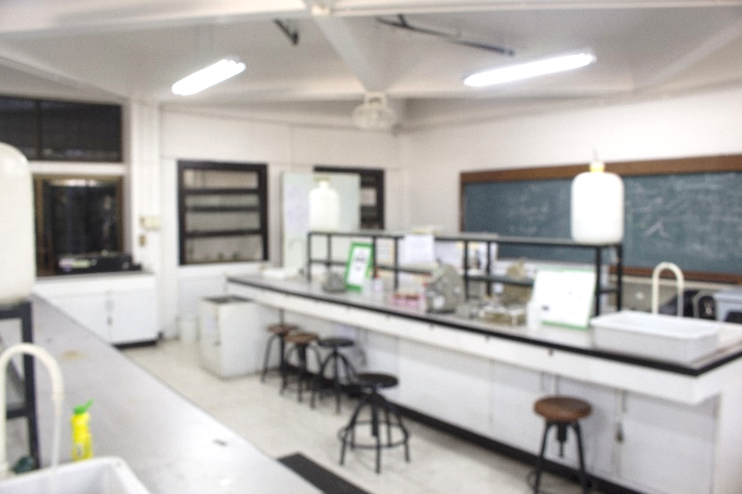
IPM in Your Curriculum
IPM is not an additional item to cover in your curriculum
IPM can be used as a real world example of a problem-solving process
IPM helps you and your students to combine knowledge from different subjects
IPM provides excellent
examples to enhance your
class time and hands-on
science labs

Slide 23
IPM in Your Curriculum – Concepts to Consider
  A weed is a plant out of place (plant biology)
  A pest is any animal that competes with humans for food, water and shelter (animal biology)
  IPM is an ecological approach to pest management (requiring an understanding of pest ecology)
  Understanding pest problems can become an in-depth investigation
  Excluding pests can include discussions on weatherproofing and energy saving buildings
  Sanitation improvements can be used to avoid attracting pests - This can be appreciated if students have watched ants trailing to food substances placed on index cards (outside the classroom)
  Clutter control can be appreciated understanding how mice nest

Slide 24

IPM in Your Curriculum
IPM can be a valuable classroom topic because it can address several current global issues
  Pesticide pollution
  Invasive species and biodiversity
  Environmental safety and health tradeoffs
  Food security
  Role of government in environmental decision-making
  Genetic engineering as a pest management tool
  Human and animal infectious diseases
  Quarantine
  Pesticide resistance problems
  and many more…

Slide 25

A Lesson Plan with IPM
Title: Human environmental impacts
Grade level: 8 – 10
Lesson length: Two 50-minute classes
Activities: Lecture, discussion, student poster presentations
Basic purpose of this lesson:
  Develop student interest in global issues
  Develop student ability to gather, interpret, evaluate and use information to explain phenomena in the natural world and predict future outcomes that result from human interventions
  Develop student ability to read, write, discuss and present coherent ideas about science

Slide 26
A Lesson Plan with IPM
Learning objectives:
Identify the different ways human activities influence the environment (industrialization, urbanization, agriculture, deforestation, increasing population, advances in medicine, etc.)
Identify problems resulting from human interventions (environmental pollution), and one source of this pollution (pesticides)
Explain reasons for increased pesticide use (e.g., to produce food for growing populations)
Describe the benefits of judicious pesticide use, alternate methods of pest management and IPM

Slide 27
A Lesson Plan with IPM
Materials:
  Computers with internet access
  Library research materials (journals/magazines)
  Poster paper and boards
  Stationery (scissors, markers, glue, etc.)
Preparation:
  Students must have covered different dimensions of the environment prior to this class
    They should know about basic plant and animal biology and ecology
    Before this class, the teacher will ask students to read up about relevant topics such as human environmental impacts, agriculture, how pests affect crop production, and how they can be controlled

Slide 28
A Lesson Plan with IPM
Activity:
The teacher will begin with a leading question about human activities influencing the environment
Students will provide answers based on what they know or have read
The teacher will then discuss
problems due to human
activities, with emphasis on
environmental pollution and
specifically, pesticides

Slide 29

A Lesson Plan with IPM
Activity:
The teacher will explain why excessive use of pesticides occurred in earlier days and how it affected the environment (Silent Spring)
The teacher will briefly cover alternate methods of pest management and the benefits of reducing dependence on pesticides
Rachel Carson 1962 Silent Spring 1962. Boston, Houghton Mifflin

Slide 30

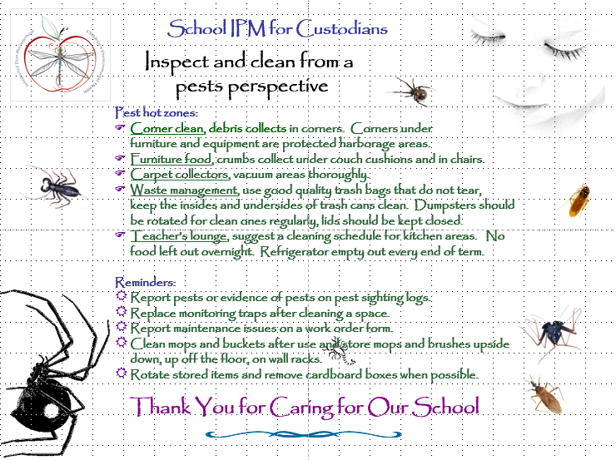
A Lesson Plan with IPM
Activity:
Students will form groups of 3-5
Each group will be assigned to research a pest management problem and determine the advantages and disadvantages of the available control methods
They will have two weeks to produce a poster with their findings
The teacher will provide
help with resources
Student poster – Dawn H. Gouge, University of Arizona

Slide 31
A Lesson Plan with IPM
Activity:
During the next class period, each group will present their poster to their classmates
Peers will ask questions and provide feedback
The teacher will point out that while IPM is a “human intervention” it relies on natural processes to work, and generally has less of
a harmful impact on the
environment since ecological
impacts and sustainability
are considered

Slide 32
A Lesson Plan with IPM
Safety:
  There are no safety issues for this class
Concept discovery:
  Students will be introduced to the concept of IPM - They will receive a handout with the IPM pyramid (next slide), explaining different components involved
Independent activity:
  The teacher will pose a question: Where in our everyday environments, do you think we can apply IPM, using non-agricultural and agricultural examples?
  Students will write 5 paragraphs on their ideas as a homework assignment

Slide 33
A Lesson Plan with IPM - Talk about the IPM Pyramid, risk and proactive activities
Reactive
remediation
Higher risk
Pesticides
Physical/mechanical
control
Cultural/sanitation
practices
Education &
Communication
Lower risk
Proactive
prevention
IPM Pyramid – Dawn H. Gouge, University of Arizona

Slide 34

A Lesson Plan with IPM
Conclusion/wrapping up:
  The teacher will conclude the class with a short PowerPoint presentation/story with pictures/video demonstrating the benefits of IPM
  Students can ask questions about the concepts learned
Assessment/grading:
  Students will be assigned grades on
  their posters based on content,
  teamwork, and involvement in the project

Slide 35

A Lesson Plan with IPM
Connections to other subjects:
Social studies: Students connect
harmful and beneficial human interventions in the environment with economic development (economics), history of crop production (history), and movement of pests between geographic regions (geography), impact of pathogen vectors on human history (malaria)
Math: Students can calculate pest population explosions and cost benefits of differing management methods
Language arts: In researching and presenting their findings about pest management methods, students refine their language skills and artistic talents

Slide 36
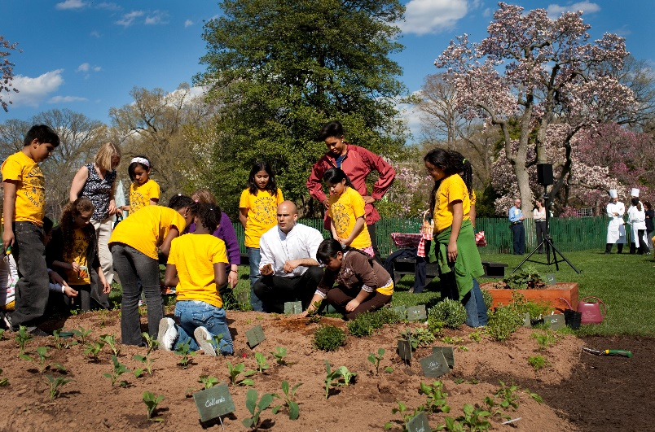
Farm to School Initiative
Is a national movement, in which school districts source more foods locally and provide complementary educational activities to students that emphasize food, farming, and nutrition
Schools use local or regionally produced foods in cafeterias; engage students in hands-on learning activities such as school gardening, farm visits, and culinary classes
Food-related education is integrated into the regular, standards-based classroom curriculum
Aims to enrich children’s bodies and minds while supporting local economies
Michelle Obama & Sam Kass show Bancroft students how to plant a garden - Samantha Appleton, Wikimedia Commons

Slide 37

Farm to School Initiative
The United States Department of
Agriculture (USDA) supports such
efforts through its Farm to School Program, which includes research, training, technical assistance, and grants
The USDA Farm to School Program is operated by the Food and Nutrition Service, which has seven regional offices around the country; in each is a Farm to School Regional Lead who is available to provide support to state agencies and other entities in their region
A list of regions, along with the names and contact information for regional and national USDA Farm to School Program staff, can be found at http://www.fns.usda.gov/farmtoschool/farm-school

Slide 38
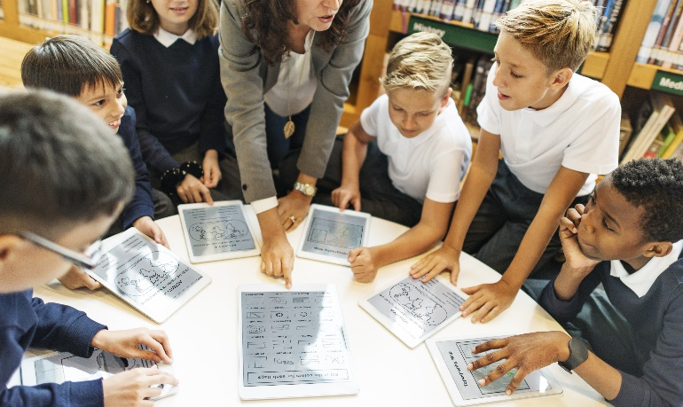
Check In!
In this lesson you learned:
How to describe how IPM curriculum meets common core requirements for biology/biodiversity, ecology, evolution, problem solving, teamwork, etc.
How to describe a lesson plan that incorporates IPM into science-related curriculum
Congratulations, you have completed Using IPM as a Curriculum Element
There are many other resources available see http://maine.gov/dacf/php/integrated_pest_management/school-ipm-curricula/index.shtml

Slide 39
Resources
National School IPM Information Source: IPM for School Faculty and Staff. http://schoolipm.ifas.ufl.edu/Florida/faculty.htm
IPM Institute of North America. Ideas for classroom activities. http://www.ipminstitute.org/School_IPM_Week/schoolipmweek_ideas_for_ambassadors.htm#College
Texas A&M University. Insects in the classroom: Bugs as teaching tools for all ages. Lesson plans.
http://iitc.tamu.edu/1998and2000/lesson_plans.html
eXtension. (2014). School Integrated Pest Management for Teachers. http://www.extension.org/pages/21012/school-integrated-pest-management-for-teachers#.U9h98rHLNeo
PennState Extension. IPM for Teachers Curriculum.
http://extension.psu.edu/pests/ipm/schools/educators/curriculum/contents/whenisapest
University of Nebraska—Lincoln IPM Curricula and Resources for Teachers
http://pested.unl.edu/teachipm

