Slide 1
Changing Structures and Densities of Symbiotic Dinoflagellates in Reef Systems
By: Mara Potthoff

Slide 2
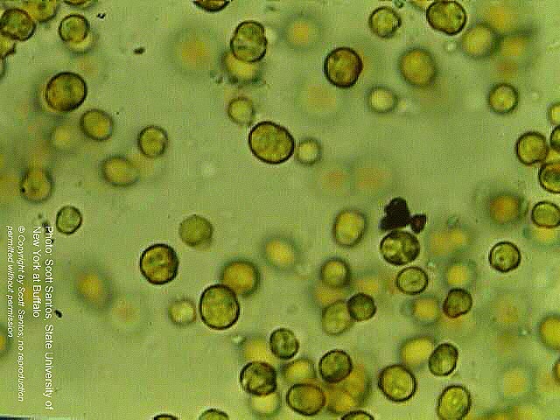
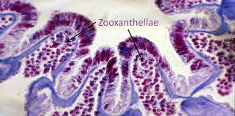
Zooxanthellae
Key component to the health of a coral reef system.
Photosynthetic algae.
Has a symbiotic relationship with corals.
Coral provides the algae with protection and compounds that is needs to perform photosynthesis.
The algae in turn produces oxygen and will help the coral host to remove waste.
Zooxanthellae supply the coral with glucose, glycerol and amino acids.
Notes:
Pic 1 . www.Oceanservices.noaa.gov/education/kits/corals/coral02_zooxanthellae.html
Pic 2. www.livingoceansfoundation.org/living-in-harmony-but-stress-can-kill/

Slide 3
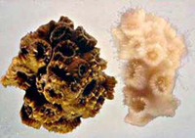
Coral Bleaching
Photosynthetic algae is responsible for the pigmentation of the coral reefs.
When corals become stressed their polyps will expel their algal cell and as a result of this the coral will become devoid of all color.
Many types of zooxanthallae are intolerant to heat stress, and as a result, when the ocean temperatures rise in many cases the zooxanthallae will leave its host.
Coral bleaching is becoming more prevalent as ocean water continues to warm around the world.
Notes:
Pic 3. oceanservices.noaa.gov/education/kits/corals/coral02_zooxanthellae.html

Slide 4
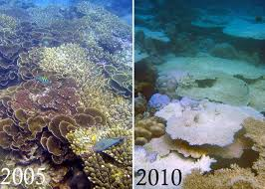
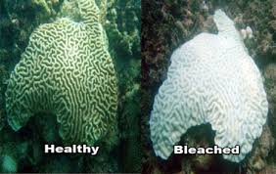
Coral Bleaching
All of the reef-building corals are completely depending on this symbiotic relationship between the dinoflagellates otherwise referred to as zooxanthellae.
Biologist are concerned that as global warming continues coral bleaching combined with ocean acidification could destroy many coral reefs systems.
Though transplantation of more resilient algae is taking place, many coral types will not host the new species of zooxanthellae.
Notes:
Pic 4. www.emax.com/@AICFFWXFC/coral
Pic5. https;//blog.uvm.edu/lspechle-flcoralreefs/timeline/

Slide 5
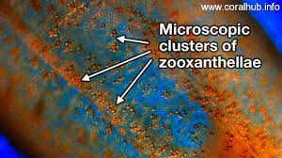
Differences in Light
Several different studies have suggested that there is a disruption of photosynthesis in Symbiodinium spp. when undergoing exposure to temperatures above 32 degrees Celsius.
In a culture zooxanthellae has shown interspecies differences in the capacity to photo-acclimate to low light.
Biologist predict that corals who harbor multiple types of zooxanthallae may be more resilient to future warming events.
Notes:
Pic 6. extrememarine.org.uk/coralreefs/sample-page/

Slide 6
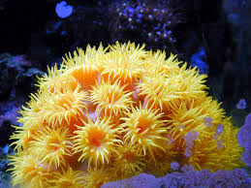
Ecospecies
Studies have shown that the long-term survival of coral reefs is linked to the ability for some corals to host multiple types of the eight phylogenetic clades of zooxanthellae.
As ocean waters warm, studies show that the symbiont type can greatly influence the growth rate of corals.
Multiple symbiont types enhance the corals ability to adapt to stress.
Notes:
Pic 7. learnsomethingaboutplants.blogspot.com

Slide 7
Conclusion
The Mutualistic relationship between dinoflagellate algae and corals is a sensitive balance where both organisms continually benefit form one another.
This long-lived relationship has begun to be offset due to anthropogenic changes in the earth’s atmosphere as a result, there is a decoupling.
Only a few species of zooxanthellae are tolerant to temperature changes.
This mutualistic relationship is the building block for the overall coral reef ecosystem and as changes occur this relationship has become stressed beyond its limits.

Slide 8
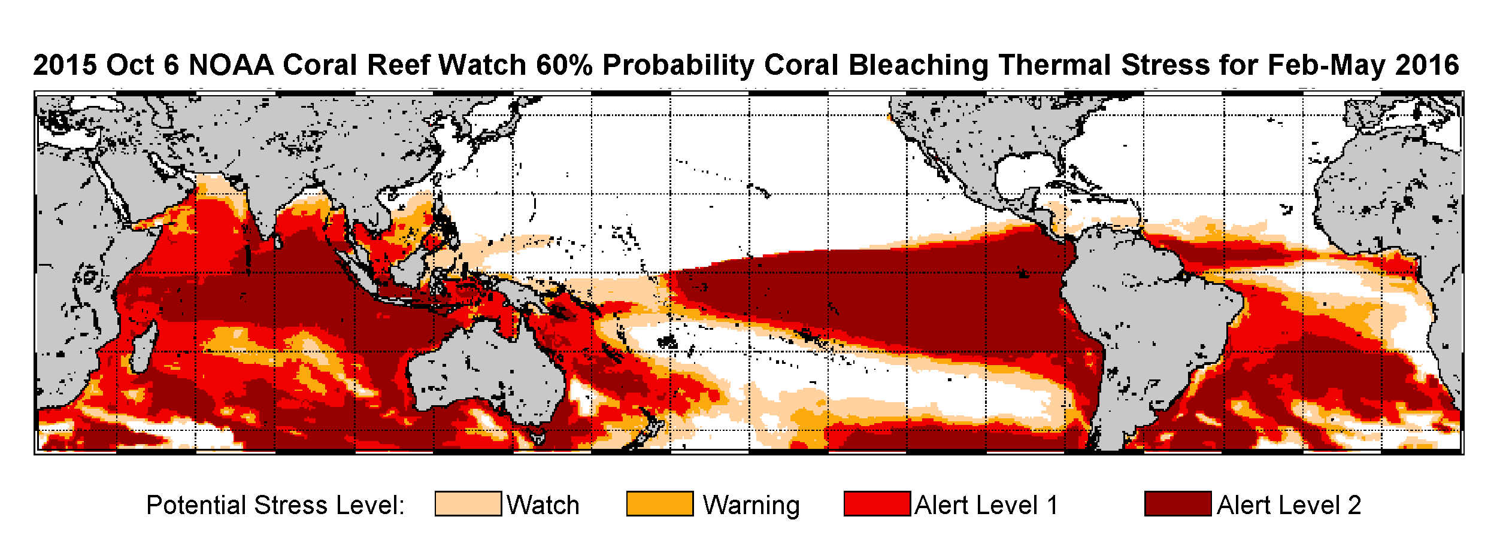
Figure 1. In February NOAA released a map of coral reefs that are under high concern for coral bleaching.

Slide 9
References
Anthony, K. R. N., D. I. Kline, G. Diaz-Pulido, S. Dove, and O. Hoegh-Guldberg. "Ocean Acidification Causes Bleaching and Productivity Loss in Coral Reef Builders." Proceedings of the National Academy of Sciences 105.45 (2008): 17442-7446.
Berkelmans, Ray, and Madeleine J.H Van Oppen. (2006) "The Role of Zooxanthellae in the Thermal Tolerance of Corals: A ‘nugget of Hope’ for Coral Reefs in an Era of Climate Change." Proceedings of the Royal Society B: Biological Sciences. 273:2305-2312. The Royal Society.
Fitt, W. K., F. K. Mcfarland, M. E. Warner, and G. C. Chilcoat. "Seasonal Patterns of Tissue Biomass and Densities of Symbiotic Dinoflagellates in Reef Corals and Relation to Coral Bleaching." Limnol. Oceanogr. Limnology and Oceanography 45.3 (2000): 677-85.
Hoegh-Guldberg, Ove. "Climate Change, Coral Bleaching and the Future of the World's Coral Reefs." Mar. Freshwater Res. Marine and Freshwater Research 50.8 (1999): 839.
Robison, Jennifer D., and Mark E. Warner. "Differential Impacts Of Photoacclimation And Thermal Stress On The Photobiology Of Four Different Phylotypes Of Symbiodinium (Pyrrhophyta)1." Journal of Phycology J Phycol 42.3 (2006): 568-79.

