Slide 1
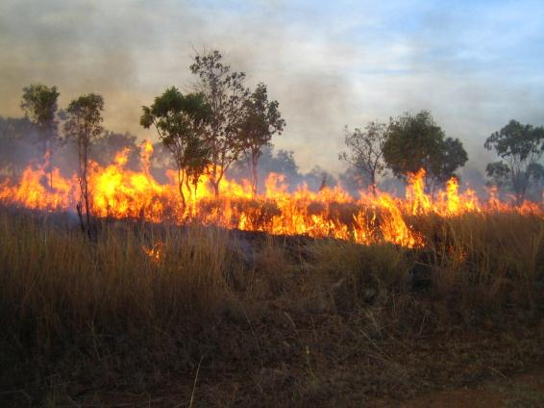
Forest fires in south-eastern Australia
Dr Tina Bell

Slide 2
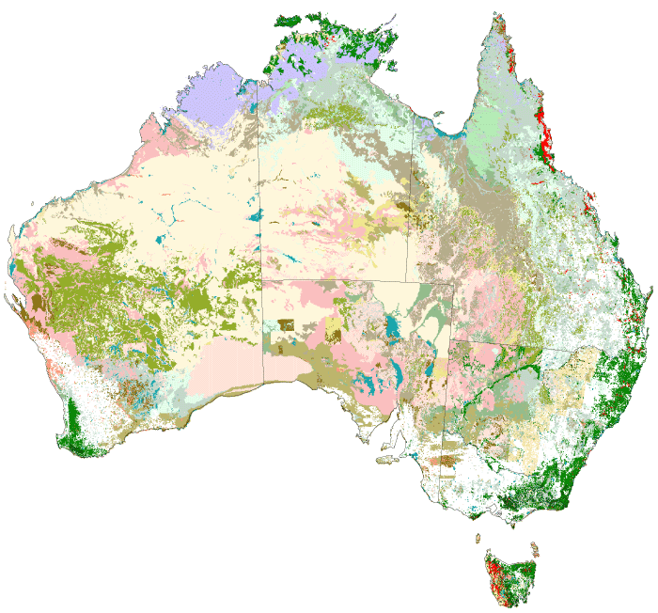
Australia has 149 million ha of forest
© Commonwealth of Australia

Slide 3
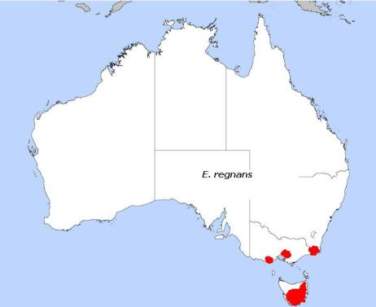
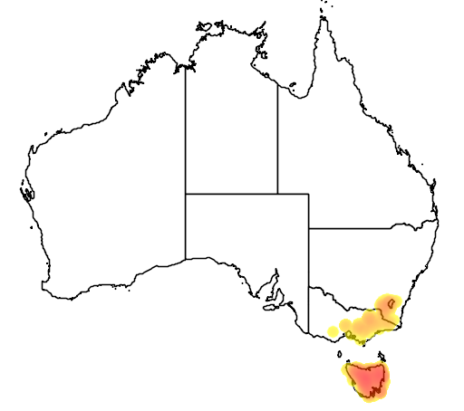
Ash-type species in south-eastern forests
Mountain Ash
Eucalyptus regnans
Alpine Ash
Eucalyptus delegatensis

Slide 4
Australia is a fire-prone country
Area burnt in Australia (1996-2009)
1 hectare = 2.47 acre
Modified from Giglio et al. (2010) Biogeosciences 7, 1171-1186
Data sets compiled from four sensors (ATSR, VIRS, Terra MODIS, MODIS) using three methodologies (500 m map, local regression and regression tree)

Slide 5
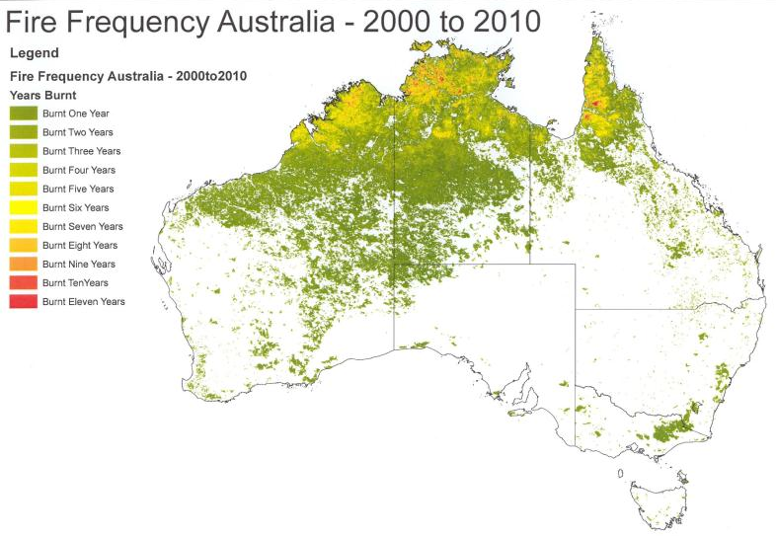
Fire frequency 2000-2010

Slide 6
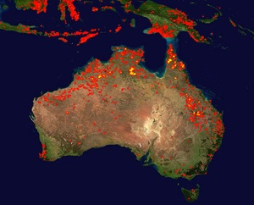
MODIS satellite map 10 day period in Jan 2012

Slide 7
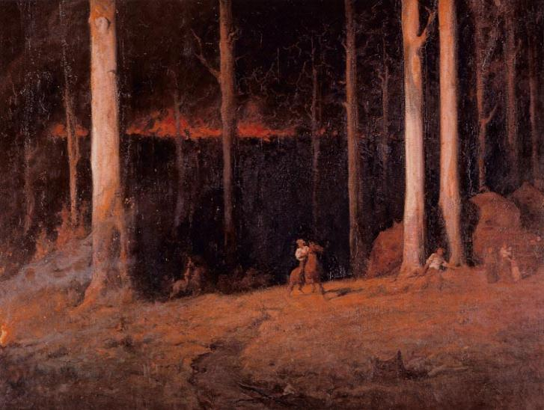
Gippsland, Sunday Night, February 20th 1898 John Longstaff

Slide 8
Major fires in south-eastern Australia
, Victoria

Slide 9
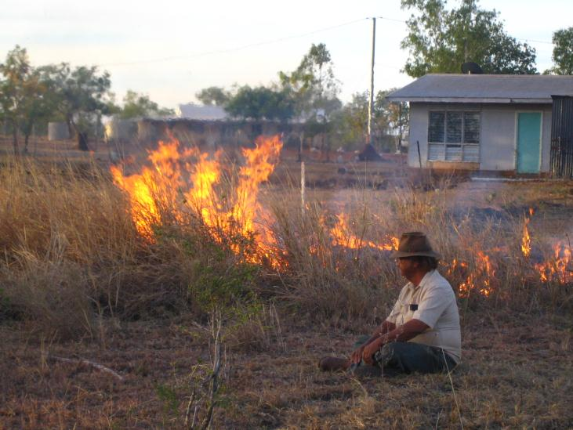
Not all fires are the same...

Slide 10
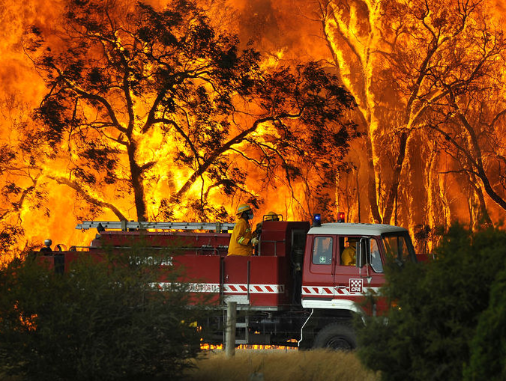
Black Saturday fires, Victoria 2009

Slide 11
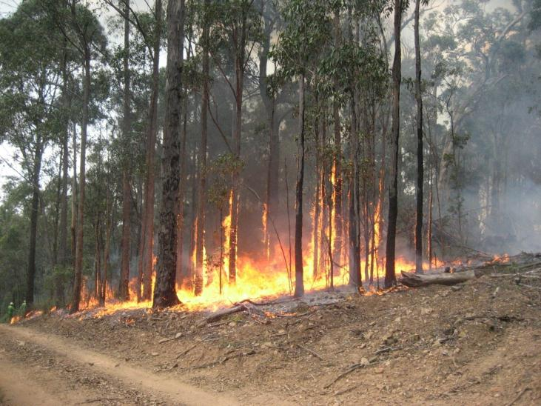
Prescribed fire in south-eastern Australia

Slide 12
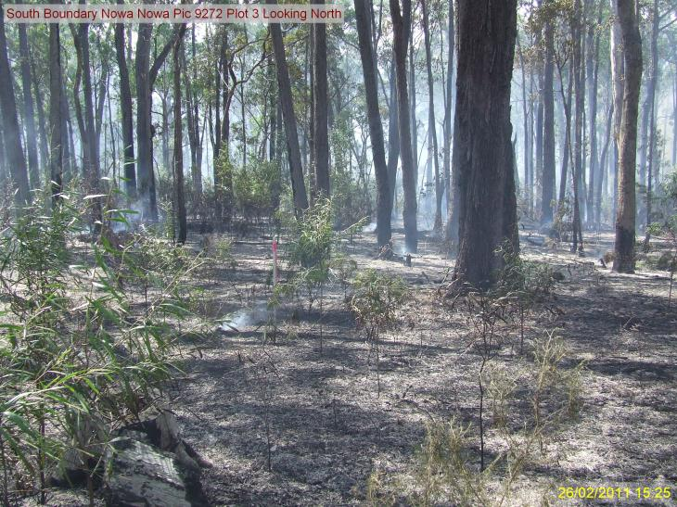
The aftermath can be different...

Slide 13
Carbon balances and prescribed burning
UNDERSTOREY PLANTS

Slide 14
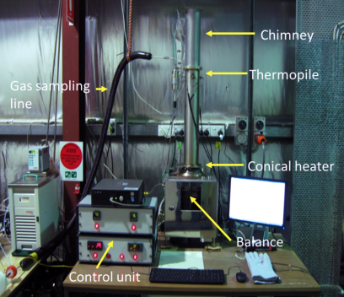
Carbon balances and prescribed burning
LITTER
Biomass (t/ha)
Mass Loss Calorimeter and gas analysis (CO₂, CO, VOCs)

Slide 15
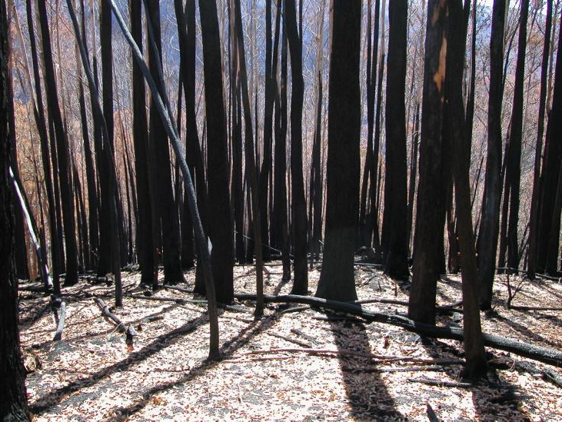
High severity fire in Alpine Ash forest in 2003

Slide 16
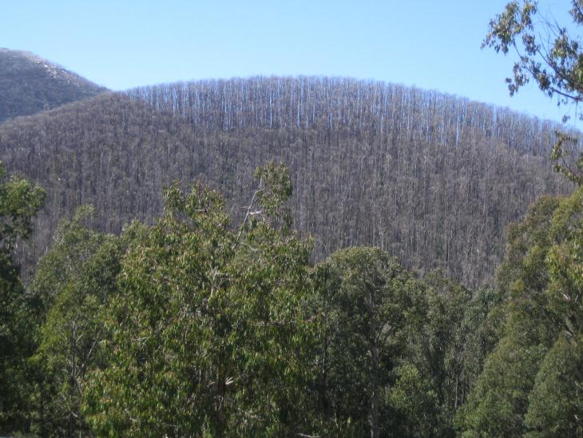
High severity fire in Alpine Ash forest in 2003

Slide 17
C and N recovery in forest soil
Total nitrogen (%)
Total carbon (%)
Nov 2002
Pre-fire
2003
2005
2008
Nov 2002
Pre-fire
2003
2005
2008

Slide 18
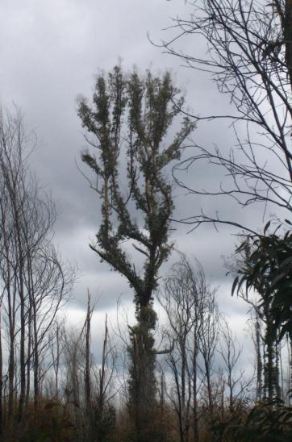
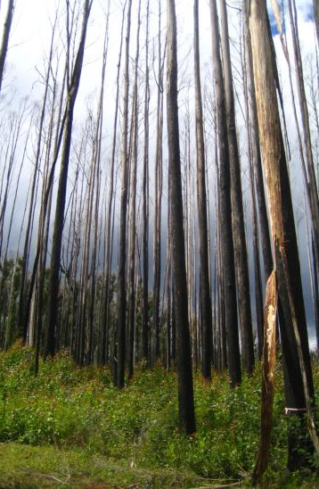
Not all plants recover in the same way...

Slide 19
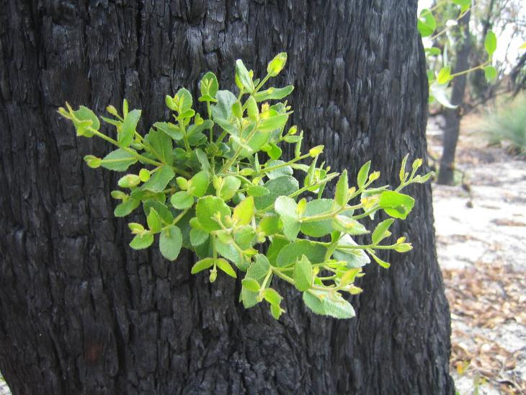
Epicormic sprouting in Eucalypts

Slide 20
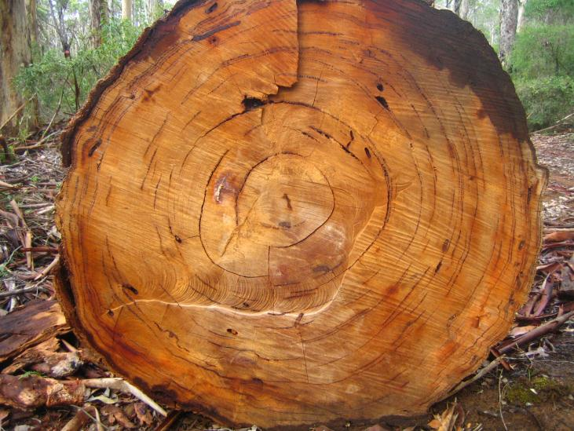
Evidence of past fires

Slide 21
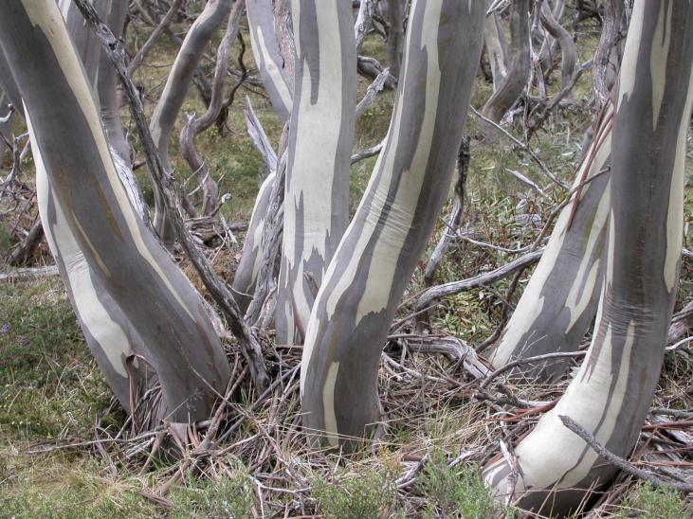
Snowgum (Eucalyptus pauciflora)

Slide 22
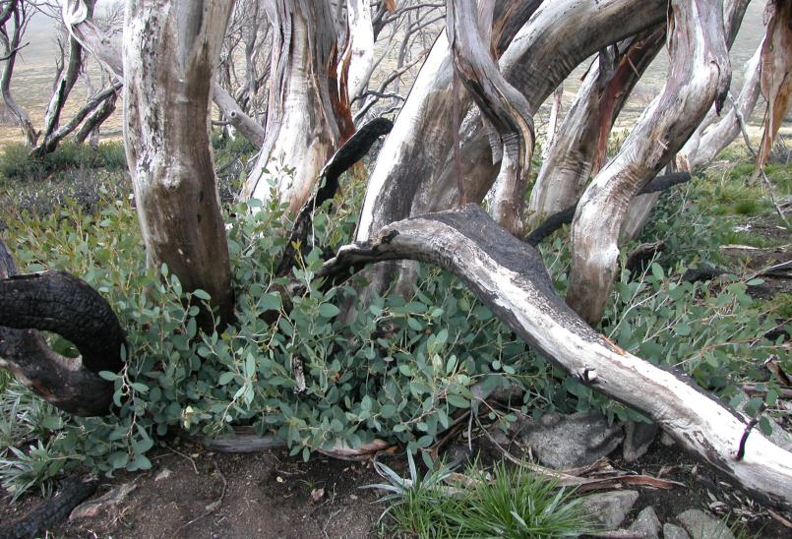
Resprouting from an underground lignotuber

Slide 23
Fire-sensitive Eucalyptus delegatensis

Slide 24
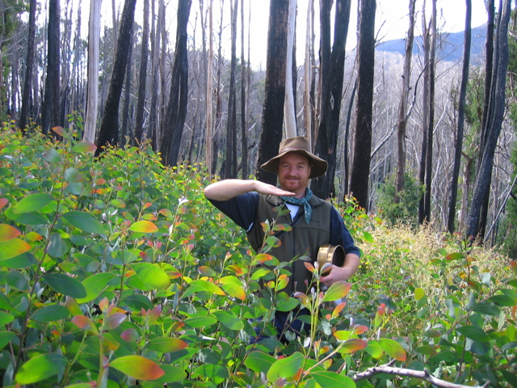
Mass germination of fire-sensitive species

Slide 25
Mass germination of fire-sensitive species
1 hectare = 2.47 acre

Slide 26
Survivorship curves

Slide 27
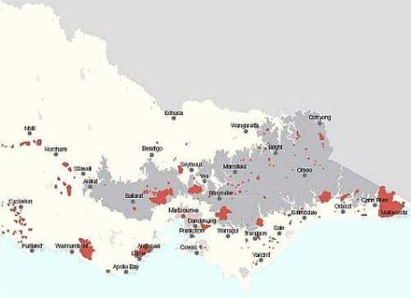
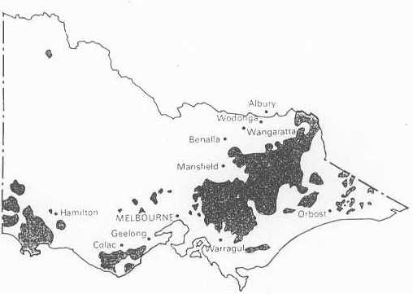
Fire in south-eastern forests
1983 fires
1939 fires

Slide 28
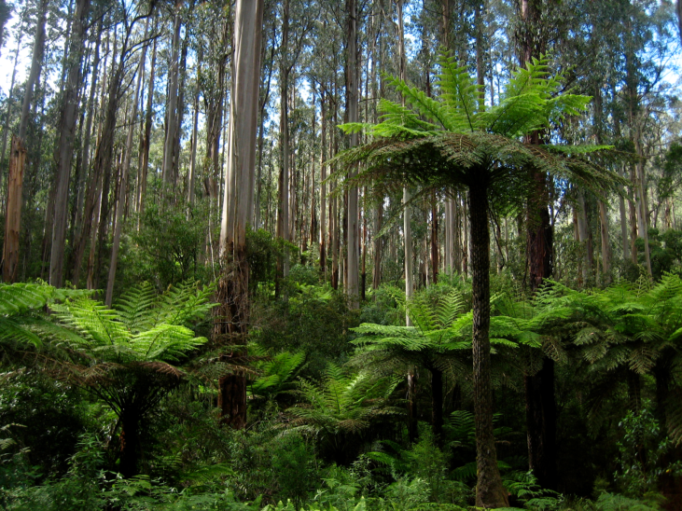
1983 regrowth

Slide 30
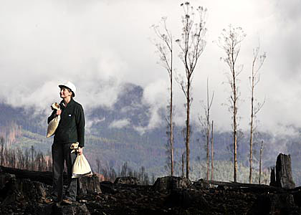
A recovery program was needed
In 2004/05
Aerial re-seeding of 3314 ha of Mountain Ash and Alpine Ash forest
Hand planting of 183 500 seedlings
Salvage logging and site preparation
$5.8 million spent on rehabilitation
In 2008/09
Aerial re-seeding of 4500 ha of Mountain Ash and Alpine Ash forest
3500 kg of seed distributed during 250 hours flying time
The Age Newspaper

Slide 31
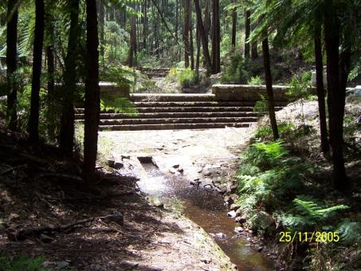
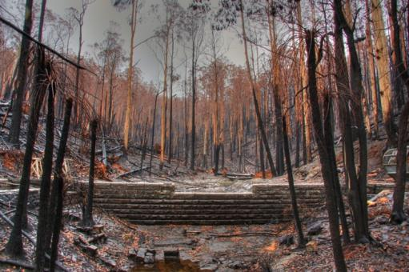
Forest catchments in south-eastern Australia
Half of the catchments from which SE Australian cities draw water are E. regnans forest
Half classified as Mixed-species Open Forest (containing specimens of E. obliqua, E. radiata, E. dives, E. viminalis, E. rubida, E. globulus, E. mannifera, E. macrorhyncha, E. baxteri)

Slide 32
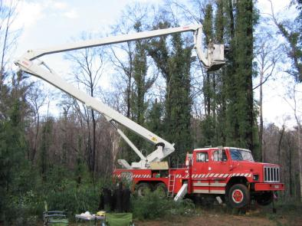
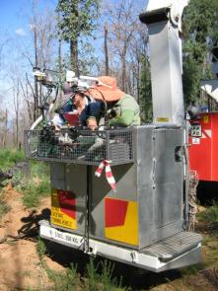
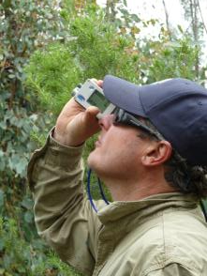
Forest catchments in south-eastern Australia
Water yield is strongly linked to water use by vegetation – 5% change in water use may result in a 20% reduction in streamflow
3 years after crown fires trees are still bearing epicormic branches and juvenile foliage
Structure is changing over time – many small branches distributed evenly along trunk in 2010 to fewer and larger branches in 2012

Slide 33
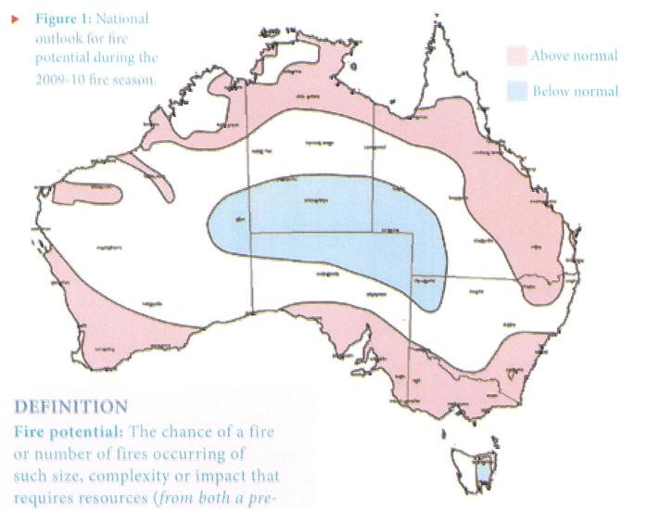
Seasonal outlook 2009-2010
Above normal fire activity
Below normal fire activity

Slide 34
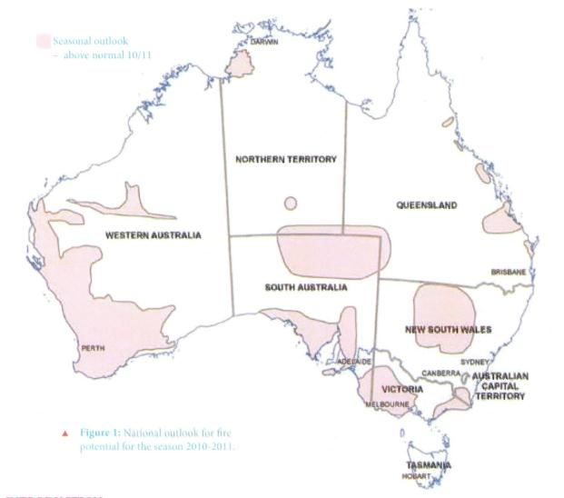
Seasonal outlook 2010-2011
Above normal fire activity

Slide 35
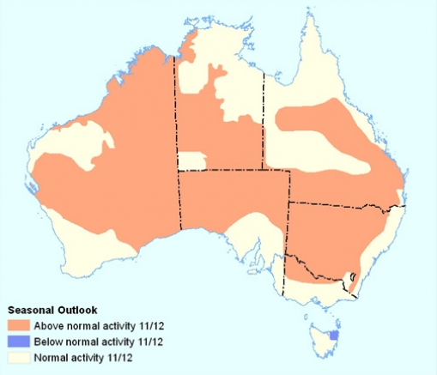
Seasonal outlook 2011-2012

Slide 36
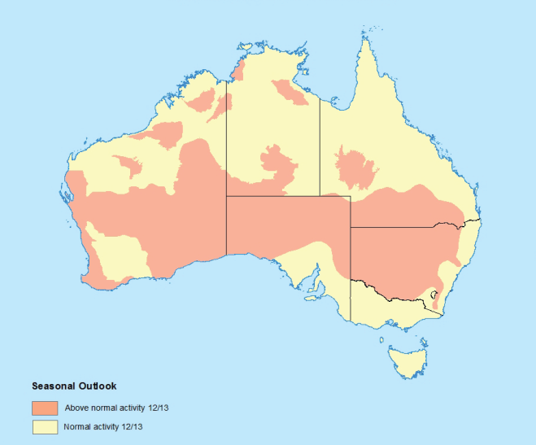
Seasonal outlook 2012-2013

Slide 37
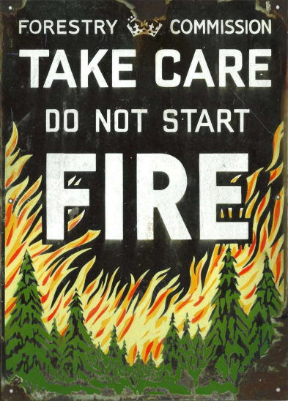
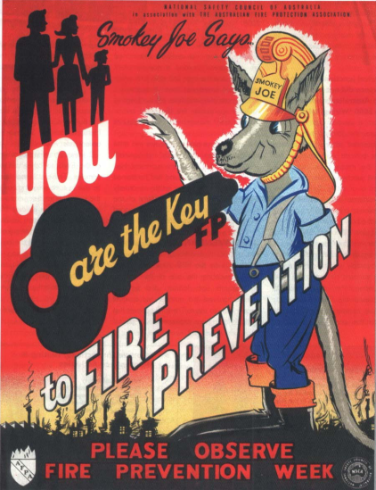

Slide 38
Why am I here?
Gottstein Fellowship awarded 2011
The Joseph William Gottstein Memorial Trust Fund was established in 1971 as a national educational Trust for the benefit of Australia’s forest products industries. The purpose of the fund is
"to create opportunities for selected persons to acquire knowledge which will promote the interests of Australian industries which use forest products for the production of sawn timber, plywood, composite wood, pulp and paper and similar derived products."
“Burning ambition – tertiary education opportunities for bushfire professionals”

Slide 39
Comparing Australia and the US
Country | Fire-specific UG subjects | Fire-specific PG subjects | Alternative format subjects
Australia This study (n = 25) | 8 | 10 | 14
United States Kobziar et al. (2009) (n = 22) | 50 | 22 | 29
NOT a consequence of the size of the university
  (US: 3 024-60 347, Australia: 12 482-55 000)
Related to decline of production-focused departments and faculties (agriculture, forestry)?
Are Australian students ignorant of the importance and relevance of fire?

