Slide 1
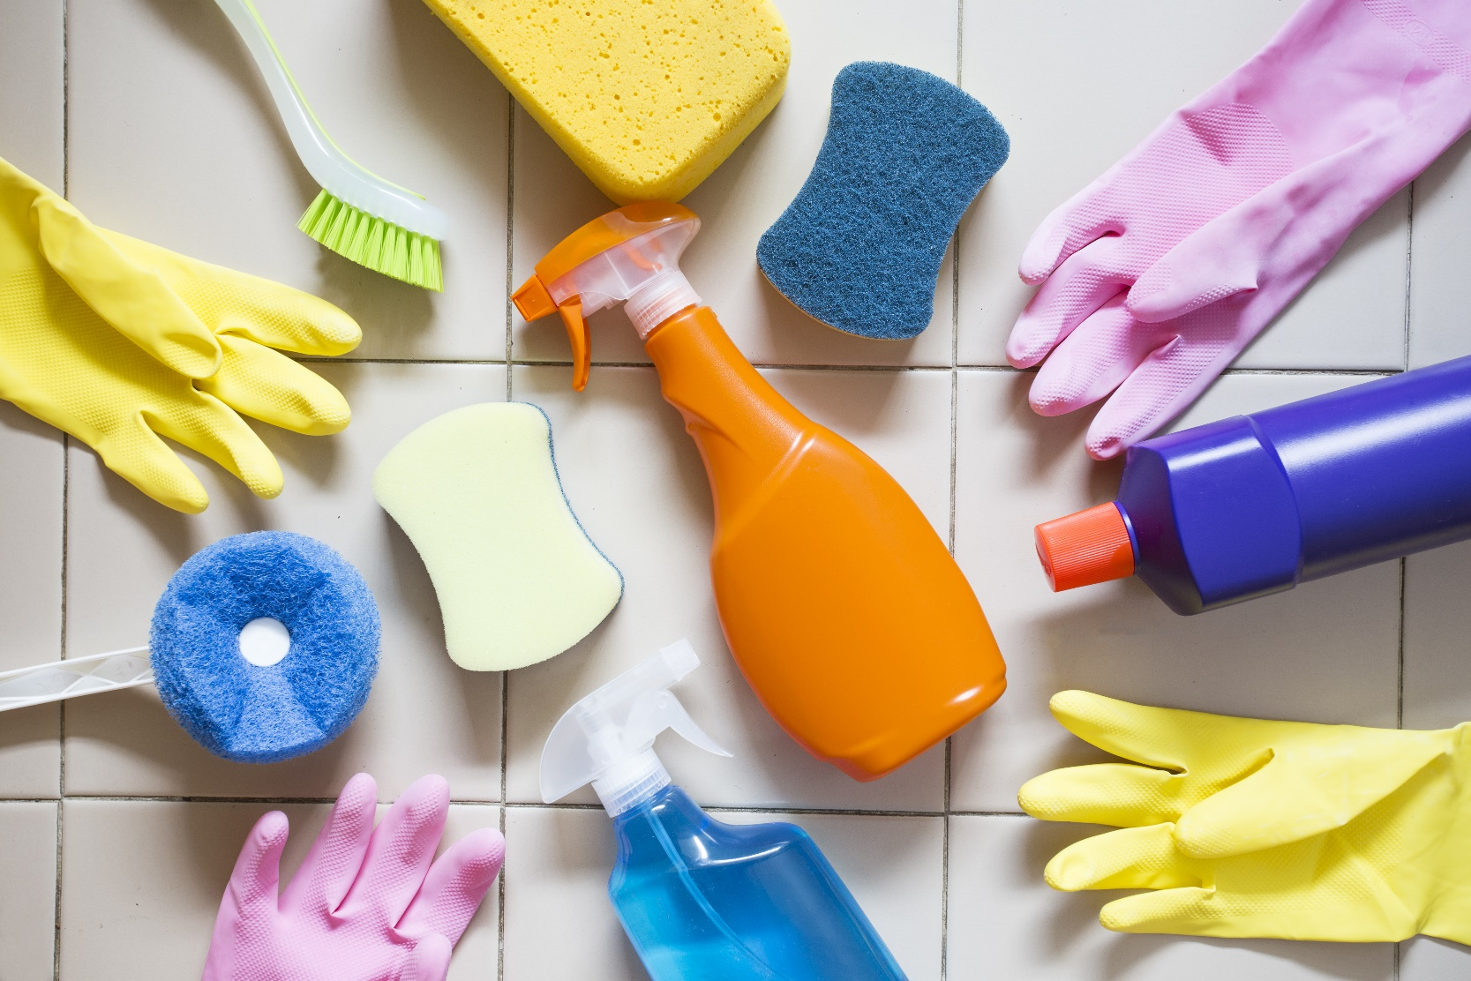
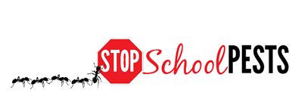
School IPM FOR CLEANING PROFESSIONALS
Lesson 1 of 1
In-Person Education Module

Slide 2
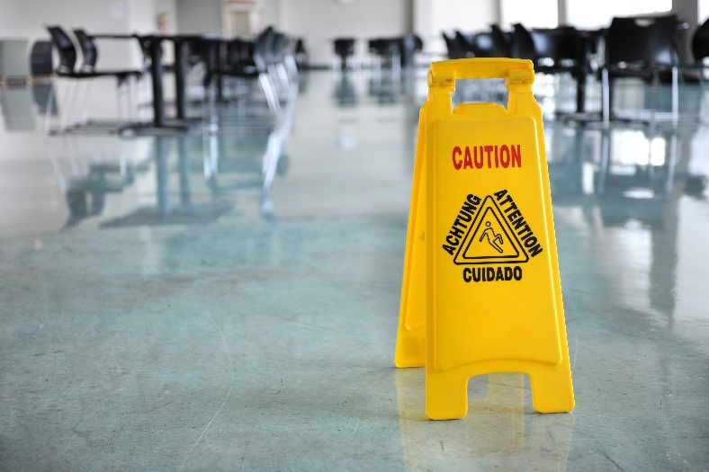
Learning Objectives
Sanitation issues and problem areas
Elements of sanitation and exclusion
Strategies
Tactics
Tools
Inspection and monitoring
What to look for
Where to look
Tools used
Frequency

Slide 3
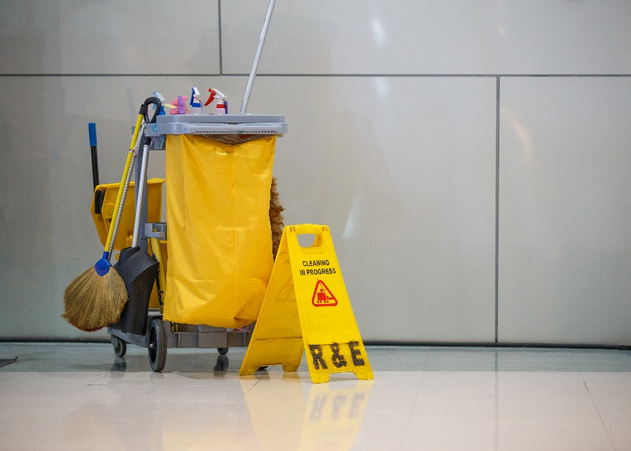
Learning Objectives
Data collection, recording and evaluation
Sanitation
Monitoring
Inspection
Cleaning procedures for:
Drain areas
Floors
Corners
Beneath equipment
Floor joints

Slide 4
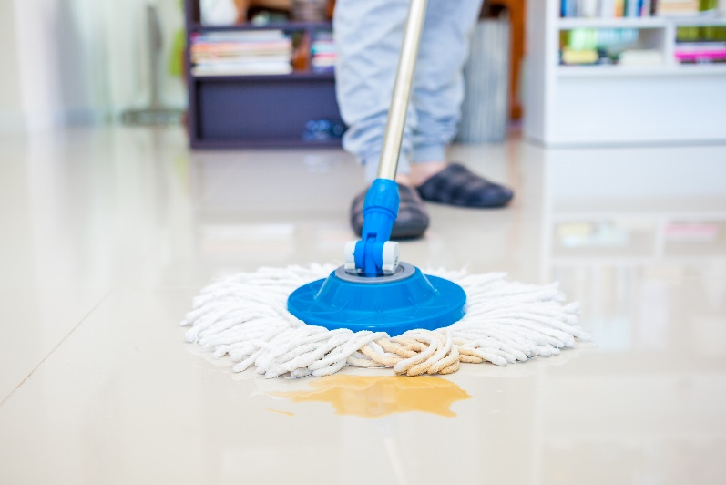
Learning Objectives
Maintenance and storage of cleaning equipment
Correct storage, including inspection of deliveries for pest presence and good sanitation of storage areas

Slide 5
Learning Objectives
Effective communication, education and cooperation between relevant parties:
Facility users
Contractors
Custodial
Food service
Landscape and grounds maintenance
Teachers
Administrators

Slide 6
1.
Do What You Already Do, Just Think Pest!
Quality of the learning environment directly impacts the quality of learning
Notes:
Custodians are among the most important people for IPM in any environment!
Custodians working in schools affect the quality of the learning environment and directly impact the quality of learning.

Slide 7
Do What You Already Do, Just Think Pest!
“I am very proud to be the custodian of my school. I want the students here to enjoy how it feels to be in a clean and safe place”
- Robin Anderson,
Salt Lake City Schools
Robin Anderson - Ricardo Zubiate, Salt Lake City School District

Slide 8
1.
Do What You Already Do, Just Think Pest!
IPM Coordinators rely on custodians to inform them of pest sightings and conducive conditions
Custodians correct conducive conditions by denying pests access to food and moisture

Slide 9
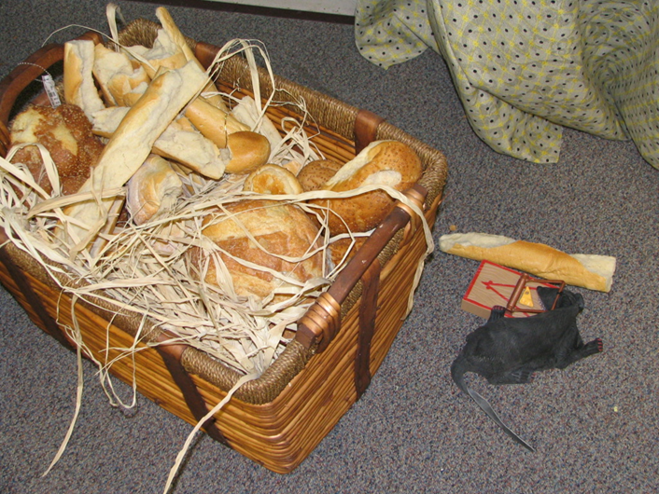
Do What You Already Do, Just Think Pest!
Staff education
Basket of bread from school play left on stage over winter break, roof rats were delighted! Jerry Jochim, Monroe County
Community School Corporation
Notes:
Custodians can play an important role educating staff and students on how to avoid pest-conducive conditions.

Slide 10
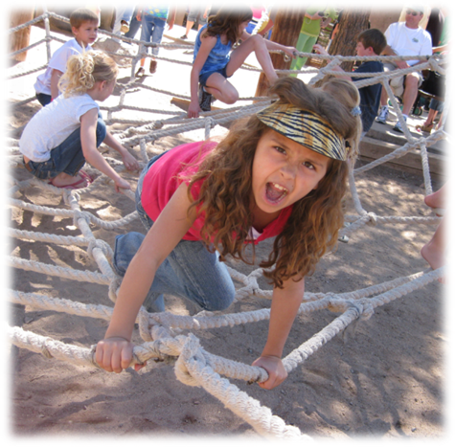
1.
Sensible Rules Go A Long Way
Custodians manage an environment affected by everyone
Building occupant behavior should be well managed
Head custodians can give valuable insight
Children can be unpredictable –
Dawn H. Gouge, University of Arizona
Notes:
The Head Custodian should be included on committees that develop policies for behavior.
Example: School districts restricting drinks in outdoor areas to water or electrolyte drinks have dramatically reduced stinging insect problems around outdoor trashcans.

Slide 11
1.
Common Sanitation Issues and Problem Areas
Poor sanitation leads directly to pest problems by providing food, water and shelter
Custodians should:
Have high standards and expectations for cleanliness and organization
Be detail oriented

Slide 12
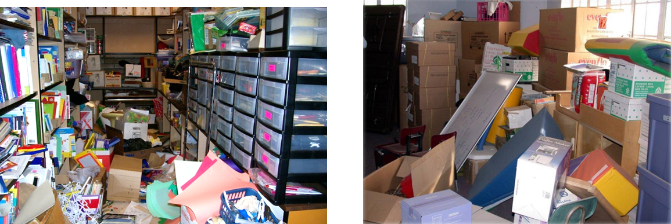
1.
Clutter Bugs - Most Schools Have One
It is impossible for any cleaning professional to effectively remove dirt from these spaces!
Cluttered storage - Dawn H. Gouge, University of Arizona

Slide 13
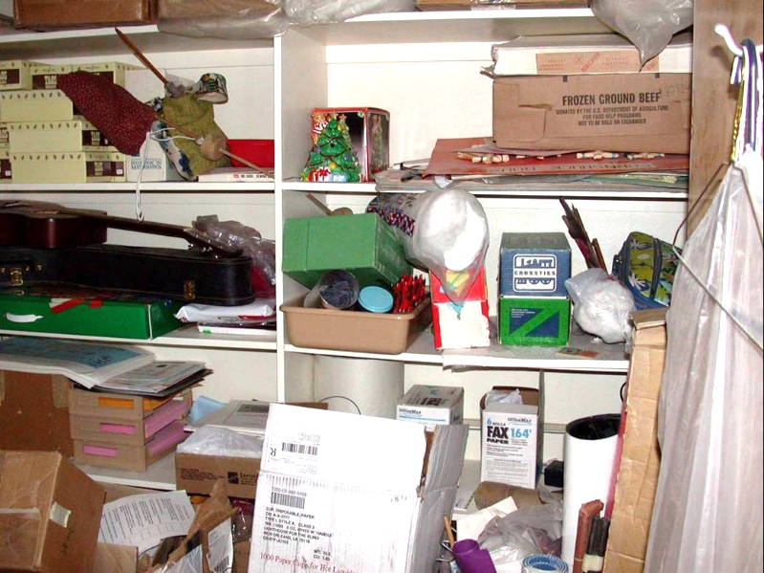
Administrative Support
School policies should prohibit clutter:
Fire safety
Allergen reduction
Pest prevention
Custodial staff must have the support of the school administration
Cluttered storage - Marc Lame, Indiana University

Slide 14
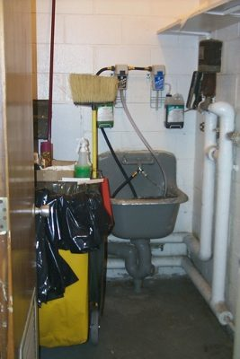
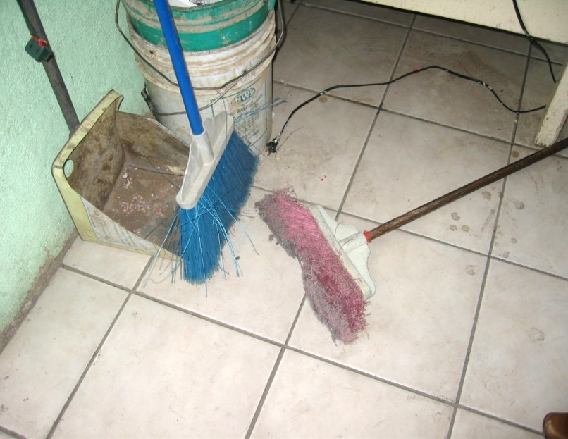
1.
Common Sanitation Issues and Problem Areas
Poor quality and/or poorly maintained cleaning supplies and tools generate problems
Dawn H. Gouge, University of Arizona
Brooms should be stored upside down so they can dry properly
Nicely organized cleaning supply closet

Slide 15
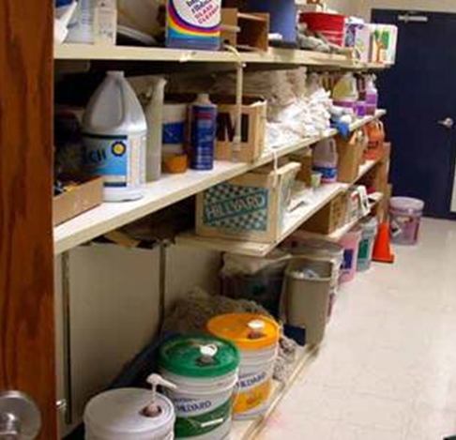
Cleaning Equipment Maintenance and Storage
Custodial closets can provide food, water, and shelter for pests
Avoid storing items on the floor, which makes cleaning and inspection difficult – Dawn H. Gouge, University of Arizona

Slide 16
Cleaning Equipment Maintenance and Storage
Custodial Closet Tips
Inspect closets
Discard items no longer used
Clean and paint
Evaluate the mechanicals
Check lighting
Restock, organize and prioritize
Notes:
Meet with cleaning crew and inspect each custodial closet.
Empty closets of items no longer used or have not been used in months.
Clean and paint. Standards applied to the rest of the facilities, should be applied to custodial closets.
Evaluate the mechanicals (is there efferent storage space, shelving units, etc.)
Check the lighting. Often custodial closets do not have lights, making it more difficult to keep clean and organized.
Restock, organize and prioritize. Items should be organized by need and use.

Slide 17
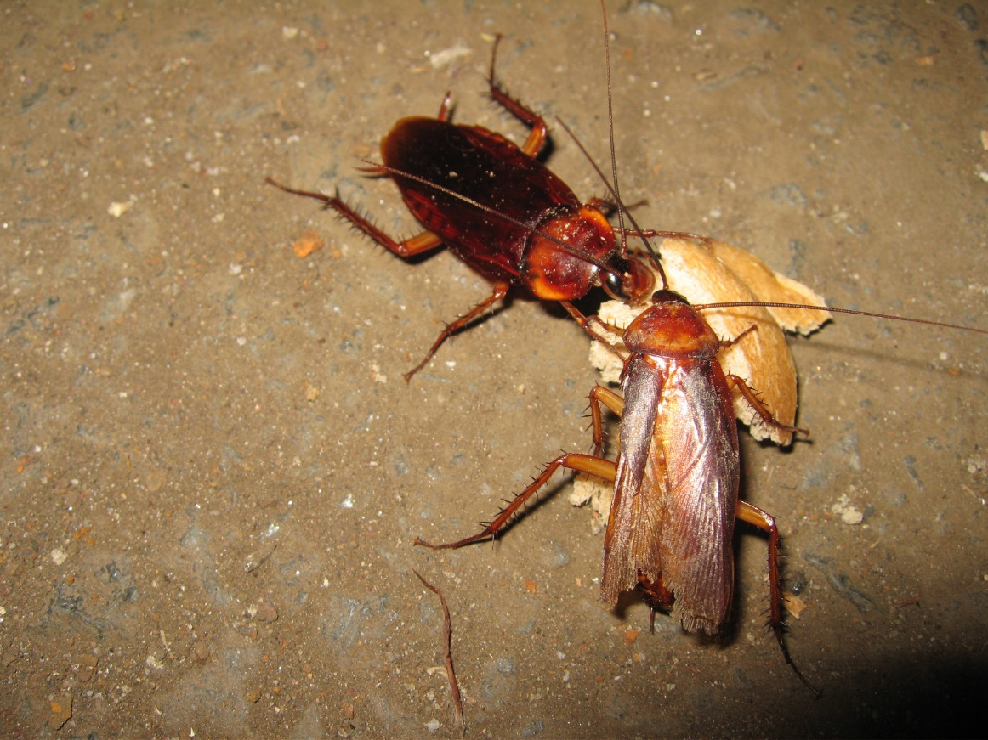
Common Sanitation Issues and Problem Areas
Sanitation standards may be compromised if too few custodians are staffing a school
American cockroaches eating food scraps – Dawn H. Gouge, University of Arizona
Notes:
National median maintained per full-time custodial worker: 32,100 square feet (American School and University Magazine, 2009).

Slide 18
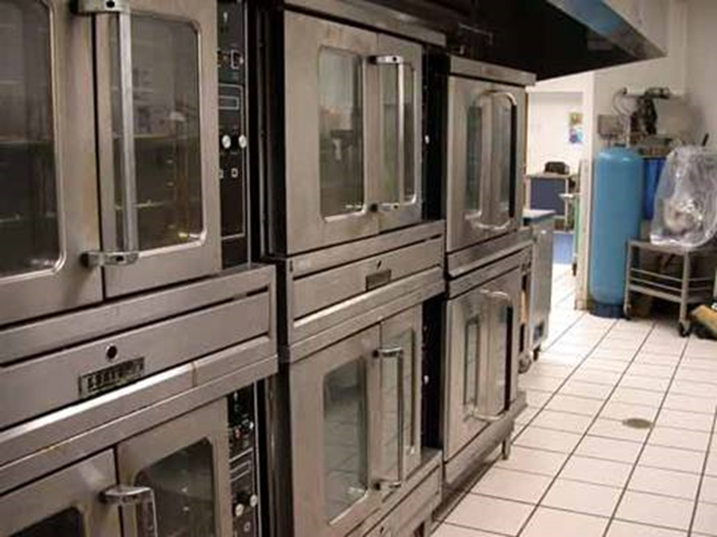
Common Sanitation Issues and Problem Areas
Hard-to-reach places can be ideal for pests
Under and behind fixed equipment can be difficult to reach for cleaning or inspection – Dawn H. Gouge, University of Arizona
Notes:
Hard to reach places are dark; food and water can collect there, providing ideal habitat for cockroaches, fly maggots and other pests.

Slide 19
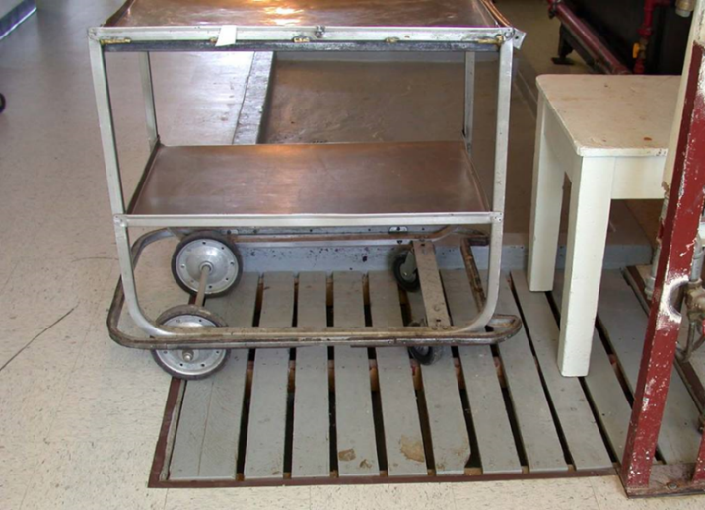
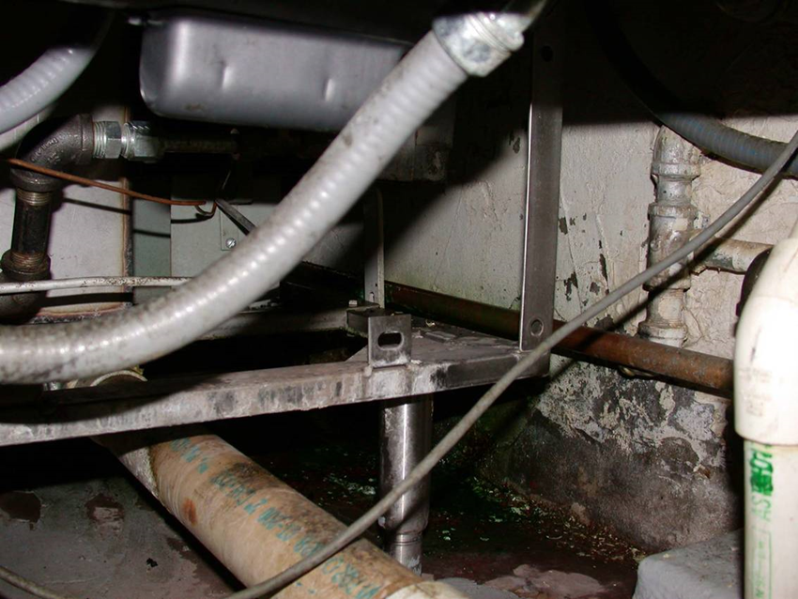
1.
More Hard-to-Reach Locations
Covered floor drains
Organic matter, grease feed pests
Jerry Jochim, Monroe County Community School Corporation
Under heating units

Slide 20
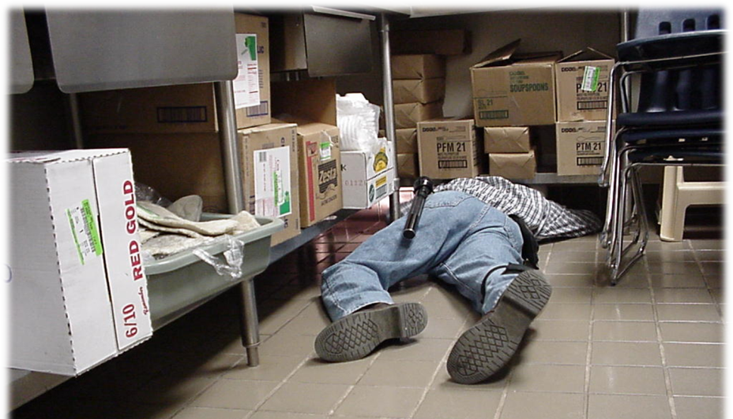
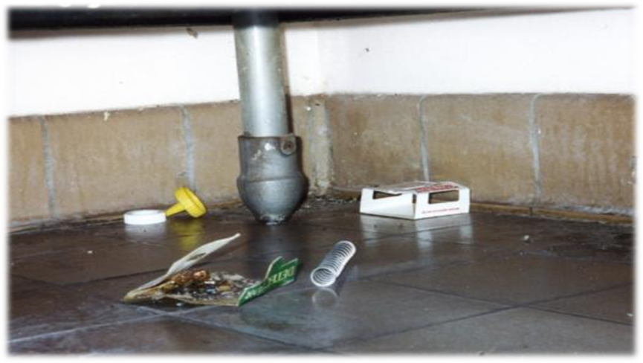
Corner Cleaning
Debris collects in corners, under furniture, behind equipment
“Back-leg zone”
Dawn H. Gouge, University of Arizona
Sweeping and mopping can push food debris into corners. That’s why pests love these areas!
The “back-leg zone”

Slide 21
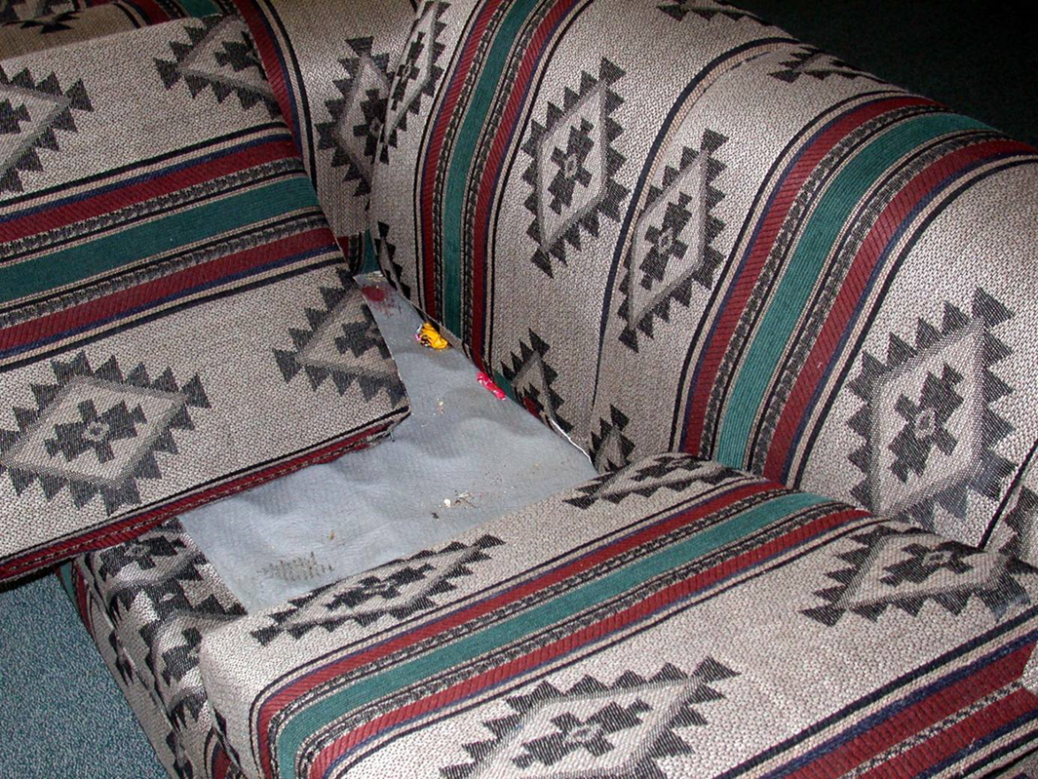
Furniture food!
Crumbs collect under cushions
Upholstered furniture is difficult to keep clean, especially where food is consumed including teacher’s lounges, and coaches, maintenance or custodial offices – Dawn H. Gouge, University of Arizona

Slide 22
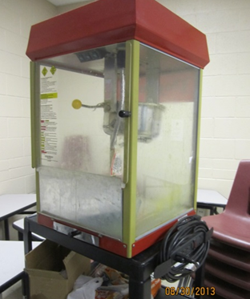
1.
Unmanaged Areas
Some areas in schools may not be managed by custodians
E.g., student stores and parent-run concession stands
Head custodians and IPM Coordinators must be allowed to inspect all areas – Dawn H. Gouge, University of Arizona
Notes:
These areas can be especially vulnerable to pests.

Slide 23
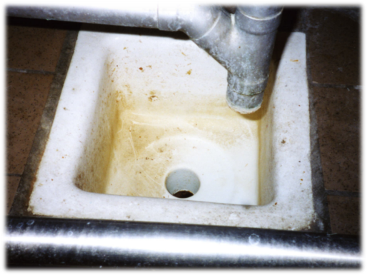
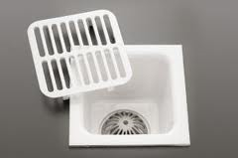
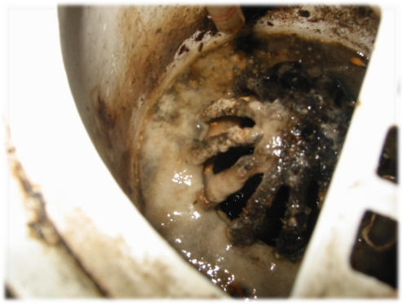
1.
Floor Drains and Floor Sinks
Organic matter builds up and drain fly maggots breed in drain
Drains may be hidden
Dawn H. Gouge, University of Arizona
Not good
Clean!
Bad!
Notes:
Often, food service staff clean from the floor up, and don’t have the tools or training to clean floor drains.

Slide 24
1.
Problem Zones
Problems zones can support pests
Principals are expected to give them the authority they need to access and keep all areas of the school clean

Slide 25
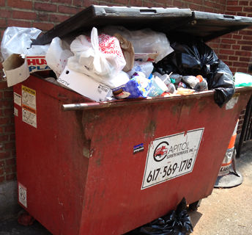
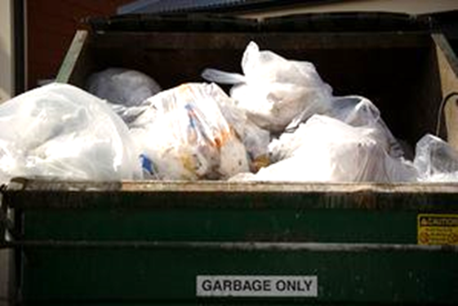
1.
Waste Management
Waste management is pest management:
Quality trash bags
Keep it clean
Bag all waste going into dumpsters
Marc Lame, Indiana University
Left: Trash is haphazardly thrown into dumpster
Right: All trash is secured in tied trash bags with no over flow
Notes:
Use good quality trash bags that do not tear!
Keep the insides and undersides of trash cans clean to avoid providing food for pests.
Bag all waste going into dumpsters.

Slide 26
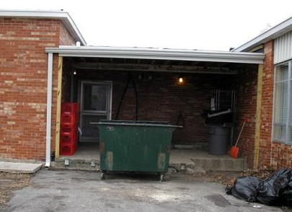
Waste Management
Place dumpsters on a concrete or asphalt surface 30-50 feet away from building entryways
This dumpster is way too close to the kitchen entryway – Dawn H. Gouge, University of Arizona

Slide 27
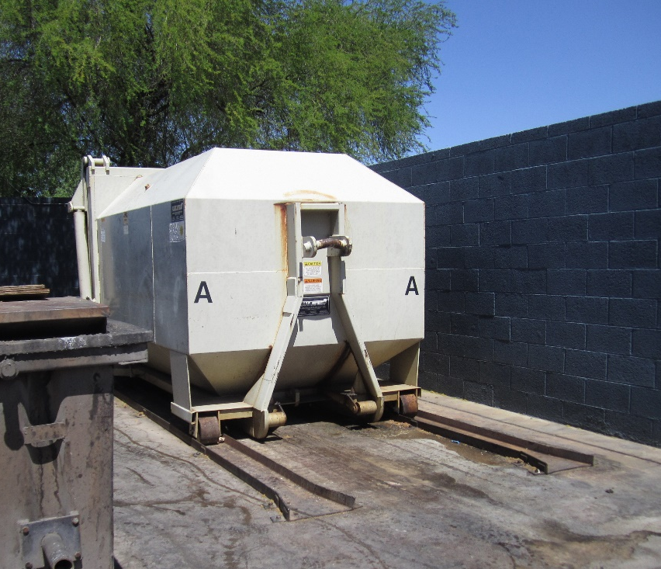
More About Waste Management
Dumpster should be:
Rotated out by your service provider when dirty
Emptied at least weekly
Consider sealed, leak-proof, self-contained compactors, available in many sizes – Shujuan Li, University of Arizona

Slide 28
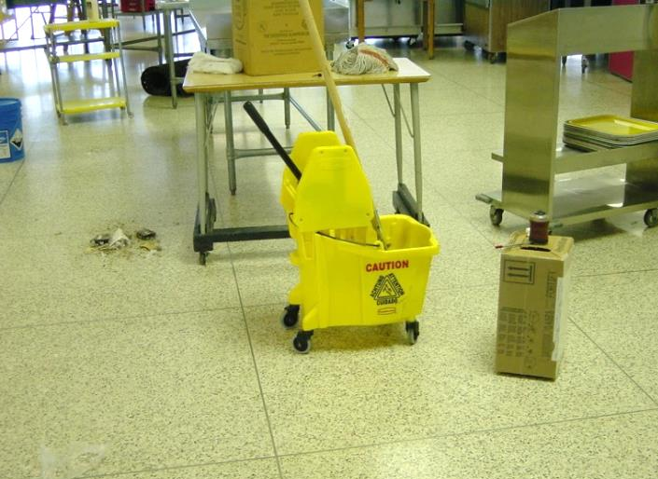
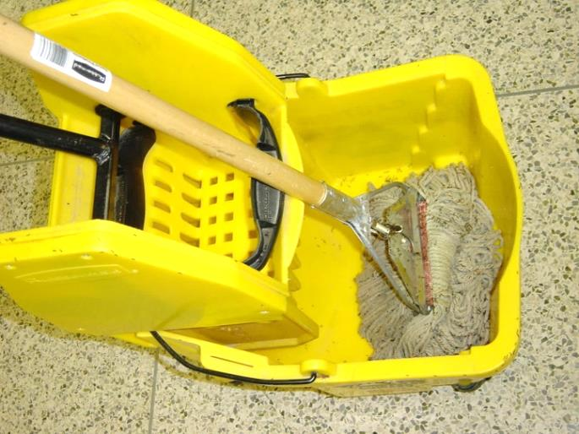
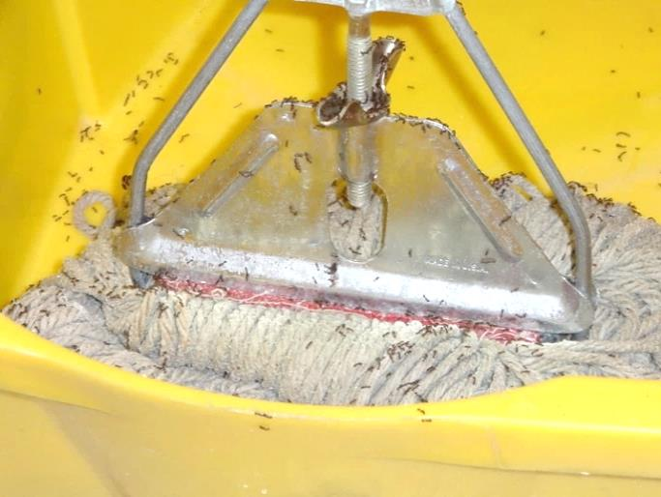
Key Strategies
Do what you do now, just think “pests”
Southern fire ants discover a mop used to clean up a soda pop spill - Jerry Jochim, Monroe County Community School Corporation
Notes:
Here a custodian mopped up a pop spill and took a break. Just 20 minutes later fire ants had discovered the sugary treat.
If the custodian was “thinking pest”, he or she would have emptied the bucket and rinsed and hung the mop before taking a break, and avoided the ants.

Slide 29
Key Strategies
Don’t attract pests
Custodial closets can provide food, water, and shelter for pests
Avoid storing items on the floor, which makes cleaning and inspection difficult – Dawn H. Gouge, University of Arizona

Slide 30
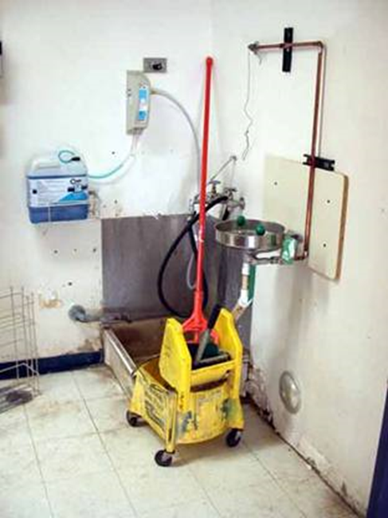
Key Strategies
Equipment used to clean will be full of food particles and moisture
Clean equipment before storing
Avoid leaving mops in dirty water – Dawn H. Gouge, University of Arizona
Notes:
Examples
Hang wet mops up-side-down on wall hanger.
Store mop bucket upside down in floor sink.

Slide 31
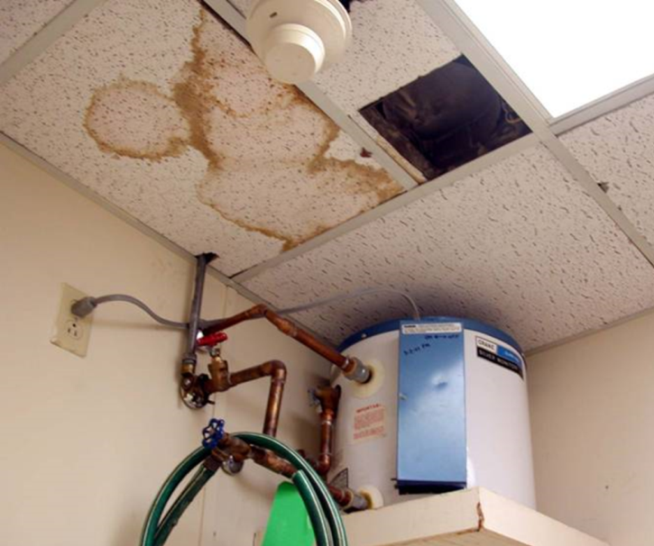
Key strategies
Report pest-proofing needs to the IPM Coordinator or submit work orders for the building maintenance crew
Water leaks can lead to mold, carpenter ants, termites and flies - Report all leaks promptly – Dawn H. Gouge, University of Arizona
Notes:
Custodians know their building better than anyone else.

Slide 32
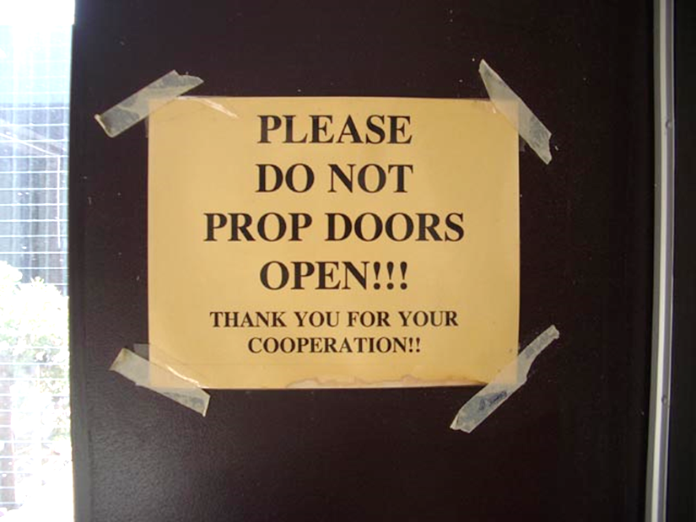
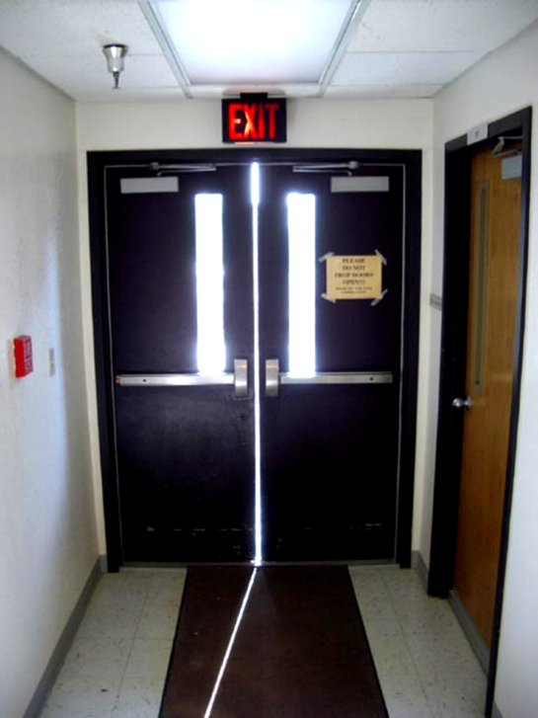
Reportable Conditions:
Missing or Damaged Door Sweeps and Seals
Mice can enter through a ¼” gap
Effective door sweeps can cut pest complaints by 65%!
Dawn H. Gouge, University of Arizona
The horizontal door sweeps are present, but not the vertical
Notes:
The vertical gap in the doorway below should be closed with brushes.
Exterior doors should never be left propped open.

Slide 33
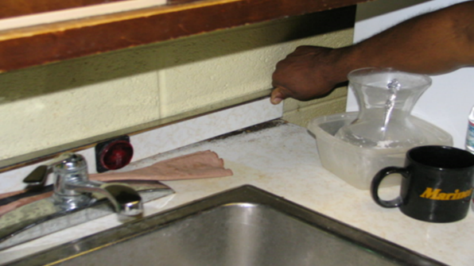
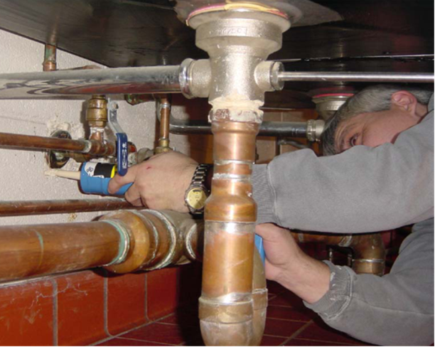
Reportable Conditions:
Gaps that Provide Cover For Pests
Cockroaches spend daytime hours harboring in cracks and crevices including:
Open plumbing and electrical penetrations
Unsealed crevices
Custodians sealing around a pipe escutcheon plate and sealing a back-splash - Jerry Jochim, Monroe County Community School Corporation
Notes:
Report/submit work orders to correct these conducive conditions, especially in areas where food is stored, prepared or served.

Slide 34
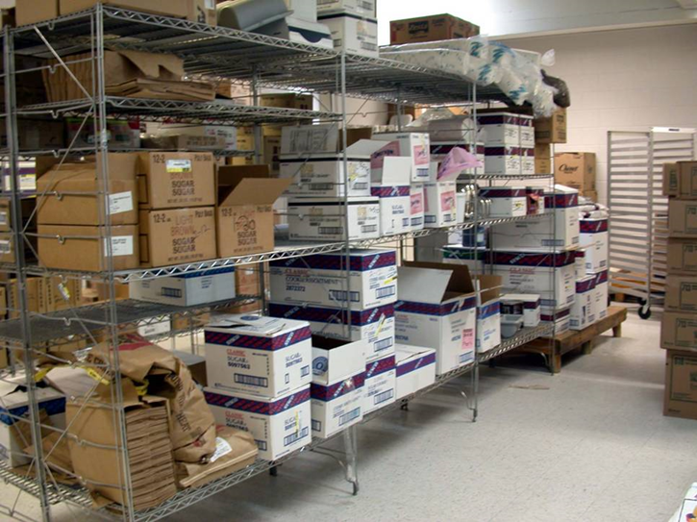
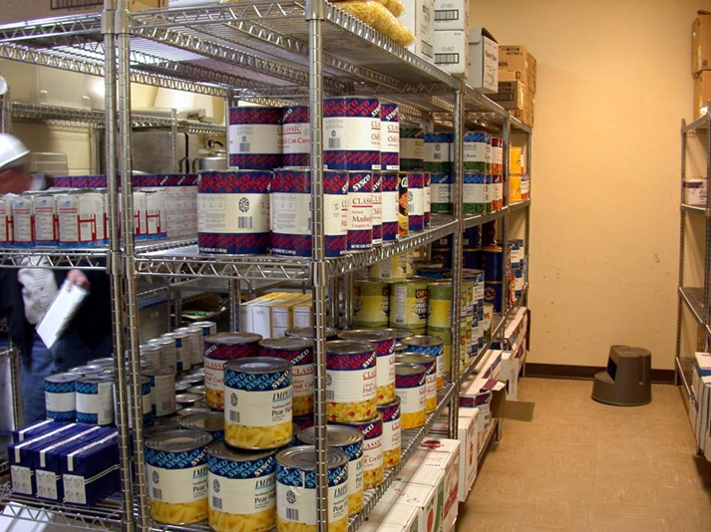
Cardboard
Corrugations in cardboard boxes provide excellent harborage for cockroaches
Problematic
Excellent
Kitchen pantry, before and after cardboard removal
Marc Lame, Indiana University
Notes:
The glue used in boxes is a food source. Avoiding cardboard in storage is an important part of cockroach management.

Slide 35
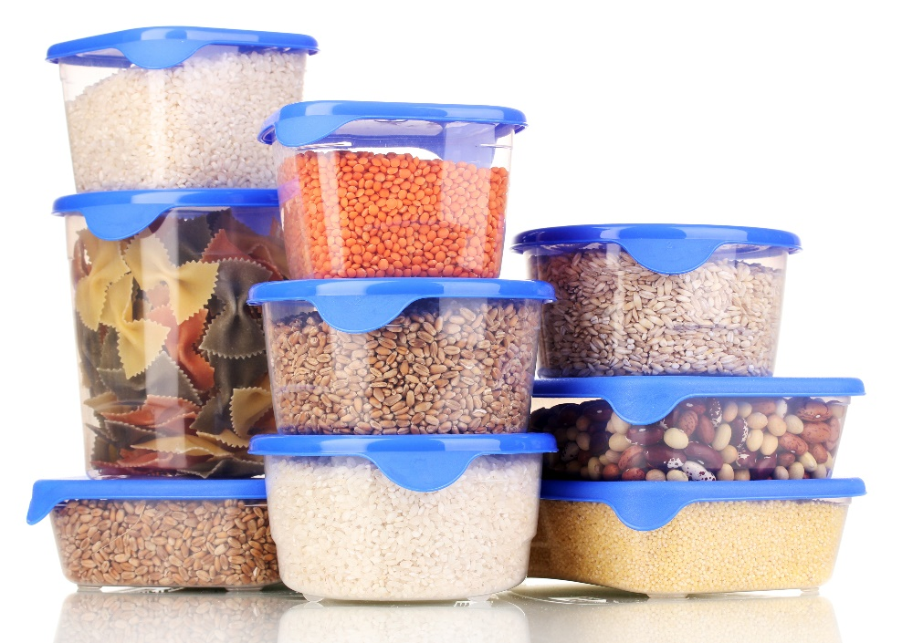
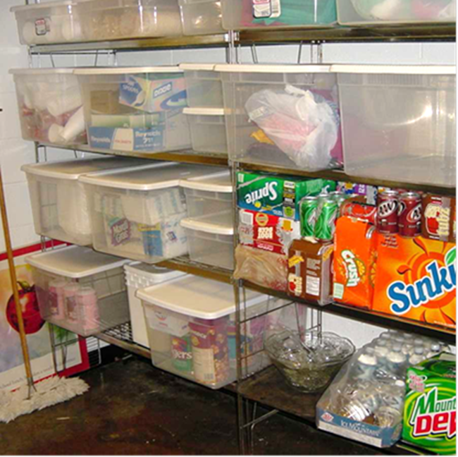
Reportable Conditions: Access to Food
Teachers should use airtight containers for storage of any edible classroom supplies
See-through storage totes can reduce and prevent ant and cockroach problems - Dawn H. Gouge, University of Arizona

Slide 36
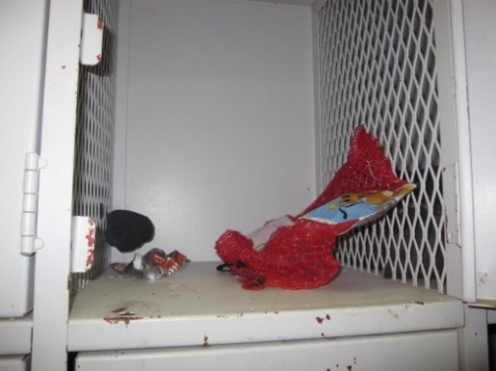
2.
Key Elements of Inspection and Monitoring
What to look for:
Pests
Signs of pests
Pest conducive conditions
Mouse poop on a spoon
Dawn H. Gouge, University of Arizona
Wrappers and decomposing food in athletic locker

Slide 37
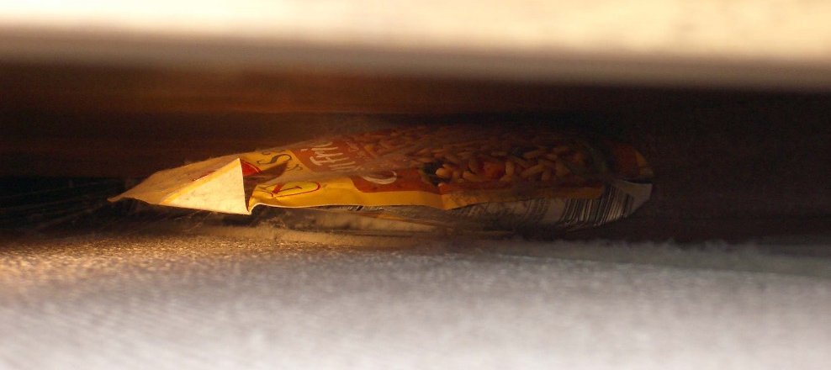
2.
Key Elements of Inspection and Monitoring
Where to look:
Dark shadowy corners
Hard to reach areas
Undisturbed places
Warm and/or wet places
Food storage and/or preparation areas
Waste collection containers and areas
Suspended ceilings
Food packet under refrigerator – Dawn H. Gouge, University of Arizona

Slide 38
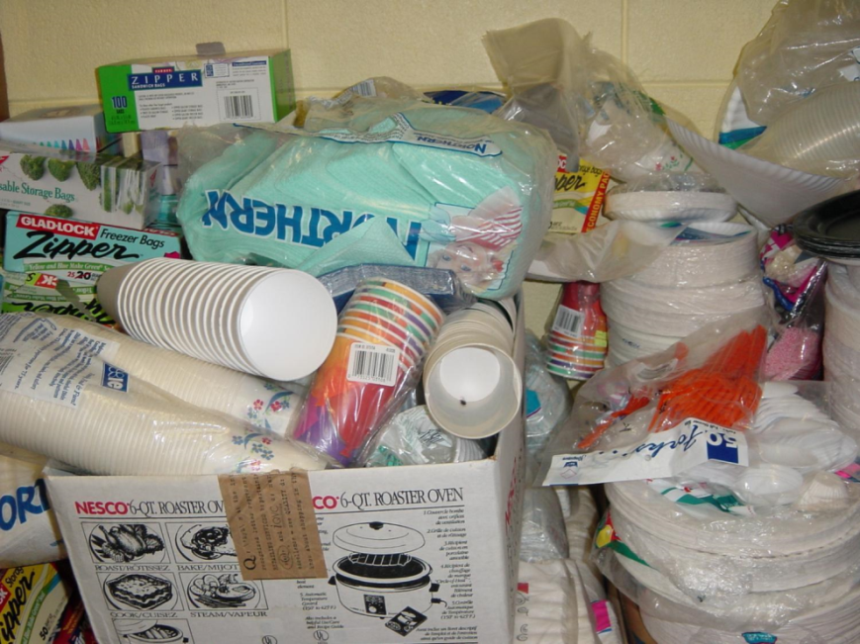
2.
Key Elements of Inspection and Monitoring
Where to look:
Warm walls with penetrations
Compressor motor voids in equipment
Unsealed floors and floor to wall junctures
Undisturbed containers
Cardboard boxes
Clutter
Locked PTO storage, off limits to custodial staff – Dawn H. Gouge, University of Arizona

Slide 39
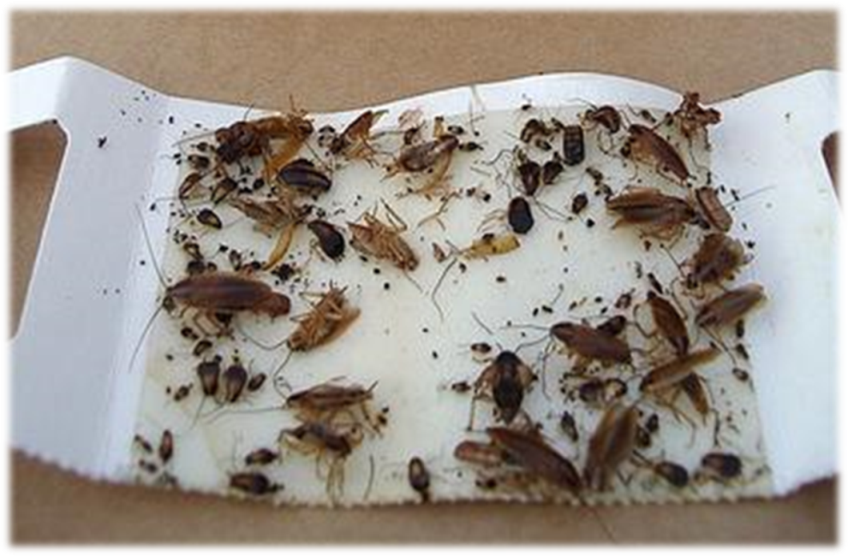
2.
Key Elements of Inspection and Monitoring
Tools:
Monitoring traps
Bright flashlight
Hand lens
Pest monitoring trap catching German cockroaches – Dawn H. Gouge, University of Arizona
Marc Lame identifying
an insect pest -
Jerry Jochim, Monroe County Community School Corporation

Slide 40
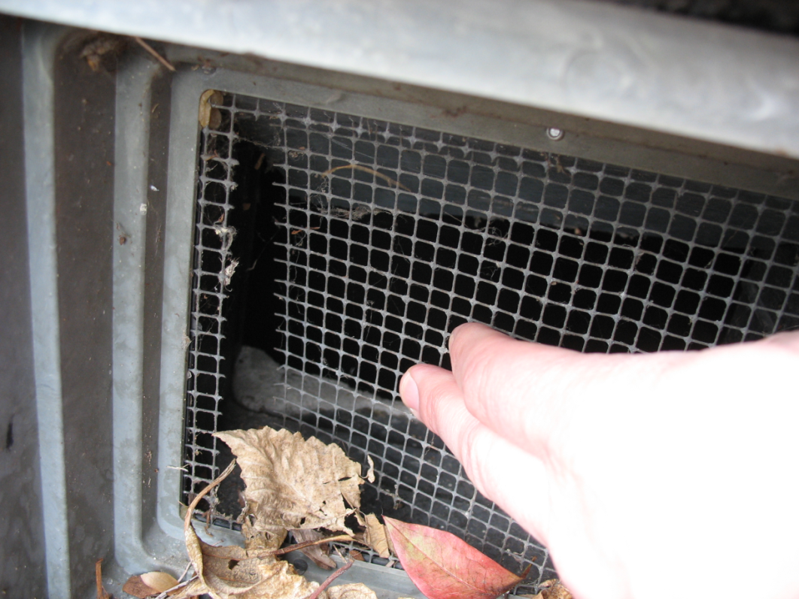
3.
Key Elements of Inspection and Monitoring
Consider recording:
Pests
Signs of pests
Pest-conducive conditions
Broken exclusion mesh
Jerry Jochim, Monroe County Community School Corporation
Notes:
Communicating in writing to IPM Coordinators and others about pest issues documents your actions.

Slide 41
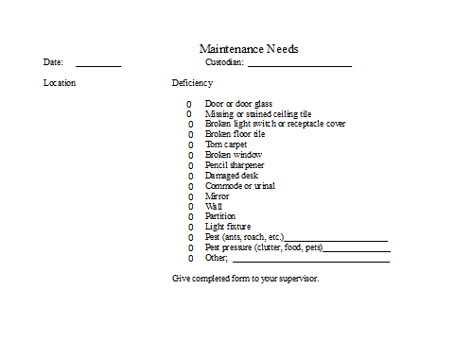
3.
Key Elements of Inspection and Monitoring
Some custodians carry a note pad on their equipment cart or develop their own checklists
Maintenance issues recording - Jerry Jochim, Monroe County Community School Corporation

Slide 42
Thorough Cleaning Procedures
3.
Drains
P-traps in drains prevent gases, odors and insects from entering buildings - keep them filled with water
Dry icky drain which was giving access to American cockroaches – Dawn H. Gouge, University of Arizona
Notes:
Example: dry P-traps can create access to your building from the sewer for American cockroaches.

Slide 43
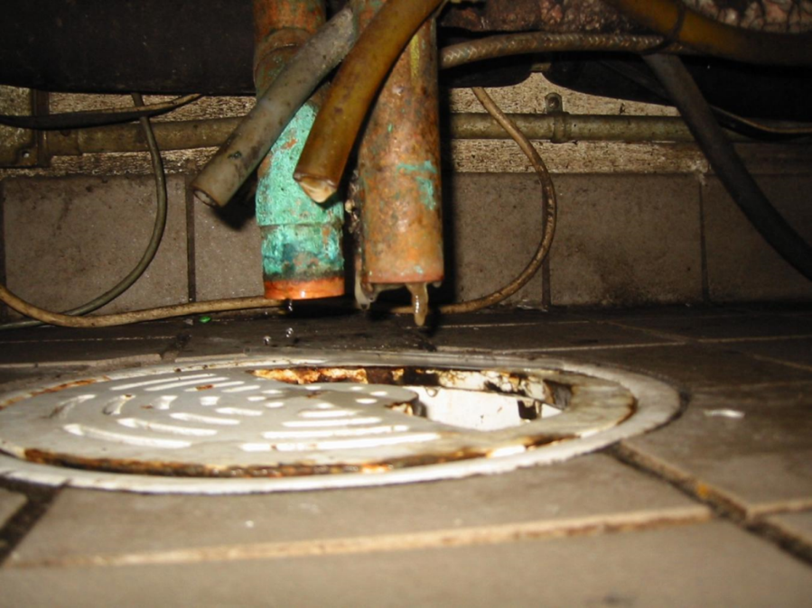
Thorough Cleaning Procedures
Drains under fixed equipment can be difficult to clean
Drain tucked under a fixed kitchen appliance in a difficult-to-reach place had not been cleaned in a long time – Dawn H. Gouge, University of Arizona

Slide 44
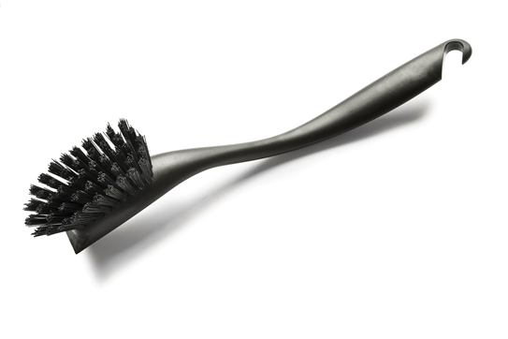
Thorough Cleaning Procedures
3.
Organic matter buildup in drains can be scraped out with a scraper or stiff brush (when no food is out and before surfaces are cleaned)
Monthly maintenance with an enzyme or biological cleaner
Notes:
3. Do this after food has been put away, and before food prep surfaces are cleaned to avoid contamination with listeria and other pathogens sometimes found in drains.

Slide 45
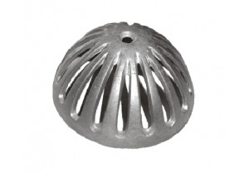
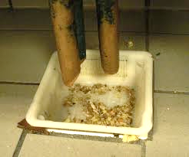
Thorough Cleaning Procedures
3.
Sink nets or floor dome strainers should also be cleaned regularly
Clean sink net
Clean floor sink dome strainer
Floor sink strainer catching food – Dawn H. Gouge, University of Arizona
Notes:
Some are dishwasher safe.

Slide 46
Thorough Cleaning Procedures
3.
Floors
Remove debris
Never dry sweep in areas where food is on display or people are eating
A damp mop may be used to contain spilled liquids
Use quality garbage bags
Tie garbage bags shut prior to placing them in a dumpster
Notes:
Remove debris. A long handled dustpan and brush are useful for solid items, paper and other trash.
To avoid contamination, never dry sweep in areas where food is on display or people are eating.
A damp mop may be used to contain spilled liquids
Place food residues in garbage containers lined with good quality plastic liners that don’t tear easily.
Tie plastic bags shut prior to placing them in a dumpster for removal to avoid spillage and reduce pest access.

Slide 47
Thorough Cleaning Procedures
3.
Floors
Avoid spraying water directly on motors and other electrical equipment
Do not allow moisture to come in contact with stored dry goods
If food debris is present, remember some proteins coagulate at 140° to 145°F, making them more difficult to clean
Notes:
If you hose down floors with water, avoid spraying water directly on motors and other electrical equipment.
Do not allow moisture to come in contact with stored dry goods; moisture promotes mold growth.
If food debris is present, remember some proteins coagulate at 140° to 145°F, making them more difficult to clean. Excessively hot water or steam can bake proteins onto equipment much like an egg sticks to an ungreased frying pan.

Slide 48
Thorough Cleaning Procedures
3.
Floors
Make your selection of detergents based on:
The type of dirt to be removed
Surface type
Water quality
Cleaning method
Cost

Slide 49
Thorough cleaning procedures
3.
Floors
After applying detergent, rinse with clean potable water
Pay special attention to corners, floor joints and under equipment – Dawn H. Gouge, University of Arizona
Notes:
It is important to remove all detergent residue.

Slide 50
Cleaning Equipment Maintenance and Storage
Emptying
Wiping down, washing and rinsing
Notes:
Emptying
Vacuum cleaners, floor scrubbers and other pieces of equipment may need to be emptied of debris or chemicals before they are stored.
Wiping Down, Washing and Rinsing
After use, each piece of equipment should be wiped down and, when appropriate, washed and rinsed to prevent build up of grit and grime.

Slide 51
Cleaning Equipment Maintenance and Storage
Empty before storing
Vacuum cleaners
Floor scrubbers
Other equipment that hold debris or chemicals
Wiping Down, Washing and Rinsing
After use, each piece of equipment should be wiped down and, washed to prevent build up of grit and grime

Slide 52
Cleaning Equipment Maintenance and Storage
Storage
Once brooms, mops and other tools are clean, store the items on off-the-floor racks
Clean and dry mop heads may be stored in transparent plastic totes or on wire shelving
Store equipment off the floor and in a manner that will allow it to dry rapidly – Dawn H. Gouge, University of Arizona
Notes:
Avoid heaping them on the floor or on solid shelving, they provide great harborage for spiders and cockroaches, and even nesting materials for mice.

Slide 53
Cleaning Equipment Maintenance and Storage
Custodial Closets
Custodial closets should be clean and well organized

Slide 54
Cleaning Equipment Maintenance and Storage
Custodial Cart and Closet Tips
Clean-out carts and closets
Discard items no longer used
Clean and paint closets
Evaluate storage and organizational needs
Check lighting
Restock, organize and prioritize, according to need and use

Slide 55
Proper Storage Procedures for Consumables
4.
Inspect deliveries for pests or signs of pests
Example: German cockroaches
Insect monitoring traps help detect problems early in storage areas
Think child safety, indoor air quality and pests
Easy access to bleach under this classroom sink is a hazard for children – Dawn H. Gouge, University of Arizona

Slide 56
Proper Storage Procedures for Consumables
4.
Store hazardous products in inaccessible locked cabinets
Store products together by type and in a place with good ventilation
Check storage areas and make sure that containers are closed and notleaking
Notes:
5. If you can smell a product (cleaning product or pesticide) while it is in storage, the lid may be loose or ventilation may be insufficient to protect air quality and health.

Slide 57
Green Cleaning
4.
Informed Green Solutions, Inc. is a 501(c)(3) created to educate the general public on the benefits of environmentally preferable purchasing http://www.informedgreensolutions.org/
The Ashkin Group, LLC working to green the cleaning industry http://ashkingroup.com/news-2

Slide 58
Check In!
In this lesson you learned:
Common sanitation issues and problem areas
Key elements of sanitation and exclusion
Key elements of data collection, recording and evaluation
Proper and thorough cleaning procedures
Proper maintenance and storage practices of cleaning equipment
Congratulations, you have completed the Cleaning Professional Module!

Slide 59
Resources
North Carolina Cooperative Extension Service. Get Tough on Pests in School Facilities http://schoolipm.ncsu.edu/documents/Custodial_and_Maintenance_staff.pdf
North Carolina Cooperative Extension Service (2012) Implementing an IPM Program for Schools and Child Care Facilities Retrieved from http://schoolipm.ncsu.edu/documents/Manual-Chapter2.pdf
eXtension. (2012). Indoor and Outdoor School IPM Strategies http://www.extension.org/pages/20416/indoor-and-outdoor-school-ipm-strategies#.Utf6rPugnro
38th Annual M&O Cost Study (2009) American School and University Magazine http://asumag.com/Maintenance/school-district-maintenance-operations-cost-study-200904/

