Slide 1
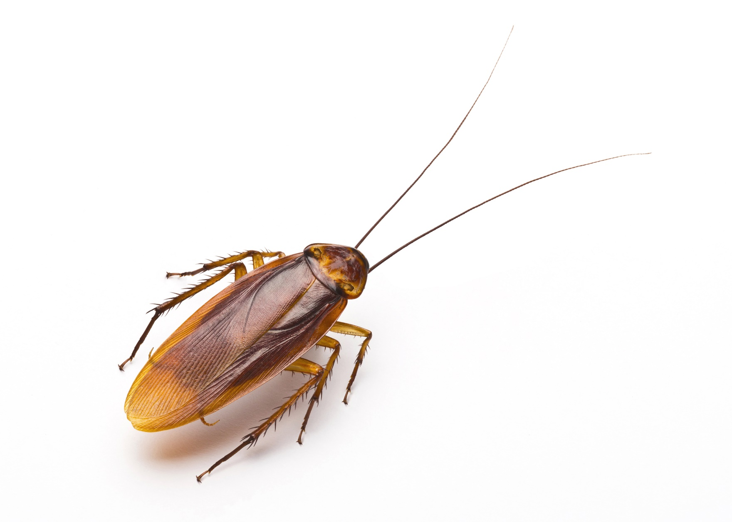
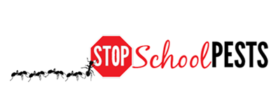
Key pest groups
Lesson 3 of 3
In-Person Education Module

Slide 2
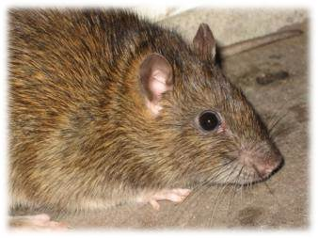
Learning Objectives
How to identify key exterior and landscape pest groups, including:
Biting and stinging pests
Flies
Ants
Cockroaches
Rodents
Wood-destroying insects
Common weeds
Norway rat - Dawn H. Gouge,
University of Arizona

Slide 3
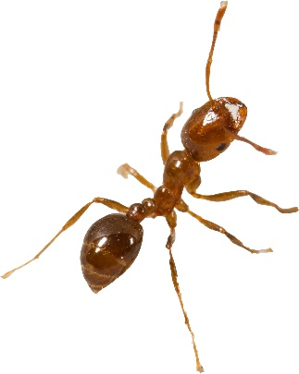
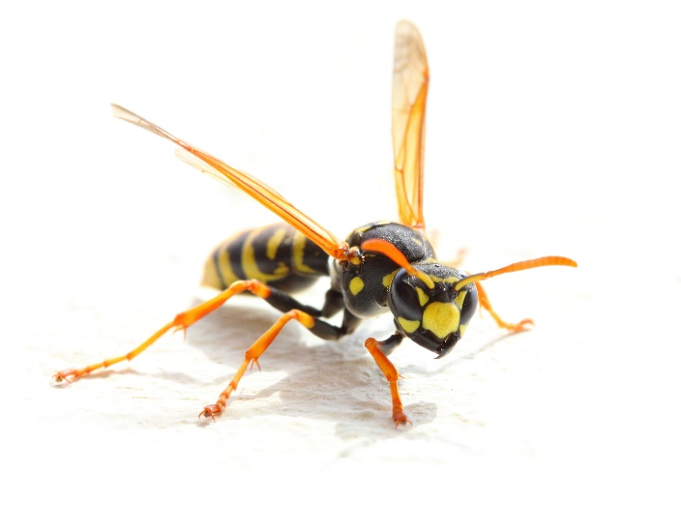
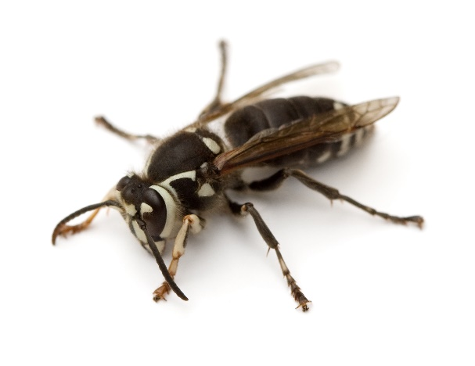
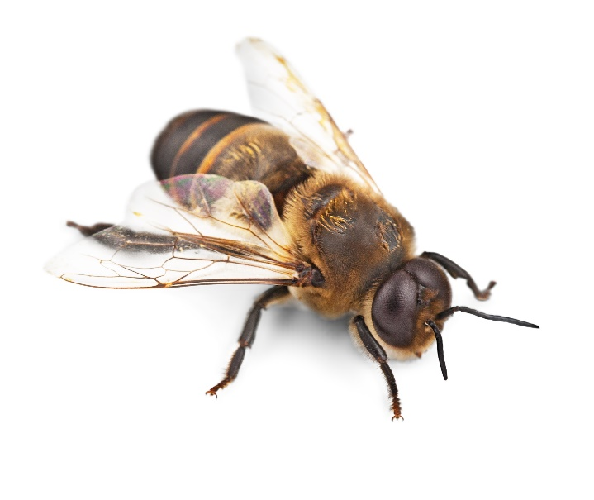
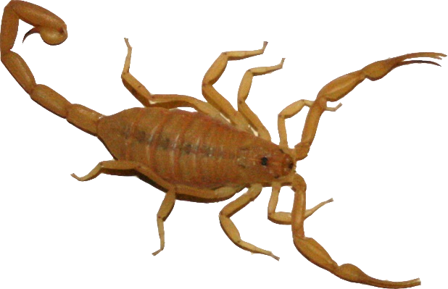
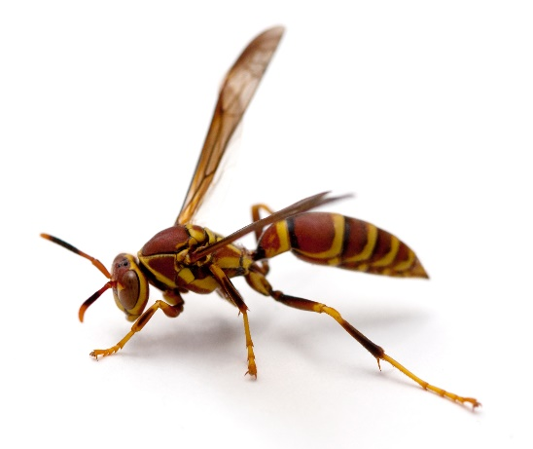
Stinging Pests
Fire ant – Robert LaMorte, University of Arizona
Yellowjacket
Baldfaced hornet
Scorpion – Dawn H. Gouge, University of Arizona
Honey bee
Paper wasp

Slide 4
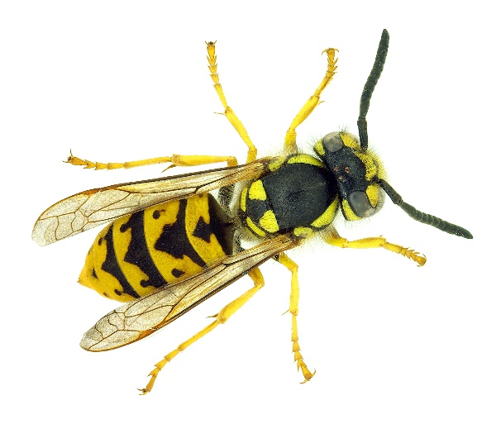
Biting and Stinging Pests
Yellowjackets, hornets and paper wasps are both beneficial and problematic
Yellowjackets and paper wasps can sting repeatedly, while a bee can sting only once

Slide 5
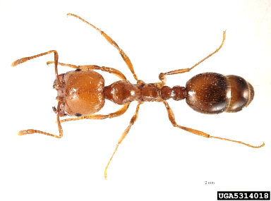
Biting and Stinging Pests Continued
Fire ants respond rapidly and aggressively to disturbance
Fire ants can sting repeatedly
Polymorphic workers (workers are obviously a mix of different sizes)
There are native and introduced species
Fire Ant -
Pest and Diseases Image Library, bugwood.org

Slide 6
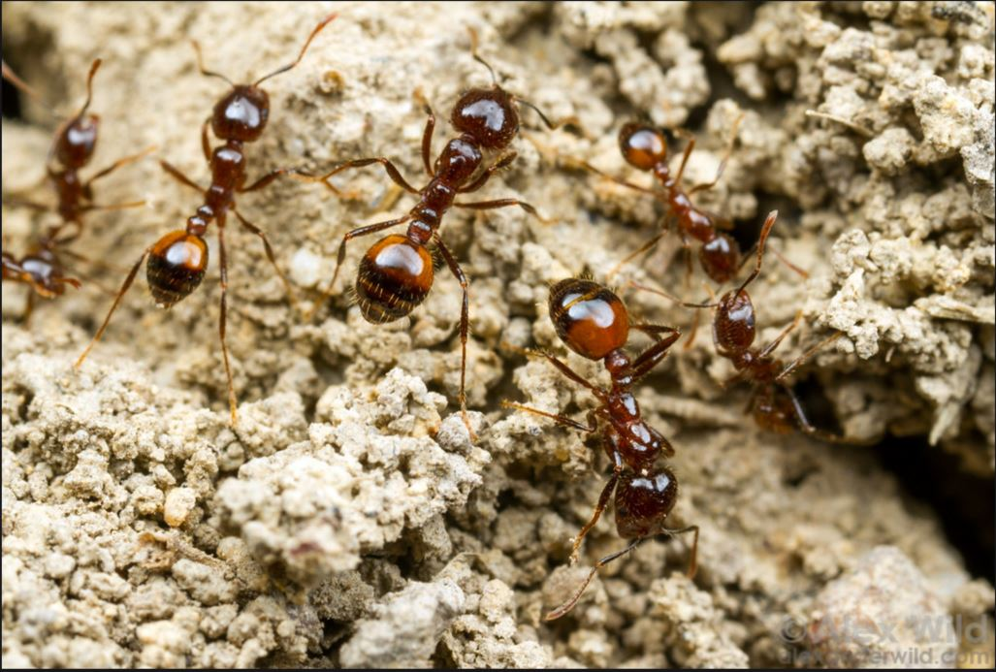
Biting and Stinging Pests Continued
Fire ants are a medically significant pest
Forage indoors and out
Red imported fire ants require a specific management plan
Native species can be discouraged:
Improve turf health
Use pesticide baits
Black imported fire ants – Alex Wild, alexanderwild.com

Slide 7
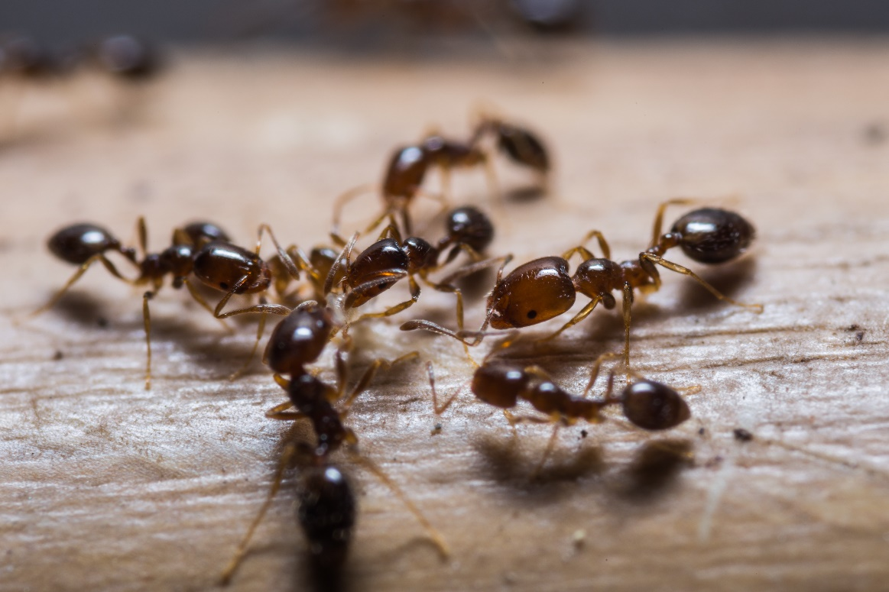
Biting and Stinging Pests Continued
Stings of fire ants, bees and wasps may cause allergic reactions
Red imported fire ants

Slide 8
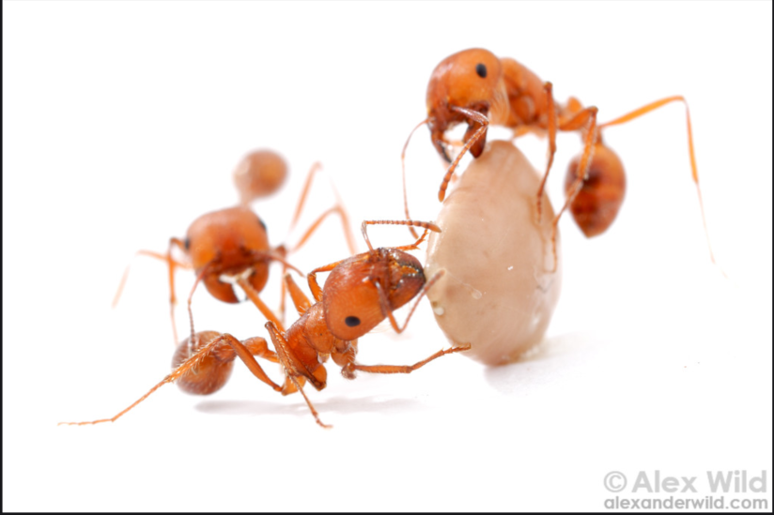
Other Ants
Some ants only become pests when they invade buildings
Sealing entry points is a challenge, but possible
Many species of ants are beneficial
Harvester ants – Alex Wild, alexanderwild.com

Slide 9
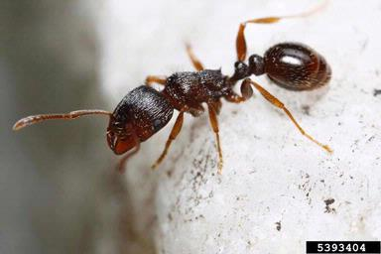
Other Ants
Identify the ant
Management strategies may be species specific
Pavement Ant -
Joseph Berger, bugwood.org

Slide 10
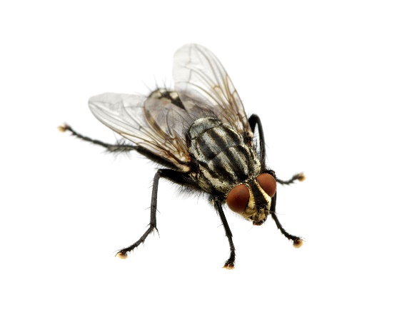
Flies
House flies, dump flies, bottle flies, flesh flies
Breed in garbage and/or animal feces
Not aggressive and do not bite
Carry bacteria and other microbes from garbage onto food, utensils and food preparation surfaces
Foodborne illness risk

Slide 11
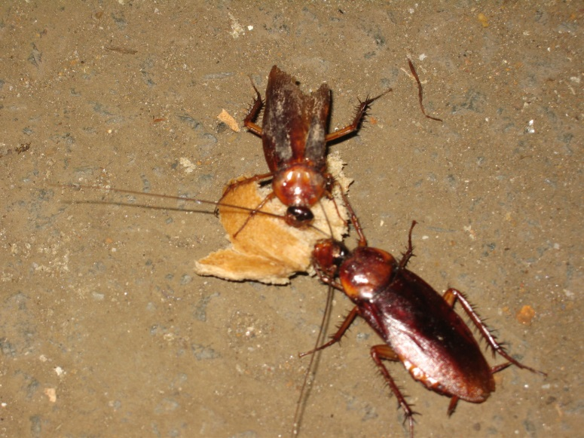
Cockroaches
Species are flattened, oval-shaped insects with long legs and antennae
Heads are tucked under and most have hind “cerci”
Most common are German, brown-banded, American, and oriental cockroaches
American cockroaches – Dawn H. Gouge, University of Arizona

Slide 12
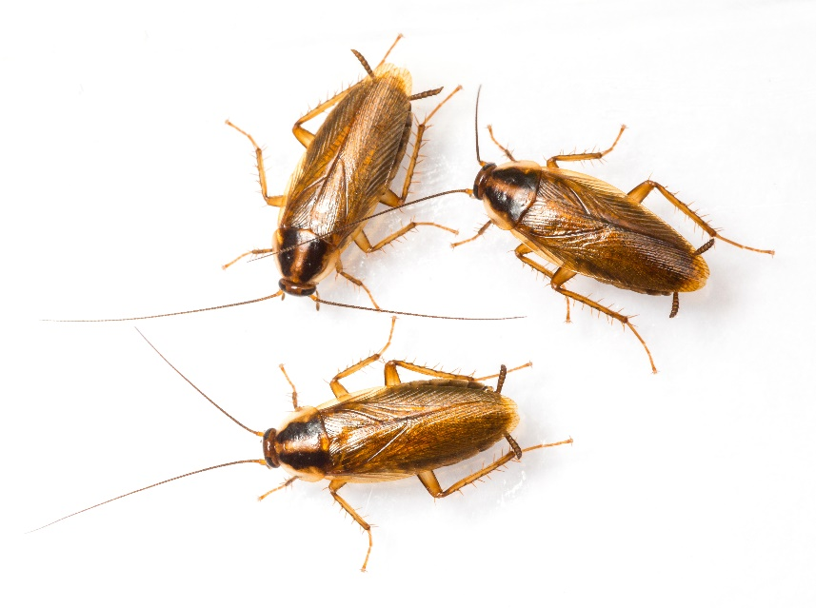
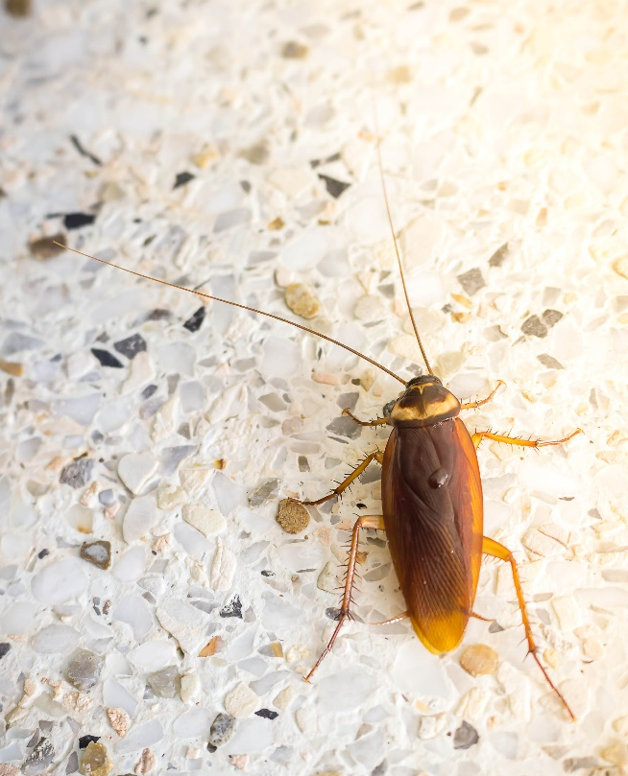
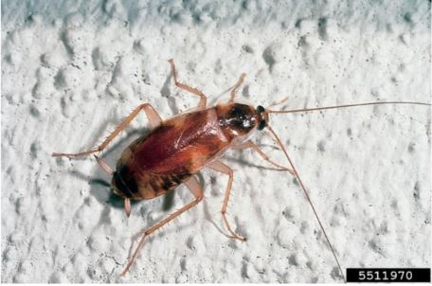
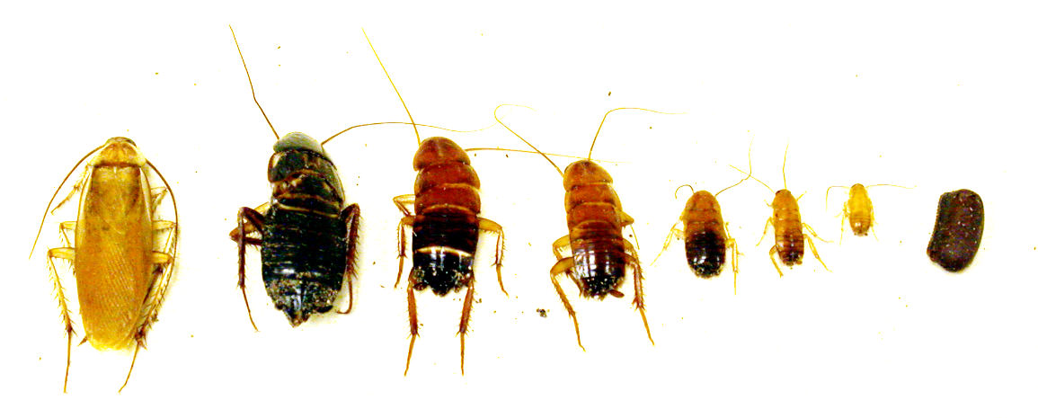
Cockroaches Continued
German cockroaches
American cockroach
Oriental cockroach
Brownbanded cockroach - Kansas Department of Agriculture, Bugwood.org
Turkestan cockroach – Dawn H. Gouge, University of Arizona
Notes:
National Center for Environmental Health, 2009

Slide 13
Cockroaches Continued
Many like to squeeze into warm cracks and crevices
German cockroaches prefer warm and wet environments
Brownbanded cockroaches are most often found in drier locations
American and oriental cockroaches are found where there is high moisture, but leave these environments to roam

Slide 14
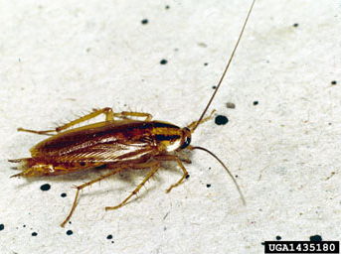
German Cockroaches
German cockroaches produce allergens that can trigger asthma symptoms in sensitive individuals
German Cockroach
Clemson University - USDA Cooperative Extension Slide Series, bugwood.org
Notes:
National Center for Environmental Health, 2009

Slide 15
Rodents
Rats and mice often enter schools and warehouses in search of food and shelter
The most common rodent pests are the commensal rats and mice
They include the roof rat, Norway rat and house mouse
Rats and mice consume or contaminate large quantities of food and damage structures, stored clothing and documents, and can cause a great deal of damage to computer and electrical systems due to their habit of chewing wires

Slide 16
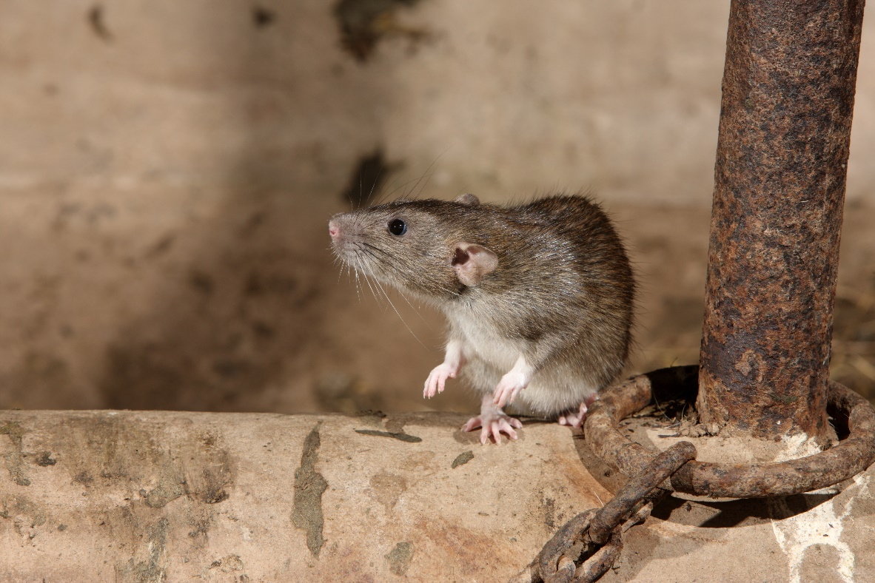
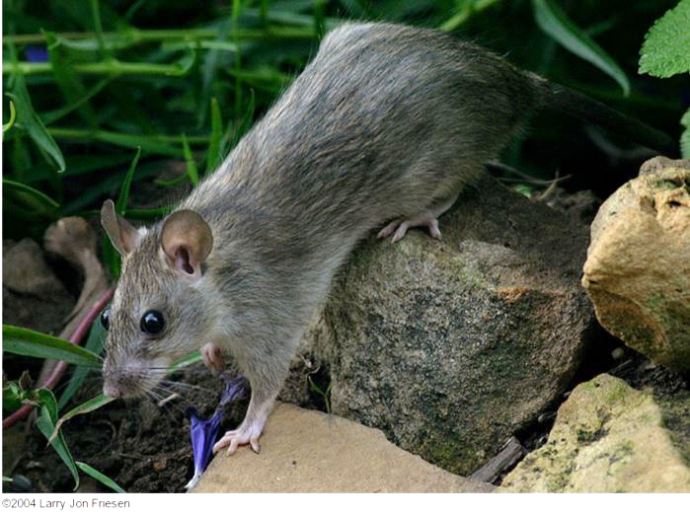
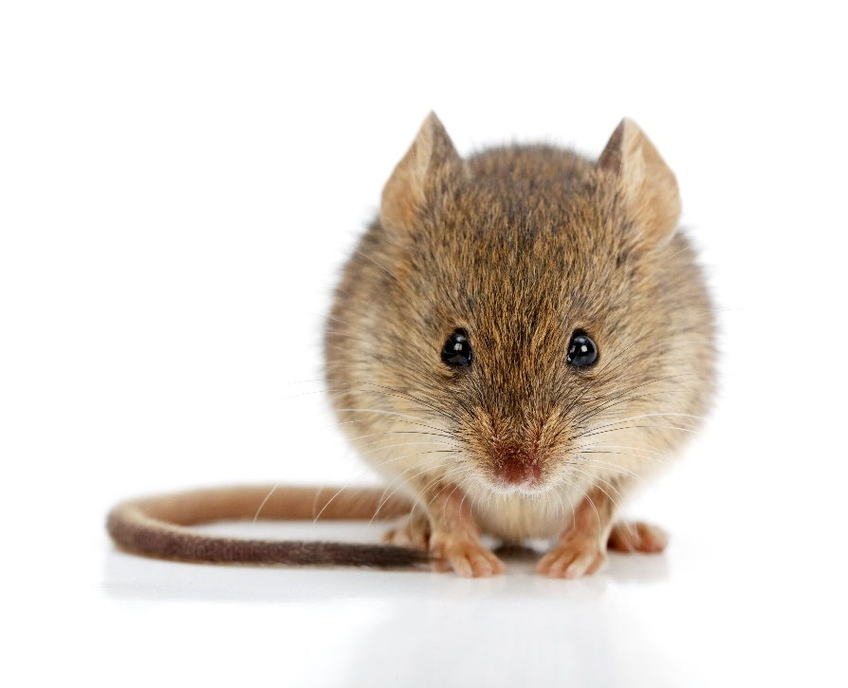
Rodents Continued
Norway rat
Roof rat – Larry Jon Friesen Copyright © 1995-2016 UC Regents
House mouse
Notes:
National Center for Environmental Health, 2009

Slide 17
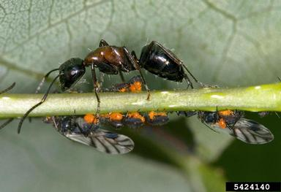
Wood-destroying Insects
Carpenter Ants
Cavity dwellers
Establish nests in wall voids and spaces
External colonies associated with tree stumps
Prefer weakened, damp or rotting wood
Carpenter ant - David Cappaert, Michigan State University, bugwood.org

Slide 18
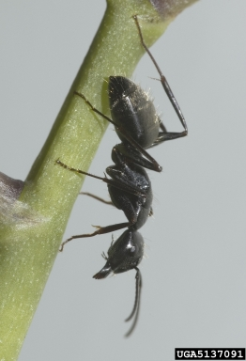
Wood-destroying Insects Continued
Carpenter Ants
Do not consume wood, they tunnel and nest in it
Large, can bite and spray formic acid, but do not sting
Carpenter ant - Susan Ellis, bugwood.org

Slide 19
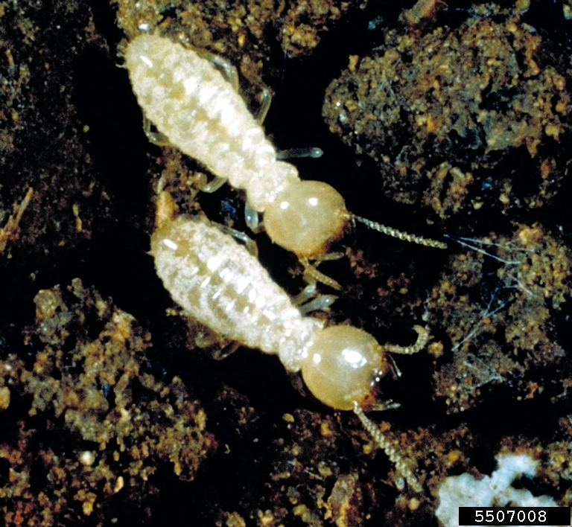
Wood-destroying Insects Continued
Termites
Several types
Dry wood
Subterranean
Social insects that live in colonies
Thousands or millions of members
Eastern subterranean termites - Phil Sloderbeck, Kansas State University, Bugwood.org

Slide 20
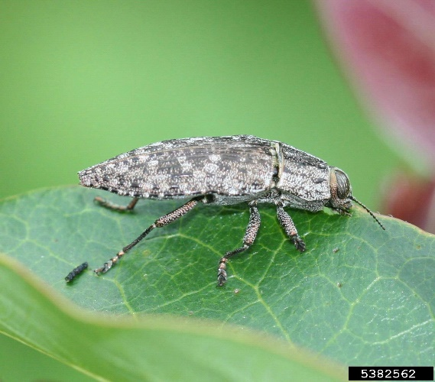
Bark Beetles and Wood Borers
Metalic wood-boring beetle - Johnny N. Dell, Bugwood.org
Most often attack weakened, injured or dying trees
Burn or destroy infested wood
Bark beetles and wood borers bore through the bark of trees

Slide 21
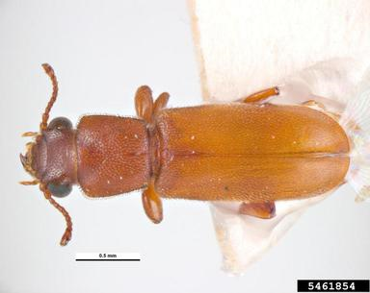
Wood-destroying Insects Continued
Powderpost Beetles
Wood-boring in wood products manufactured from hardwoods
Powderpost beetles change the wood into a fine powder or dust
Powderpost beetle
- Pest and Diseases Image Library, bugwood.org
Notes:
www.prevailpest.com

Slide 22
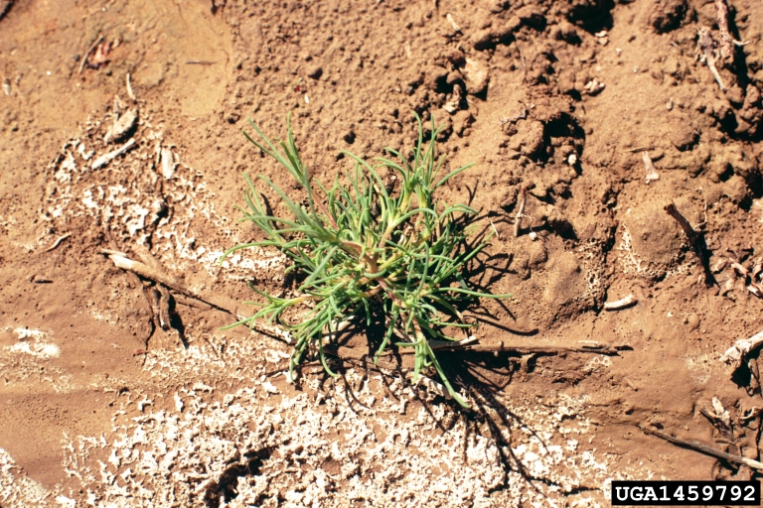
Common Weeds
Accurately identify common weed species on school grounds
Knowing the scientific name makes it easier to obtain accurate information
Russian-thistle -
Utah State University Archive, Utah State University, bugwood.org

Slide 23
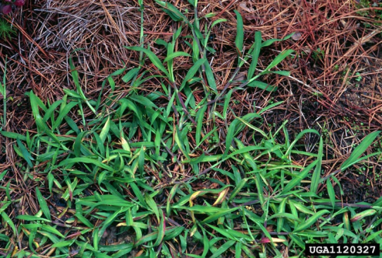
Annual Weeds
Most common weed group
Rapid life cycle
Requires minimal water and nutrients
Some can produce >20,000 seeds per plant
Most are known as summer annuals (germinate in spring, grow to maturity during summer, and die by fall or winter)
Examples: prostrate spurge, purslane, crabgrass and pigweed
Crab Grass -
James H. Miller & Ted Bodner, Southern Weed Science Society, bugwood.org

Slide 24
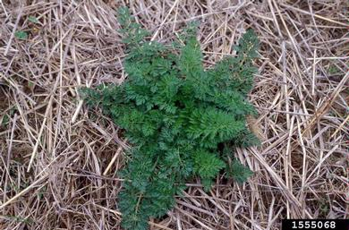
Biennial Weeds
Grow during the spring, summer, and fall of their first year, survive the following winter, and flower during the next growing season
Germinate at any time during the growing season
In the second year they produce flower stalks using food stored from the first season’s growth, then they produce seeds, and die
Examples: wild carrot, common mullein, musk thistle
Wild Carrot -
Ohio State Weed Lab Archive, The Ohio State University, bugwood.org

Slide 25
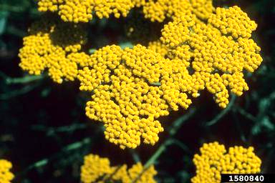
Perennial Weeds
3.
Live more than two years
Spread by seeds and vegetative means (bulbs, rhizomes, tubers or stolons)
Common examples: bindweed, plantain, thistle, dock, dandelion, ground ivy, quackgrass, sorrel, clover and yarrow
Yarrow -
John Ruter, University of Georgia, bugwood.org

Slide 26
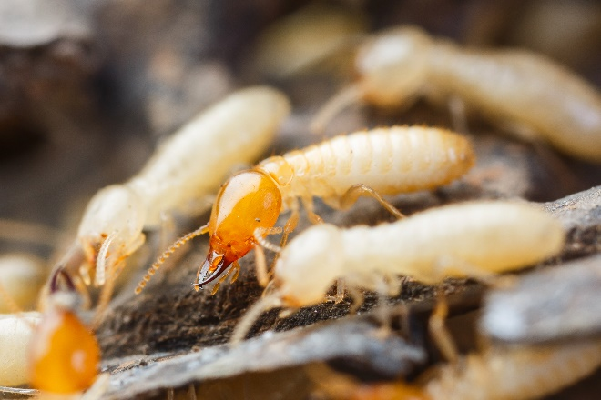
Check In!
In this lesson you learned
Key exterior and landscape pest groups
For information on many other key pests see the IPM Coordinator/Pest Management Professional, school nurse, and Landscape and Grounds education lessons
Congratulations, you have completed the Facility Manager Module!

Slide 27
Resources
Green, T.A., D.H. Gouge, J.A. Hurley, M.L. Lame and M.D. Snyder. (2014). School IPM 2020: A Strategic Plan for Integrated Pest Management in Schools in the United States.
How to Develop an Integrated Pest Management (IPM) Policy and Plan for Your School District. PENN STATE. Retrieved from http://extension.psu.edu/pests/ipm/schools/facilitiesmanagers/resourcespaschools/faq/ipmschoolplan
How to Do… IPM at School A How to Manual for New Jersey schools. New Jersey Department of Environmental Protection Pesticide Control Program http://www.state.nj.us/dep/enforcement/pcp/bpc/ipm/How_to_Do_IPM.pdf
New Jersey Department of Environmental Protection Pesticide Control Program. How to Do… IPM at School A How to Manual for New Jersey Schools. Retrieved from http://www.state.nj.us/dep/enforcement/pcp/bpc/ipm/How_to_Do_IPM.pdf

