Slide 1


Notes:
UCAP was launched in 2017 in order to support better career progression, to better define nonacademic job titles, and to support better compensation practices with those used outside the University while keeping the UA competitive relative to peer institutions and other organizations.
If you have not yet had an opportunity to attend one of our town halls, I would like to invite you to visit the project website at ucap.Arizona.edu to learn more about the project, including a recording of previous town halls, an overview of our project governance, frequently asked questions and a glossary of frequently used terminology.

Slide 2

PROJECT OBJECTIVES
Agenda
Compensation
Philosophy
Job
Function
Head
Head
The University Career Architecture Project will enable:
INFORMED DECISIONS: Relevant market data for the University, managers and employees to make quicker and more informed decisions
SHARED LANGUAGE: Common career models, level descriptors, title guidelines and compensation ranges to allow for transparent dialogue
CAREER POSSIBILITIES: Career progression opportunities for the vast array of professions at the University
Notes:
We do not currently have the appropriate level of market information to allow the University as a whole to financially model or plan for compensation analysis on an annual basis. Through the project, we will gather the needed information, which will allow for a more transparent dialogue for both employees and managers regarding compensation, career conversations and career progression opportunities.
Having a shared language, will allow us to operate as one university with regards to a career framework, compensation guidelines and pay ranges, and to identify comparable work at comparable levels, regardless of existing job title.
And career possibilities will be better identified throughout the framework for the vast array of professions we have at the University.

Slide 3
KEY DELIVERABLE
Appointed Professionals
Classified Staff
Job Functions and Families
Notes:
We are going to evolve our current categories of appointed professionals and classified staff into a new model of job functions and families. The function and family concept has been considered a best practice for quite a long time in the external market. Many higher education institutions and our peer universities have moved to this model over the past ten years.
This model allows us to ensure that our framework is market referenced and maintainable over time.
The population of employees that are in scope for UCAP, include our appointed professionals and classified staff who are nonfaculty, non graduate assistants, non post docs, non student employees, and non continuing status as it relates to their conditions of employment. Approximately 11,000 employees are in scope, with 6800 being classified staff.

Slide 4
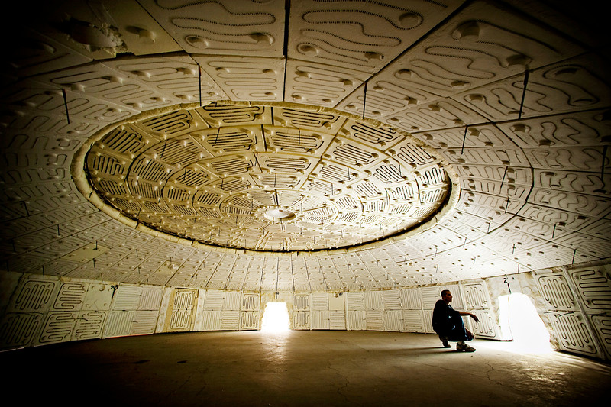

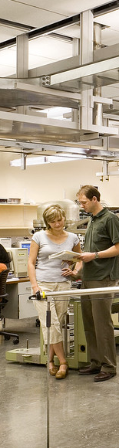



CURRENT STATE
Number of classified staff and appointed professionals in scope
10,823
Number of unique job titles
2,940
Number of single incumbent titles
2,176
Notes:
Jan – Discuss:
Overall # in scope
Unique titles in scope and single incumbent titles (and define what is meant by that)
How we got to this state
How many unique jobs we might expect given the market and comparable organizations (land grant, research one, w/ colleges of medicine)
We will still have working titles that allow for specificity of the unique position, but the work will be logically organized and consistently mapped to functions, families and levels across the organization.

Slide 5


Agenda
Compensation
Philosophy
Job
Function
Head
Head
CAREER ARCHITECTURE: AN ANALOGY
BEFORE
AFTER

Slide 6
CAREER ARCHITECTURE:
PUTTING IT TOGETHER
FUNCTION
FAMILY
CAREER STREAM
LEVEL
JOB FUNCTION
Partial List
JOB FAMILY
Examples
CAREER
STREAM
CAREER
LEVEL
Administration
Communications
Finance
Management and
Leadership(M)
(M7)
University Advancement
Content Development
Content Development
(M6)
Legal & Compliance
Interpretation
Professional Contributor (PC)
Interpretation
(M5)
Human Resources
Communications
Marketing
Organizational Contributor (OC)
(M4)
Athletics
Media Relations
(M3)
Media Relations
Ag & Extension
Multimedia
Multimedia
(M2)
Healthcare & Wellness
Research
University Press
Illustrative Example:
(M1)
Job Family Title: Marketing Manager III
Working Title: Senior Manager, Marketing Special Events
-
family, career stream and career level
Notes:
The Career Framework includes functions, families, career streams, and career levels. This combination makes up an individual’s job at the University.
A sample of some of our job functions are illustrated on the slide. Functions consist of broad groupings of jobs that can be logically grouped together based on having similar characteristics and prerequisite skills. Functions often include jobs that exist across multiple departments
Let’s walk through an example to see how the entire framework works:
We have an employee Ann who is a Senior Manager, Marketing Special Events. This job will fall in the Communication Job Function and the Marketing job family where the job will be grouped with other jobs focused on Marketing.
This job will be further grouped with jobs in the same career stream. Ann’s job will be grouped with other Managers who perform similar work. Lastly Ann’s job will be placed into a level based on the work performed in the job. You can visit the UCAP website for a glossary of terms

Slide 7
CAREER STREAMS AND LEVELS
Manager & Leader
CAREER STREAM DEFINITIONS
Manager & Leader (M1 – M7): oversee area of responsibility, plan, prioritize and/or direct responsibilities of employees and/or manages strategy and policy development for a major UA function. Typically have 3+ direct reports.
Professional Contributor (PC1 – PC5): oversee the design, implementation or delivery of processes, programs and policies using specialized knowledge or skills typically acquired through advanced education or equivalent advanced learning attained through experience. Typically salaried positions, though entry levels may include hourly jobs.
Organizational Contributor (OC1 – OC4): provide organizational related support or service (administrative or clerical OR operate in a “hands-on” environment in support of daily activities (e.g., technical, craft, etc.). Typically hourly positions.
Professional
Contributor
M1
M2
M3
M4
M5
M6
M7
Organizational Contributor
PC1
PC2
PC3
PC4
PC5
OC1
OC2
OC3
OC4
Notes:
Career Streams allow employees to navigate career advancement opportunities more effectively by grouping jobs together that have the same focus.
Manager and Leader positions contribute to the University by managing or overseeing people or major UA functions. Employees that pursue careers in this area enjoy directing, mentoring, and planning. Typically, positions in this stream supervise a team of 3 or more employees.
Professional Contributors contribute by designing and implementing programs utilizing specialized knowledge typically obtained through advance education. Employees that pursue careers in this area enjoy developing, advising, educating.
Organizational Contributors contribute by directly providing services and “hands-on” operations. Employees in these jobs like to provide direct service, work with their hands, or deliver the day-to-day work that makes our University operational.

Slide 8
WORK DIMENSIONS
UA WORK DIMENSIONS
Complexity of Work
Degree and difficulty level of problem solving and innovation required in the job.
Communication
Scope and nature of internal and external interpersonal contact.
Operational Latitude & Impact
Extent of oversight for and implications of decision making required of the job.
Knowledge, Education & Experience
The understanding of the job content required.
Management Only
Leadership & Influence
Scope of management responsibilities and impact with respect to strategy, operations, and people.
  A career level guide describing sample detailed expectations for each job level is embedded within JDXpert
Notes:
Work dimensions allow us to level jobs internally and externally. Work dimensions have been in use in the compensation and titling profession for many years. Most organizations (whether private or public) use some version of work dimensions to level jobs. Work dimensions are also incorporated into market data.
The work dimensions that will be considered in leveling our jobs are:
Complexity of Work, Communication, Operational Latitude & Impact, and Knowledge, Education and experience.
Complexity of Work is the degree and difficulty of problem solving. Some considerations include: -- How many different concepts must be considered when making a decision. How difficult are concepts to understand. Does the job require the development of novel approaches to address those issues.
Communication involves the Scope and nature of interpersonal contacts. Some considerations are: --Does the job require ability to influence and persuade. Does the job require the ability to communicate with all levels?
Operational Latitude & Impact includes the Scope of the job and latitude of decision making. Some considerations are: How the decisions made in the job impact the unit, department, school, college or the University as a whole. Are there standard guidelines to guide the work? Does the position require the ability to determine what needs to be done and how to complete it.
Knowledge, Education & Experience covers the typical knowledge, education and experience needed to perform the work. It is important to note that this is different than the knowledge, education, and experience of an employee. For example an employee may have a PhD and 20 years of experience but might choose to work in a position that doesn’t require that level of experience or education.
Leadership and Influence is specific to jobs on the managerial path. This dimension levels management jobs by the scope of the management responsibilities and the level of strategy and planning involved. Considerations include: How many different groups of employees report to this position? Does the position manage other managers? Does the position have full authority for all aspects of managing the workforce, including organizational strategy and design.
Our career architecture describes these work dimensions for each of the levels and will be a great guide for managers and employees as they work on the mapping of positions.

Slide 9
Compensation
Philosophy
Job
Function
DEVELOPMENT OF ARCHITECTURE
Agenda
Head
Head
Working draft of architecture available at ucap.arizona.edu
26 Job Functions
146 Job Families
1,413 Jobs
300 Subject Matter Experts
65 Calibration Sessions
Ongoing
Feedback Loop
Mercer
UA
Notes:
Over the past few months, the project team has been partnering with Mercer, our external consultant, and university subject matter experts to organize and develop a working draft of the career architecture.
An initial draft of functions and families was created through the project’s shared governance groups, and has been revised and vetted to identify 26 job functions and 146 job families. A working draft of the architecture has been published on the project website.
We have engaged more than 300 subject matter experts in working sessions to review the drafts and edit content and terminology in advance of broadly sharing the architecture for University input. Through the feedback loop process, we have incorporated feedback, while validating that changes are aligned from an external market perspective.
We expect the architecture to continue to evolve through the position mapping phase as we receive additional feedback and identify positions that are not able to be mapped.

Slide 10
Compensation
Philosophy
Job
Function
MAPPING PROCESS AND TIMELINE
Agenda
Head
Head
Review Career Architecture
Work with employee to review or create job description
Map positions to architecture
Job function and family summaries
Work dimensions for each level
Career stream definitions
Current crosswalk of existing jobs to career architecture
Have open discussion with employees to gather information and understanding.
Determine the initial mapping for each position.
Enter mapping into the UAccess system.
Utilize resources to make the most informed decision.
Use existing position descriptions to facilitate discussion.
Use the new position form to create a position.
REVIEW
COLLABORATE
We need your support!
MAP
Notes:
This week, communication will be going out to all employees regarding the roll out of the architecture and upcoming position mapping phase.
As we start the mapping phase, we are providing a variety of resources to help facilitate this process. These resources can be utilized to help make the most informed decisions when mapping positions to jobs within the architecture. Before mapping takes place, it is highly encouraged to review and have an understanding of the job function and families, career stream definitions and the purpose of the work dimensions.
The mapping process creates an opportunity for employees and supervisors to have open discussions regarding position responsibilities. This would be an opportune time to calibrate and have a mutual understanding of the work and job duties the employee is performing. If an existing position description is available, this can be used to help facilitate the discussion. If an existing position description is unavailable, a new one can be created using the new position description web form.
The initial mapping will be done in UAccess. There will be specific resources available such as the “UCAP Mapping tool guide” which will walk through the steps for using the mapping tool.

Slide 11
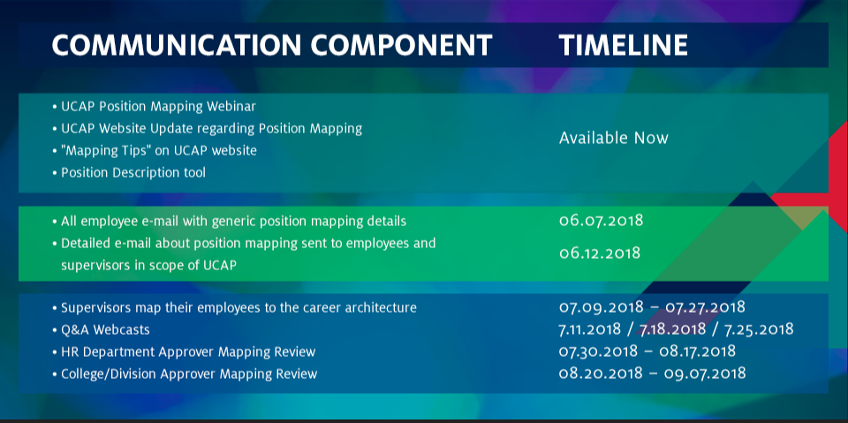
Agenda
Compensation
Philosophy
Job
Function
COMMUNICATION PLAN & TIMELINE
Head
Head

Slide 12
Agenda
Job
Function
Head
Head
SOME THINGS WON’T CHANGE FOR CURRENT EMPLOYEES
RETIREMENT PLAN ELECTIONS: Retirement plan elections can remain the same
VACATION ACCRUAL RATES: Vacation accrual rates and balances will not be reduced
EXISTING TITLES: Individuals may retain current titles as working titles
PAY: Pay will not be reduced if above the new salary range maximum

Slide 13
UCAP TIMELINE
Progress
PROJECT TIMELINE
Preliminary: Design Project Strategy
Step I: Develop Career Model, Define Jobs and Map Employees
Step II: Assess Market and Design Pay Structure
Step III: Benchmark Jobs and Evaluate Cost
Step IV: Plan for Change and Communication
Testing and Implementation
2017
2018
2019
GO LIVE
JULY 1, 2019
WHAT’S NEXT?
Complete position mapping process and revise architecture, as needed
Facilitate calibration sessions to review overall position mapping and outliers
Assessment of market information and the design of a new pay structure
Mapping jobs to the new pay structure
Evaluate impact
Pay Equity Analysis
Employee notification process
Notes:
Moving through the project, the next steps will include:
Completing the position mapping process and make any necessary revisions to the architecture.
Facilitating calibration sessions to review overall position mapping and outliers
Assessment of market data and complete the design of a new pay structure
Mapping jobs from the architecture to the new pay structure
Evaluating the financial impact of the proposed pay structure and conducting a pay equity analysis and
Notifying employees of their mapping results and corresponding pay structure assignment.

Slide 14

WHAT QUESTIONS OR INPUT DO YOU HAVE?
WHAT QUESTIONS OR INPUT DO YOU HAVE?

