Slide 1
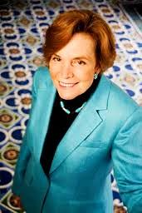
SYLVIA ALICE EARLE, Ph.D.
BOTANIST, MARINE BIOLOGIST, UNDERSEA EXPLORER, OCEANOGRAPHER, AUTHOR, and MORE!!!

Slide 2
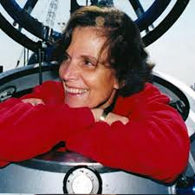
NICKNAMES
Affectionately “Her Deepness” ~ New Yorker & NY Times
“Living Legend” ~ Library of Congress
“Hero for the Planet” ~ Time Magazine

Slide 3
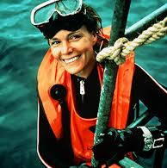
EARLE’S EARLY LIFE
Born August 30, 1935 Gibbstown, NJ
Moved to FL @ 13 yoa
First (Helmet) Dive @ 17 yoa

Slide 4
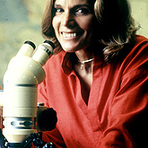
EDUCATION
B.S. in Botany ~ FSU 1955
M.S. in Botany ~ Duke University, NC 1956
Ph.D. ~ Duke University, NC 1966
Also Currently has 15 Honorary Degrees

Slide 5
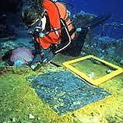
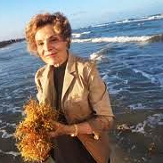
EDUCATION
Dissertation ~ “Phaeophyta of the Eastern Gulf of Mexico”
She still follows project & has collected over 20,000 samples of algae

Slide 6
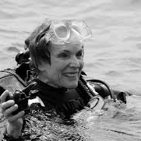
SCUBA!
One of the 1st to utilize modern SCUBA equipment for research
Holds record for deepest women’s solo dive (3,281 feet)

Slide 7
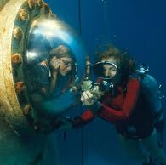
CONTRIBUTIONS TO OCEAN EXPLORATION
1969 Tektite Project
Enclosed habitat on ocean floor 50 feet below surface for teams of scientists to live (and research) for weeks at a time.
1970 - Tektite II!

Slide 8
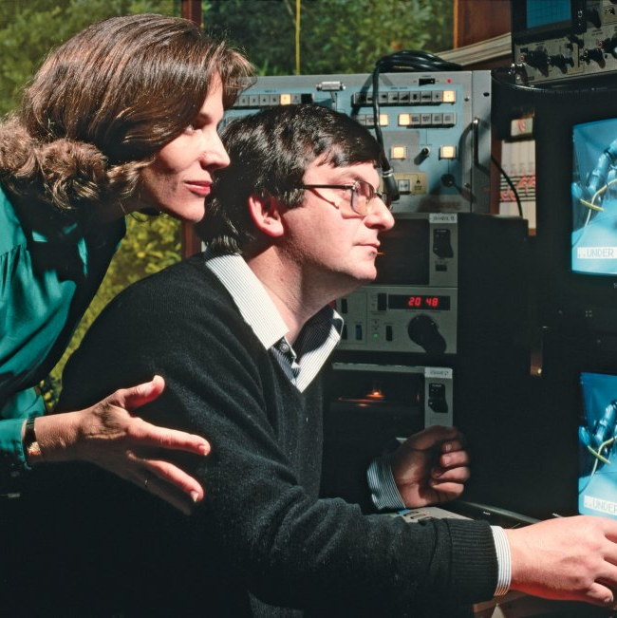
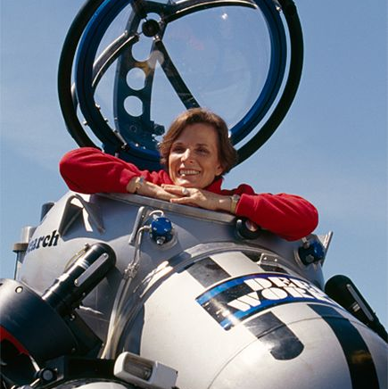
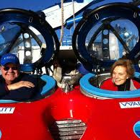
CONTRIBUTIONS TO OCEAN EXPLORATION
1980’s she and (former) husband who was an engineer began to design and build submersibles
(Speaking of family … she has also raised 3 children!)

Slide 9
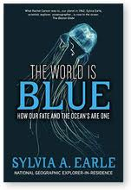
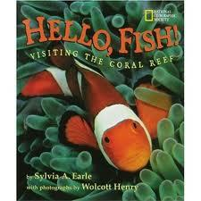
PUBLICATION
More than 150 scientific and popular publications
*7 Books*
“Exploring the Deep Frontier: The Adventure of Man in the Sea” 1980
“Sea Change: A Message of the Oceans” 1995
“Dive!” 1999
“Hello Fish” 2001
“Sea Critters” 2000
“Ocean: An Illustrated Atlas” 2008
“The World is Blue: How our Fate and the Oceans are One” 2009

Slide 10
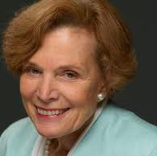
CAREER
1st Woman to Hold Position of Chief Scientist for the U.S. National Oceanic and Atmospheric Administration (1990 – 1991)
Currently explorer-in-residence at the National Geographic Society along with many, many more positions & titles.

Slide 11
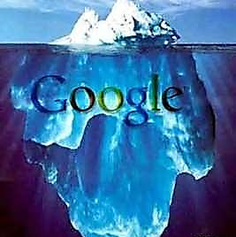
Dr. Earle played a big role in Google Earth mapping of the ocean floor (Google Ocean)

Slide 12
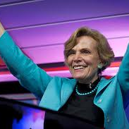
RECOGNITION
TV AWARD WINNER 2009
“To Join Me in Protecting the Vital Blue Heart of the Planet” ~ Dr. Sylvia Alice Earle
http://www.ted.com/talks/sylvia_earle_s_ted_prize_wish_to_protect_our_oceans.html

