Slide 1
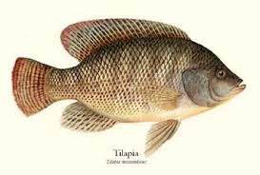
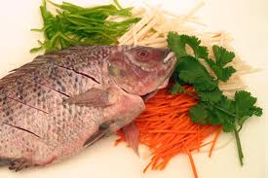
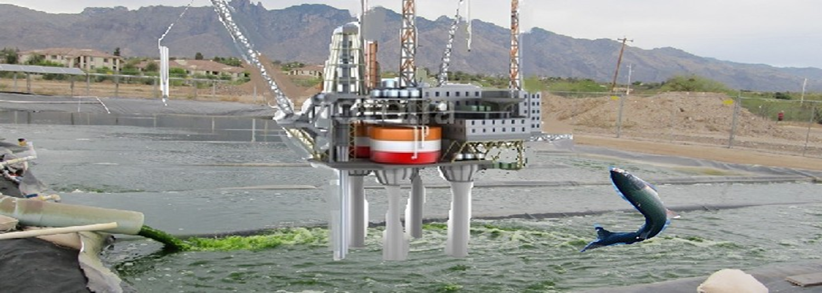
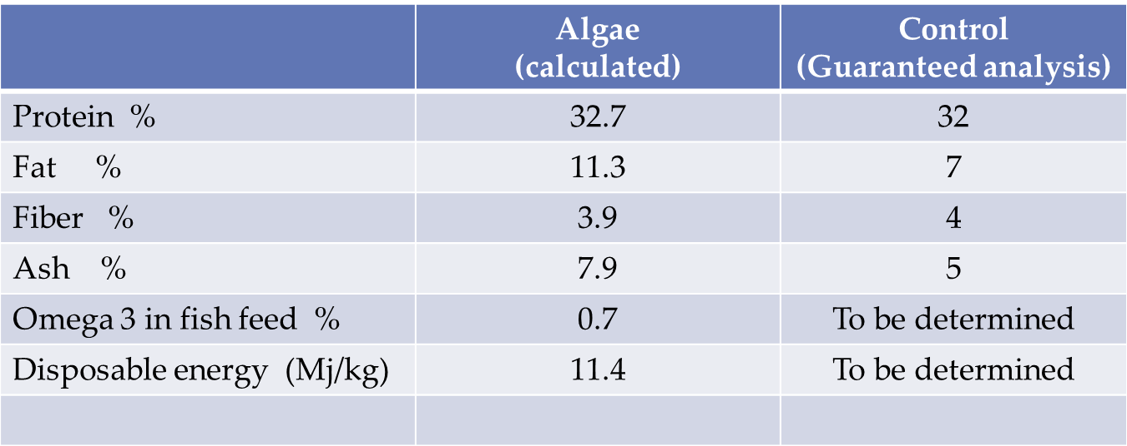
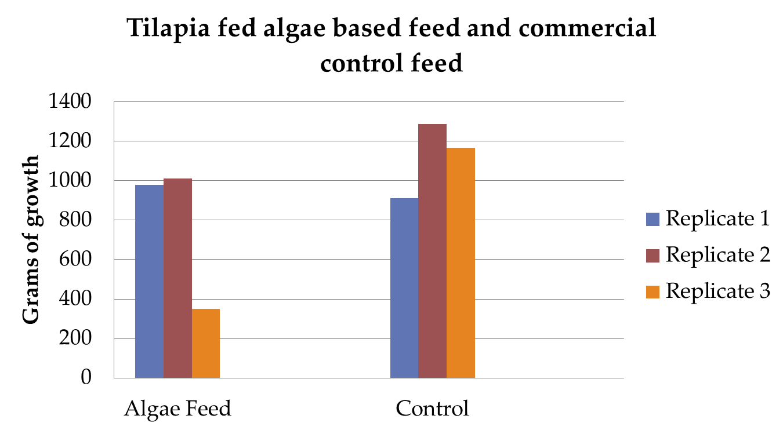
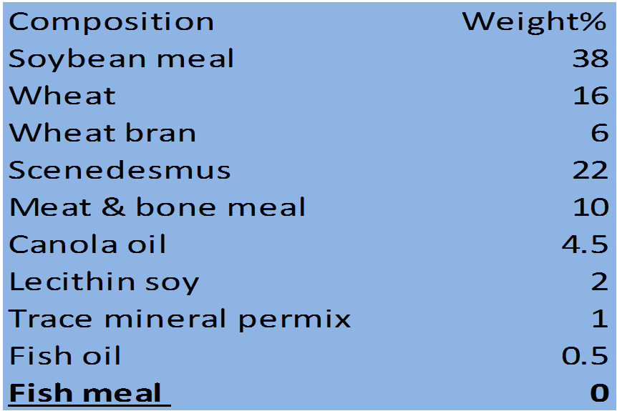
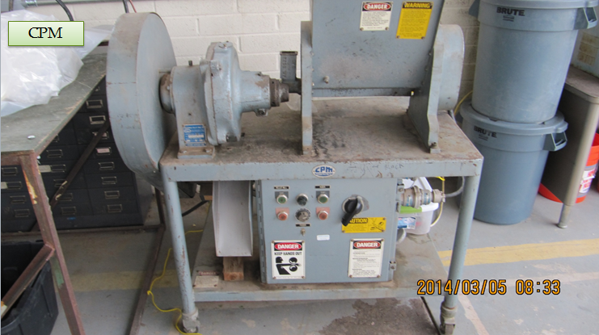
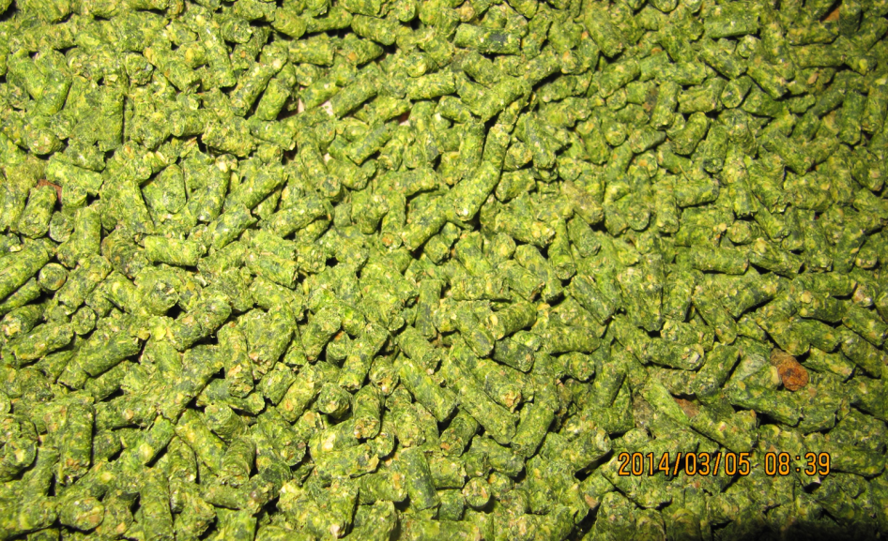
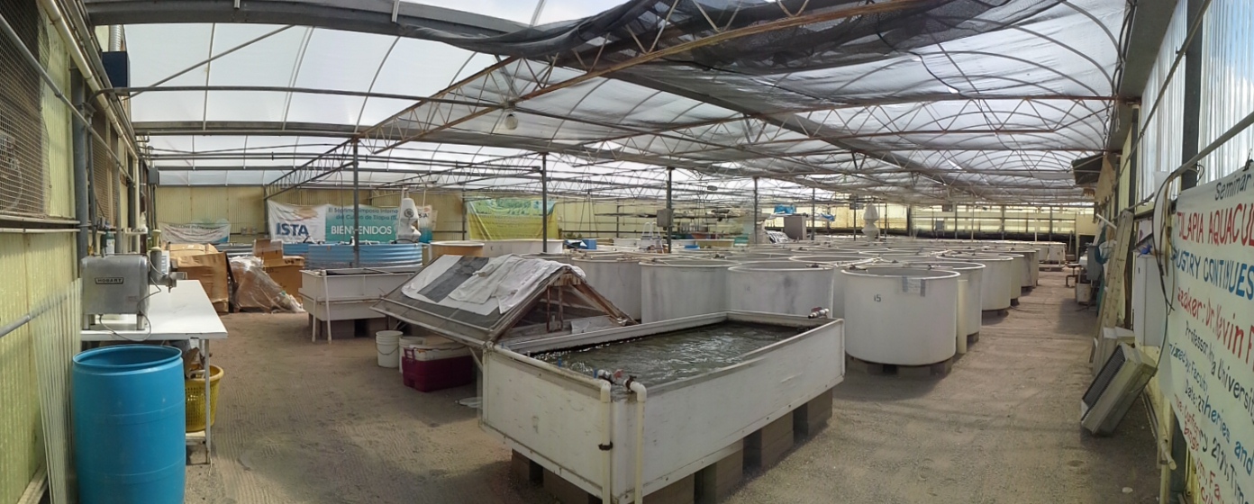
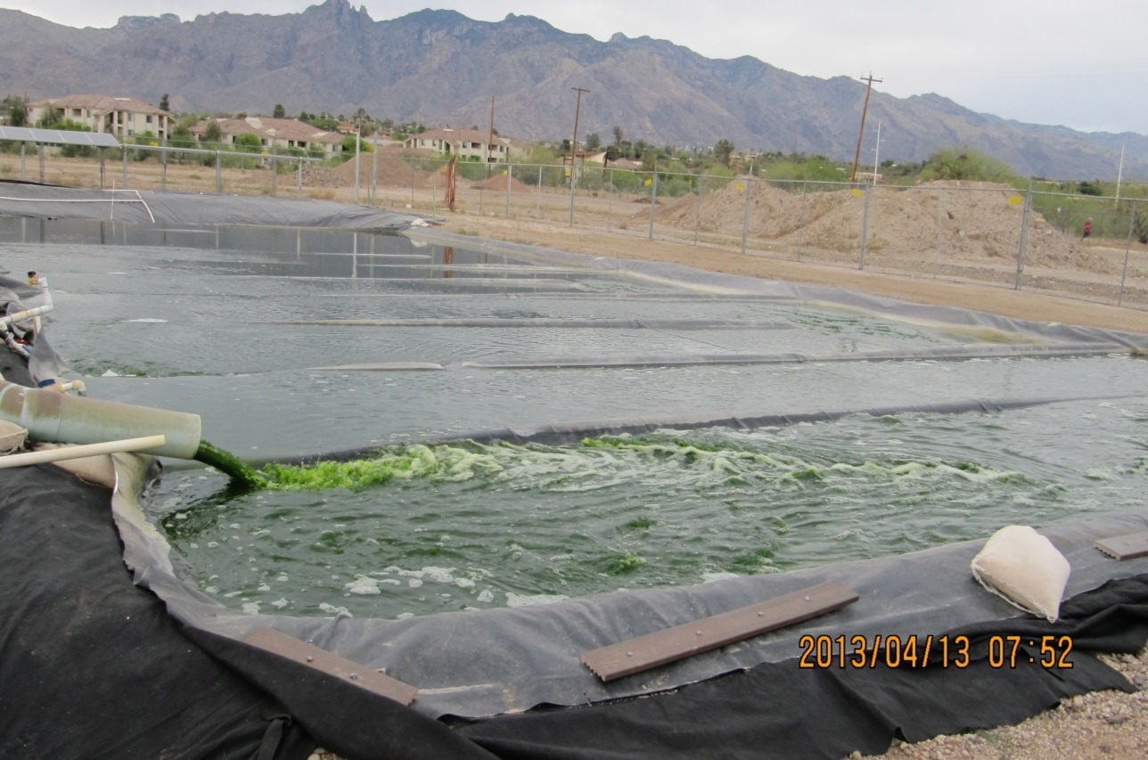
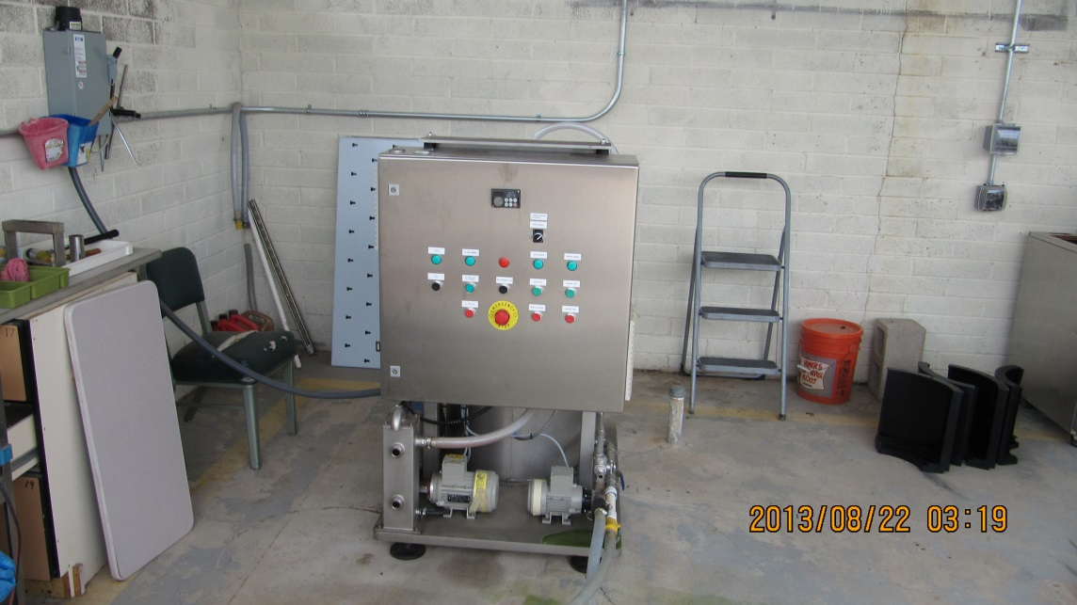
Algae Biomass Production for Fish Feed and Fuel
Qi Li₁ Dr. Pete Waller₁ Joni Lee Giovanna Hesley₁ Randy Ryan₂ Dr. Kevin Fitzsimmons₂ Brunno Cerozi₃
1 Agriculture and Biosystems Engineering 2 Agriculture and Life Science 3 Environmental Science
Introduction
Feed analyses
Results
Presently, fish meal and soymeal are the major sources of proteins in tilapia diets and these proteins represents the highest cost in the diets. Thus, it is important to find alternative protein sources, such as algae to have economic success of the aquaculture industry. Algae are gradually being included into fish diets in particular, to replace plant protein concentrates. Research has found algae can be included in tilapia diets without compromising fish growth (Ramotar and Fitzsimmons, 2012). The benefits of including
algae as a protein source or feed additive may increase aquaculture’s usefulness in human food production.
The high protein content of algae and its amino acid profiles are the main reason why they are considered a valuable components in tilapia diets.
Fish Feed Composition
Discussion
The preliminary results demonstrated the algae diets performed similar to the control diet. Algae have attention as a possible alternative protein source for cultured fish since they contain a high amount of protein, vitamins and essential fatty acids contents (El-Hindawy et al. 2006). The use of microalgae as fish feed inputs has been studied with encouraging results. (Broun, 1980), reported positive growth performance in fish feed diets containing algae cells. This study supports Broun’s finding.
Pellet Mill
Conclusion
In conclusion, the present experiment showed that examined algae could be utilized in Nile tilapia (Oreochromis niloticus) diets up to 50% instead of the dietary ingredient without any adverse effects on fish growth performances, feed utilization parameters and body composition.
The Goal of Algae Production
Obtain long term algal cultivation data in outdoor pond systems,
Optimize biomass and lipid content for production of biofuel using impaired waters
Use algae for feed fish.
Future plan
Why do we grow algae?
Product
Run additional feeding trials with algae fish feed.
Increase the ratio of algae from 20% to 50%
Run oil extraction system
Algae is a photosynthetic organism.
Grows rapidly (100 X more than plants).
Can produce oil (biodiesel and biojet fuel).
Replaces fish meal.
Replaces alfalfa for cattle and chicken feed.
Could grow in recycled water or sea water
Can be converted into bioplastics
Makes proteins
References
Broun, W. 1980. Note on the survival of algal resting cells during long-term maintenance in darkness and minimum lake bottom temperature. Comparison of Anabaena, (5): 677-680.
EL-Hadidiy, Z. A., M. A. Abd Allah, A. Dawlat, A. Salama and Asmaa A. EL-Kerdawy. 1993. Effect of untraditional dietary protein sources on some chemical composition of Nile tilapia fish. Annals Agric. Sci., Ain Shams Univ. Cairo. Egypt, 38 (1): 51-59.
Ramotar, B. P. And Fitzsimmons, K. 2012. Tilapia (Oreochromis niloticus) growth using “Standard Commercial” and “Alternative” Ingredients with Different Lipid and Protein Levels. World Aquac. Soc. Conference. Prague, Sept 2nd -5th 2012.
Materials and methods
A twenty two day feeding trial with mature tilapia (Oreochromis niloticus) was conducted in a greenhouse using six 200 L fiberglass tanks. Three tanks were fed a control diet (Star Milling Ace Hi Tilapia feed) while three tanks were fed the algae diet which was manufactured using the algae (Scenedesmus) harvested from the ARID Raceway. The fishes were fed at 1.5% of their body weight and water quality characteristics (dissolved oxygen, temperature, pH, ammonia, and nitrates), were maintained within acceptable ranges for tilapia.
Acknowledgement
Seth Steichen: Chemical and Environmental Engineering
Dr. Kimberly Ogden: Chemical and Environmental Engineering
Said Attalah: Agriculture and Biosystems Engineering
George Khawan: Agriculture and Biosystems Engineering
Kayle Thunstrom: Soil, Water and Environment Science
Fish feed production
Cultivation and harvest of algae

