Slide 1
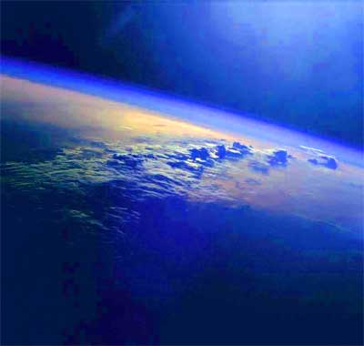

Slide 2
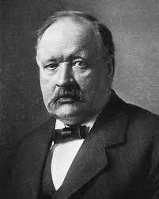
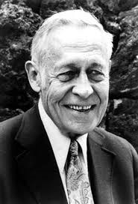
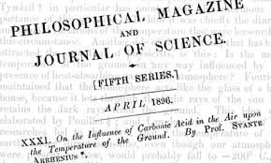
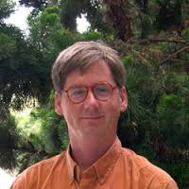
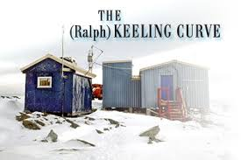
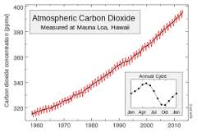
Pioneers of Climate Change Research
Svante Arrhenius
Roger Revelle
Ralph Keeling

Slide 3
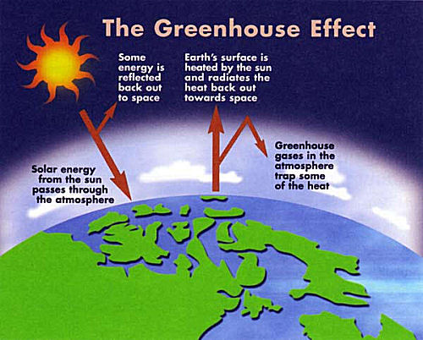
Water and Other Greenhouse Gasses Trap Heat to Warm the Planet
Greenhouse
Gasses:
Water Vapor
Carbon Dioxide*
Methane*
Nitrous Oxide*
*Increasing Due
To Human
Activity

Slide 4
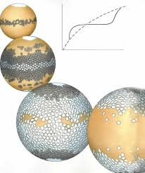
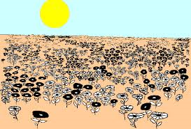
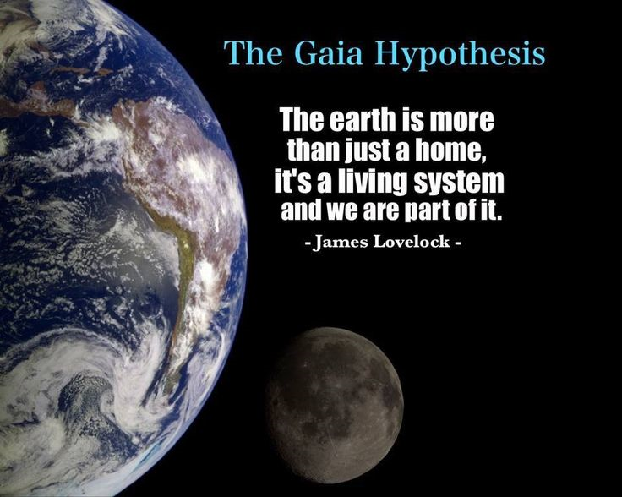
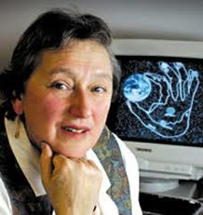
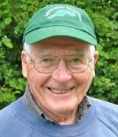
Gaia Hypothesis – Earth is a Self-Regulating System of Feedback Loops
Daisy World
James Lovelock Lynn Margulis

Slide 5
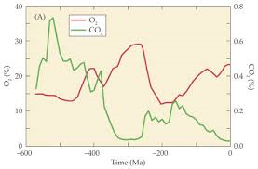
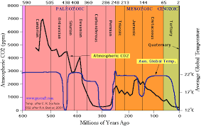
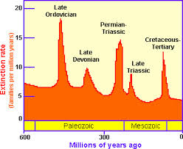
Modern Era – Oxygen is High,
Carbon Dioxide Very Low
Much of Carbon Tied Up in Fossil
Fuels (Oil, Gas, Coal, Peat) Formed
In Carboniferous Per, 300-360 MYA

Slide 6
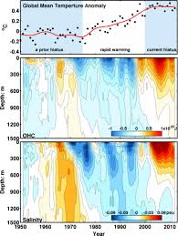
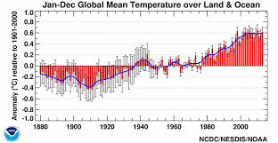
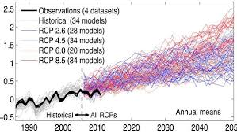
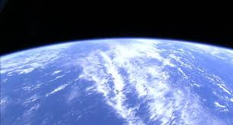
Release of Carbon Dioxide From Fossil Fuels and Deforestation Is Responsible for Global Warming
Hiatus
Atlantic Ocean Heat Sink
IPCC Projections

Slide 7
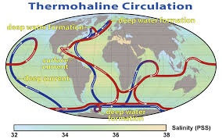
Ultimately Excess Carbon Will Be Absorbed into Oceans and Other Long Term Sinks
Radioactive carbon-isotope dating of the deep waters indicates that from the time of sinking into the deep until its return to the surface, a period of several hundred or even up to 1000 years will pass.

Slide 8
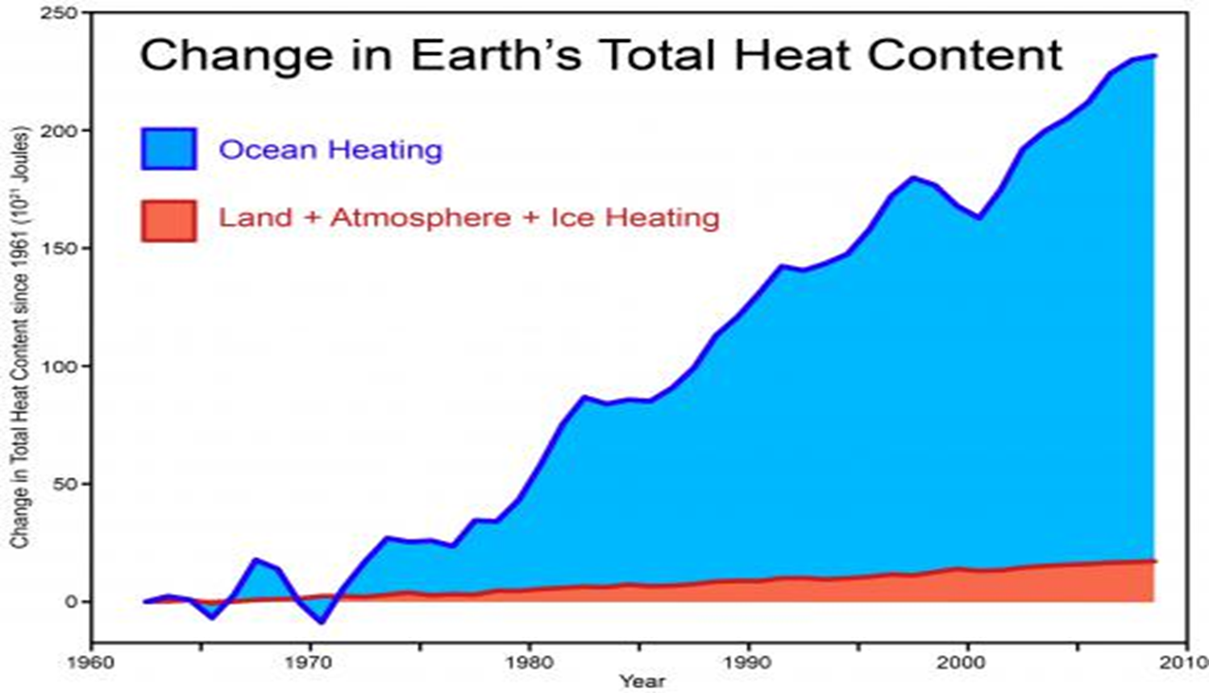

Slide 9
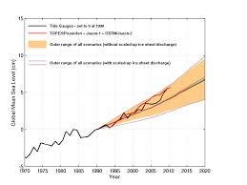
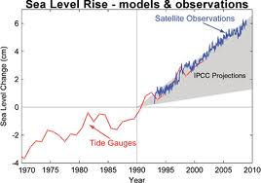
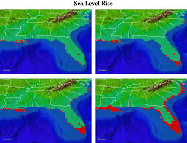
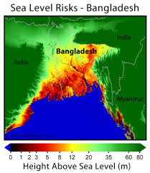
Consequences of Global Warming Include Sea Level Rise

Slide 10
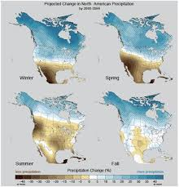
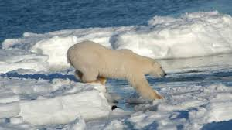
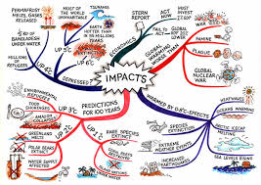
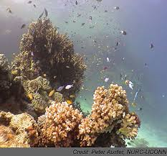
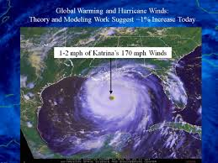
Changes in Precipitation
And Other Weather
Patterns
Ecological Disruptions Economic Disruptions

Slide 11
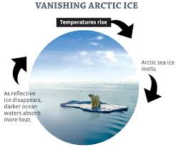
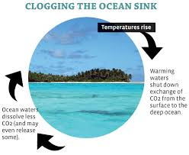
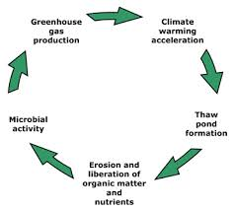
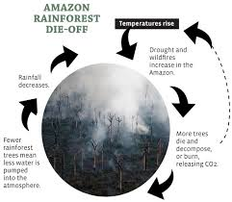
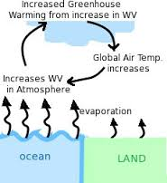
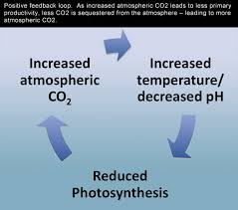
Positive (Reinforcing) Feedback Effects

Slide 12
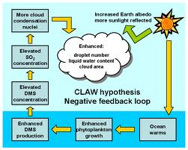
Negative Feedback Loops Also Possible

Slide 13
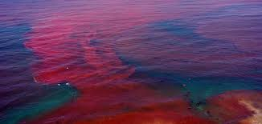
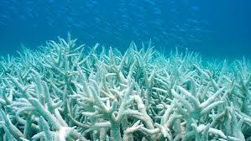
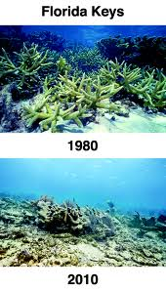
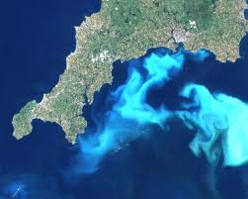
Impacts of Climate Change on Algae in Oceans
More Harmful Algae Blooms Coral Bleaching
Ocean Acidification Positive Feedback Through
CO₂ Release from Coccolithophore Blooms

Slide 14
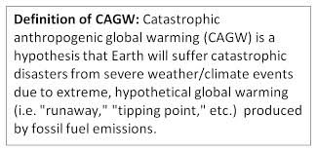
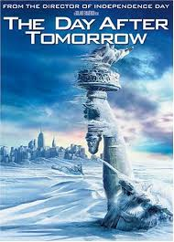
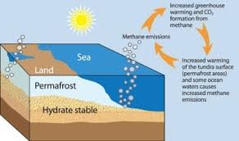
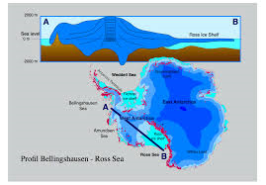
Runaway Greenhouse Effects Are Possible….
Melting of Methane Hydrates Failure of Gulf Stream Rapid Sea Level Rise from
Melting of Ice Sheets

Slide 15
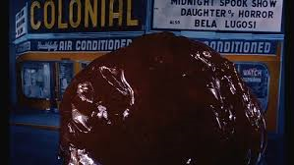
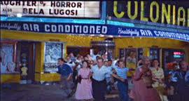
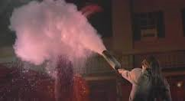
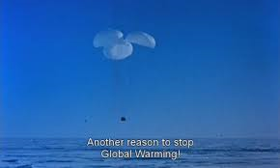
Melting of Ice
Caps Predicted
In 1958

